Slide 1
Comments for MEDB 5501, Week 2

Slide 2
Extensions on homework
Automatic extension for students adding late
All others
Must be asked for in advance
Must have a reasonable explanation
Do not abuse this privilege
Assign a zero if no extension was asked for.
Notes:
Let me briefly mention a few issues about homework extensions. A few students added the class late, and I am happy to give them an extra week to catch up.
All others must ask for permission in advance. This is very important.
I’ve told Xi Wang to assign a zero to anyone who did not turn in the homework and who did not add the class late and who did not ask for an extension.
Doing all the assignments by the due dates are very important. If I lost track of who asked for an extension and accidentally give you a zero, please let me know. I’ll fix it.
If you have extenuating circumstances that prevented you from asking in advance, please let me know. I’ll fix it.
I want to be reasonable with extensions and ask in return that you do not abuse this privilege.

Slide 3
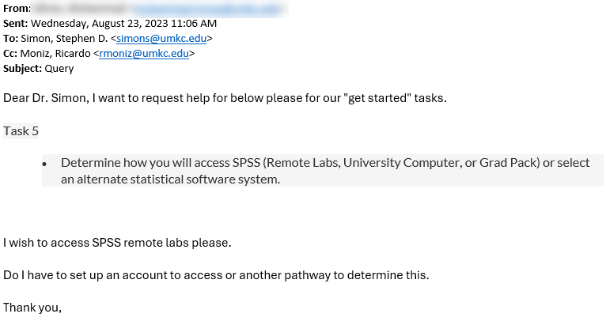
August 23 email inquiry
Figure 1: Screenshot from an email message
Notes:
I am sharing an email that I got a few days ago. I love email inquiries like this, with one exception.
This was a question about the content of this course and the sender included Ricardo Moniz in the CC line. Now some of you know Ricardo and he is a great resource for many things. I myself rely on him for many questions. But please don’t include him on questions regarding the content of this course.
Ricardo is available to answer all sorts of administrative questions. That keeps him pretty busy. Now he actually did answer this question before I did, and he didn’t really mind. Let’s save questions for Ricardo that relate to administrative issues, such as how to switch from the synchronous version of this class to the asynchronous version.
On a related note, please send any questions about grading to me rather than to Xi Wang. I am in constant contact with her and I share with her how I want to grade things. So if you don’t like how something was graded, your beef is with me.
Now I don’t want you to ever feel that you can’t complain about grades. That’s something that goes with the job. Just be sure that I’m the one that gets the complaint and not Xi Wang.
Thanks!

Slide 4
Possible choices for copyright
One student listed
Copyright: only author can view it
This is not a good option. Here are some possible choices.
You cannot use, modify, or re-publish this program without the express written consent of the author.
Contact the author is you wish to use this program.
Creative Commons CC-BY license
Public domain
Notes:
The choices for copyright varied. Most students placed their programs in the public domain. At least one was a bit confusing.
Public domain is what I recommend. My programs are not good enough to make money off of, so I might as well make it as easy as possible for others to use them freely and without restrictions. But other choices are listed here.

Slide 5
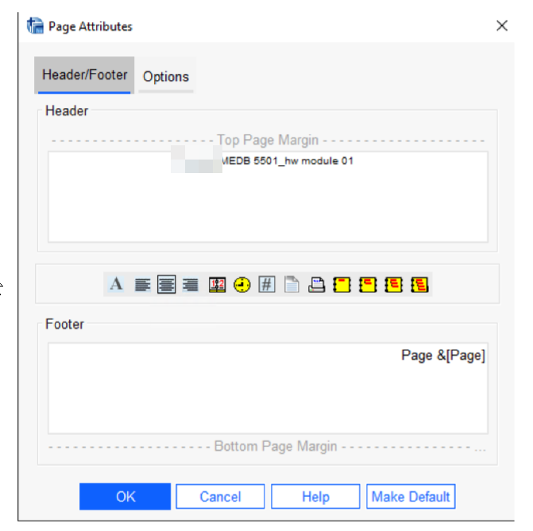
Mistake on documentation header
Figure 2: Screenshot from homework submission
Notes:
There are several ways to put in a documentation header, and this one was close, but not close.
SPSS let’s you put anything you want at the top (header) and bottom (footer) of each page of output. The header here could just be a one line title, or it could be multiple lines that described the author, creation date, purpose, and copyright.
But this header did not include any of this information.
In the real world, documentation headers are very important. I put them on almost all of my programs. The one exception is a program that I write once and then throw away. Anything that I keep for possible re-use has a documentation header.
There’s a great quote, documentation is a gift to my future self. I can’t tell you how many times I have had to re-use a program and I look at it and say “Who’s the idiot who wrote this piece of junk.” A bit of documentation will remind you what you were thinking of six months earlier when you originally wrote that program.

Slide 6
Review of Discussion Board 00
Thanks for all your wonderful comments.

Slide 7
Quiz 00, I goofed, you get a second chance
Problems with my syllabus quiz
Subtle wording issues
At least one flat out mistake
All students will get a chance to retake the quiz
Deadline date extended
Number of tries extended

Slide 8
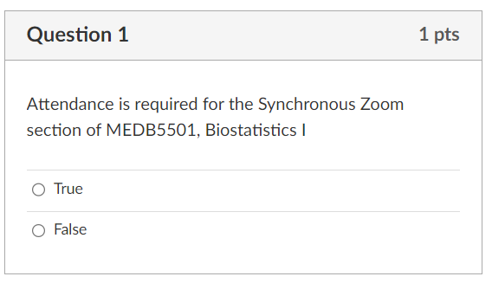
Quiz 00, question 1
Figure 3: Screenshot from quiz
Notes:
There were some problems with the syllabus quiz. Part of it was me not be precise with the language, but one question was just a flat out mistake.
Q1. Attendance is required for the Synchronous Zoom section of MEDB5501, Biostatistics I.
True.
Students in the synchronous class can ask for an excused absence.

Slide 9
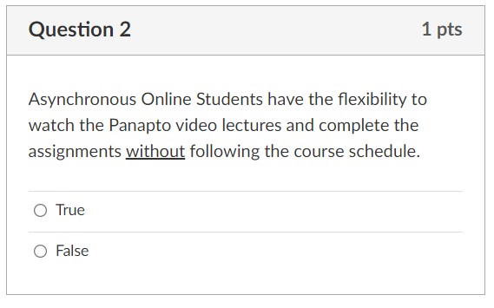
Quiz 00, question 2
Figure 4: Screenshot from quiz
Notes:
Q2. Asynchronous Online Students have the flexibility to watch the Panapto video lectures and complete the assignments without following the course schedule.
False.
While you have slightly more flexibility in the asynchronous class, you must view the week 1 videos in week 1, the week 2 videos in week 2, etc. The due dates for all homework are the same for the synchronous and asynchronous classes.

Slide 10
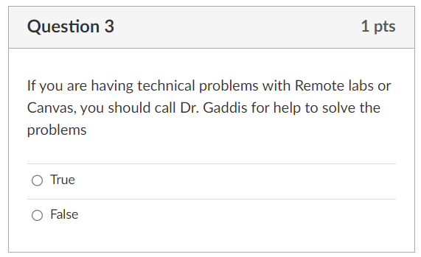
Quiz 00, question 3
Figure 5: Screenshot from quiz
Notes:
Q3. If you are having technical problems with Remote labs or Canvas, you should call Dr. Gaddis for help to solve the problems
False.
While I don’t mind being asked technical questions about Remote Labs or Canvas, I honestly can’t answer most of them.
In contrast, please don’t ask UMKC IT about how to draw boxplots in SPSS.

Slide 11
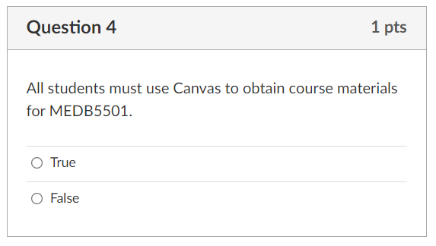
Quiz 00, question 4
Figure 6: Screenshot from quiz
Notes:
Q4. All students must use Canvas to obtain course materials for MEDB5501.
True.
While I do store some of the material for this class on my website and my github site, you should access these files through the links listed on Canvas. If there is a discrepancy between Canvas and my github site, bring it to my attention, but the Canvas site always takes precedence.

Slide 12
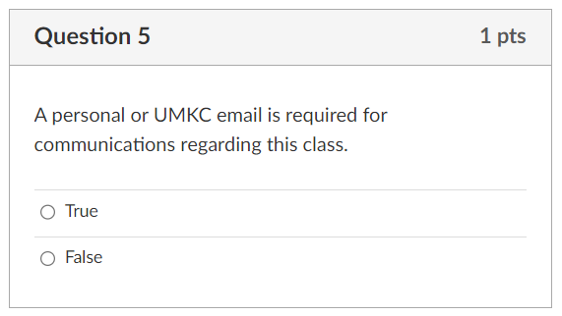
Quiz 00, question 5
Figure 7: Screenshot from quiz
Notes:
Q5. A personal or UMKC email is required for communications regarding this class.
False.
Watch the conjunction “or”. You can use and should use and must use your UMKC email for all communications. This is a University-wide requirement.

Slide 13
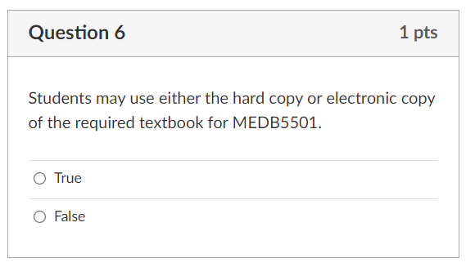
Quiz 00, question 6
Figure 8: Screenshot from quiz
Notes:
Q6. Students may use either the hard copy or electronic copy of the required textbook for MEDB5501.
True.

Slide 14
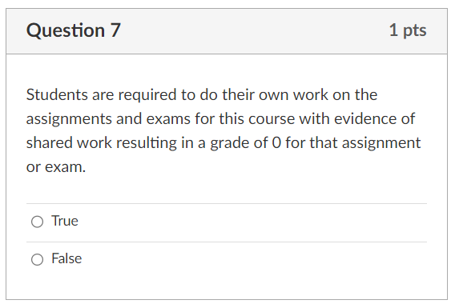
Quiz 00, question 7
Figure 9: Screenshot from quiz
Notes:
Q7. Students are required to do their own work on the assignments and exams for this course with evidence of shared work resulting in a grade of 0 for that assignment or exam.
True.
The one exception is that you can seek help from me, another student, or anyone actually, to help you understand why your SPSS program is not working. You can’t take their program and claim that it is your own.
There are no group assignments in this class. I really like group assignments, but I doubt that I will have time to add any. If I do, they will be clearly labeled as group assignments.

Slide 15
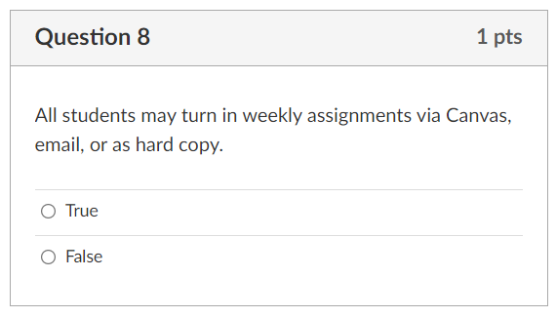
Quiz 00, question 8
Figure 10: Screenshot from quiz
Notes:
Q8. All students may turn in weekly assignments via Canvas, email, or as hard copy.
False.
Unless it is clearly stated otherwise on a specific assignment, submit all your homework via Canvas.

Slide 16
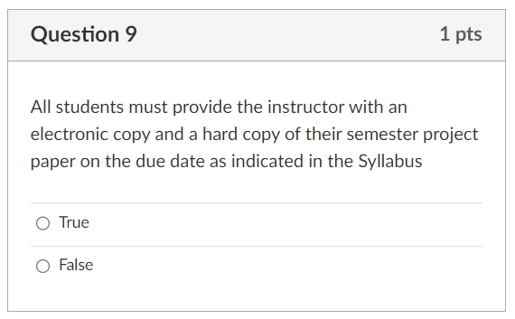
Quiz 00, question 9
Figure 11: Screenshot from quiz
Notes:
Q9. All students must provide the instructor with an electronic copy and a hard copy of their semester project paper on the due date as indicated in the Syllabus
False. Watch that conjunction “and” here. You are required to turn in your assignment electronically via Canvas. You are not required and should not submit your assignment as hard copy. Do not submit by email either.

Slide 17
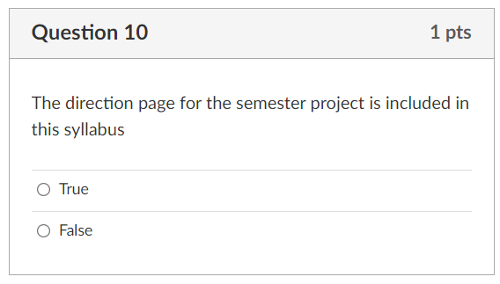
Quiz 00, question 10
Figure 12: Screenshot from quiz
Notes:
Q10. The direction page for the semester project is included in this syllabus
True.
I have a different teaching style than Monica Gaddis. Neither her way nor my way are superior. But her syllabus, which I have left largely unchanged, does describe the final project.
Dr. Gaddis’s style is that if something is important, she will repeat it in several places on Canvas. I prefer to mention it only once because I have too great a tendency to provide inconsistent guidance if I mention it in two or more locations.
I should warn you, however, that I may make minor changes to that assignment. If I do, I will try to update it on the assignment page and on the syllabus. If you notice any discrepancies, please bring them to my attention.
Now since this assignment is important, let me discuss it briefly now. Your assignment is not due until November, but it’s not too early to start thinking about it.

Slide 18
Semester project

Slide 19
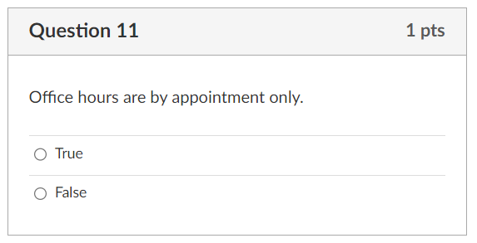
Quiz 00, question 11
Figure 13: Screenshot from quiz
Notes:
Q11. Office hours are by appointment only.
True.
But, a Friday morning review session is available if you have questions.

Slide 20
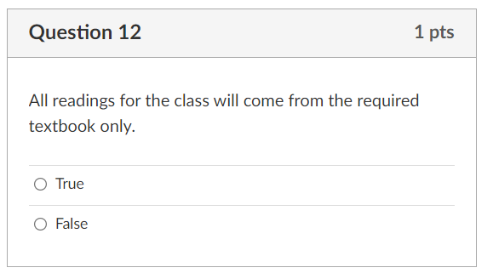
Quiz 00, question 12
Figure 14: Screenshot from quiz
Notes:
Q12. All readings for the class will come from the required textbook only.
False.
In some modules, you will see some additional resources linked from the Canvas site.

Slide 21
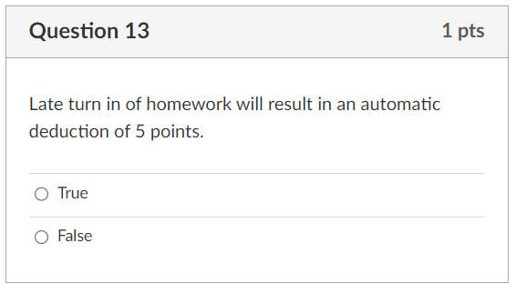
Quiz 00, question 13
Figure 15: Screenshot from quiz
Notes:
Q13. Late turn in of homework will result in an automatic deduction of 5 points.
False.
All assignments have a deadline. If you need an extension and have a reasonable explanation, please ask for this in advance. If you submit your work late without prior approval of an extension, you will lose points, but the amount will vary.

Slide 22
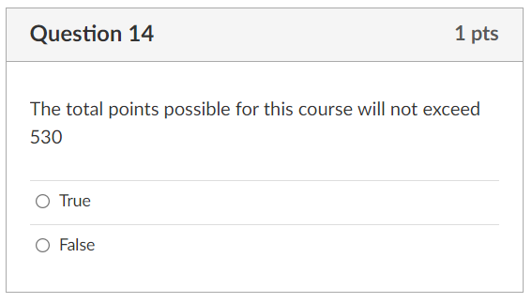
Quiz 00, question 14
Figure 16: Screenshot from quiz
Notes:
Q14. The total points possible for this course will not exceed 530
False.
I have the discretion of adding additional graded assignments, quizzes, and discussion boards. I may also include some optional assignments graded as extra credit.

Slide 23
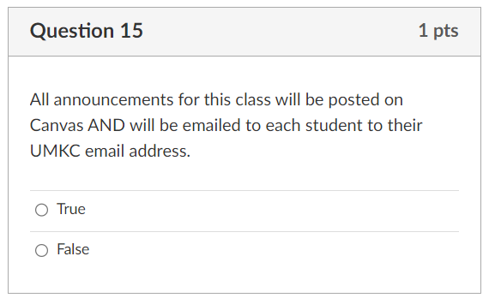
Quiz 00, question 15
Figure 17: Screenshot from quiz
Notes:
Q15. All announcements for this class will be posted on Canvas AND will be emailed to each student to their UMKC email address.
True.
This is a point that at least one student contended with. Those darned conjunctions. The most accurate statement is that all announcments will be posted on Canvas AND/OR emailed to each student. So please check Canvas regularly and check your email regularly.

Slide 24
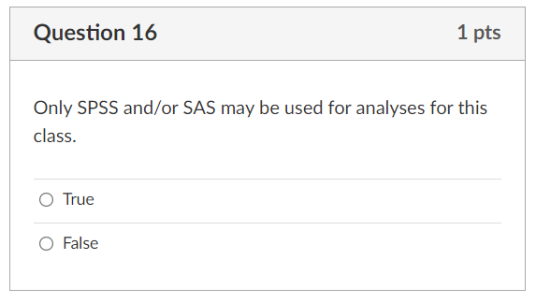
Quiz 00, question 16
Figure 18: Screenshot from quiz
Notes:
Q16. Only SPSS and/or SAS may be used for analyses for this class.
True for Monica Gaddis, but not true for me.
This is a mistake on my part. I changed this requirement, but forgot to change it everywhere on Canvas. If you take the quiz again, mark this as true, but recognize that I am allowing any reasonable software choices.
This is a controversial position, and most faculty I know insist on limiting the software choices that you have. It is a lot more work for me and for my grader, Xi Wang, but I want to be agnostic with respect to your software choices. This may, at times, cause me some difficulty when I get questions about software that I am less familiar with. Just be patient, please, when this happens.

Slide 25
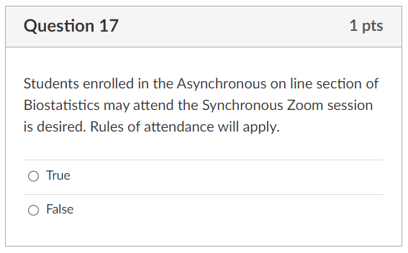
Quiz 00, question 17
Figure 19: Screenshot from quiz
Notes:
Q17. Students enrolled in the Asynchronous on line section of Biostatistics may attend the Synchronous Zoom session is desired. Rules of attendance will apply.
True.
It is good to email the instructor in advance if you plan to attend, but it is not required.

Slide 26
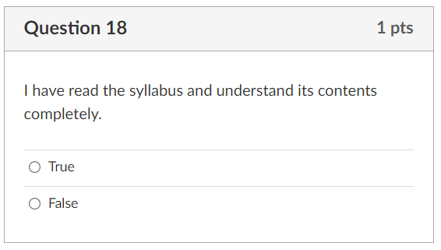
Quiz 00, question 18
Figure 20: Screenshot from quiz
Notes:
Q18. I have read the syllabus and understand its contents completely.
True.
If there are inconsistencies caused by some of the changes I made to the class, I apologize.

Slide 27
Categorical data
Limited to a small number of possible values
Types of categorical data
Binary, dichotomous
Polychotomous, polytomous
Andy Field uses nominal variable
Nominal scale
Ordinal scale

Slide 28
Continuous data
Large number of possible values
Theoretically any value in some interval
In SPSS, continuous is called “scale”
Types of continuous data
Interval scale
Ratio scale
Counts
Proportions, Rates
Notes:
In contrast to categorical data, you have continuous data. The distinction is in the number of possible values.

Slide 29
Discrete data
Very similar to continuous data
But not all values in an interval are possible
Examples
Counts
Age (rounded to the nearest year)
Mean may be difficult to interpret
Average family has 2.2 children

Slide 30
Data types
Developed by SS. Stevens in 1946
Nominal
Ordinal
Interval
Ratio
Data types tell you what you can and cannot do
Notes:
The nominal, ordinal, interval, and ratio scales that are presented in this module were first defined by a Psychologist, S.S. Stevens in 1946.
These scales are important because they tell you what statistical manipulations and what statistical calculations and what statistical displays make sense or don’t make sense. Some software, including SPSS will designate some of these scales in the meta-data, and this will help guide you to what statistics and what graphs are most appropriate.
Now there are some statisticians who argue with this. In particular, they fight against some of the limitations that the nominal, ordinal, interval, and ratio scales impose.

Slide 31
What can you do with nominal data?
Categorical data with no obvious ordering
Example: marital status
Statistical manipulations/calculations
Assessing equality/inequality
Computing the mode
There is no good measure of variation
Note: “primitive” versus “limited”
Notes:
Nominal data represents categories where the categories do not have a natural ordering. The Wikpedia page on scales of measurement is quite good and I am stealing some information from them on this and the next few slides.
With nominal data, you can assess equality or inequality, but other types of mathematical manipulation are not possible.
You can compute the mode for nominal data, but other measures of central tendency are not available to you. You’ll have to wait a week for details about how to compute the mode and other statistical measures that I will mention in the next few slides.
There is no good measure of variation for nominal data. Some might argue that entropy is a measure of variation for nominal data, but that is well beyond the scope of this class.
Monica Gaddis uses the term “primitive” to describe nominal data, and I want to quibble a bit with that word. I don’t want anyone to get the impression that nominal data is less sophsticated than other types of data. It is not the Neanderthal of data. In fact, nominal data often offers as many if not more types of sophisticated data analyses as other typoes of data. I prefer to say that nominal data is “limited” meaning that you have fewer choices in how to compare and how to calculate with nominal data.

Slide 32
What can you do with ordinal data?
Categorical data with a natural ordering
Example: Strongly disagree to strongly agree
Any manipulations/calculations for nominal data, plus,
Assessing magnitude (less than, greater than)
Computing the median
Computing the range or interquartile range
Notes:
Ordinal data has categories with a natural ordering.
Ordinal data has fewer limitations than nominal data. Anything you can do with nominal data (assessing inequality, calculating the mode) you can also do with ordinal data.
You can sort ordinal data and assess magnitude. One ordinal value might be less than or greater than another. You can compute a median of ordinal data, as well as the range and interquartile range.

Slide 33
What can you do with interval data?
Continuous data with meaningful differences
Example: IQ score
Any manipulations/calculations for ordinal data, plus,
Addition, subtraction
Computing the mean
Computing the standard deviation
Ratios are NOT meaningful for interval data
Notes:
Interval data is data that is continuous where differences have a reasonable interpretation.
You can do any statistical manipulations or calculations that you can do with ordinal data. You can also add and subtract interval data without causing any controversy.
You can compute a mean and a standard deviation for interval data.
There is a minor error in one of the slides. The comment that “8 is two times greater than 4” is only applicable for ratio data. For interval data, differences have meaning. You can talk about 10 degrees warmer and it means pretty much the same thing in wintertime and summertime. But you can’t talk about a 30 degree day being three times warmer than a 10 degree day.
It’s even more obvious for IQ data. You can’t talk about someone with an IQ of 150 being “twice as smart” as someone with an IQ of 75.

Slide 34
What can you do with ratio data?
Continuous data with meaningful ratios
Example: Net worth calculation
Any manipulations/calculations for interval data, plus
Multiplication, division
Geometric mean, coefficient of variation
But only for non-negative ratio data
Note: “absolute” versus “natural” zero
Notes:
Ratio data is continuous data where both differences and ratios have a reasonable interpretation.

Slide 35
Distinctions between ordinal and interval data
Biggest area of controversy
Purists versus pragmatist
Never argue with a purist
Grade point
Clearly ordinal, but everyone uses GPA

Slide 36
Distinctions between interval and ratio data
“Interpretable” is a judgement call
“Natural zero” is a judgement call

Slide 37
Special cases
Counts
Proportions
Count divided by another count
Numerator is subset of denominator
Always between 0 and 1
Rates
Count divided by time (sometimes area)
Greater than 0, sometimes can be larger than 1

Slide 38
Independent versus dependent variables
Gestational age
Dependent variable to ob/gyn
Independent variable to neonatologist

Slide 39
One more classification!
Intervention
Something you do that you HOPE will make things better.
Exposure
Something that your patients endure that you worry might harm them.
Sometimes, interventions cause harm or exposures are actually helpful
The original intention matters, not the final outcome

Slide 40
Are data types confusing?
YES!
Sometimes a distinction without a difference
But they help with
Choosing best statistic
Choosing the best graph
If you have to remember two distinctions…
Categorical versus continuous/discrete
Nominal versus ordinal

Slide 41
Data dictionaries
Separate PowerPoint file

Slide 42
Summary
Data types
Categorical, continuous, discrete
Nominal, ordinal, interval, ratio
Counts, proportions, rates

