Slide 1
Basic programming expectations
Steve Simon

Slide 2
Overview
Guidelines for every programming assignment
File name and format requirements
Common directory structure
Documentation header
Readable code
No lengthy outputs
Show both the code and the output
Include both my questions and your answers
Notes:
If you learned programming like I did, you learned it with a bunch of bad habits that are very hard to break. I don’t want you to develop these same bad habits, so I want you to adopt some good habits early.
Some of these items are not really important for developing good programming habits, but rather are for my convenience. Grading is a lot of work, and it is complicated by having some students attending two different classes of mine at the same time. There are a few simple things you can do that can help make my difficult job a bit easier.
There are seven different items that I want to cover in this talk.

Slide 3
File name and format requirements
Filename must include
Your last name
The class number (e.g., 5505 for Introduction to R)
The canvas module number
Examples
Steve Simon homework, part a, for 5505, Module02
hw02a-5505-simon
File format
Single pdf file, if possible but multiple pdf files acceptable
Notes:
I teach multiple classes and sometimes the same student will be in two of my classes simultaneously. To avoid confusion, please make sure that you include certain information in any file that you submit to me on Canvas.
You need at least your last name, and if your last name is fairly common, either here or in your home country, your first name as well.
You need to indicate the four digit number for the class. The classes that I currently teach are
MEDB 5505, for Introduction to R
MEDB 5507, for Introduction to SAS
MEDB 5508, for Introduction to SQL (co-taught with Suman Sahil)
MEDB 5510, for Clinical Research Methodology, though this class will not have any programming exercises.
All of my classes are divided into modules and you need to indicate which module your assignment came from.
There are several ways you can name your files and meet these requirements. Here are two examples.
“Steve Simon homework, part a, for 5505, Module02” is lengthy file name.
“hw02a-5505-simon” is a terse file name. Either is fine as long as it has “02”” for module02, “5505” for Introduction to R and “simon” (actually your name would go here).
It is hard for me to grade if I have to juggle several different programs because student submit their assignments in several different formats. It really helps if you can produce pdf files, no matter what the original format of your work.
Ideally, you should combine all the pdf files into a single file.
There are a million different ways to create pdf files, and to combine multiple pdf files into a single file. I won’t go over them here, but if you have problems, let me know.
Now, if you are struggling to get an assignment in, don’t let the format requirements hold you back. I’d rather have an assignment turned in on time in any format rather than late in the required format.

Slide 4
Common directory structure
Store everything for this class in a single folder
Any name is fine
Use different folder for different classes
Subdirectory structure
data (for data files)
src (for program files)
optional: doc, images, results
Backup your folder regularly
Notes:
You should store all your programs, data, and output in a single folder with a specific subdirectory structure. Choose any name you want for your folder, but don’t make two or more folders, unless this is done purposefully (such as a separate folder for each module).
For some classes, you may need to store this folder on a network drive.
If you are taking two different programming classes, please use two separate folders so that your programs don’t clash.
It is very important to set up a common subdirectory structure. This will make things a lot easier for me when I try to answer questions about why your program doesn’t work. The two key subdirectory folders that you must use are data (for data files) and src (for program files). You are welcome to set up additional folders, such as images for graphs stored as image files and doc for important documentation details.
Backup your folder regularly. The simplest way to do this is to have an archive folder and you just create subdirectories in the archive folder that are complete copies of the whole class folder.

Slide 5
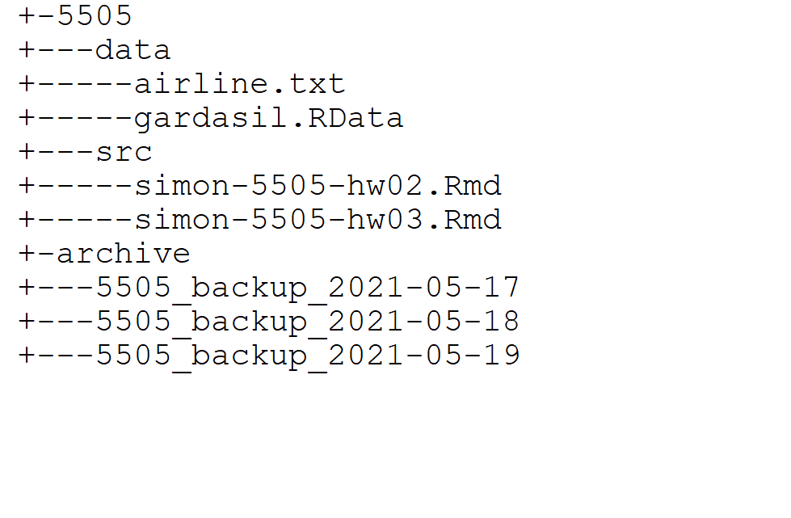
Example of directory structure
Notes:
Here’s an example of this directory structure. The main folder is names 5505.
The data subdirectory has two files: airline.txt, and gardasil.RData. There are two programs in the src subdirectory: simon-55505-hw02.Rmd and simon-5505-hw03.Rmd.
The archive folder has backups of the complete 5505 folder from May 17, 18, and 19 of 2021.

Slide 6
Documentation header (1/2)
Key information at the top of every program
Author
Creation date (Created yyyyy-mm-dd)
Purpose
Permissions
Other elements may be added
Notes:
At the top of every program, you should put information about the program that will help others understand important details.
The information that belongs in a documentation header is variable, but here are some of the things that I recommend.
Put your name in the documentation header. I will know it is from you, of course, because of how it is delivered to me via Canvas. But it is still a good habit to get into. If you are adapting someone else’s code, you might offer them some credit here. In some settings you might want to include contact information (e.g., email address) as well.
Get in the habit of putting in the creation date. It is a bit silly perhaps in a program that you submit in a time limited setting like this class. It does become important when you are working on a project that spans multiple months or years.
I’d encourage the use of the word “Created” so that any reader does not confuse this with the data last modified. Date last modified is sometimes a nice addition, especially on complex projects, but if you can’t get the computer to insert a last modified date, then you may find this information a bit tedious to maintain.
Also, there is a standard format for dates, a four-digit year, a two-digit month, and a two-digit day with dashes (-) as separators. This is known as the ISO 8601 format, and I may or may not talk about this later in the class.
Describe the purpose of this program. Use something more descriptive than “Homework assignment,” such as “Read data from [some data source] and calculate an overall mean and standard deviation.”
It’s always provide permissions: what others can (or cannot) do with this program. For my class, I’d appreciate it if you let me know whether I can or cannot use anonymized pieces of your program as teaching examples in future classes. For programs in the real world, I would encourage you to place your programming code in the public domain, unless your employer has a different requirement. There are a a variety of open source licenses that are also good choices. I may or may not talk about licensing options later in this class.
Other elements of documentation may be added. It depends a lot on the context in which your program is being developed. I may or may not cover some of these additional elements later in the class.

Slide 7
Documentation header (2/2)
R
Use # comment for single line comments
Markdown, anything outside program chunks or yaml header
SAS
Use * comment; or /* comment */
SQL
Use /* comment */ or -- comment
Notes:
Each program has a slightly differet way of adding comments.
In your R code, use the poind sign (#). Anything following this through to the end of the line will be considered a comment. If your comments extend across several lines, place the pound sign in front of each line of comments.
For R, however, I recommend that you use R Markdown. In R markdown, the R programming statements are placed inside program chunks. Anything outside a program chunk is considered a comment.
The header at the top of an R Markdown file, the yaml header, is also a place where you can include comments. Some of these comments, like the program author and the date will automatically appear in your output. Others will not, so be careful with the yaml header.
In SAS, you can use an asterisk (*) to start a comment, which only ends when SAS sees a semicolon. You can also start a SAS comment with a slash-asterisk and end it with an asterisk-slash. SAS comments automatically extend to a fresh line.
SQL also uses the slash-asterisk at the beginning and asterisk-slash at the end of a comment. You can also start a comment with a double dash (–) and this comment will extend to the end of a line.
If you are using R or SAS to access SQL, you can place your documentation header at the top of your R or SAS code.
You have a lot of flexibility with your documentation header, but if it is not included, or if it does not include the four items described above, you will lose points on your assignment.

Slide 8
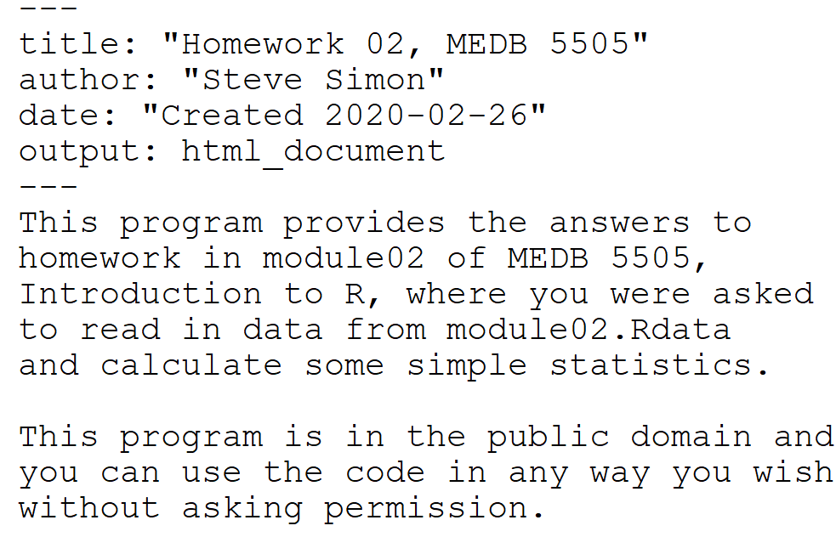
Documentation header example in R Markdown
Notes:
Here’s an example of a documentation header using R Markdown. The author and creation date are in the yaml header.
The first sentence below the yaml header describes the purpose of the program.
The second sentence places the code in the public domain so you can use the code any way that you might please.

Slide 9
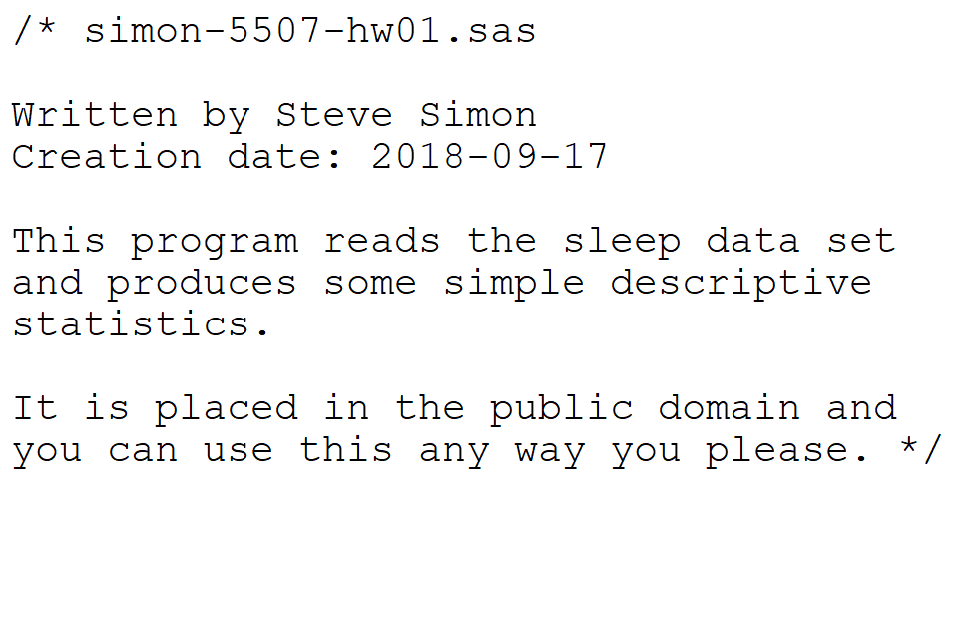
Documentation header example in SAS
Notes:
Here’s an example using SAS. The comment starts with an asterisk and ends with a semi-colon on the next slide. It covers the same details.
I won’t show the code in SQL, but it would look similar

Slide 10
Readable code
To make your code more readable
Use indents
Break long lines of code
insert blank lines to create sections
Create vertical lists

Slide 11
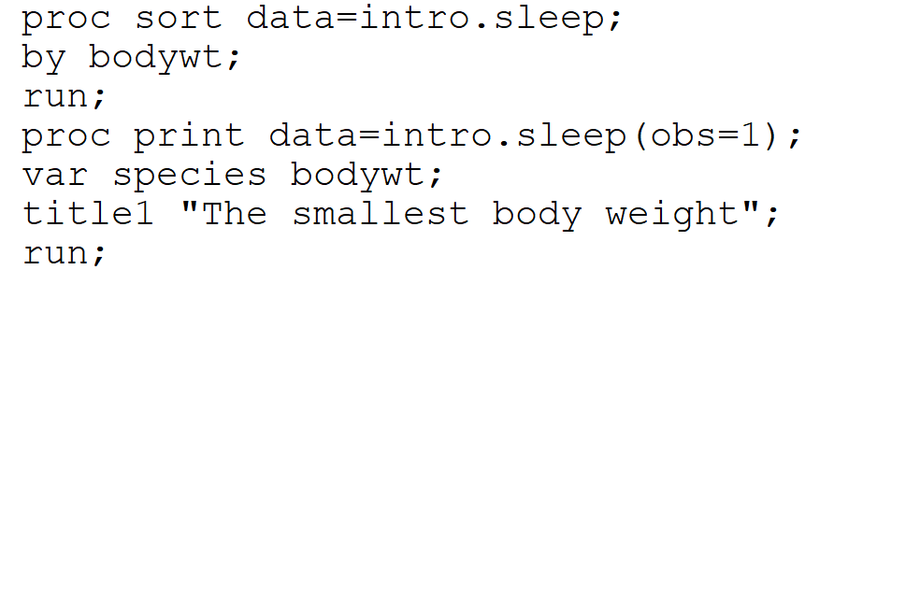
SAS example (difficult to read code)
Notes:
Here’s an example using the print procedure in SAS. It’s not too hard to read, but you can improve it quite a bit by adding line breaks, indenting, and vertical lists

Slide 12
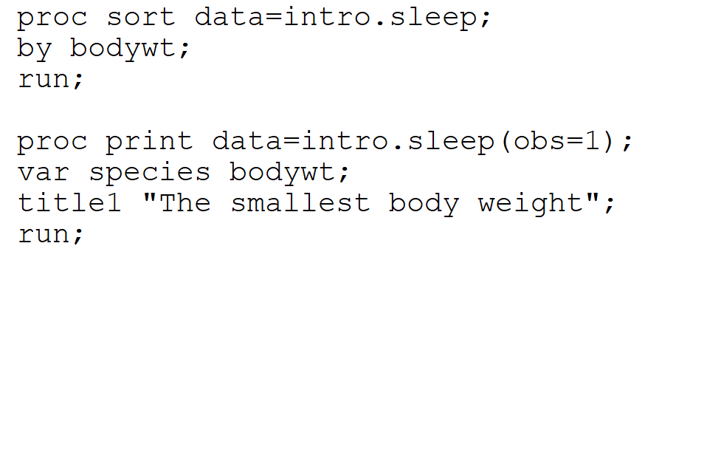
SAS example, Add line break
Notes:
A blank link emphasizes the two steps in this program, sorting and printing.

Slide 13
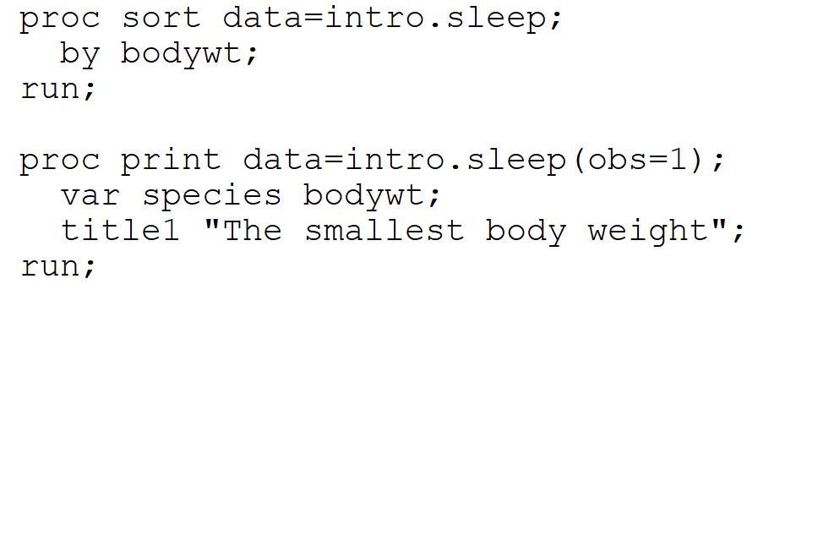
SAS example, Indent
Notes:
By indenting the by subcommand within the sort and the var and title1 subcommands in the print procedure, you further emphasize the desicrete steps in the program.

Slide 14
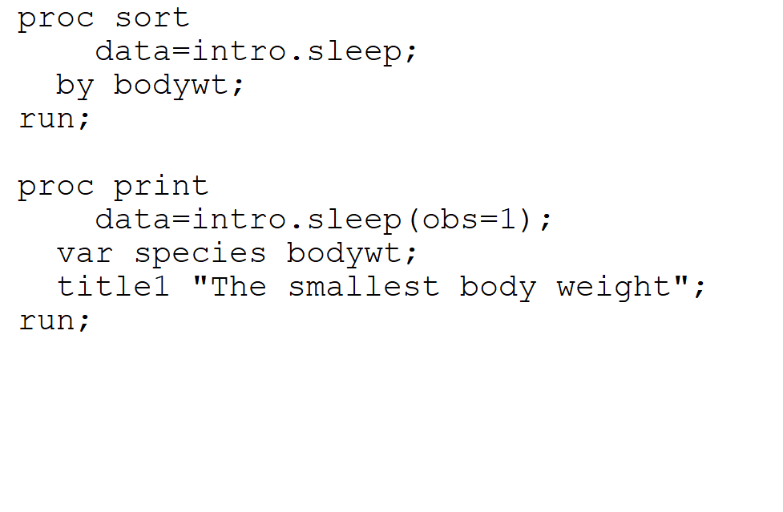
SAS example, Break long lines
Notes:
There is no line that is terribly long in this example, but you could split the proc sort and the proc print at data to make the line shorter.
I used a double indent here to emphasize that data is part of the previous procedure.

Slide 15
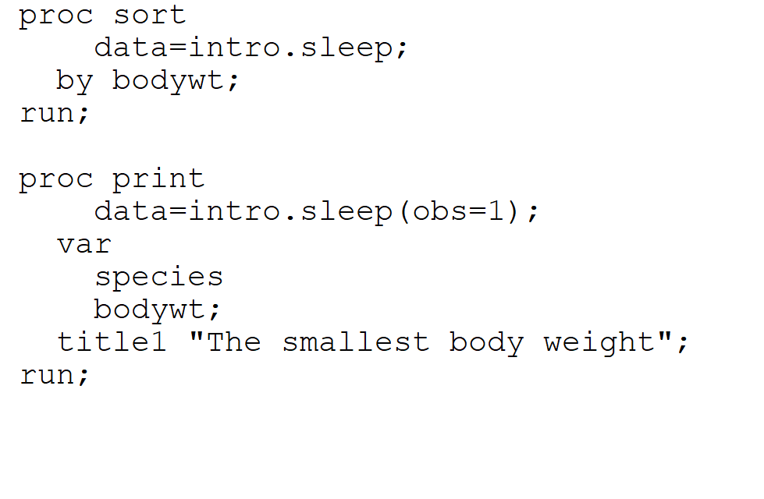
SAS example, Create vertical lists
Notes:
When there are multiple variable names within a statement, a vertical list can sometimes make things easier to read. You can also use this when you have multiple options in a single statement or multiple arguments in single function.

Slide 16
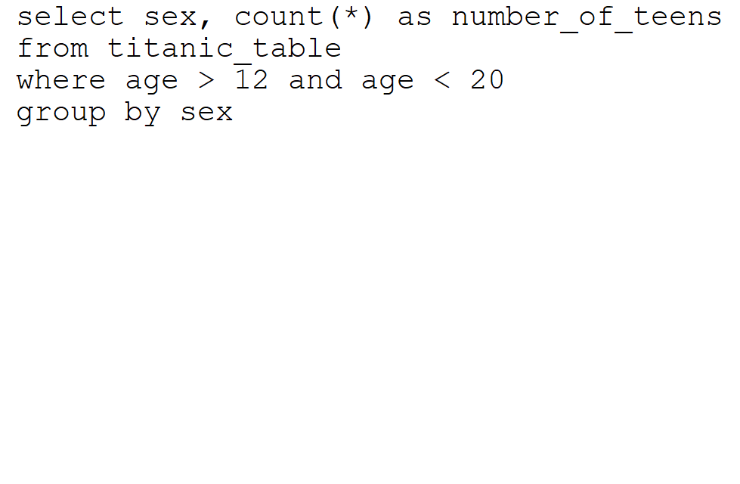
SQL code (hard to read)
Notes:
You can see some of the same principles in this SQL code. It is not terrible, but it could be a bit better.

Slide 17
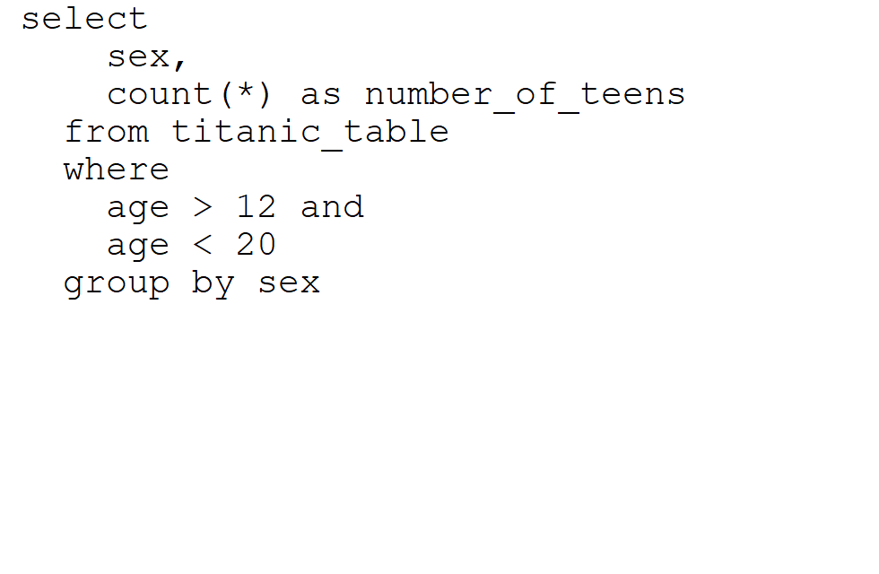
SQL code (easier to read)
Notes:
Notice the changes.
The from, where, and group by statements are indented.
The variables sex and count(*) are a vertical list and are double indented because they are pare of the select statement. The age conditions (>12 and <20) are split and lined up beneath one another.

Slide 18
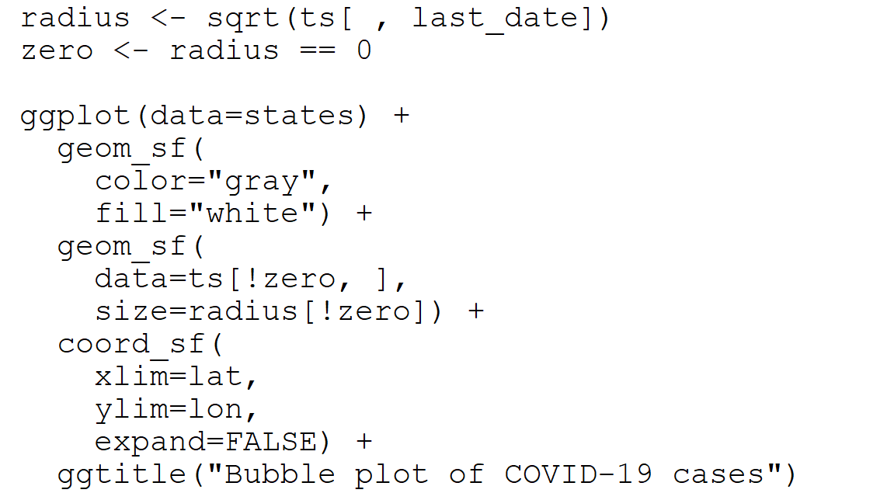
R example (hard to read)
Notes:
Here’s an example using R. It’s a bit more advanced, but notice the three commands that create new variables: i, circle_size, and non_zero_cases. They are separated by a blank line from the ggplot function.
The ggplot function has several graphics options that are added: geom_sf (twice), coord_sf, and ggtitle. Each of these is on a separate line and indented consistently.
Each of these graphics options have multiple arguments and they are arranged in a vertical list.

Slide 19
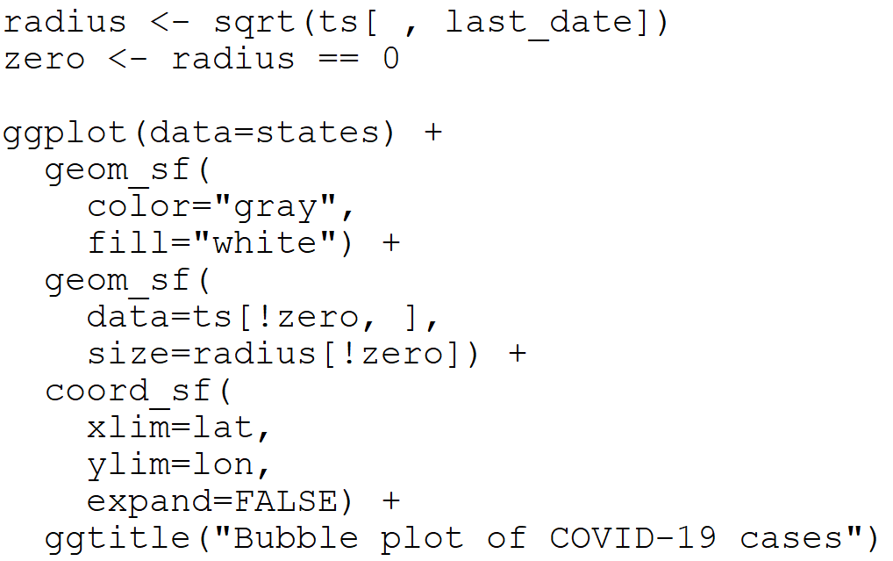
R example (easier to read)
Notes:
Here’s an example using R. It’s a bit more advanced, but notice the two commands that create new variables: zero and circle_size. They are separated by a blank line from the ggplot function.
The ggplot function has several graphics options that are added: geom_sf (twice), coord_sf, and ggtitle. Each of these is on a separate line and indented consistently.
Each of these graphics options have multiple arguments and they are arranged in a vertical list. Notice how easy it is now to identify the individual arguments:
color and file for the first geom_sf option
data and size for the second geom_sf option
xlim, ylim, and expand for the coord_sf option

Slide 20
No lengthy outputs
Avoid long printouts
R: head(sleep, n=10)
SAS: proc print sleep(obs=10)
SQLite: limit 10
Oracle SQL: where row_num <= 10
SAS SQL: where monotonic() <= 10
Notes:
You should never print out all the rows in a lengthy dataset. If I don’t explicitly ask you to limit the number of rows that you print, limit them anyway.
In R, you use the head function and in SAS you include obs= in parentheses after the dataset name.
In SQL it is a bit trickier and depends on which version of Oracle you are using. It is also complicated by a monotonic function that SAS uses when it accesses SQL files.
You’ll see lots of examples of this in various lectures.

Slide 21
Show both the code and the output
Code
Check documentation and readability
Helps debugging if things go wrong
Notes:
I need to see both your code and your output. Ideally this should be combined in a single pdf document, but you can submit two separate files, one for the code and one for the output.
The code is important because it allows me to assess whether you have a good documentation header and if you are using line breaks, indents, and vertical lists to make your code more readable.
It also helps with debugging if your program doesn’t do what it is supposed to do.
You need to include the output, of course, to prove that your program actually ran properly.

Slide 22
Include both my questions and your answers
Use comments or titles for questions
Cut-and-paste orginal question
Add text interpretation before or after your output
One or sometimes two sentences.
Round numbers liberally
Output without interpretation will be downgraded.
Examples:
Here are the first ten rows of data.
The largest animal in the data set is the African elephant.
About 40% of the patients got all three shots.
There are no missing values for this data set.
Notes:
I need to see the original questions in the code as a comment or in the output as a title or footnote. With mutliple assignments to grade in multiple classes, I often fail to remember what I wanted you to do for a particular homework assignment.
As you answer each question, I want a brief comment. Often it is a single sentence, but you might need two or maybe three sentences. What I needs is an explanation of how the output answers the question. This might be obvious, but it still needs to be done. If you include the correct output, but do not add a brief comment, you will lose points on your assignment.
If any numbers are part of your interpretation, round them liberally (see the next slide for details)
Here are some examples of the comments you might include.
Note the use of 40% in the first interpretation. This reads a whole lot better than “Only 39.56% of the patients.” Even a percentage like 41.7% reads better when rounded to “about 40%.”

Slide 23
Round your results
Two significant digits is best
54.23% -> 54%
0.03476 -> 0.035
Sometimes one or three digits
Values close to one or a bit larger than 100
SQL and R
round function
No easy equivalent in SAS
Always round in your interpretations
Notes:
Numbers with lots of digits in them are hard to read. The rule of thumb is that you round to two significant digits. This is not the same as rounding to two decimal places.
A value of 0.03426 is properly rounded to 0.034 as the leading zeros do not count as significant digits.
Percentages almost never need more than two digits. Too many people report one or even two decimal places for a percentage. No one cares about the .23 in 54.23%. Round it to 54%, It is much more readable.
Now no one ever got thrown in jail for violating a rule of thumb. Sometimes you might prefer to round to one or three significant digits. Numbers close to 1, especially odds ratios, might need an extra digit. Values just a bit larger than 100 might require a third significant digit. Correlations are sometimes between with a single significant digit. I won’t quibble with you for one, two, or three significant digits, but once you include a fourth significant digit, I’m going to complain.
Both R and SQL use the round function. There is no equivalent in SAS. There are ways to control rounding in the data step, but getting SAS to do rounding in the output is tricky. When you can do it, it is buried as an obscure option deep in the documentation and what works for one SAS PROC will often not work for another.
Even when you can’t get rounded results in your output, though, make sure that any interpretation that you provide uses nice round numbers.

Slide 24
Summary
Guidelines for every programming assignment
File name and format requirements
Documentation header
Readable code
No lengthy outputs
Show both the code and the output
Include both my questions and your answers
Notes:
Remember these guidelinesfor every assignment that you turn in. Use the proper file name and format, include a documentation header, make your code readable, avoid lengthy outputs, show both your code and your output and be sure that both the original question and your answer appear in what you submit.

