Slide 1
Video09c - Internal and External validity
Steve Simon

Slide 2
9c, Sampling
Sample size
General rules
Representativeness vs number
Impact of having very large sample sizes
Generally –
Need sample to be large enough so you don’t miss important findings
If very large sample, need to distinguish statistical significance vs clinically important
Notes:
How many people do I need. This best done using a power analysis. Take account of the measures being used and what you expect to see. Information from previous research or other kinds of things.
Representativeness is more important than the absolute size of the sample.
Large enough so you don’t miss important findings.
In cases with really large sample sizes where you get statistical significance without practical significance. Effects.

Slide 3
9c, Internal Validity
“The extent to which we can infer that the independent variable caused the dependent variable.”
For non-experimental studies –
How “well designed and conducted” was the study?
Three criteria for causality
Notes:
It’s really only randomized trials that can establish causality. But even in quasi-experimental and non-experimental studies, you can still talk about internal validity.
The cause has to precede the effect, it must be connected to the effect, and there must be no other variables that could explain why the cause is related to the effect.

Slide 4
9c, Internal Validity
“The extent to which we can infer that the independent variable caused the dependent variable.”
Three criteria for causality
IV must precede the outcome variable
IV must be related to the outcome
There must be no other variables that could explain why the IV is related to the outcome

Slide 5
9c, Internal Validity
Three criteria for causality –
IV must precede the outcome variable
IV must be related to the outcome
There must be no other variables that could explain why the IV is related to the outcome
By Research Approach –
Randomized Exp
Quasi- Exp
Comparative
Associational
Descriptive

Slide 6
9c, Internal Validity
Notes:
For randomized designs, the cause precedes the effect, the cause is related to the outcome and there are no other variables that could explain the relationship.

Slide 7
9c, Internal Validity
Meeting the 3 causality criteria based on –
Strength of the research design
Internal validity
Notes:
The strength of the research design and the internal validity determine whether you can claim causality. Try to design the study to maximize internal validity.

Slide 8
9c, Internal Validity
Internal validity -
Most often discussed with reference to randomized experimental and quasi-experimental designs
Can also be applied to non-experimental studies

Slide 9
9c, Internal Validity
Evaluating the internal validity of a study –
Equivalence of the groups on participant characteristics
Control of extraneous experiences and environmental variables
Notes:
There are two aspects of internal validity, equivalence and control.

Slide 10
9c, Internal Validity
Equivalence of the groups on participant characteristics –
Are groups equivalent prior to introduction of IV?
Randomized experimental design –
Random assignment
Quasi-experimental design –
Random assignment of treatments
Matching
Checking pretest scores
Notes:
Random assignment assures equivalence of the two groups on average. A rule of thumb is 30 people assigned to each group should give you confidence that random assignment will assure equivalence. If you are using random assignment, you should not need to test for baseline equivalence. We feel that random assignment is the best way to achieve equivalence.
In quasi-experimental design, you don’t have random assignment, but you can randomly assign between the two groups. You can also use matching to achieve equivalence. Finally, you can check baseline scores for equivalence.

Slide 11
9c, Internal Validity
Equivalence of the groups on participant characteristics –
Are groups equivalent prior to introduction of IV?
Comparative design –
Statistical adjustment (ANCOVA) to adjust DV scores to make groups more nearly equivalent
Matching participants on variables other than the primary IV
E.g. Case-control study
Check after the study for comparability
Notes:
Since non-randomized trials have an attribute variable, you need to rely on statistical adjustment or matching. You can also check after the study for comparability.

Slide 12
9c, Internal Validity
Equivalence of the groups on participant characteristics –
Are groups equivalent prior to introduction of IV?
Associational design –
Only 1 group
Not able to provide evidence of causation
“Equivalence” – “… whether those who score high on the IV … are similar to those … who score low in terms of other attributes that may be related to the DV.”
May be able to provide some statistical control
Notes:
Equivalence when you have a continuous independent variable means that those who score high on the variable are similar to those who score low.

Slide 13
9c, Internal Validity
Control of extraneous experiences and environmental variables –
Extraneous variables – variables other than the IV and DV
Environmental variables – conditions/variables that occur during the study
Contamination
Issue – Is one group affected more than the other(s)?
Less of an issue with a more controlled research setting
Notes:
Your study could be contaminated by other variables. These variables might be out of your control but which can influence the outcome.
Contamination: people in the intervention group are friends with the control group and share information.
The key issue is whether one group is more affected by extraneous variables.
In a controlled setting, there are fewer extraneous variables, but this changes in a field setting.

Slide 14
9c, Internal Validity
Rating the dimensions of internal validity
Figure 8.2
Evaluating Research Validity framework
“Good” study – moderate to high internal validity on both dimensions
Notes:
Internal validity is measured by whether the two dimensions are addressed.

Slide 15
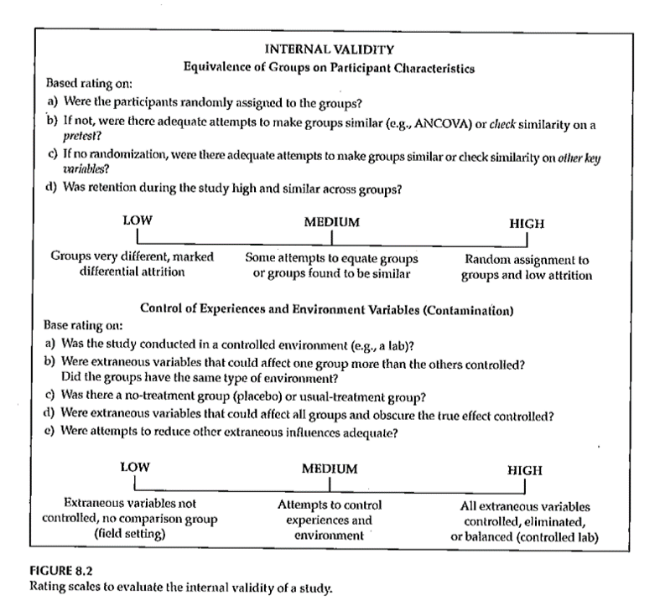
9c, Internal Validity
Rating the dimensions of internal validity
Notes:
Figure 8.2.

Slide 16
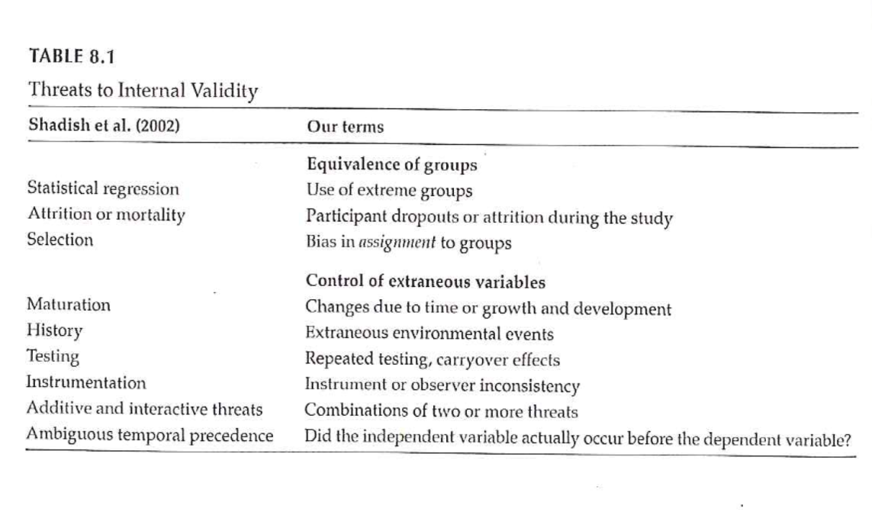
9c, Threats to Internal Validity
Notes:
Table 8.1 relates statistical terminology to identify threats to internal validity. This table tries to take those technical terms and express them
Extreme groups have issues with regression to the mean. Even without any intervention, the extremities will tend to lessen.
Dropouts or attrition means that you’ve designed a setting that is so difficult that no one can stay in. Differential attrition is especially troublesome.
Bias in assignment occurs when patients or their physicians directly or indirectly influence the assignment. Random assignment eliminates this bias.
Cook and Campbell.

Slide 17
9c, Threats to Internal Validity
Equivalence of Groups
Use of extreme groups
Participant dropouts or attrition during the study
Bias in assignment to groups

Slide 18
9c, Threats to Internal Validity
Control of extraneous/environmental variables
Changes due to time or growth and development
Extraneous environmental events
Repeated testing, carryover effects
Instrument or observer inconsistency
Combinations of two or more threats
Did the IV actually occur before the DV?
Notes:
Here are some of the sources of extraneous variables.
Maturation.
History. Something that occurs between the pre and post measurements that is independent of the intervention but which can influence the outcome.
Worry about sensitization to the issue in the baseline measurement that causes people to go out and find more.
Long studies have problems with instrumentation or observers (e.g., because of turnover).
There are also combinations of these events where one magnifies the other.
Temporal order of the variables. If you can’t assure that the independent variable occurs before the dependent variable, you can’t establish causation.

Slide 19
9c, Threats to Internal Validity
Other threats
Effects of being in the control group
Expectation effect
Control for expectation
Observer / experimenter bias
Notes:
Control group contamination. Demoralization.
Hawthorne effect.
Blinding helps control for expectation effects and observer bias.

Slide 20
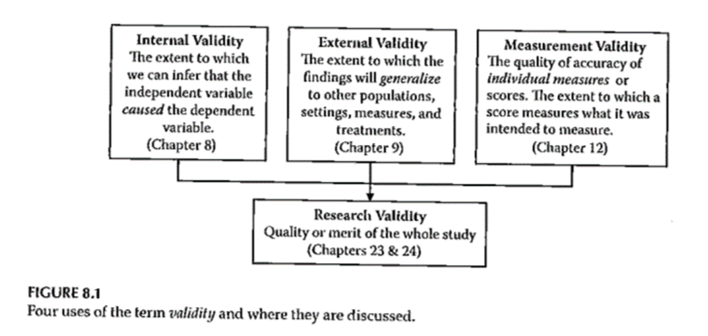
9c, Validity
Notes:
Here is figure 8.1 again. The next part of this lecture talks about sampling and external validity.

Slide 21
9c, Validity
Notes:
Here is figure 8.1 again. The extent to which results will generalize.

Slide 22
9c, Measurement
What do we mean “ measurement ” ?
assignment of numbers or symbols to the different levels or values of variables according to rules. ”
Notes:
We are talking about measurement this week. You are either taking stats or have taken it in the past. This is not a statistics class. Think about what type of variables you will collect and propose what statistical analysis.
Your book defines it as the assignment of numbers or symbols. Notice that this takes a quantitative approach. But even in a qualitative study, you still going to want to summarize information like demographics of your sample. Describe the quality or quantity of a variable.
There are qualitative or quantitative ways to measure things like pain.
We can also use measurements to make absolute decisions. Establish a cut-point.
Conditions, distinctions.

Slide 23
9c, Measurement
Assigning a number to represent …
Continuous value
Discrete value
Precision of measurement
Continuous variable …
Discrete variable …
Notes:
Value that is assigned can take on any value. Preciseness is dependent on the device used to collect the measurement. It could be the precision of a laser versus a cruder measure. Precision should be appropriate to what you are trying to get at. Lack precision does not mean that your results are not continuous. If you round to the nearest inch, you still are measuring an underlying construct that can take on more precision. Example is blood pressure, interbeat interval, where rounding is done but it still represents a continuous variable.
Discrete values because of rounding, using counts, or a limited number of categories. As long as it represents an underlying construct, consider it as continuous.

Slide 24
9c, Measurement
What is the measurement representing?
Actual measurement …
Length, time, …
Indirect measurement
Constructs
Whatever you are trying to measure ..
Must be able to define it!
Notes:
A survey or scale to get at depression, pain, those kind of things. These are abstract variables.
Bottom line is to define and operationalize how you measure something. It’s easy to say something like quality of life but you have to pin this down and establish measurement validity. Consistency is important to avoid measurement bias.
Even for pretty obvious values like blood pressure, there are different ways to measure and you need to choose a single method for consistency and careful control, and when there are multiple methods, chose the method that is optimal for your needs. Blood pressure, for example, can be influenced by whether you are sitting or standing and whether you are talking while the measurement is being done.
Formalizing the rules for measurement helps reduce bias. This is a real concern when you have a variety of people doing the same measurements. How are new hires trained? Can you verify that they are trained to the standard that you have promised.

Slide 25
9c, Measurement
Traditional levels (scales) of measurement
Nominal
Ordinal
Interval
Ratio
Notes:
Nominal means names, classification, or categorical assignment. Names are mutually exclusive and exhaustive. Value that is shown is a number code or a text word.
Ordinal is similar to nominal plus some orderliness as to what those responses mean. Example five point scale.
There is no true zero point. Can’t perform arithmetic operatitons on ordinal variables.
You can talk about the direction of change.
Interval - difference between levels is consistent across the range of the scale.
Ratio. There is a true zero point.

Slide 26
9c, Measurement
Authors categorization of levels of measurement
Nominal
Dichotomous
Ordinal
Normally distributed
Table 10.1
Notes:
Gliner et al have a slightly different take. They talk about a normally distributed scale. It is hard to talk about the difference between ordinal and interval.
Look at the literature in the area you work with. Several Likert scales summed to get a subscale.

Slide 27
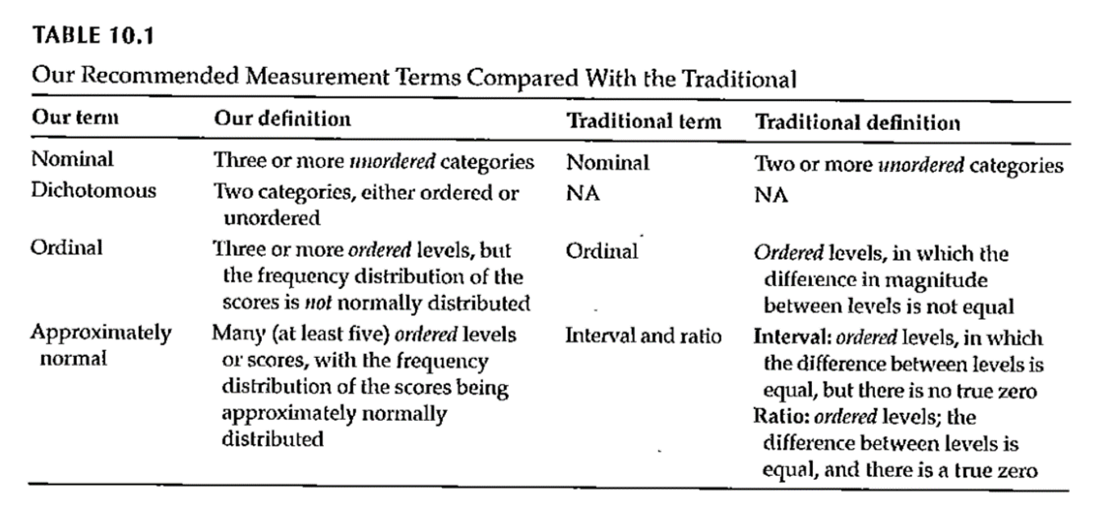
9c, Measurement
Notes:
Table 10.1. This scale splits nominal into those with two levels (dichotomous, also known as binary) and more than two levels (nominal).
Remember how you coded nominal variables. You can (and should) use zero-one coding for dichotomous variables.
The average of a zero-one coded variable represents a probability.
Approximately normal scale requires at least five levels accorind to Gliner et al.

Slide 28
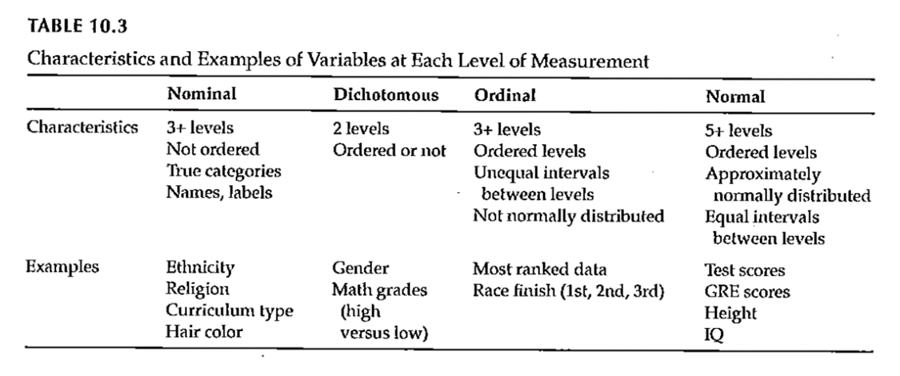
9c, Measurement
Notes:
Table 10.3 gives examples of the Gliner et al scales.

Slide 29
9c, Measurement
Why does the scale of measurement matter?
How it reflects your design and your research question
How it determines the types of statistical analyses you will do
How it defines what you can say about your results
Notes:
The level of measurement comes from what you are trying to get at in your research.
Measurement scales can limit what you can say about your results.

Slide 30
9c, External Validity
Generalizability
Fig. 9.3
Evaluating Research Validity Framework
Two main aspects
Population external validity
Ecological external validity
Notes:
The extent to which results can be generalized beyond this study. Extrapolate to the bigger world.
Evaluating freamework (questions 14 and 15).
Population: how participants were selected.
Ecologic validity: the more control you have, the better the internal validity but the less like it is for real world. The naturalness of the setting, rapport.
Figure 9.3.

Slide 31
9c, External Validity
Population external validity
How participants were selected for the study?
Is sample representative of the target population?
Validity framework

Slide 32
9c, External Validity
Ecological external validity
Whether the results can be generalized to real-life outcomes
Trade-off with control of study
Validity framework

Slide 33
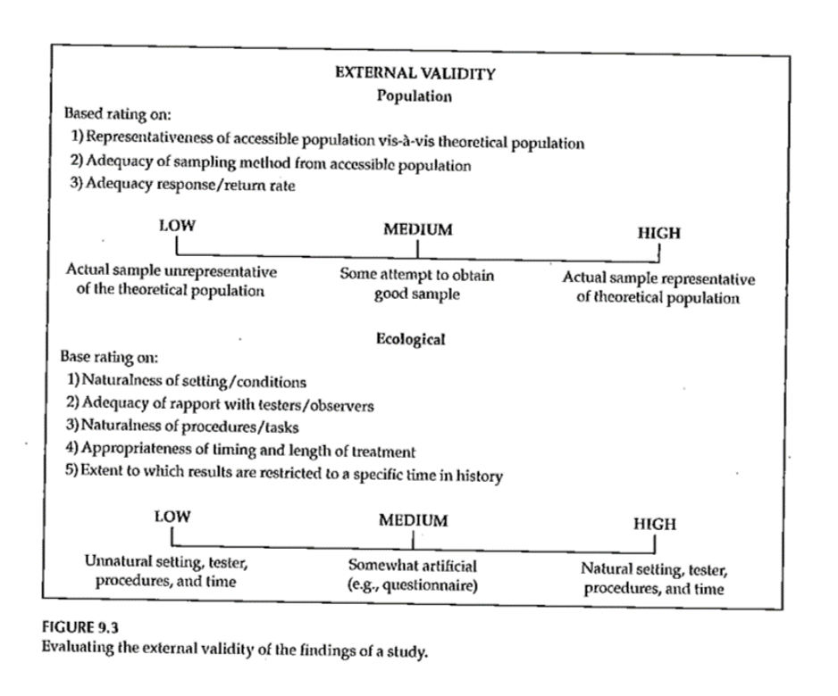
9c, External Validity

Slide 34
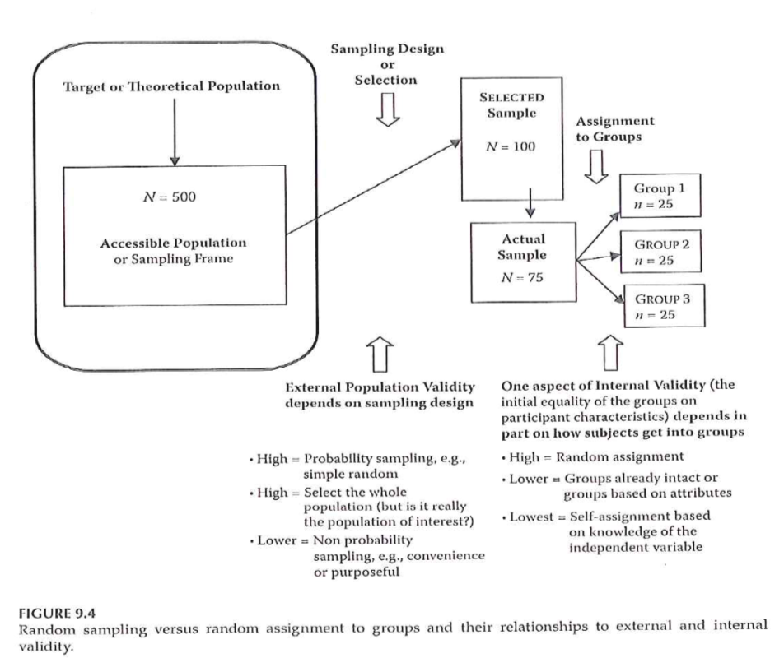
9c, Sampling and Validity
Notes:
Figure 9.4. External validity is influenced by the sampling process. Internal validity is influenced by the allocation of this sample to treatment groups.

Slide 35
9c, Measurement Validity
Internal structure evidence –
“Evidence from several types of analysis, including factor analysis and differential item functioning …”
Does an analysis of the internal structure of a measure match the conceptual framework?
Notes:
Factor analysis is a method of grouping items representative of individual constructs.
In the week 9 folder is the MOTIV* document. The CES-D score has twenty items rated on a 0 to 4 scale, with four of the items reverse scaled.
There is a somatic factor in this scale. This might be considered a subscale. Run a factor analysis, even though it only has four levels. Do the items all hang together.

Slide 36
9c, Measurement Validity
Factor analysis – Beliefs about ART measure
The following questions involve your personal views about the HIV medications that have been prescribed for you. Please indicate the extent to which you agree or disagree with the following statements.
Response scale: 1 (strongly disagree), 2 (disagree), 3 (uncertain), 4 (agree), 5 (strongly agree)
Notes:
The ones in yellow. Multiple items to represent a measure. Is there variability in any of those items. If you had selected one and only one item, it might be influenced by external factors like your mood. Multiple items avoid this problem.
The N items had Cronbach’s alpha of ?? and the C items had Cronbach’s alpha of ??.
A factor analysis allows us to see if the measure is behaving the way we expect it to.

Slide 37
9c, Sampling
Sample size
General rules
Representativeness vs number
Impact of having very large sample sizes
Generally –
Need sample to be large enough so you don’t miss important findings
If very large sample, need to distinguish statistical significance vs clinically important
Notes:
How many people do I need. This best done using a power analysis. Take account of the measures being used and what you expect to see. Information from previous research or other kinds of things.
Representativeness is more important than the absolute size of the sample.
Large enough so you don’t miss important findings.
In cases with really large sample sizes where you get statistical significance without practical significance. Effects.

Slide 38
9c, Internal Validity
“The extent to which we can infer that the independent variable caused the dependent variable.”
For non-experimental studies –
How “well designed and conducted” was the study?
Three criteria for causality
Notes:
It’s really only randomized trials that can establish causality. But even in quasi-experimental and non-experimental studies, you can still talk about internal validity.
The cause has to precede the effect, it must be connected to the effect, and there must be no other variables that could explain why the cause is related to the effect.

Slide 39
9c, Internal Validity
“The extent to which we can infer that the independent variable caused the dependent variable.”
Three criteria for causality
IV must precede the outcome variable
IV must be related to the outcome
There must be no other variables that could explain why the IV is related to the outcome

Slide 40
9c, Internal Validity
Three criteria for causality –
IV must precede the outcome variable
IV must be related to the outcome
There must be no other variables that could explain why the IV is related to the outcome
By Research Approach –
Randomized Exp
Quasi- Exp
Comparative
Associational
Descriptive

Slide 41
9c, Internal validity
Notes:
For randomized designs, the cause precedes the effect, the cause is related to the outcome and there are no other variables that could explain the relationship.

Slide 42
9c, Internal Validity
Meeting the 3 causality criteria based on –
Strength of the research design
Internal validity
Notes:
The strength of the research design and the internal validity determine whether you can claim causality. Try to design the study to maximize internal validity.

Slide 43
9c, Internal Validity
Internal validity -
Most often discussed with reference to randomized experimental and quasi-experimental designs
Can also be applied to non-experimental studies

Slide 44
9c, Internal Validity
Evaluating the internal validity of a study –
Equivalence of the groups on participant characteristics
Control of extraneous experiences and environmental variables
Notes:
There are two aspects of internal validity, equivalence and control.

Slide 45
9c, Internal Validity
Equivalence of the groups on participant characteristics –
Are groups equivalent prior to introduction of IV?
Randomized experimental design –
Random assignment
Quasi-experimental design –
Random assignment of treatments
Matching
Checking pretest scores
Notes:
Random assignment assures equivalence of the two groups on average. A rule of thumb is 30 people assigned to each group should give you confidence that random assignment will assure equivalence. If you are using random assignment, you should not need to test for baseline equivalence. We feel that random assignment is the best way to achieve equivalence.
In quasi-experimental design, you don’t have random assignment, but you can randomly assign between the two groups. You can also use matching to achieve equivalence. Finally, you can check baseline scores for equivalence.

Slide 46
9c, Internal Validity
Equivalence of the groups on participant characteristics –
Are groups equivalent prior to introduction of IV?
Comparative design –
Statistical adjustment (ANCOVA) to adjust DV scores to make groups more nearly equivalent
Matching participants on variables other than the primary IV
E.g. Case-control study
Check after the study for comparability
Notes:
Since non-randomized trials have an attribute variable, you need to rely on statistical adjustment or matching. You can also check after the study for comparability.

Slide 47
9c, Internal Validity
Equivalence of the groups on participant characteristics –
Are groups equivalent prior to introduction of IV?
Associational design –
Only 1 group
Not able to provide evidence of causation
“Equivalence” – “… whether those who score high on the IV … are similar to those … who score low in terms of other attributes that may be related to the DV.”
May be able to provide some statistical control
Notes:
Equivalence when you have a continuous independent variable means that those who score high on the variable are similar to those who score low.

Slide 48
9c, Internal Validity
Control of extraneous experiences and environmental variables –
Extraneous variables – variables other than the IV and DV
Environmental variables – conditions/variables that occur during the study
Contamination
Issue – Is one group affected more than the other(s)?
Less of an issue with a more controlled research setting
Notes:
Your study could be contaminated by other variables. These variables might be out of your control but which can influence the outcome.
Contamination: people in the intervention group are friends with the control group and share information.
The key issue is whether one group is more affected by extraneous variables.
In a controlled setting, there are fewer extraneous variables, but this changes in a field setting.

Slide 49
9c, Internal Validity
Rating the dimensions of internal validity
Figure 8.2
Evaluating Research Validity framework
“Good” study – moderate to high internal validity on both dimensions
Notes:
Internal validity is measured by whether the two dimensions are addressed.

Slide 50
9c, Internal Validity
Rating the dimensions of internal validity
Notes:
Figure 8.2.

Slide 51
9c, Threats to Internal Validity
Notes:
Table 8.1 relates statistical terminology to identify threats to internal validity. This table tries to take those technical terms and express them
Extreme groups have issues with regression to the mean. Even without any intervention, the extremities will tend to lessen.
Dropouts or attrition means that you’ve designed a setting that is so difficult that no one can stay in. Differential attrition is especially troublesome.
Bias in assignment occurs when patients or their physicians directly or indirectly influence the assignment. Random assignment eliminates this bias.
Cook and Campbell.

Slide 52
9c, Threats to Internal Validity
Equivalence of Groups
Use of extreme groups
Participant dropouts or attrition during the study
Bias in assignment to groups

Slide 53
9c, Threats to Internal Validity
Control of extraneous/environmental variables
Changes due to time or growth and development
Extraneous environmental events
Repeated testing, carryover effects
Instrument or observer inconsistency
Combinations of two or more threats
Did the IV actually occur before the DV?
Notes:
Here are some of the sources of extraneous variables.
Maturation.
History. Something that occurs between the pre and post measurements that is independent of the intervention but which can influence the outcome.
Worry about sensitization to the issue in the baseline measurement that causes people to go out and find more.
Long studies have problems with instrumentation or observers (e.g., because of turnover).
There are also combinations of these events where one magnifies the other.
Temporal order of the variables. If you can’t assure that the independent variable occurs before the dependent variable, you can’t establish causation.

Slide 54
9c, Threats to Internal Validity
Other threats
Effects of being in the control group
Expectation effect
Control for expectation
Observer / experimenter bias
Notes:
Control group contamination. Demoralization.
Hawthorne effect.
Blinding helps control for expectation effects and observer bias.

Slide 55
9c, Validity
Notes:
Here is figure 8.1 again. The next part of this lecture talks about sampling and external validity.

Slide 56
9c, Validity
Notes:
Here is figure 8.1 again. The extent to which results will generalize.

Slide 57
9c, Measurement
What do we mean “ measurement ” ?
assignment of numbers or symbols to the different levels or values of variables according to rules. ”
Notes:
We are talking about measurement this week. You are either taking stats or have taken it in the past. This is not a statistics class. Think about what type of variables you will collect and propose what statistical analysis.
Your book defines it as the assignment of numbers or symbols. Notice that this takes a quantitative approach. But even in a qualitative study, you still going to want to summarize information like demographics of your sample. Describe the quality or quantity of a variable.
There are qualitative or quantitative ways to measure things like pain.
We can also use measurements to make absolute decisions. Establish a cut-point.
Conditions, distinctions.

Slide 58
9c, Measurement
Assigning a number to represent …
Continuous value
Discrete value
Precision of measurement
Continuous variable …
Discrete variable …
Notes:
Value that is assigned can take on any value. Preciseness is dependent on the device used to collect the measurement. It could be the precision of a laser versus a cruder measure. Precision should be appropriate to what you are trying to get at. Lack precision does not mean that your results are not continuous. If you round to the nearest inch, you still are measuring an underlying construct that can take on more precision. Example is blood pressure, interbeat interval, where rounding is done but it still represents a continuous variable.
Discrete values because of rounding, using counts, or a limited number of categories. As long as it represents an underlying construct, consider it as continuous.

Slide 59
9c, Measurement
What is the measurement representing?
Actual measurement …
Length, time, …
Indirect measurement
Constructs
Whatever you are trying to measure ..
Must be able to define it!
Notes:
A survey or scale to get at depression, pain, those kind of things. These are abstract variables.
Bottom line is to define and operationalize how you measure something. It’s easy to say something like quality of life but you have to pin this down and establish measurement validity. Consistency is important to avoid measurement bias.
Even for pretty obvious values like blood pressure, there are different ways to measure and you need to choose a single method for consistency and careful control, and when there are multiple methods, chose the method that is optimal for your needs. Blood pressure, for example, can be influenced by whether you are sitting or standing and whether you are talking while the measurement is being done.
Formalizing the rules for measurement helps reduce bias. This is a real concern when you have a variety of people doing the same measurements. How are new hires trained? Can you verify that they are trained to the standard that you have promised.

Slide 60
9c, Measurement
Traditional levels (scales) of measurement
Nominal
Ordinal
Interval
Ratio
Notes:
Nominal means names, classification, or categorical assignment. Names are mutually exclusive and exhaustive. Value that is shown is a number code or a text word.
Ordinal is similar to nominal plus some orderliness as to what those responses mean. Example five point scale.
There is no true zero point. Can’t perform arithmetic operatitons on ordinal variables.
You can talk about the direction of change.
Interval - difference between levels is consistent across the range of the scale.
Ratio. There is a true zero point.

Slide 61
9c, Measurement
Authors categorization of levels of measurement
Nominal
Dichotomous
Ordinal
Normally distributed
Table 10.1
Notes:
Gliner et al have a slightly different take. They talk about a normally distributed scale. It is hard to talk about the difference between ordinal and interval.
Look at the literature in the area you work with. Several Likert scales summed to get a subscale.

Slide 62
9c, Measurement
Notes:
Table 10.1. This scale splits nominal into those with two levels (dichotomous, also known as binary) and more than two levels (nominal).
Remember how you coded nominal variables. You can (and should) use zero-one coding for dichotomous variables.
The average of a zero-one coded variable represents a probability.
Approximately normal scale requires at least five levels accorind to Gliner et al.

Slide 63
9c, Measurement
Notes:
Table 10.3 gives examples of the Gliner et al scales.

Slide 64
9c, Measurement
Why does the scale of measurement matter?
How it reflects your design and your research question
How it determines the types of statistical analyses you will do
How it defines what you can say about your results
Notes:
The level of measurement comes from what you are trying to get at in your research.
Measurement scales can limit what you can say about your results.

Slide 65
9c, Assignment #6
Prepare a brief paragraph that describes the research design you are using for your research proposal. This is the information that will probably appear in the Methods section of your proposal.
Notes:
Go back are refer to Figure 4.1. Week 8 activities relate to the exemplar articles. These are on the Canvas site. There are six included. Pick one and get familiar with it.

Slide 66
9c, External Validity
Generalizability
Fig. 9.3
Evaluating Research Validity Framework
Two main aspects
Population external validity
Ecological external validity
Notes:
The extent to which results can be generalized beyond this study. Extrapolate to the bigger world.
Evaluating freamework (questions 14 and 15).
Population: how participants were selected.
Ecologic validity: the more control you have, the better the internal validity but the less like it is for real world. The naturalness of the setting, rapport.
Figure 9.3.

Slide 67
9c, External Validity
Population external validity
How participants were selected for the study?
Is sample representative of the target population?
Validity framework

Slide 68
9c, External Validity
Ecological external validity
Whether the results can be generalized to real-life outcomes
Trade-off with control of study
Validity framework

Slide 69
9c, External Validity

Slide 70
9c, Sampling and Validity
Notes:
Figure 9.4. External validity is influenced by the sampling process. Internal validity is influenced by the allocation of this sample to treatment groups.

Slide 71
9c, Measurement Validity
Internal structure evidence –
“Evidence from several types of analysis, including factor analysis and differential item functioning …”
Does an analysis of the internal structure of a measure match the conceptual framework?
Notes:
Factor analysis is a method of grouping items representative of individual constructs.
In the week 9 folder is the MOTIV* document. The CES-D score has twenty items rated on a 0 to 4 scale, with four of the items reverse scaled.
There is a somatic factor in this scale. This might be considered a subscale. Run a factor analysis, even though it only has four levels. Do the items all hang together.

Slide 72
9c, Measurement Validity
Factor analysis – Beliefs about ART measure
The following questions involve your personal views about the HIV medications that have been prescribed for you. Please indicate the extent to which you agree or disagree with the following statements.
Response scale: 1 (strongly disagree), 2 (disagree), 3 (uncertain), 4 (agree), 5 (strongly agree)
Notes:
The ones in yellow. Multiple items to represent a measure. Is there variability in any of those items. If you had selected one and only one item, it might be influenced by external factors like your mood. Multiple items avoid this problem.
The N items had Cronbach’s alpha of ?? and the C items had Cronbach’s alpha of ??.
A factor analysis allows us to see if the measure is behaving the way we expect it to.

