Slide 1
Introduction to R, module06
Steve Simon

Slide 2
Introduction
suppressMessages( suppressWarnings( library(tidyverse))) R.version.string
## [1] "R version 4.1.1 (2021-08-10)"
Sys.Date()
## [1] "2022-05-09"
Notes:
This Powerpoint presentation was created using an R Markdown file. This slide shows the version of R that I used and when it was last modified.

Slide 3
What is longitudinal data
Definition
Measurements taken at different times
Closely related datasets
Crossover
Pre-test/post-test
Repeated measures
Split plot
Notes:
I’m going to use the term “longitudinal” data to designate data sets where a patient is measured at multiple different time points. This encompasses certain other data sets, such as from a crossover, pre-test/post-test, repeated measures, and split plot.
Don’t worry about the technical distinctions among these terms. The important thing to know for now is that longitudinal data represents one of the biggest challenges in data management and we will spend most of this section discussing these challenges.

Slide 4
Two formats for longitudinal data
Short and fat format
Many columns
Not so many rows
Tall and thin format
Not so many columns
Many rows
Notes:
Longitudinal data usually come in one of two specific formats. The first is the short and fat format and the second is the tall and thin format.

Slide 5
Example: effect of surface and vision on balance
Repeated measures experiment
Vision has 3 levels
Eyes open, eyes closed, dome
Surface has 2 levels
Normal or foam
Two replications of each format
There are 3*2*2=12 measurements
Notes:
Normally, you can only find a dataset stored in one of the two formats, but I did find an example of the same dataset being stored in both formats.
Look here for more details: www.statsci.org/data/oz/ctsib.html

Slide 6
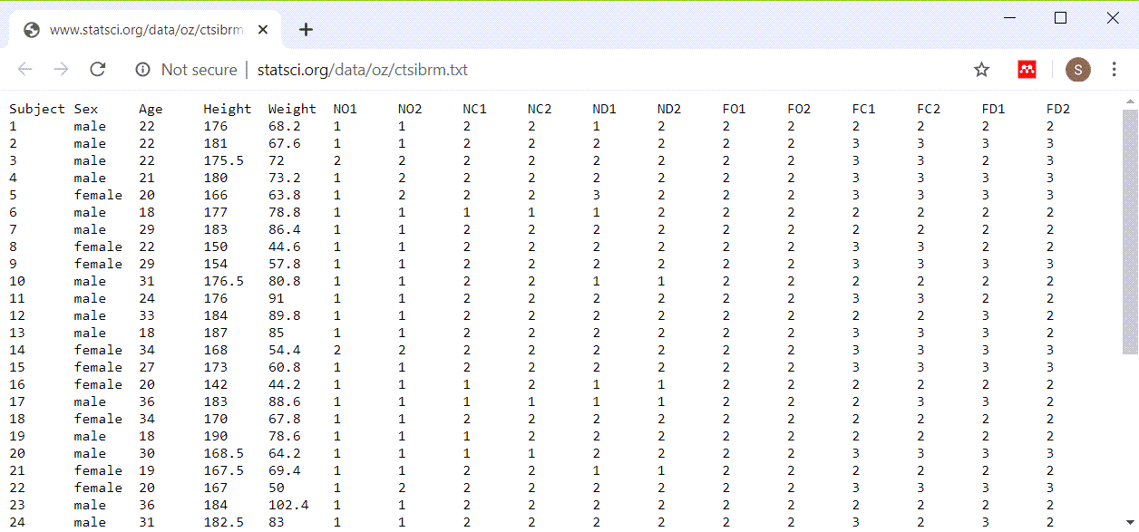
Short and fat example
Longitudinal data stored one row per subject
Notes:
The short and fat format has one row per patient and each successive patient encounter is strung out horizontally.

Slide 7
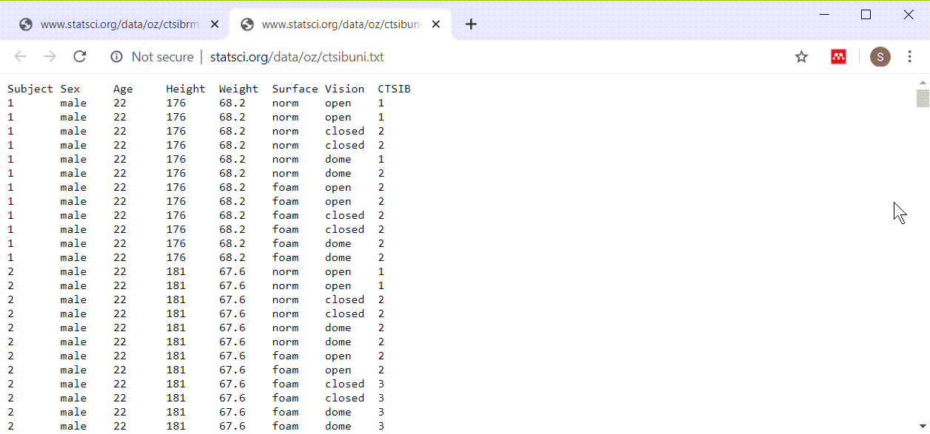
Tall and thin example
Longitudinal data stores with multiple rows per patient
Notes:
The tall and thin format has one row per patient encounter and therefore multiple rows per patient.

Slide 8
Which format is better?
Short and fat advantages:
easy to compute change scores
easy to examine correlations over time
easy to insure consistency of demographic data
Short and fat disadvantages:
hard to read because of the excessive need to scroll left and right
Notes:
Both formats have advantages and disadvantages, and you need to know how to create a longitudinal file in either format and how to transform from one format to another.
The short and fat format makes it easy to compute change scores, the difference between a later measurementn and an earlier one. Correlations are also easier.
Because the short and fat format stretches each visits data out to the right, you end up doing a lot of left/right scrolling with this type of file.

Slide 9
Which format is better?
Tall and thin advantages:
easy to plot longitudinal trends
less need for missing value codes
easy to read because most scrolling is up and down
Tall and thin disadvantages
hard to maintain consistency of demographic variables
Notes:
While some statistical tasks are easier with the short and fat format, the one that is usually easier with the tall and thin format is plotting.
If a subject misses a visit, the short and fat visit format makes you put in missing value codes for all the data that was not collected at that time. A tall and thin format is easier because you just leave out the row that corresponds to the missing visit.
The problem with this format is in the repetition that occurs. If you have demographic variables like gender and race, those are listed on each row. This allows an opportunity for mischief, where a patient can have a different gender on different rows.

Slide 10
Break #1
What have you learned
Two formats for longitudinal data
What is coming next
Converting to tall and thin format
Notes:
I want to keep these videos short, so let’s stop here.

Slide 11
Energy dataset (short and fat format)
Completely randomized block design
Blocks are subjects (8 total)
Treatment are exercise
Running, walking, cycling
There are 3*2*2=12 measurements
Notes:
Here’s another interesting data set that you can work with. It comes in a short and fat format.
Look here for more details: www.statsci.org/data/general/energy.html

Slide 12
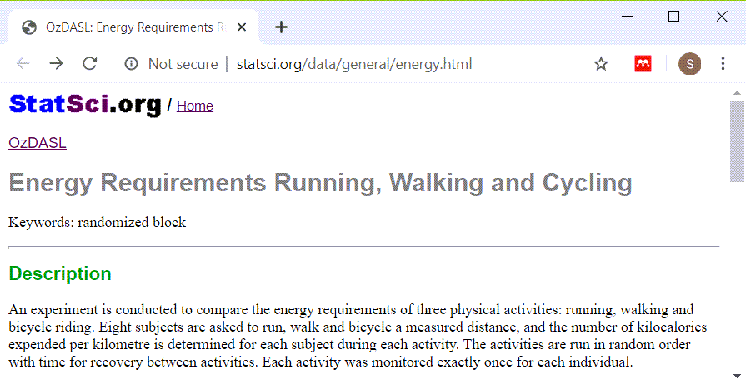
Energy dataset (short and fat format)

Slide 13
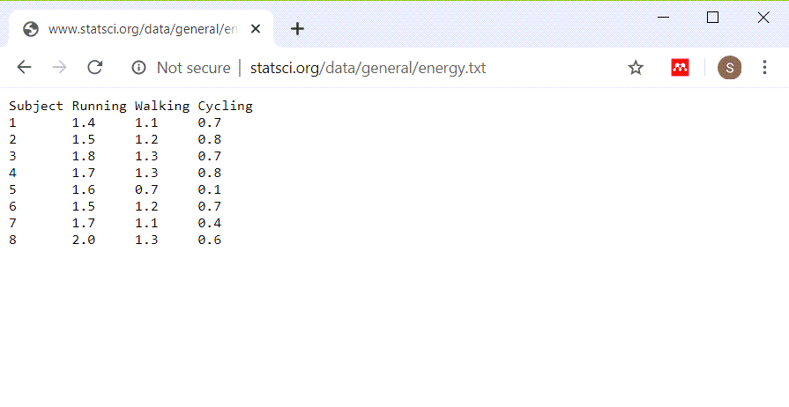
Energy dataset (short and fat format)

Slide 14
Import energy dataset (short and fat format)
fi <- "../data/energy.txt" en <- read_table(fi, col_types="nnnn")

Slide 15
Energy dataset, glimpse
glimpse(en)
## Rows: 8 ## Columns: 4 ## $ Subject <dbl> 1, 2, 3, 4, 5, 6, 7, 8 ## $ Running <dbl> 1.4, 1.5, 1.8, 1.7, 1.~ ## $ Walking <dbl> 1.1, 1.2, 1.3, 1.3, 0.~ ## $ Cycling <dbl> 0.7, 0.8, 0.7, 0.8, 0.~
Notes:
Here is the structure of this dataset. It doesn’t look that fat, but it strings out three separate measurements on each patient across three columns.
You can convert this to a tall and thin format by stacking the running, walking, and cycling values in a single column. You’ll need a new variable to remind you whether the value you are converting comes from the first patient, second patient, etc.
This is important to remember. For the short and fat datasets, with one row per subject, you do not need to record a patient identification number. But with the tall and thin format, with multiple rows per patient, if you don’t have an identification number, you won’t be able to know which rows belong together under a single patient.

Slide 16
Converting to tall and thin, code
en_tall <- pivot_longer(en, c(Running, Walking, Cycling), names_to="activity", values_to="energy")
Notes:
The pivot_longer function creates two new variables. The “names_to” variable is the name of the column where the data value came from and “values_to” is the data value itself. Any variable or variables left out of the list are treated like an identifier for a particular row.

Slide 17
Converting to tall and thin, output
glimpse(en_tall)
## Rows: 24 ## Columns: 3 ## $ Subject <dbl> 1, 1, 1, 2, 2, 2, 3, ~ ## $ activity <chr> "Running", "Walking",~ ## $ energy <dbl> 1.4, 1.1, 0.7, 1.5, 1~
Notes:
Here is the tall and thin format. Notice that there are 24 rows now, 3 for each of the 8 subjects. All the energy measurements are now in a single column.

Slide 18
Lineplot
activity_lineplot <- ggplot(en_tall, aes(x=activity, y=energy, group=Subject)) + geom_line() ggsave( "../images/activity-by-energy.png", activity_lineplot, width=4, height=4)
Notes:
One possible graph that could not have done in the short and fat format is a lineplot. The group parameter in the aes function tells R that separate lines are defined for each subject.

Slide 19
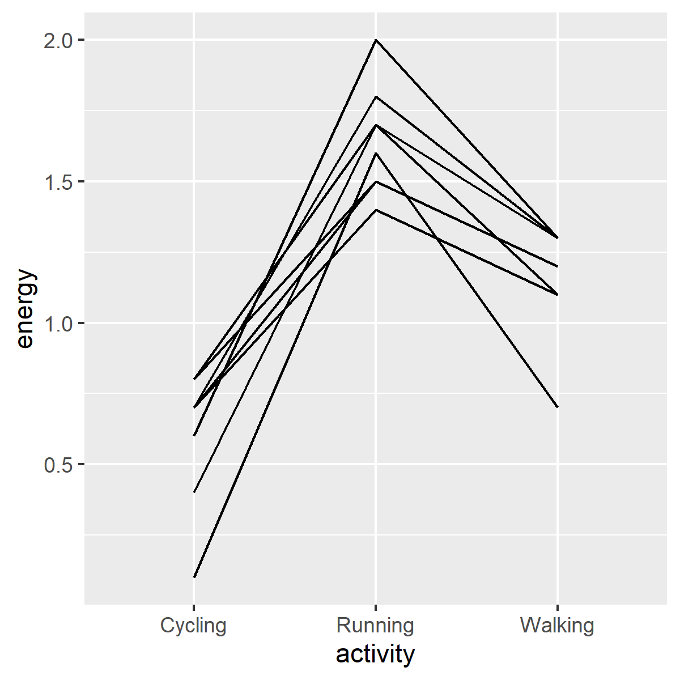
Lineplot
Plot showing activity levels by activity
Notes:
Here is the graph. Notice the inverted V shape for each line. This shows that running uses the most energy for any individual subject.

Slide 20
Earthquake dataset
Longitudinal study of stress
Study started two weeks prior to major earthquake (Week0)
Researchers added extra stress measurments
Week3, Week6, Week9, Week12
There are 26 subjects
There are 5*26=130 measurements
Notes:
Here is a dataset stored in the short and fat format. This dataset will serve as a second example of how to convert from a short and fat format to a tall and thin format.
For more information, see www.statsci.org/data/general/lomaprie.txt

Slide 21
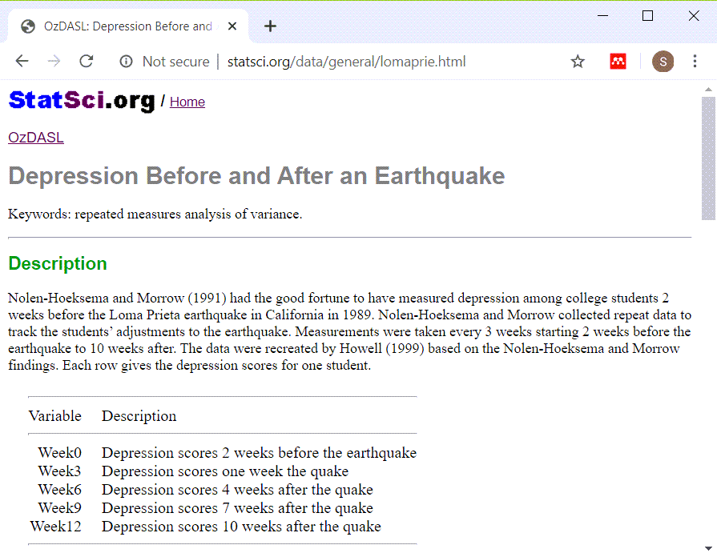
Earthquake dataset
Screenshot of data dictionary website
Notes:
Here is the data dictionary

Slide 22
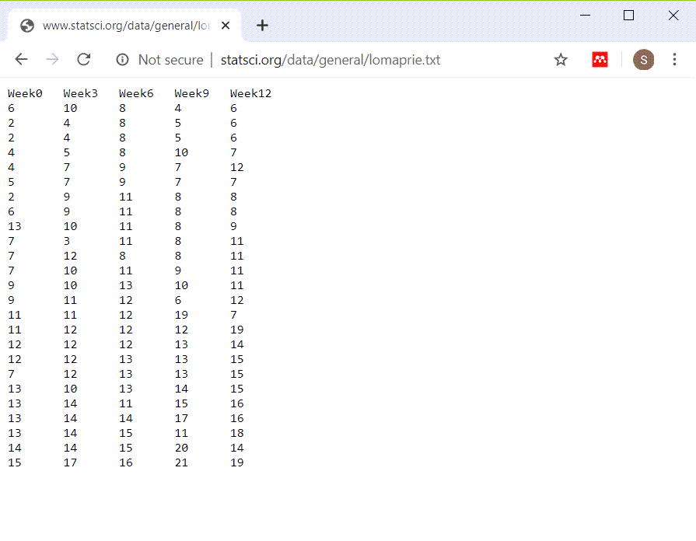
Earthquake dataset
View of the earthquake dataset
Notes:
This is clearly a tab delimited file. All of the fields are left justified.

Slide 23
Read in the earthquake data
fn <- "../data/quake.txt" qu <- read_table(fn, col_types="nnnnn")

Slide 24
Check structure of the earthquake data
glimpse(qu)
## Rows: 25 ## Columns: 5 ## $ Week0 <dbl> 6, 2, 2, 4, 4, 5, 2, 6,~ ## $ Week3 <dbl> 10, 4, 4, 5, 7, 7, 9, 9~ ## $ Week6 <dbl> 8, 8, 8, 8, 9, 9, 11, 1~ ## $ Week9 <dbl> 4, 5, 5, 10, 7, 7, 8, 8~ ## $ Week12 <dbl> 6, 6, 6, 7, 12, 7, 8, 8~
Notes:
There are measurements at weeks 0, 3, 6, 9, and 12.

Slide 25
Convert to tall and thin format
qu$id <- 1:25 qu_tall <- pivot_longer(qu, contains("Week"), names_to="time", values_to="depression")
Notes:
Suggestion: create an id variable with values 1:25 before you convert the format. It is not needed for the boxplots that I draw later, but if you do anything more complex with this data, you need to know which data in the tall and thin format comes from the first row of the original data set, from the second row, etc.
The names of the columns Week0, Week3, etc. will be stored in a new column, Week, and the values in a new column, depression.

Slide 26
Display new structure
glimpse(qu_tall)
## Rows: 125 ## Columns: 3 ## $ id <int> 1, 1, 1, 1, 1, 2, 2~ ## $ time <chr> "Week0", "Week3", "~ ## $ depression <dbl> 6, 10, 8, 4, 6, 2, ~
Notes:
Here is the structore of the tall and thin format.

Slide 27
Boxplot
depression_boxplot01 <- ggplot( qu_tall, aes(x=time, y=depression)) + geom_boxplot() ggsave( "../images/time-by-depression01.png", depression_boxplot01, width=4, height=4)
Notes:
Notice how R orders the weeks. From a strict alphabetical perspective, week12 is between week0 and week3. Here’s a fix.

Slide 28
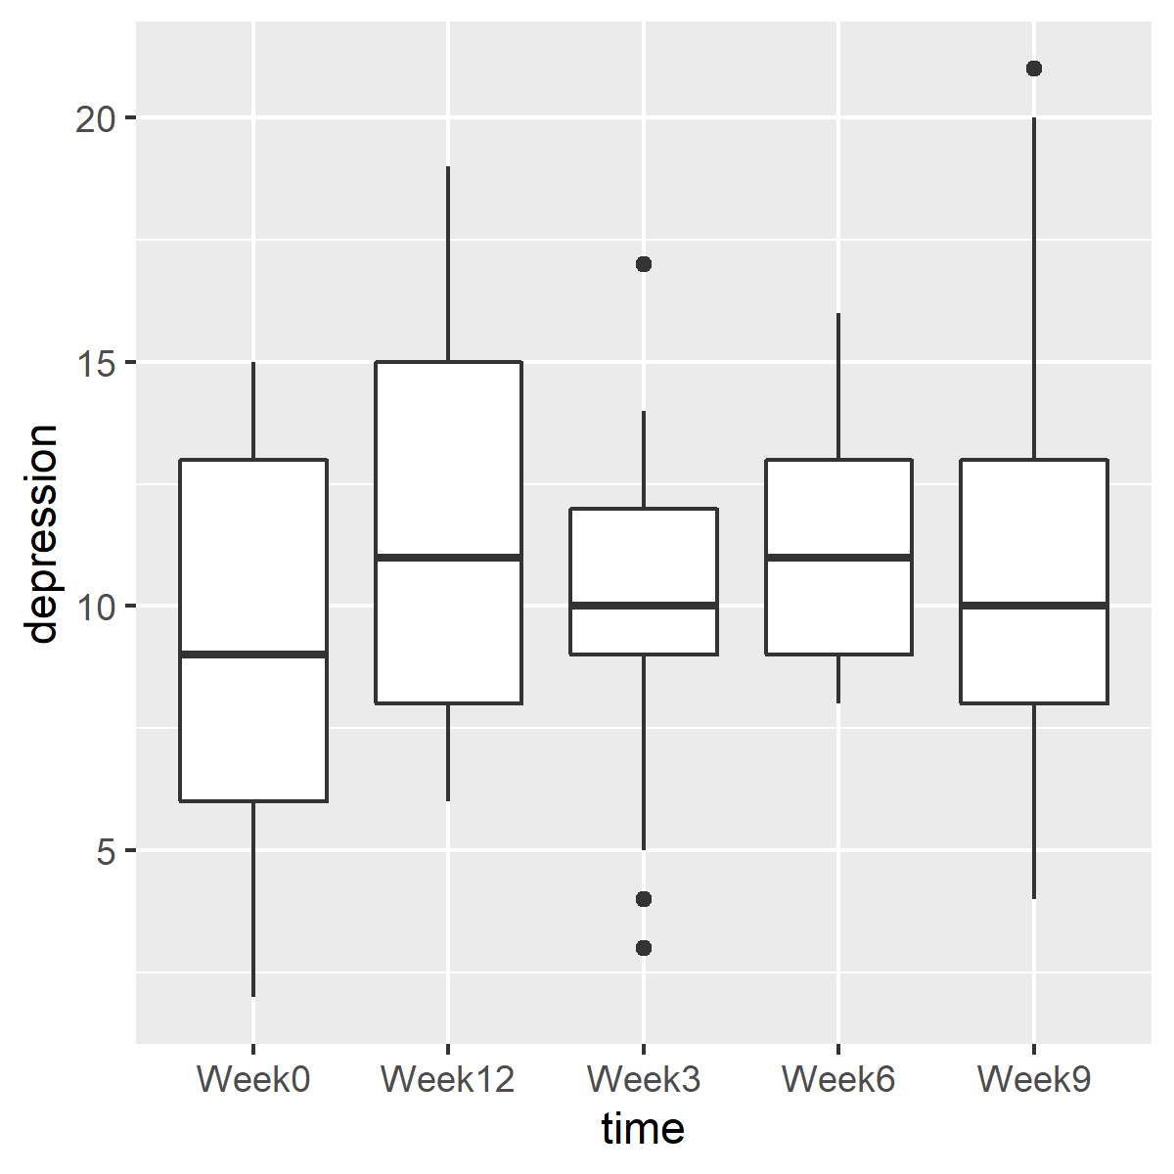
Boxplot
Boxplots showing depression levels over time
Notes:
Here is the plot. The order of the weeks is not correct, because week12 appears between week0 and week3.
There are several ways to fix this.

Slide 29
Boxplot
qu_tall$time <- case_when( qu_tall$time=="Week0"~"week00", qu_tall$time=="Week3"~"week03", qu_tall$time=="Week6"~"week06", qu_tall$time=="Week9"~"week09", qu_tall$time=="Week12"~"week12")

Slide 30
Re-drawn boxplot
depression_boxplot02 <- ggplot(qu_tall, aes(x=time, y=depression)) + geom_boxplot() ggsave("../images/time-by-depression02.png", depression_boxplot02, width=4, height=4)
Notes:
An easy way to fix this is to use two numeric digits, even for weeks that have only a single digit.

Slide 31
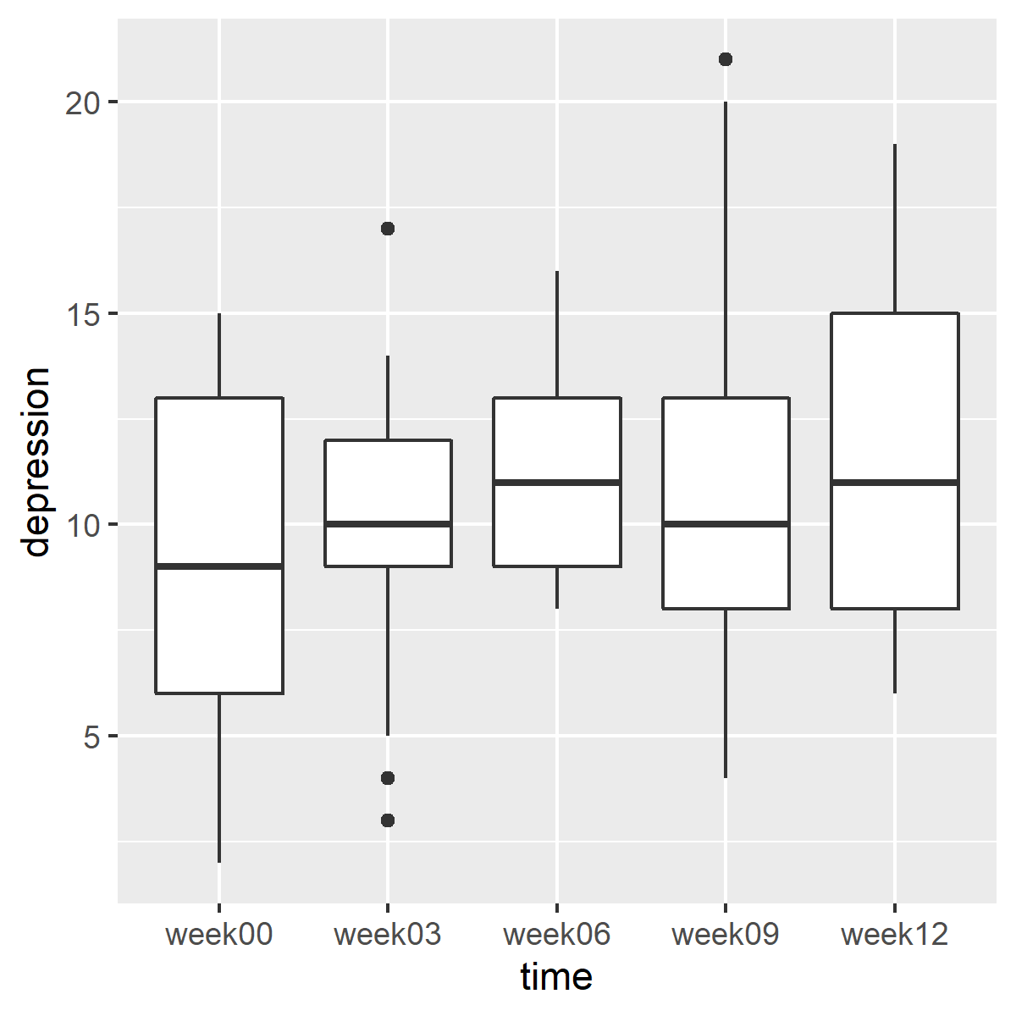
Boxplot
Modified boxplots showing depression levels over time
Notes:
Here are the boxplots in the proper order. There are changes in depression levels across time, but these changes are small.

Slide 32
Break #2
What have you learned
Converting to tall and thin format
What is coming next
Converting to short and fat format
Notes:
I want to keep these videos short, so let’s stop here.

Slide 33
Backpain dataset
Matched case-control study
Study of 11 runners with back pain
Two control groups
Runners without pain, Sedentary volunteers
Matched by age, height, weight
Outcome variables
Flexibility and length of various muscle groups
Also collected covariates
Type of running, number of years running
Our focus: quality of matching
There are 3*11=33 measurements
Notes:
Now let’s read in a tall and thin format and convert it to a short and wide format.
For more information about this dataset, see http://www.statsci.org/data/oz/backpain.html

Slide 34
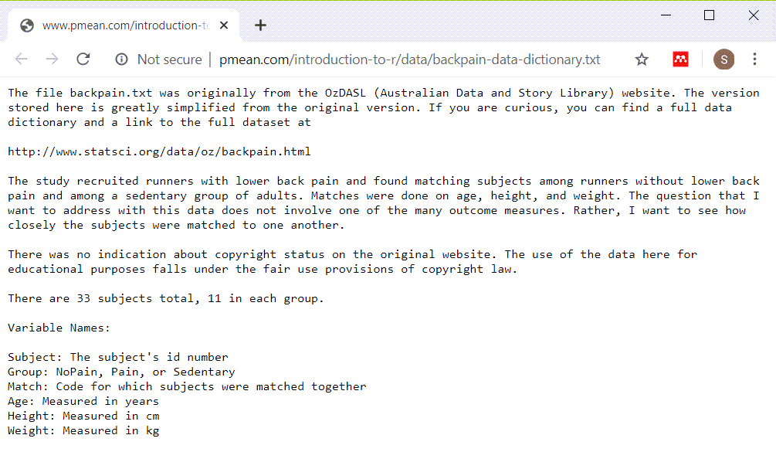
Backpain overview
Data dictionary for backpain dataset
Notes:
Here is the data dictionary for the backpain dataset.

Slide 35
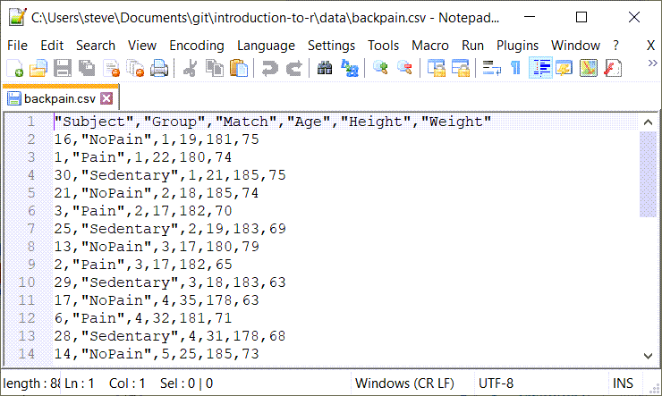
Backpain dataset
Partial view of backpain raw data
Notes:
No question here. This is a comma separated value dataset.

Slide 36
Reading in the backpain dataset
fn <- "../data/backpain.csv" pain <- read_csv(fn, col_types="ncnnn")

Slide 37
Display
glimpse(pain)
## Rows: 33 ## Columns: 6 ## $ Subject <dbl> 16, 1, 30, 21, 3, 25, ~ ## $ Group <chr> "NoPain", "Pain", "Sed~ ## $ Match <dbl> 1, 1, 1, 2, 2, 2, 3, 3~ ## $ Age <dbl> 19, 22, 21, 18, 17, 19~ ## $ Height <dbl> 181, 180, 185, 185, 18~ ## $ Weight <dbl> 75, 74, 75, 74, 70, 69~
Notes:
There are 33 rows in this dataset. Each is a different subject, but we are interested in examing the matched triples. Notice for example that the ages for the first group of three matched patients are 19, 22, and 21. For the second goup of matched patients, that are 18, 17, and 19. That looks pretty good to me, but to look at this across the entire data set, we need to put the ages, heights, and weights side by side in a short and fat format.
This means that we need to reduce the dataset from 33 rows to 11 rows, and we need to note the age for the No Pain, Pain, and Sedentary patients, the Height for the No Pain, Pain, and Sedentary patients, and the Weight for the No Pain, Pain, and Sedentary patients. So the Age, Height, and Weight columns will be expanded from 3 to 9.

Slide 38
Converting to short and fat
pain_fat <- pivot_wider(pain, id_cols=Match, names_from=Group, values_from=c(Age, Height, Weight))
Notes:
To expand the columns from 3 to 9, we need to pull names from the Group column. This will be appended to the Age, Height, and Weight columns.

Slide 39
Display new structure
glimpse(pain_fat)
## Rows: 11 ## Columns: 10 ## $ Match <dbl> 1, 2, 3, 4, 5~ ## $ Age_NoPain <dbl> 19, 18, 17, 3~ ## $ Age_Pain <dbl> 22, 17, 17, 3~ ## $ Age_Sedentary <dbl> 21, 19, 18, 3~ ## $ Height_NoPain <dbl> 181, 185, 180~ ## $ Height_Pain <dbl> 180, 182, 182~ ## $ Height_Sedentary <dbl> 185, 183, 183~ ## $ Weight_NoPain <dbl> 75, 74, 79, 6~ ## $ Weight_Pain <dbl> 74, 70, 65, 7~ ## $ Weight_Sedentary <dbl> 75, 69, 63, 6~
Notes:
Here is the structure of the short and fat format. There are too many columns to display on a single PowerPoint slide, so I am listing the names of the remaining columns on a separate slide.

Slide 40
Remaining variables
names(pain_fat)[7:10]
## [1] "Height_Sedentary" ## [2] "Weight_NoPain" ## [3] "Weight_Pain" ## [4] "Weight_Sedentary"

Slide 41
Backpain plot code (1 of 3)
age_range <- range(c( pain_fat$Age_Pain, pain_fat$Age_NoPain, pain_fat$Age_Sedentary))
Notes:
One thing that you can do in the new format that couldn’t be done in the old format is graphically displaying the closeness of matching. In a visualization of matching, it is important to use the same scale for the X and Y axis, so your first step is to find a range that would include Ages for the Pain, No Pain, and Sedentary groups combined.

Slide 42
Backpain plot code (2 of 3)
agreement_age <- ggplot(pain_fat, aes(x=Age_Pain, y=Age_NoPain, label=Match)) + geom_text(color="darkgreen") + geom_text(aes(y=Age_Sedentary), color="red") + ylab("Age_Sedentary (red) and Age_NoPain (green)" )
Notes:
Getting the Age_Pain and Age_NoPain values in a scatterplot is pretty easy. They are plotted in dark green. Plotting Age_Pain versus Age _sedentary requires a second call to the geom_text function.

Slide 43
Backpain plot code (3 of 3)
agreement_age <- agreement_age + expand_limits( x=age_range, y=age_range) + geom_segment( x=age_range[1], xend=age_range[2], y=age_range[1], yend=age_range[2]) ggsave( "../images/agreement_age.png", agreement_age, width=4, height=4)
Notes:
We have to expand the limits on both the X and Y axis to insure that the graph is “square” meaning it has the same range in either direction. I am also drawing a reference line using the geom_segment function.
This code shows the agreement between the ages of the patients in the NoPain group and the patients in the Pain group.

Slide 44
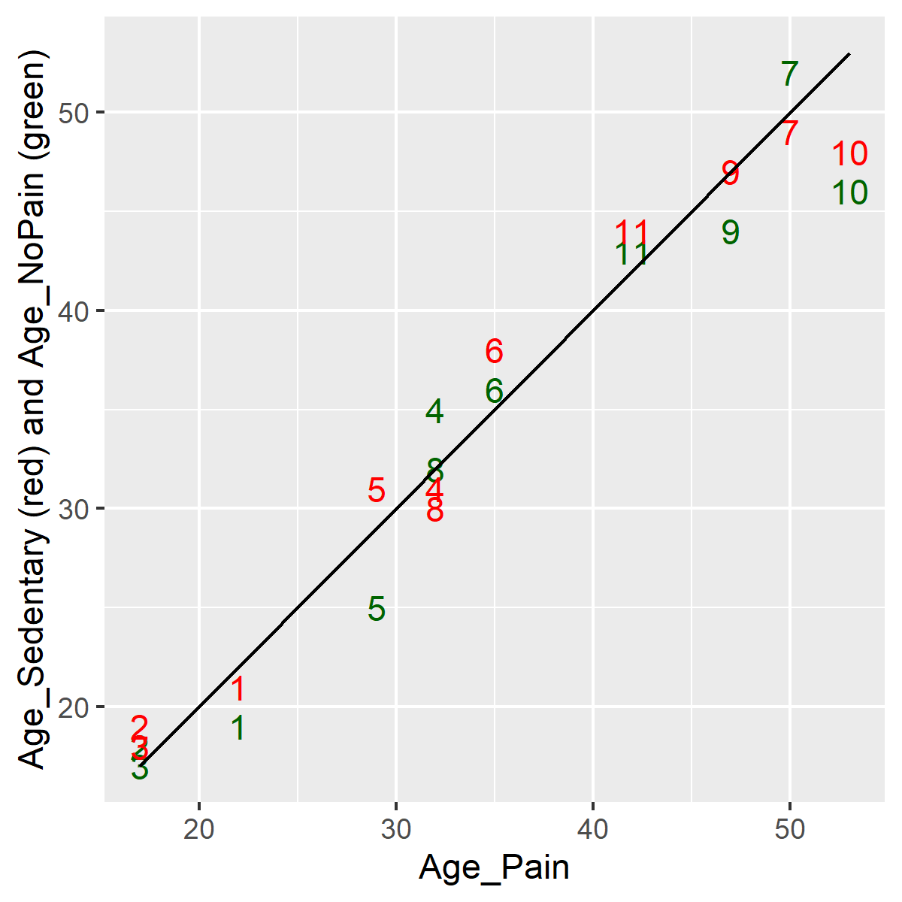
Plots of agreement
Plot showing agreement in ages
Notes:
The agreement is quite good. There is a bit less agreement for older subjects.

Slide 45
Break #2
What have you learned
Converting to short and fat format
What is coming next
Separating into time constant/time varying tables
Notes:
I want to keep these videos short, so let’s stop here.

Slide 46
One last recommendation
Both formats have problems
Tall and thin: repetition of demographic information
Short and fat: poor handling of missing value
Ideal solution: normalization
Put time constant data in first table
Put time varying data in second table

Slide 47
Balance data set: Short and fat format
Longitudinal data stored one row per subject
Notes:
Here is the short and fat format again. It has one row per patient and each successive patient encounter is strung out horizontally.

Slide 48
Tall and thin example
Longitudinal data stores with multiple rows per patient
Notes:
Here is the tall and thin format again. It has one row per patient encounter and therefore multiple rows per patient.

Slide 49
Read balance in short and fat structure
fn <- "../data/balance1.txt" short_and_fat_data <- read_tsv(fn, col_types="ncnnnnnnnnnnnnnnnnnn")

Slide 50
Display balance short and fat structure
glimpse(short_and_fat_data)
## Rows: 40 ## Columns: 17 ## $ Subject <dbl> 1, 2, 3, 4, 5, 6, 7, 8~ ## $ Sex <chr> "male", "male", "male"~ ## $ Age <dbl> 22, 22, 22, 21, 20, 18~ ## $ Height <dbl> 176.0, 181.0, 175.5, 1~ ## $ Weight <dbl> 68.2, 67.6, 72.0, 73.2~ ## $ NO1 <dbl> 1, 1, 2, 1, 1, 1, 1, 1~ ## $ NO2 <dbl> 1, 1, 2, 2, 2, 1, 1, 1~ ## $ NC1 <dbl> 2, 2, 2, 2, 2, 1, 2, 2~ ## $ NC2 <dbl> 2, 2, 2, 2, 2, 1, 2, 2~ ## $ ND1 <dbl> 1, 2, 2, 2, 3, 1, 2, 2~ ## $ ND2 <dbl> 2, 2, 2, 2, 2, 2, 2, 2~ ## $ FO1 <dbl> 2, 2, 2, 2, 2, 2, 2, 2~ ## $ FO2 <dbl> 2, 2, 2, 2, 2, 2, 2, 2~ ## $ FC1 <dbl> 2, 3, 3, 3, 3, 2, 2, 3~ ## $ FC2 <dbl> 2, 3, 3, 3, 3, 2, 2, 3~ ## $ FD1 <dbl> 2, 3, 2, 3, 3, 2, 2, 2~ ## $ FD2 <dbl> 2, 3, 3, 3, 3, 2, 2, 2~

Slide 51
Additional variables
names(short_and_fat_data)[7:17]
## [1] "NO2" "NC1" "NC2" "ND1" "ND2" "FO1" ## [7] "FO2" "FC1" "FC2" "FD1" "FD2"

Slide 52
Create time constant data
time_constant <- c( "Subject", "Sex", "Age", "Height", "Weight") time_constant_data <- short_and_fat_data[ , time_constant]

Slide 53
Structure of time constant data
glimpse(time_constant_data)
## Rows: 40 ## Columns: 5 ## $ Subject <dbl> 1, 2, 3, 4, 5, 6, 7, 8~ ## $ Sex <chr> "male", "male", "male"~ ## $ Age <dbl> 22, 22, 22, 21, 20, 18~ ## $ Height <dbl> 176.0, 181.0, 175.5, 1~ ## $ Weight <dbl> 68.2, 67.6, 72.0, 73.2~
Notes:
The time constant variables are sex, age, height, and weight. You must keep the subject id in this dataset as well because you will need it to link with the time variable data.

Slide 54
Read balance in tall and thin format
fn <- "../data/balance2.txt" tall_and_thin_data <- read_table(fn, col_types="ncnnnccn")

Slide 55
Balance data, tall and thing structure
glimpse(tall_and_thin_data)
## Rows: 480 ## Columns: 8 ## $ Subject <dbl> 1, 1, 1, 1, 1, 1, 1, 1~ ## $ Sex <chr> "male", "male", "male"~ ## $ Age <dbl> 22, 22, 22, 22, 22, 22~ ## $ Height <dbl> 176, 176, 176, 176, 17~ ## $ Weight <dbl> 68.2, 68.2, 68.2, 68.2~ ## $ Surface <chr> "norm", "norm", "norm"~ ## $ Vision <chr> "open", "open", "close~ ## $ CTSIB <dbl> 1, 1, 2, 2, 1, 2, 2, 2~

Slide 56
Additional variables
names(tall_and_thin_data)[7:8]
## [1] "Vision" "CTSIB"

Slide 57
Create time varying table
time_variable <- c( "Subject", "Surface", "Vision", "CTSIB") time_variable_data <- tall_and_thin_data[ , time_variable]

Slide 58
Display structure of time varying table
glimpse(time_variable_data)
## Rows: 480 ## Columns: 4 ## $ Subject <dbl> 1, 1, 1, 1, 1, 1, 1, 1~ ## $ Surface <chr> "norm", "norm", "norm"~ ## $ Vision <chr> "open", "open", "close~ ## $ CTSIB <dbl> 1, 1, 2, 2, 1, 2, 2, 2~
Notes:
Pull the time variable data from the tall and thin format.
Update the time constant table only once. Update the time varying table each time you get information at a new patient visit.
Note that this is what you should do before the data is collected. If the data is already collected by someone else, then you have to live with the limitations of whatever format they chose.

Slide 59
Summary
Two formats
Short and fat
Tall and thin
pivot_longer
converts to tall and thin
pivot_wider
converts to short and fat
Alternative approach
Time constant table
Time variable table
Notes:
We’ve covered a lot in these videos. There are two formats for longitudinal data. The short and fat format has one row per patient and strings out the data far to the right. The tall and thin format has one row per time point and strings out the data far down.
Use the gather function in the tidyr library to convert from a short and fat format into a tall and thin format. Use the spread function to convert from a tall and thin format to a short and fat format.
From a data management approach, you should consider a database term called normalization. In a longitudinal setting, this simply means putting your time constant data (usually the demographic variables) in a table using the short and fat format (one row per patient). Then put your time varying data in a different table using the tall and thin format (one row per time point).

