Slide 1
Introduction to R, module07
Steve Simon

Slide 2
Introduction
This Powerpoint presentation was created using an R Markdown file.
R.version.string
## [1] "R version 4.0.0 (2020-04-24)"
Sys.Date()
## [1] "2021-03-02"
Notes:
Like the earlier presentations, this Powerpoint file was created using Rmarkdown.

Slide 3
Some simple hypothesis tests
t.test
regression
ANOVA

Slide 4
FEV data
FEV dataset
http://www.amstat.org/publications/jse/datasets/fev.dat.txt
FEV data dictionary
http://ww2.amstat.org/publications/jse/datasets/fev.txt
Notes:
The first data set looks at pumonary function in a group of children. The acronym FEV stands for Forced Expiratory Volume and represents how air you can blow out of your lungs.

Slide 5
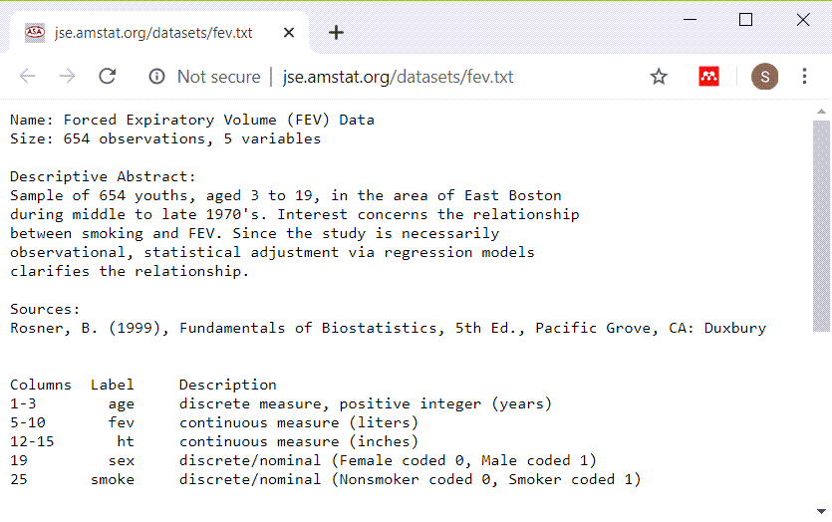
FEV data dictionary
Screenshot of data dictionary page
Notes:
This dataset has 654 rows and 5 variables: age (in years), fev (in liters), height (in inches), sex, and smoking status. Both sex and smoking status are categorical and use number codes.

Slide 6
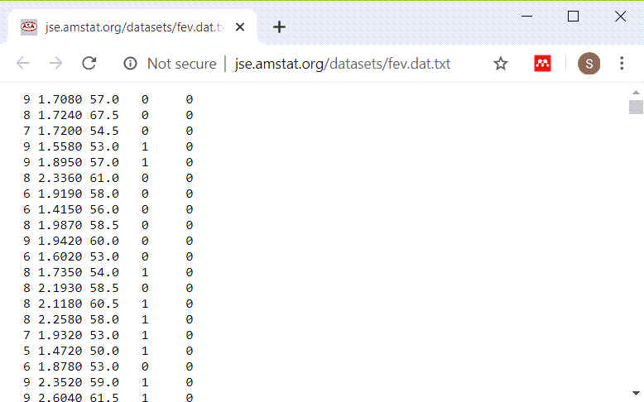
Peek at FEV dataset
Listing of first few lines of data
Notes:
This is a listing of the first few rows. It could be a tab delimited file or a fixed width file. If you look carefully at the data, you will see that there are blanks and no tabs. So this is a file that you can read in most easily using a fixed width format.

Slide 7
read in the FEV data set
fn <- "http://www.amstat.org/publications/jse/datasets/fev.dat.txt" fev <- read.fwf(file=fn, widths=c(3, 7, 5, 4, 6), header=FALSE, stringsAsFactors=FALSE) names(fev) <- c("age","fev","ht","sex","smoke") head(fev)
## age fev ht sex smoke ## 1 9 1.708 57.0 0 0 ## 2 8 1.724 67.5 0 0 ## 3 7 1.720 54.5 0 0 ## 4 9 1.558 53.0 1 0 ## 5 9 1.895 57.0 1 0 ## 6 8 2.336 61.0 0 0
Notes:
If you count carefully, you will see that the first three columns represent the first variable, you need seven more columns for the second variable, and so forth. Print out the first few lines of data to be sure.

Slide 8
Display the bottom of FEV data
tail(fev)
## age fev ht sex smoke ## 649 16 4.872 72.0 1 1 ## 650 16 4.270 67.0 1 1 ## 651 15 3.727 68.0 1 1 ## 652 18 2.853 60.0 0 0 ## 653 16 2.795 63.0 0 1 ## 654 15 3.211 66.5 0 0
Notes:
It’s always good to view the last few lines of data as well.

Slide 9
t-tests
Does average fev differ between smokers and non-smokers?
Use the t.test function
First, calculate univariate statistics
Second, draw boxplots
Only then use t.test

Slide 10
Descriptive statistics for fev
mean(fev$fev)
## [1] 2.63678
sd(fev$fev)
## [1] 0.8670591
range(fev$fev)
## [1] 0.791 5.793

Slide 11
Descriptive statistics for smoker
fev$smoke_factor <- factor( fev$smoke, levels=0:1, labels=c("nonsmoker", "smoker")) table(fev$smoke_factor)
## ## nonsmoker smoker ## 589 65

Slide 12
Boxplot
library(ggplot2) plot1 <- ggplot(fev, aes(x=smoke_factor, y=fev)) + geom_boxplot() ggsave("../images/smoke-by-fev.png", plot1, width=4, height=4)

Slide 13
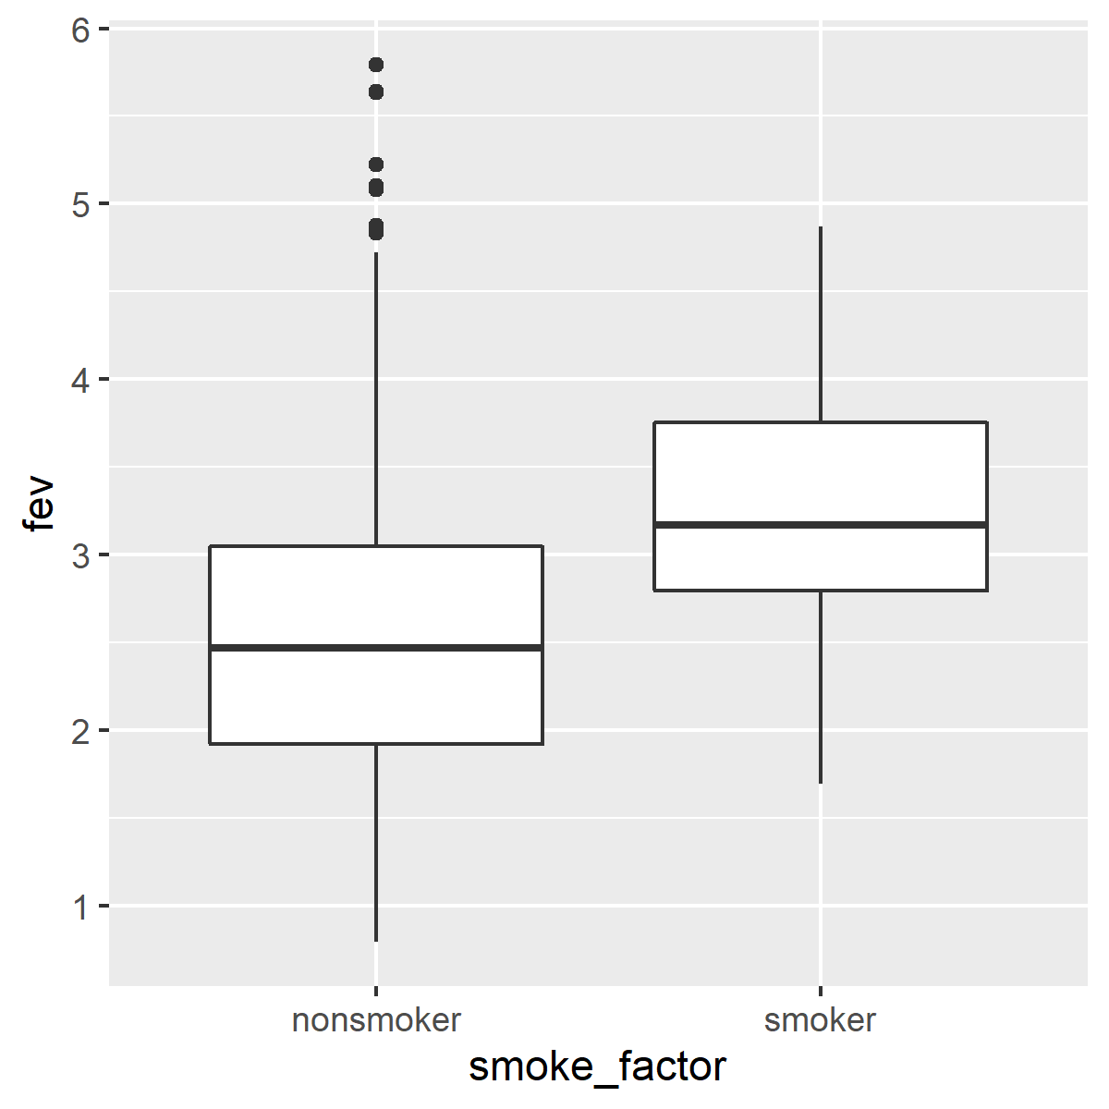
Boxplot

Slide 14
t-test
smoke_test <- t.test( fev~smoke_factor, data=fev, alternative="two.sided", paired=FALSE, var.equal=TRUE, conf.level=0.99)

Slide 15
t-test
smoke_test
## ## Two Sample t-test ## ## data: fev by smoke_factor ## t = -6.4645, df = 652, p-value = 1.993e-10 ## alternative hypothesis: true difference in means is not equal to 0 ## 99 percent confidence interval: ## -0.9947437 -0.4266942 ## sample estimates: ## mean in group nonsmoker mean in group smoker ## 2.566143 3.276862

Slide 16
t-test
str(smoke_test[1:5])
## List of 5 ## $ statistic: Named num -6.46 ## ..- attr(*, "names")= chr "t" ## $ parameter: Named num 652 ## ..- attr(*, "names")= chr "df" ## $ p.value : num 1.99e-10 ## $ conf.int : num [1:2] -0.995 -0.427 ## ..- attr(*, "conf.level")= num 0.99 ## $ estimate : Named num [1:2] 2.57 3.28 ## ..- attr(*, "names")= chr [1:2] "mean in group nonsmoker" "mean in group smoker"

Slide 17
t-test
str(smoke_test[6:10])
## List of 5 ## $ null.value : Named num 0 ## ..- attr(*, "names")= chr "difference in means" ## $ stderr : num 0.11 ## $ alternative: chr "two.sided" ## $ method : chr " Two Sample t-test" ## $ data.name : chr "fev by smoke_factor"

Slide 18
t-test
library(broom) smoke_test_data <- tidy(smoke_test) str(smoke_test_data)
## tibble [1 x 9] (S3: tbl_df/tbl/data.frame) ## $ estimate1 : num 2.57 ## $ estimate2 : num 3.28 ## $ statistic : Named num -6.46 ## ..- attr(*, "names")= chr "t" ## $ p.value : num 1.99e-10 ## $ parameter : Named num 652 ## ..- attr(*, "names")= chr "df" ## $ conf.low : num -0.995 ## $ conf.high : num -0.427 ## $ method : chr " Two Sample t-test" ## $ alternative: chr "two.sided"

Slide 19
t-test
library(knitr) kable(round(smoke_test_data[ , c("conf.low", "conf.high")], 2))

Slide 20
conf.low | conf.high
-0.99 | -0.43

Slide 21
Difference in proportions
prop.test(table(fev$sex, fev$smoke))
## ## 2-sample test for equality of proportions with continuity correction ## ## data: table(fev$sex, fev$smoke) ## X-squared = 3.2504, df = 1, p-value = 0.0714 ## alternative hypothesis: two.sided ## 95 percent confidence interval: ## -0.094321554 0.003800439 ## sample estimates: ## prop 1 prop 2 ## 0.8773585 0.9226190

Slide 22
Another set of t-tests
t.test(fev$age~fev$smoke_factor)
## ## Welch Two Sample t-test ## ## data: fev$age by fev$smoke_factor ## t = -12.81, df = 84.646, p-value < 2.2e-16 ## alternative hypothesis: true difference in means is not equal to 0 ## 95 percent confidence interval: ## -4.607356 -3.369188 ## sample estimates: ## mean in group nonsmoker mean in group smoker ## 9.534805 13.523077

Slide 23
Another set of t-tests
t.test(fev$ht~fev$smoke_factor)
## ## Welch Two Sample t-test ## ## data: fev$ht by fev$smoke_factor ## t = -11.615, df = 114.84, p-value < 2.2e-16 ## alternative hypothesis: true difference in means is not equal to 0 ## 95 percent confidence interval: ## -6.251968 -4.430258 ## sample estimates: ## mean in group nonsmoker mean in group smoker ## 60.61273 65.95385

