Slide 1
Introduction to R, module04
Steve Simon

Slide 2
Introduction
suppressMessages( suppressWarnings( library(tidyverse))) R.version.string
## [1] "R version 4.1.2 (2021-11-01)"
Sys.Date()
## [1] "2022-05-08"
Notes:
This Powerpoint presentation was created using an R Markdown file. It is always a good idea to print the version of R and the current date as the very first few lines of any R program.
The version of R is stored in an internal constant, R.version.string. You can find the current data with the Sys.Date() function.

Slide 3
The Titanic dataset
Titanic dataset
http://www.statsci.org/data/general/titanic.txt
Titanic data dictionary
http://www.statsci.org/data/general/titanic.html
Notes:
You should find the data file on mortality among passengers of the Titanic at the website listed here. There is a pretty good data dictionary as well.

Slide 4
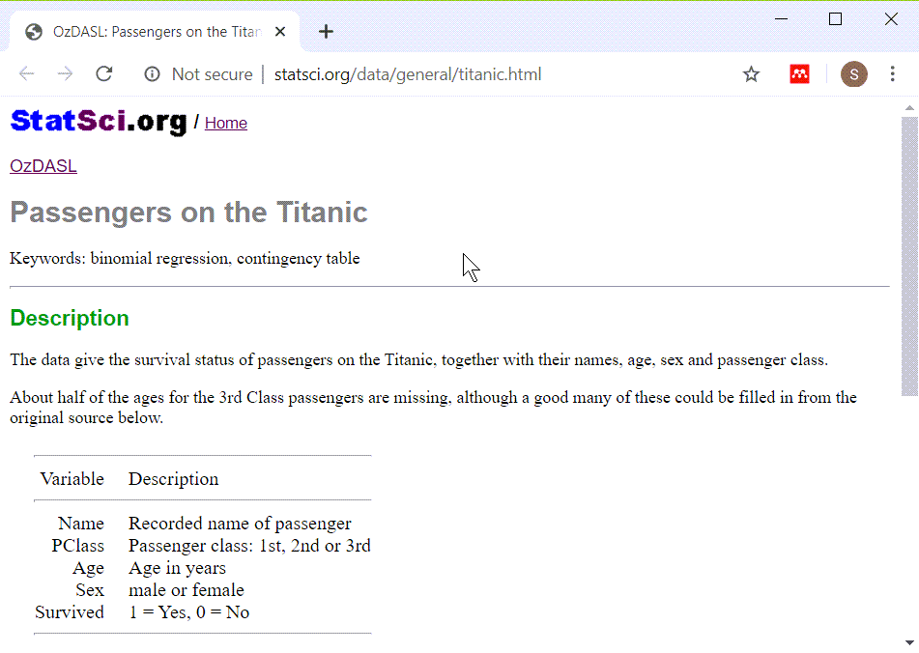
Titanic data dictionary
Screenshot from Titanic data dictionary
Notes:
There are five variables in this data set, the name of the passenger, the passenger class, the passenger age, sex, and whether they survived.

Slide 5
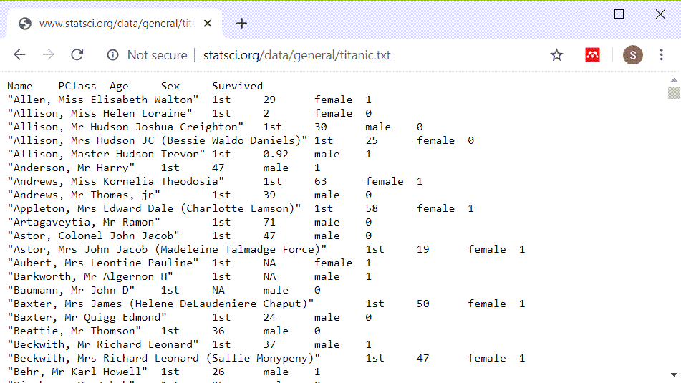
What the file looks like
Image of original dataset
Notes:
There are several hints that you may notice as you look at this file. Pssengers with longer name seem to be misaligned. Everything is left justified. It looks like when things do line up it is columns eight characters apart.
So let’s try reading it in as a tab delimited file.

Slide 6
Reading in the Titanic data set
fn <- "../data/titanic_v00.txt" ti <- read_tsv(fn, col_types="ccncn")
Notes:
The name, passenger class, and gender are strings. The age and survival variables are numeric.

Slide 7
Glimpse of the Titanic data set
glimpse(ti)
## Rows: 1,313 ## Columns: 5 ## $ Name <chr> "Allen, Miss Elisabet~ ## $ PClass <chr> "1st", "1st", "1st", ~ ## $ Age <dbl> 29.00, 2.00, 30.00, 2~ ## $ Sex <chr> "female", "female", "~ ## $ Survived <dbl> 1, 0, 0, 0, 1, 1, 1, ~
Notes:
It reads in fairly well, it seems.

Slide 8
Viewing the Titanic data set
ti
## # A tibble: 1,313 x 5 ## Name PClass Age Sex Survived ## <chr> <chr> <dbl> <chr> <dbl> ## 1 Allen, M~ 1st 29 fema~ 1 ## 2 Allison,~ 1st 2 fema~ 0 ## 3 Allison,~ 1st 30 male 0 ## 4 Allison,~ 1st 25 fema~ 0 ## 5 Allison,~ 1st 0.92 male 1 ## 6 Anderson~ 1st 47 male 1 ## 7 Andrews,~ 1st 63 fema~ 1 ## 8 Andrews,~ 1st 39 male 0 ## 9 Appleton~ 1st 58 fema~ 1 ## 10 Artagave~ 1st 71 male 0 ## # ... with 1,303 more rows
Notes:
The first few lines of data are hard to read because the passenger names are so long.

Slide 9
Displaying without the passenger names
ti[1:4, -1]
## # A tibble: 4 x 4 ## PClass Age Sex Survived ## <chr> <dbl> <chr> <dbl> ## 1 1st 29 female 1 ## 2 1st 2 female 0 ## 3 1st 30 male 0 ## 4 1st 25 female 0
Notes:
Notice how much nicer things look when you take out the column of names.

Slide 10
Peek at the bottom also
ti[1310:1313, -1]
## # A tibble: 4 x 4 ## PClass Age Sex Survived ## <chr> <dbl> <chr> <dbl> ## 1 3rd 26 male 0 ## 2 3rd 22 male 0 ## 3 3rd 24 male 0 ## 4 3rd 29 male 0
Notes:
It’s also a good idea to peek at the bottom of a data set right after you read it in. Sometimes a line in the middle gets out of sync and it throws the rest of the data off. If that happens then you will see weird things at the bottom of the data.

Slide 11
Descriptive statistics on age
summary(ti$Age)
## Min. 1st Qu. Median Mean 3rd Qu. ## 0.17 21.00 28.00 30.40 39.00 ## Max. NA's ## 71.00 557
Notes:
You learned how to get descriptive statistics for continuous variables in a previous module. The youngest passenger is 0.17 years old and the oldest is 71 years old. Let’s peek at their data values.

Slide 12
Print out information on youngest
ti[which.min(ti$Age), -1]
## # A tibble: 1 x 4 ## PClass Age Sex Survived ## <chr> <dbl> <chr> <dbl> ## 1 3rd 0.17 female 1
Notes:
The which.min and which.max functions simplify the task of finding the row or rows where a data value reaches its minimum or maximum.

Slide 13
Print out information on oldest
ti[which.max(ti$Age), -1]
## # A tibble: 1 x 4 ## PClass Age Sex Survived ## <chr> <dbl> <chr> <dbl> ## 1 1st 71 male 0
Notes:
Here is the oldest passenger. It turns out that the little baby survived, but not the old man.

Slide 14
Break #1
What have you learned
Reading in the Titanic dataset
What’s next
Categorical versus continuous variables
Counts, proportions, and percentage

Slide 15
Categorical versus continuous variables
Categorical
Small number of possible values
Each value has a name or label
Continuous
Large number of possible values
Potentially any value in a range.
Notes:
A categorical variable is defined (loosely) as a variable that has a small number of possible values. Each value is usually associated with a particular category or label. In contrast, a continuous variable is defined as a variable that has a large number of possible values, potentially any value in a particular interval.
In a previous module, almost all of the variables that you used were continuous. Today, almost all of the variables that you will use will be categorical.
The distinction between continuous and categorical variables is important in deciding what types of descriptive and inferential statistics you should use. But, there is often gray and fuzzy line between categorical and continuous variables. Don’t worry too much about this today. If you’re not sure whether a variable is categorical or continuous, try some simple descriptive statistics and graphs appropriate for categorical data and then try some simple descriptive statistics and graphs for continuous data. You will usually figure out quickly whehther treating your variable as categorical or continuous makes the most sense.
There are other types of variables also, such as count variables, that have their own special features.

Slide 16
Freqency counts
PClass_counts <- table(ti$PClass) PClass_counts
## ## 1st 2nd 3rd ## 322 280 711
Notes:
For categorical variables, you should first get frequency counts. A mean and standard deviation are usually meaningless for categorical data.
Unlike most other statistical packages, R tends to have a minimalist approach to statistics. If you asked for frequency counts in SAS or SPSS, these systems would automatically add percentages. R doesn’t add percentages automatically.
This is something that you will either love or hate. You might think that SAS and SPSS are more thoughtful because almost every time you want a count, you’d also want the corresponding percentage. Or you might find it annoying to tell those programs to not clutter up your output with information you didn’t want.
Personally, I don’t like software deciding for me what I want. I’d rather ask for percentages explicitly when I need them rather than have them come as the default.
Now this is a rather trivial issue, but it does illustrate an important difference in philosophy. R makes you ask for the extras that you might need. SAS and SPSS force you to ask to NOT include things that they think are important.
So the table function produces only counts.

Slide 17
Proportions
PClass_proportions <- prop.table(PClass_counts) PClass_proportions
## ## 1st 2nd 3rd ## 0.2452399 0.2132521 0.5415080
Notes:
If you want percentages in addition to counts, there are several approaches.
The prop.table function takes a frequency table and converts it to a proportion.

Slide 18
Percentages
PClass_percents <- round(100*PClass_proportions) PClass_percents
## ## 1st 2nd 3rd ## 25 21 54
Notes:
Multiply by 100 and round to get percentages.

Slide 19
Percentages
pct.sign <- "%" PClass_nice_percents <- paste0(PClass_percents, pct.sign) PClass_nice_percents
## [1] "25%" "21%" "54%"
Notes:
You can get even fancier. The paste function concatenates several string variables and if something is not a string, R will convert it to a string before concatenating.

Slide 20
Percentages
colon <- ": " PClass_nicest_percents <- paste0( names(PClass_percents), colon, PClass_percents, pct.sign) PClass_nicest_percents
## [1] "1st: 25%" "2nd: 21%" "3rd: 54%"
Notes:
Somehow, the names of the passenger class got lost. So let’s add them back in. A colon and a space between the names and the numbers helps as well.

Slide 21
Fractions and percentages
n <- sum(PClass_counts) slash <- "/" comma <- ", " percents_and_fractions <- paste0( PClass_nicest_percents, comma, PClass_counts, slash, n) percents_and_fractions
## [1] "1st: 25%, 322/1313" ## [2] "2nd: 21%, 280/1313" ## [3] "3rd: 54%, 711/1313"
Notes:
Finally, you can combine the counts and the total with the percents to make things look really nice.
This shows how I like to program in R. First, get something simple. Then slowly add layers to it until you get a nice polished product.
In contrast, most other statistical packages try to produce polished results right from the start. This has some advantages, but the approach used by R, where many of the functions do something simple and basic, allows you to polish the results the way you want them.

Slide 22
Tables that include counts of missing values.
PClass_missing <- table(ti$PClass, useNA="always") PClass_missing
## ## 1st 2nd 3rd <NA> ## 322 280 711 0
Notes:
The default option in the table function is to not list missing values. During the intitial data screening, you should always look for missing values. This is done with the useNA parameter.

Slide 23
Total count
PClass_total <- addmargins(PClass_missing) PClass_total
## ## 1st 2nd 3rd <NA> Sum ## 322 280 711 0 1313
Notes:
You can add a total count to the frequency table with the addmargins function.

Slide 24
An alternative approach to counts and percentages (1/6)
pclass_count <- count(ti, PClass) pclass_count
## # A tibble: 3 x 2 ## PClass n ## <chr> <int> ## 1 1st 322 ## 2 2nd 280 ## 3 3rd 711

Slide 25
An alternative approach to counts and percentages (2/6)
pclass_totals <- mutate(pclass_count, total=sum(n)) pclass_totals
## # A tibble: 3 x 3 ## PClass n total ## <chr> <int> <int> ## 1 1st 322 1313 ## 2 2nd 280 1313 ## 3 3rd 711 1313

Slide 26
An alternative approach to counts and percentages (3/6)
pclass_percents <- mutate( pclass_totals, pct=round(100*n/total))

Slide 27
An alternative approach to counts and percentages (4/6)
pclass_percents
## # A tibble: 3 x 4 ## PClass n total pct ## <chr> <int> <int> <dbl> ## 1 1st 322 1313 25 ## 2 2nd 280 1313 21 ## 3 3rd 711 1313 54

Slide 28
An alternative approach to counts and percentages (5/6)
pclass_nice_percents <- mutate( pclass_percents, pct= paste0( pct, "% (", n, "/", total, ")"))

Slide 29
An alternative approach to counts and percentages (6/6)
select(pclass_nice_percents, PClass, pct)
## # A tibble: 3 x 2 ## PClass pct ## <chr> <chr> ## 1 1st 25% (322/1313) ## 2 2nd 21% (280/1313) ## 3 3rd 54% (711/1313)

Slide 30
One more
pclass_nice_percents %>% select(PClass, pct) %>% pivot_wider(names_from=PClass, values_from=pct)
## # A tibble: 1 x 3 ## `1st` `2nd` `3rd` ## <chr> <chr> <chr> ## 1 25% (322/1313) 21% (280/1313) 54% (71~

Slide 31
Break #2
What have you learned
Categorical versus continuous variables
Counts, proportions, and percentage
What’s next
Factors
Crosstabulations

Slide 32
Factors
ti$surv_factor <- factor( ti$Survived, levels=0:1, labels=c("No","Yes")) table(ti$surv_factor)
## ## No Yes ## 863 450
Notes:
The factor function is similar to the variable label in SPSS and the format statement in SAS. It assigns category names (No and Yes) to numeric codes (0 and 1). It also has other features that are helpful in linear and logistic regression models, such as the ability to specify contrasts.

Slide 33
Crosstabulation
pclass_by_gender <- table(ti$PClass, ti$Sex) pclass_by_gender
## ## female male ## 1st 143 179 ## 2nd 107 173 ## 3rd 212 499
Notes:
A crosstabulation shows counts across the combination of two different categorical variables. This table shows that there are 143 female first class passengers, 179 male first class passengers, 107 female second class passengers, etc.

Slide 34
Row proportions, code
row_proportions <- prop.table( pclass_by_gender, margin=1)
Notes:
The prop.table function converts counts into proportions. Use margin=1 to get row proportions.

Slide 35
Row proportions, output
row_proportions
## ## female male ## 1st 0.4440994 0.5559006 ## 2nd 0.3821429 0.6178571 ## 3rd 0.2981716 0.7018284
Notes:
Row proportions add up to 1 within each row.

Slide 36
Row percentages
row_pcts <- round(100*row_proportions) row_pcts
## ## female male ## 1st 44 56 ## 2nd 38 62 ## 3rd 30 70
Notes:
It is a lot easier to read if you convert the proportions into percentages and then round. In first class, 44% of the passengers are female. In second class, 38% are female, and so forth.

Slide 37
Column percentages, code
col_proportions <- prop.table( pclass_by_gender, margin=2) col_pcts <- round(100*col_proportions)
Notes:
Setting the margin parameter to 2 gives column proportions.

Slide 38
Column percentages, output
col_pcts
## ## female male ## 1st 31 21 ## 2nd 23 20 ## 3rd 46 59
Notes:
Column proportions add up to 1 within each column. Again, converting to percents and rounding helps a lot. Among the female passengers, 31% traveled in first class, 23% in second class, and 46% in third class.

Slide 39
Cell percentages, code
cell_proportions <- prop.table(pclass_by_gender) cell_pcts <- round(100*cell_proportions)
Notes:
If you omit the margin parameter, R produces cell proportions.

Slide 40
Cell percentages, output
cell_pcts
## ## female male ## 1st 11 14 ## 2nd 8 13 ## 3rd 16 38
Notes:
Cell proportions add up to 1 across all the cells in the table. Converting to percents, you can see that 11% of the passengers were first class femles, 14% were first class males, 8% were second class females, etc.

Slide 41
Which percentages should you use
General guidance
Set the rows to your treatment/exposure
Set the columns to your outcome
Compute row percentages
why not try several formats
Revised your tables as often as you revise your writing
Notes:
It’s beyond the scope of this class, but with crosstabulations, you have choices as to what should be the rows and what should be the columns. Then you can compute row, column, or cell percentages.
I’ve found that nine times out of ten, the best choice depends on what is your treatment variable and what is your outcome. It usually works best if you place the treatment variable in the rows and the outcome in the columns and compute row percentages. That shows how often you see a particular outcome in the treatment group and the percentage in the control group is right beneath it.
That being said, I would also encourage you to try several different approaches.

Slide 42
Practical example, code
gender_by_survival <- table(ti$Sex, ti$surv_factor) survival_proportions <- prop.table( gender_by_survival, margin=1) survival_percents <- round(100*survival_proportions)

Slide 43
Practical example, output
survival_percents
## ## No Yes ## female 33 67 ## male 83 17
Notes:
The key question in the Titanic dataset is survival. Who lived and who died. Kate Winslet lived, but sad to say, Leonardo diCaprio didn’t. So what was the survival rate for all women? For all men?
Using the rules shown on the previous slide, survival is obviously the outcome. Make that the columns and gender the rows. Then compute row percentages (margin=1).
For this, you can see that 67% of the women survived, but only 17% of the men did.

Slide 44
Break #3
What have you learned
Factors
Crosstabulations
What’s next
Barplots

Slide 45
Barplot of counts, code
simple_barplot <- ggplot(ti, aes(x=PClass)) + geom_bar() ggsave( "../images/barplot1.png", simple_barplot)
## Saving 5 x 4 in image
Notes:
I’m not a big fan of bar plots, but they sometimes have their uses. You can get a barplot for the frequency count.
Because of the way Rmarkdown displays graphs, I have to put the code on a separate slide from the graph.

Slide 46
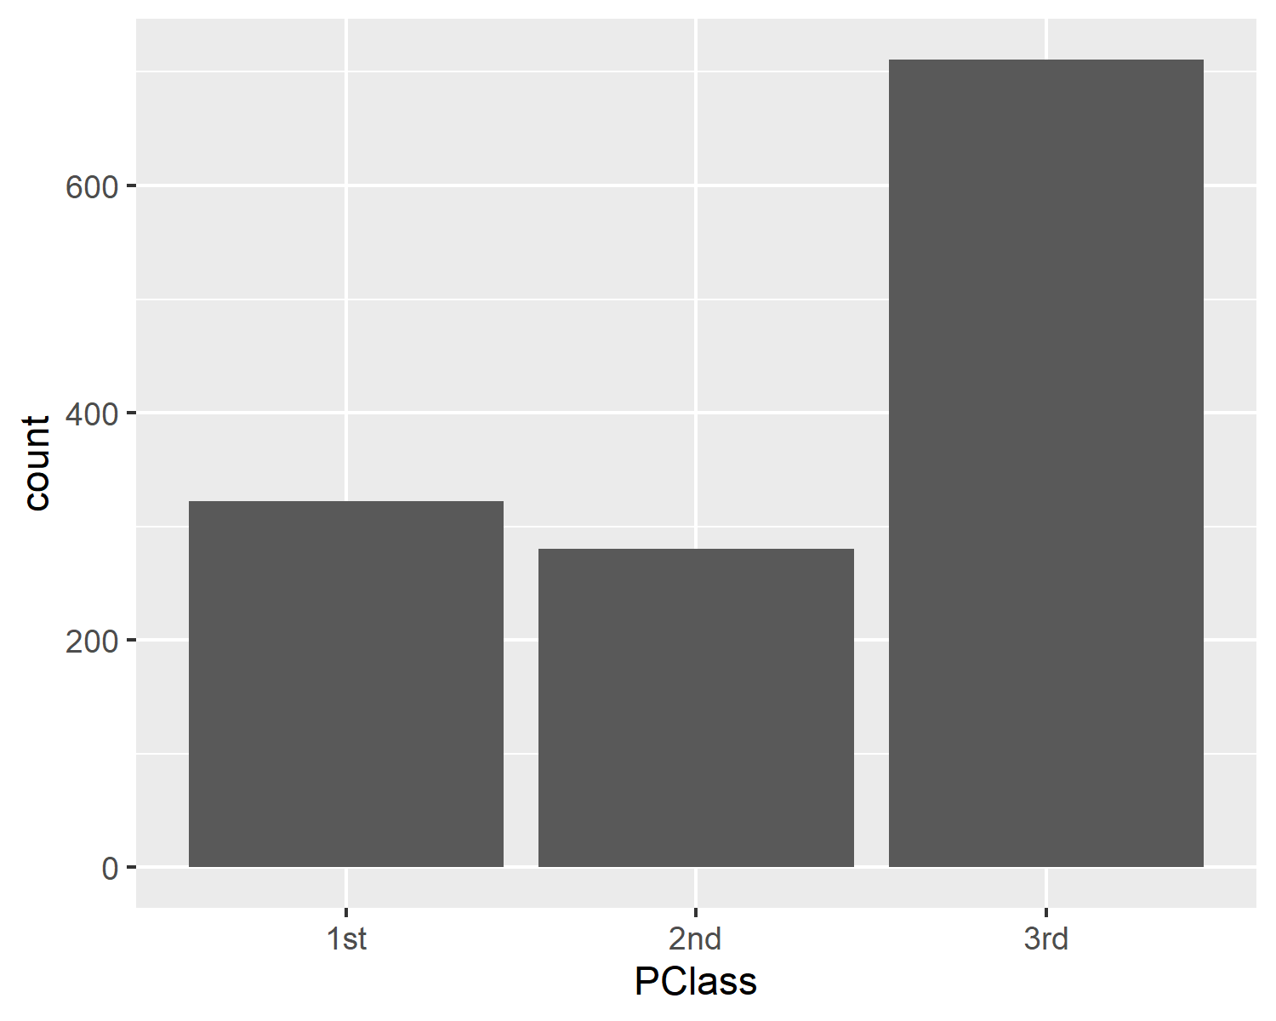
Barplot of counts, graph
Barplot of counts
Notes:
Here is what the plot looks like.

Slide 47
Barplot of percentages, code
percentages_barplot <- ggplot(ti, aes(x=PClass)) + geom_bar(aes(weight=100/n)) ggsave( "../images/barplot2.png", percentages_barplot)
## Saving 5 x 4 in image
Notes:
Use weights to get a bar chart of percentages.

Slide 48
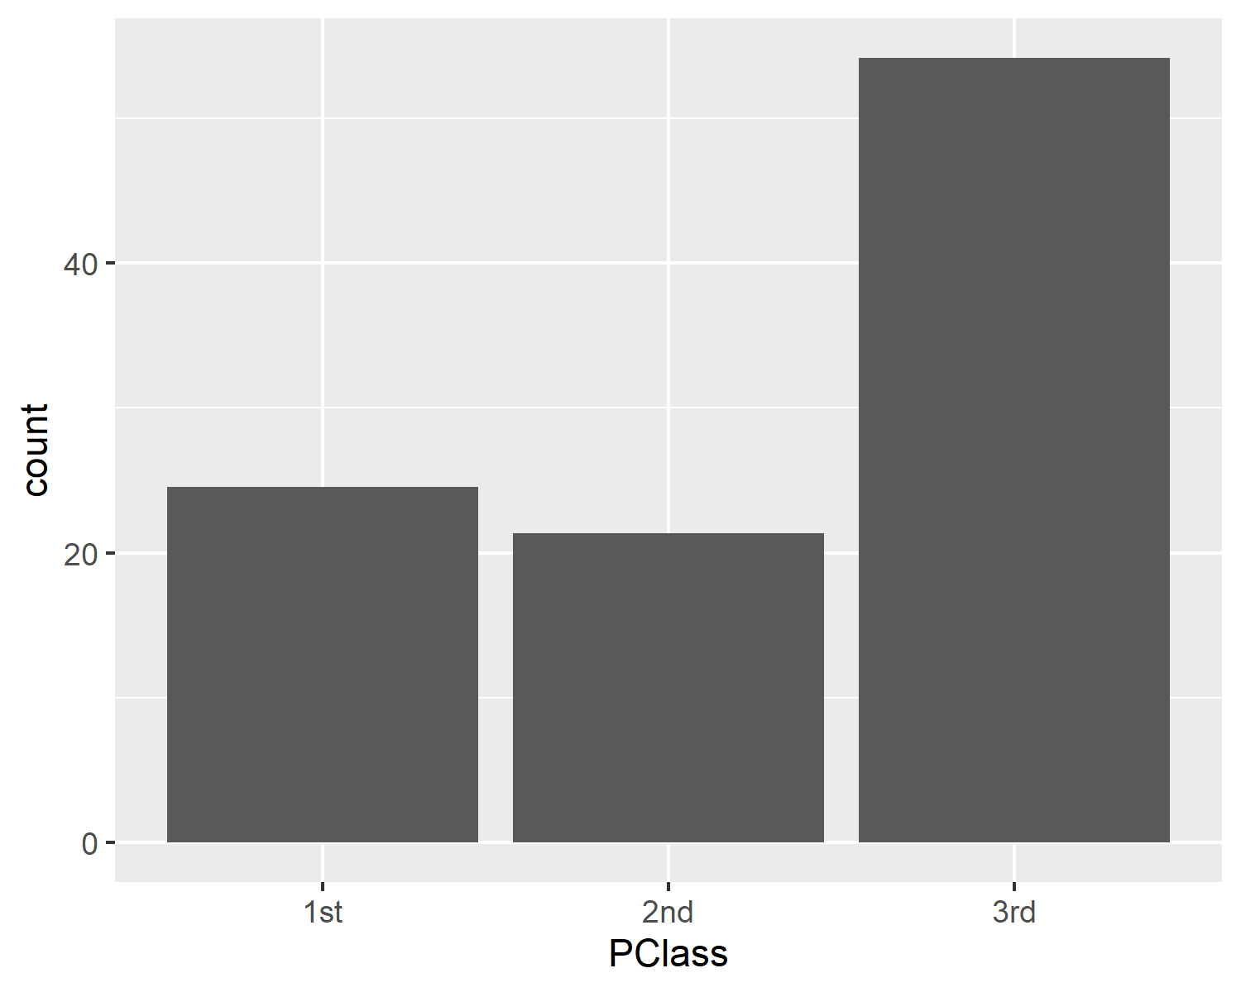
Barplot of proportions, graph
Barplot of proportions
Notes:
Here is what the plot looks like.

Slide 49
Barplot of percentages, code
labeled_barplot <- percentages_barplot + scale_y_continuous( "Percent", breaks=c(0, 20, 40), labels=c("0%", "20%", "40%")) ggsave( "../images/barplot3.png", labeled_barplot)
## Saving 5 x 4 in image
Notes:
You can control how the y-axis is labeled with the scale_y_continuous function.

Slide 50

Barplot of counts, graph
Barplot of counts
Notes:
Here is what the plot looks like.

Slide 51
Break #4
What have you learned
Barplots
What’s next
New categorical variables

Slide 52
New categorical variables
ti$child <- case_when( is.na(ti$Age) ~ "Unknown", ti$Age <= 0 ~ "Invalid", ti$Age < 18 ~ "Yes", ti$Age >= 18 ~ "No") table(ti$child, useNA="always")
## ## No Unknown Yes <NA> ## 660 557 96 0
Notes:
There are several ways to create a new categorical variable in R, but the easiest way is through the use of logical comparisons.
Suppose you wanted to compute a categorical variable called “child” which is equal to 1 if a passenger is less than 18 years old and 0 if a passenger is 18 or older. Here’s one way to do it.

Slide 53
Quality check for child
range(ti$Age[ti$child=="No"])
## [1] 18 71
range(ti$Age[ti$child=="Yes"])
## [1] 0.17 17.00
table(ti$Age[ti$child=="Unknown"], useNA="always")
## ## <NA> ## 557
Notes:
Anytime you create a new categorical variable, you should run a quality check to make sure nothing is wrong. The range function is useful for this.

Slide 54
More on recoding
ti$lower_class <- case_when( is.na(ti$PClass) ~ "Unknown", ti$PClass=="1st" ~ "No", ti$PClass=="2nd" ~ "Yes", ti$PClass=="3rd" ~ "Yes")
Notes:
Sometimes you want to combine two or more of the categories together. Here is how you might create a new passenger class variable with values of 1 for second and third class and 0 for first class.

Slide 55
More on recoding, output
table( ti$lower_class, ti$PClass, useNA="always")
## ## 1st 2nd 3rd <NA> ## No 322 0 0 0 ## Yes 0 280 711 0 ## <NA> 0 0 0 0
Notes:
As before, it’s a good a idea to run a crosstabulation to verify that the new coding was done properly.

Slide 56
Creating multi-level categories, code
ti$age_groups <- case_when( is.na(ti$Age) ~ "Missing", ti$Age <= 0 ~ "Invalid", ti$Age <= 1.5 ~ "Infant", ti$Age <= 12 ~ "Child", ti$Age <= 19 ~ "Teenager", ti$Age > 19 ~ "Adult")
Notes:
Here’s a more complex example. Notice that I check instinctively for invalid values.

Slide 57
Creating multi-level categories, output
table(ti$age_groups, useNA="always")
## ## Adult Child Infant Missing ## 607 47 13 557 ## Teenager <NA> ## 89 0
Notes:
These are the counts for each of the age groups.

Slide 58
Quality check
range(ti$Age[ti$age_groups=="Infant"])
## [1] 0.17 1.50
range(ti$Age[ti$age_groups=="Child"])
## [1] 2 12
range(ti$Age[ti$age_groups=="Teenager"])
## [1] 13 19
range(ti$Age[ti$age_groups=="Adult"])
## [1] 20 71
Notes:
Notice that the ages are consistent with our expectations. A table like this is nice documentation, since decisions about who is an adult (18 and older? 21 and older?) are sometimes forgotten.

Slide 59
Summary
What have you learned
Reading in the Titanic dataset
Categorical versus continuous variables
Counts, proportions, and percentage
Factors
Crosstabulations
Barplots
New categorical variables

