Slide 1
Comments for MEDB 5501, Week 2

Slide 2
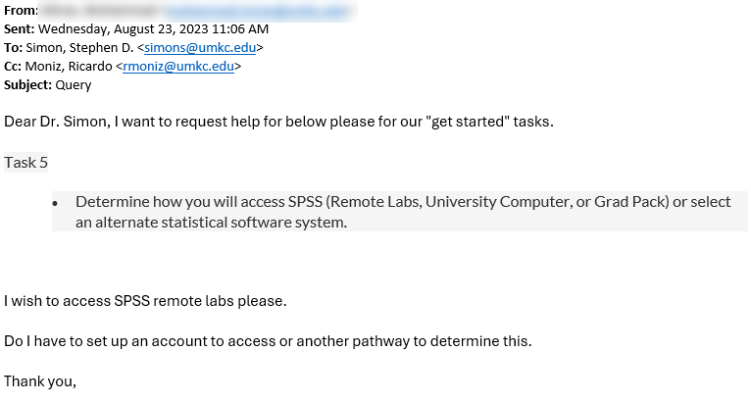
August 23 email inquiry
Figure 1: Screenshot from an email message
Notes:
I am sharing an email that I got a few days ago. I love email inquiries like this, with one exception.
This was a question about the content of this course and the sender included Ricardo Moniz in the CC line. Now some of you know Ricardo and he is a great resource for many things. I myself rely on him for many questions. But please don’t include him on questions regarding the content of this course.
Ricardo is available to answer all sorts of administrative questions. That keeps him pretty busy. Now he actually did answer this question before I did, and he didn’t really mind. Let’s save questions for Ricardo that relate to administrative issues, such as how to switch from the synchronous version of this class to the asynchronous version.
On a related note, please send any questions about grading to me rather than to Xi Wang. I am in constant contact with her and I share with her how I want to grade things. So if you don’t like how something was graded, your beef is with me.
Now I don’t want you to ever feel that you can’t complain about grades. That’s something that goes with the job. Just be sure that I’m the one that gets the complaint and not Xi Wang.
Thanks!

Slide 3
Review of Discussion Board 00
Thanks for all your wonderful comments.

Slide 4
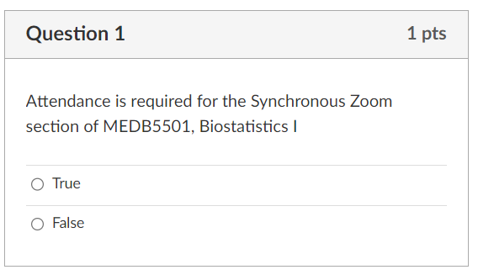
Quiz 00, question 1
Figure 2: Screenshot from quiz

Slide 5
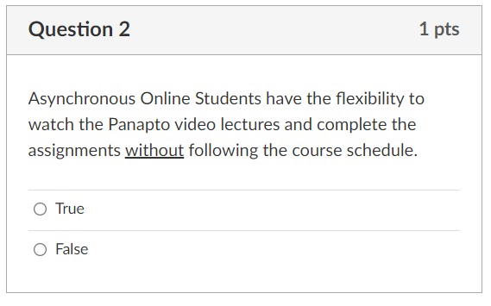
Quiz 00, question 2
Figure 3: Screenshot from quiz

Slide 6
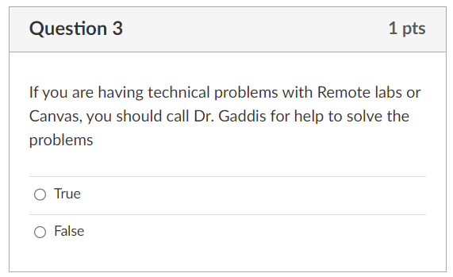
Quiz 00, question 3
Figure 4: Screenshot from quiz

Slide 7
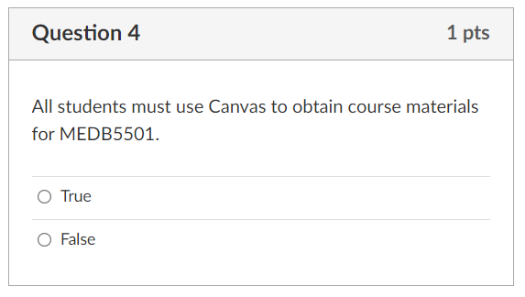
Quiz 00, question 4
Figure 5: Screenshot from quiz

Slide 8
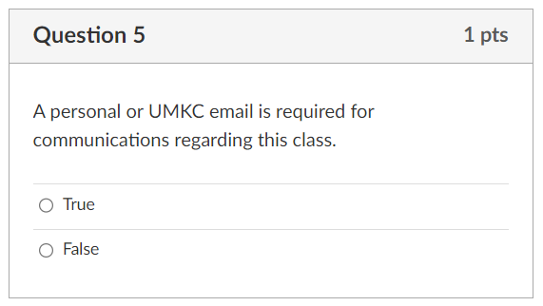
Quiz 00, question 5
Figure 6: Screenshot from quiz

Slide 9
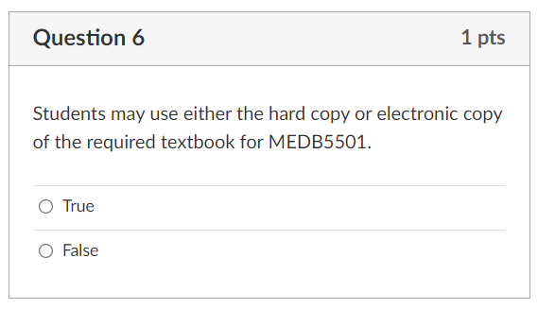
Quiz 00, question 6
Figure 7: Screenshot from quiz

Slide 10
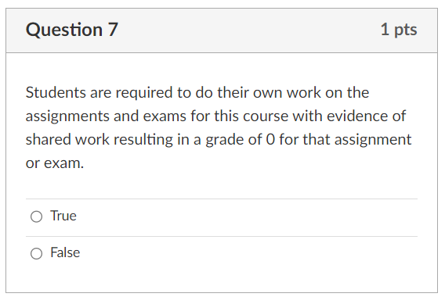
Quiz 00, question 7
Figure 8: Screenshot from quiz

Slide 11
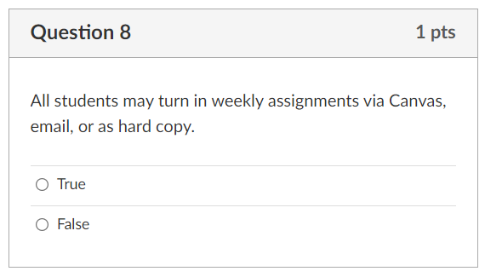
Quiz 00, question 8
Figure 9: Screenshot from quiz

Slide 12
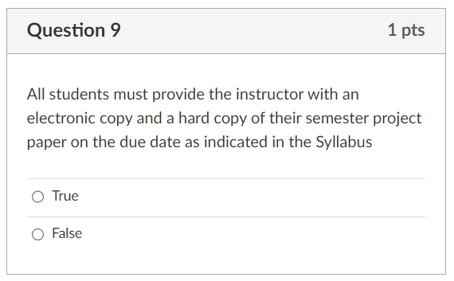
Quiz 00, question 9
Figure 10: Screenshot from quiz

Slide 13
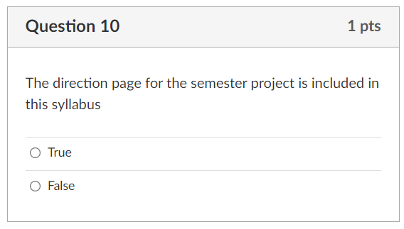
Quiz 00, question 10
Figure 11: Screenshot from quiz

Slide 14
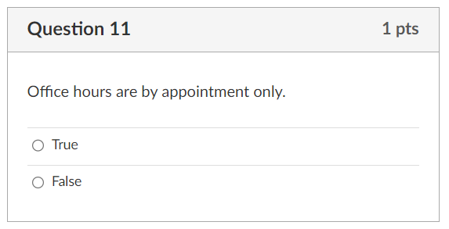
Quiz 00, question 11
Figure 12: Screenshot from quiz

Slide 15
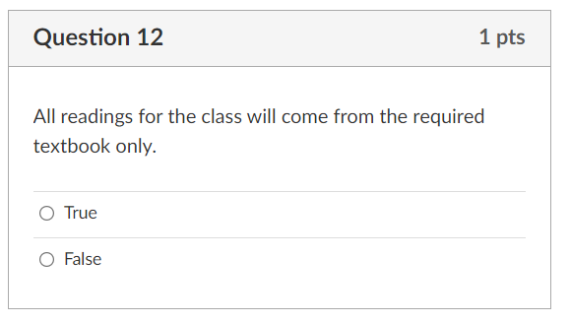
Quiz 00, question 12
Figure 13: Screenshot from quiz

Slide 16
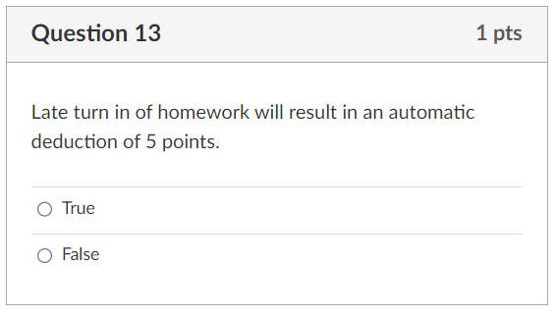
Quiz 00, question 13
Figure 14: Screenshot from quiz

Slide 17
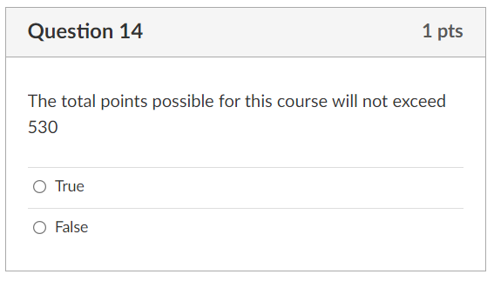
Quiz 00, question 14
Figure 15: Screenshot from quiz

Slide 18
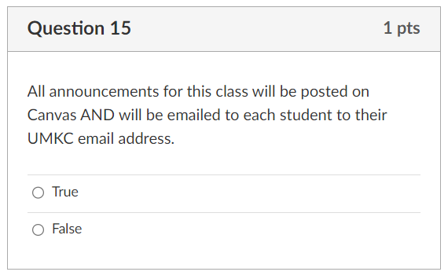
Quiz 00, question 15
Figure 16: Screenshot from quiz

Slide 19
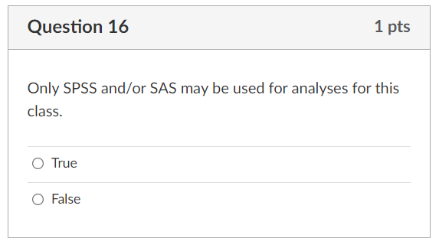
Quiz 00, question 16
Figure 17: Screenshot from quiz

Slide 20
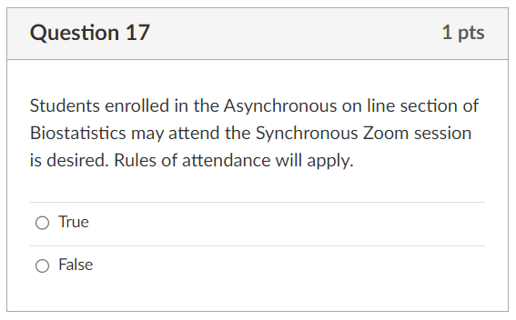
Quiz 00, question 17
Figure 18: Screenshot from quiz

Slide 21
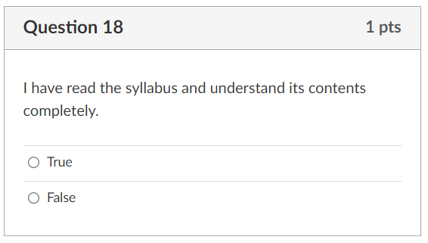
Quiz 00, question 18
Figure 19: Screenshot from quiz

