Slide 1
Introduction to R, module05
Steve Simon

Slide 2
Introduction
suppressMessages( suppressWarnings( library(tidyverse))) R.version.string
## [1] "R version 4.1.2 (2021-11-01)"
Sys.Date()
## [1] "2022-03-07"
Notes:
Like the earlier presentations, this Powerpoint file was created using Rmarkdown.

Slide 3
How do you characterize relationships?
Between two continuous variables
Correlations and scatterplots
Between two categorical variables
Crosstabulations
Between a continuous variable and a categorical variable
Boxplots
Notes:
In an earlier module, you saw datasets that had mostly continuous variables. If you wanted to examine the relationship between two continuous variables, you would look at correlations and scatterplots.
Then in a different module, you saw datasets that had mostly categorical variables. If you wanted to examine the relationship between two categorical variables, you would look at crosstabulations.
In this module, you will see datasets that have a mix of continuous and categorical variables. If you want to examine the relationship between a continuous variable and a categorical variable, you would use a boxplot.

Slide 4
FEV data
FEV dataset
http://www.amstat.org/publications/jse/datasets/fev.dat.txt
FEV data dictionary
http://ww2.amstat.org/publications/jse/datasets/fev.txt
Notes:
The first data set looks at pulmonary function in a group of children. The acronym FEV stands for Forced Expiratory Volume and represents how air you can blow out of your lungs.

Slide 5
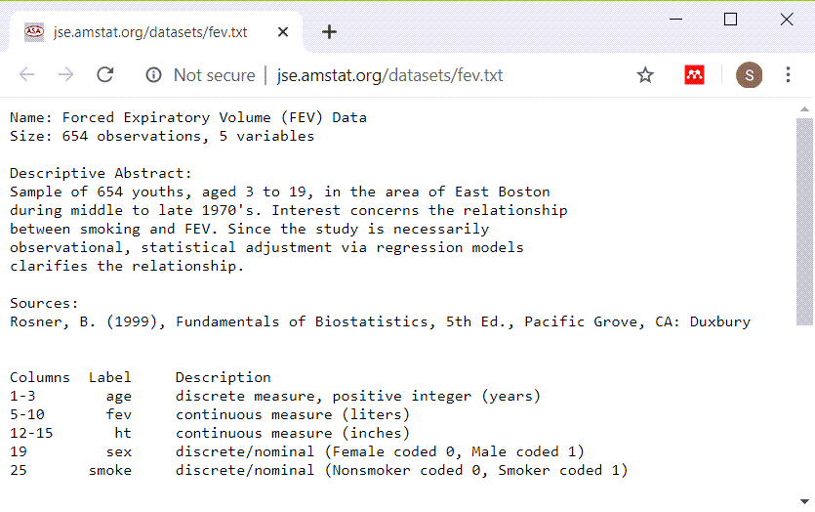
FEV data dictionary
Screenshot of data dictionary page
Notes:
This dataset has 654 rows and 5 variables: age (in years), fev (in liters), height (in inches), sex, and smoking status. Both sex and smoking status are categorical and use number codes.

Slide 6
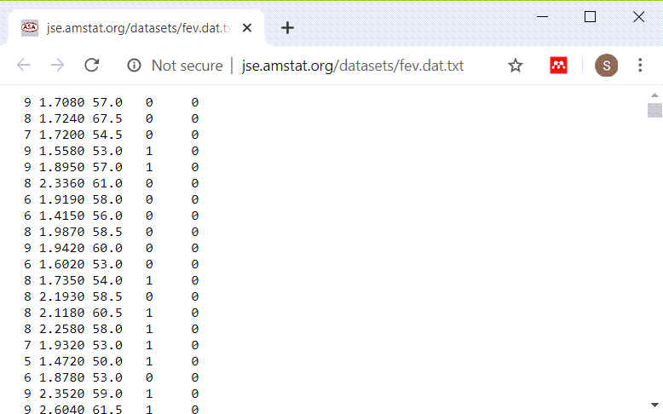
Peek at FEV dataset
Listing of first few lines of data
Notes:
This is a listing of the first few rows. It could be a tab delimited file or a fixed width file. If you look carefully at the data, you will see that there are blanks and no tabs. So this is a file that you can read in most easily using a fixed width format.

Slide 7
read in the FEV data set, code
# Original source is http://www.amstat.org/publications/jse/datasets/fev.dat.txt fn <- "../data/fev.txt" fev <- read_fwf(file=fn, fwf_cols( age=2, fev=7, ht=5, sex=4, smoke=6), col_types="nnnnn")
Notes:
If you count carefully, you will see that the first three columns represent the first variable, you need seven more columns for the second variable, and so forth.

Slide 8
read in the FEV data set, output
fev
## # A tibble: 654 x 5 ## age fev ht sex smoke ## <dbl> <dbl> <dbl> <dbl> <dbl> ## 1 NA 9 0 0 0 ## 2 NA 8 0 5 0 ## 3 NA 7 0 5 0 ## 4 NA 9 0 0 1 ## 5 NA 9 0 0 1 ## 6 NA 8 0 0 0 ## 7 NA 6 0 0 0 ## 8 NA 6 0 0 0 ## 9 NA 8 0 5 0 ## 10 NA 9 0 0 0 ## # ... with 644 more rows
Notes:
Print out the first few lines of data to be sure.

Slide 9
read in the FEV data set, glimpse
glimpse(fev)
## Rows: 654 ## Columns: 5 ## $ age <dbl> NA, NA, NA, NA, NA, NA, NA~ ## $ fev <dbl> 9, 8, 7, 9, 9, 8, 6, 6, 8,~ ## $ ht <dbl> 0, 0, 0, 0, 0, 0, 0, 0, 0,~ ## $ sex <dbl> 0, 5, 5, 0, 0, 0, 0, 0, 5,~ ## $ smoke <dbl> 0, 0, 0, 1, 1, 0, 0, 0, 0,~
Notes:
Here is the structure of the data frame.

Slide 10
Summary for continuous variables: age
mean(fev$age)
## [1] NA
sd(fev$age)
## [1] NA
range(fev$age)
## [1] NA NA
Notes:
This is clearly a pediatric population.

Slide 11
Summary for continuous variables: fev
mean(fev$fev)
## [1] 4.655963
sd(fev$fev)
## [1] 3.223096
range(fev$fev)
## [1] 0 9
Notes:
I am not an expert on FEV, but these values seem reasonable.

Slide 12
Summary for continuous variables: ht
mean(fev$ht)
## [1] 0
sd(fev$ht)
## [1] 0
range(fev$ht)
## [1] 0 0
Notes:
Again, these seem to be reasonable values.

Slide 13
Scatterplot
library(ggplot2) plot1 <- ggplot(fev, aes(x=age, y=fev)) + geom_point() ggsave("../images/age-by-fev.png", plot1, width=4, height=4)
## Warning: Removed 309 rows containing missing ## values (geom_point).
Notes:
Recall that you use a scatterplot to examine the relationship between two continuous variables.

Slide 14
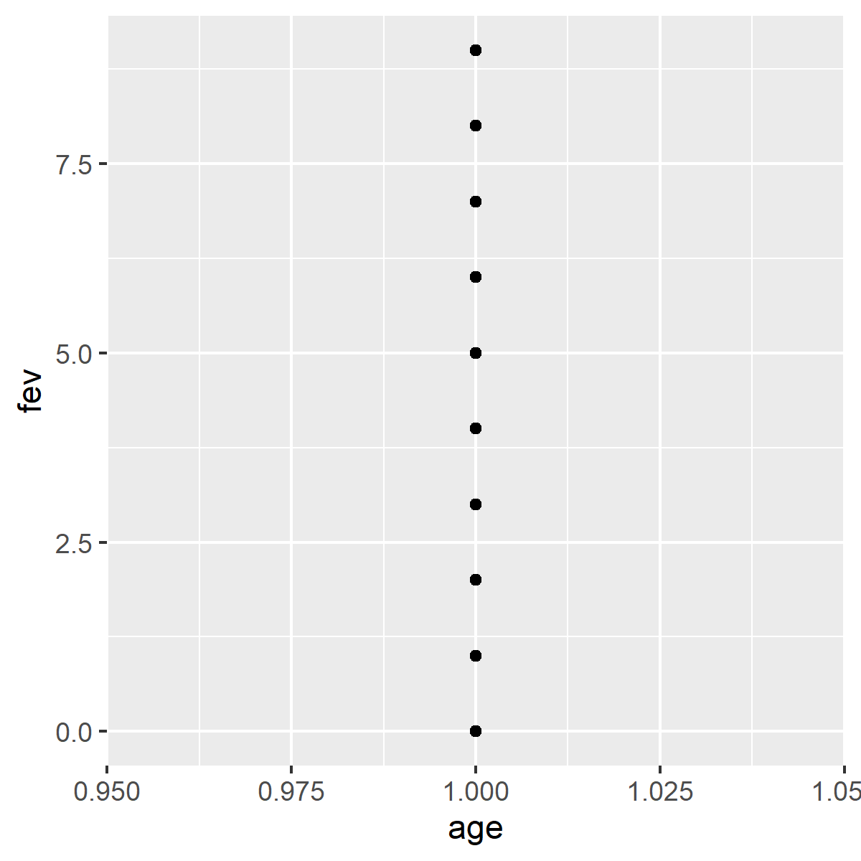
Scatterplot
Notes:
Here is the plot that is produced by this code.

Slide 15
Create factors
fev$smoke_factor <- factor( fev$smoke, levels=0:1, labels=c("nonsmoker", "smoker")) fev$sex_factor <- factor( fev$sex, levels=0:1, labels=c("female", "male"))
Notes:
When you have number codes for categorical data, it is always a good idea to create factors. Remember, though, that you should not create factors until most of the data management tasks (e.g., recoding) is done.

Slide 16
FEV frequency tables
table(fev$smoke_factor, useNA="always")
## ## nonsmoker smoker <NA> ## 318 336 0
table(fev$sex_factor, useNA="always")
## ## female male <NA> ## 424 0 230
Notes:
The two categorical variables have no missing values.

Slide 17
Crosstabs
Also recall that you use a crosstabulation to examine the relationship between two categorical variables.
crosstab <- table(fev$sex_factor,fev$smoke_factor) prop_table <- prop.table(crosstab ,margin=1) pct_table <- round(100*prop_table) pct_table
## ## nonsmoker smoker ## female 49 51 ## male
Notes:
The females smoke more often than the males, 51% versus NaN%.

Slide 18
Break #1
What have you learned
Review analysis of continuous variables
Review analysis of categorical variables
What’s next
Analysis of a mix: continuous and categorical
Notes:
Let’s take a short break here. What you’ve seen so far is review of methods that you use when examining relationships between two continuous variables (scatterplots) and methods that you use when examining relationships between two categorical variables (crosstabulations).
Coming up next is how you examine relationships between a continuous variable and a categorical variable.

Slide 19
Boxplots
plot2 <- ggplot(fev, aes(x=smoke_factor, y=fev)) + geom_boxplot() ggsave("../images/smoke-by-fev.png")
## Saving 5 x 4 in image
Notes:
When you want to look at a relationship between a categorical variable and a continuous variable, you should use a boxplot.

Slide 20
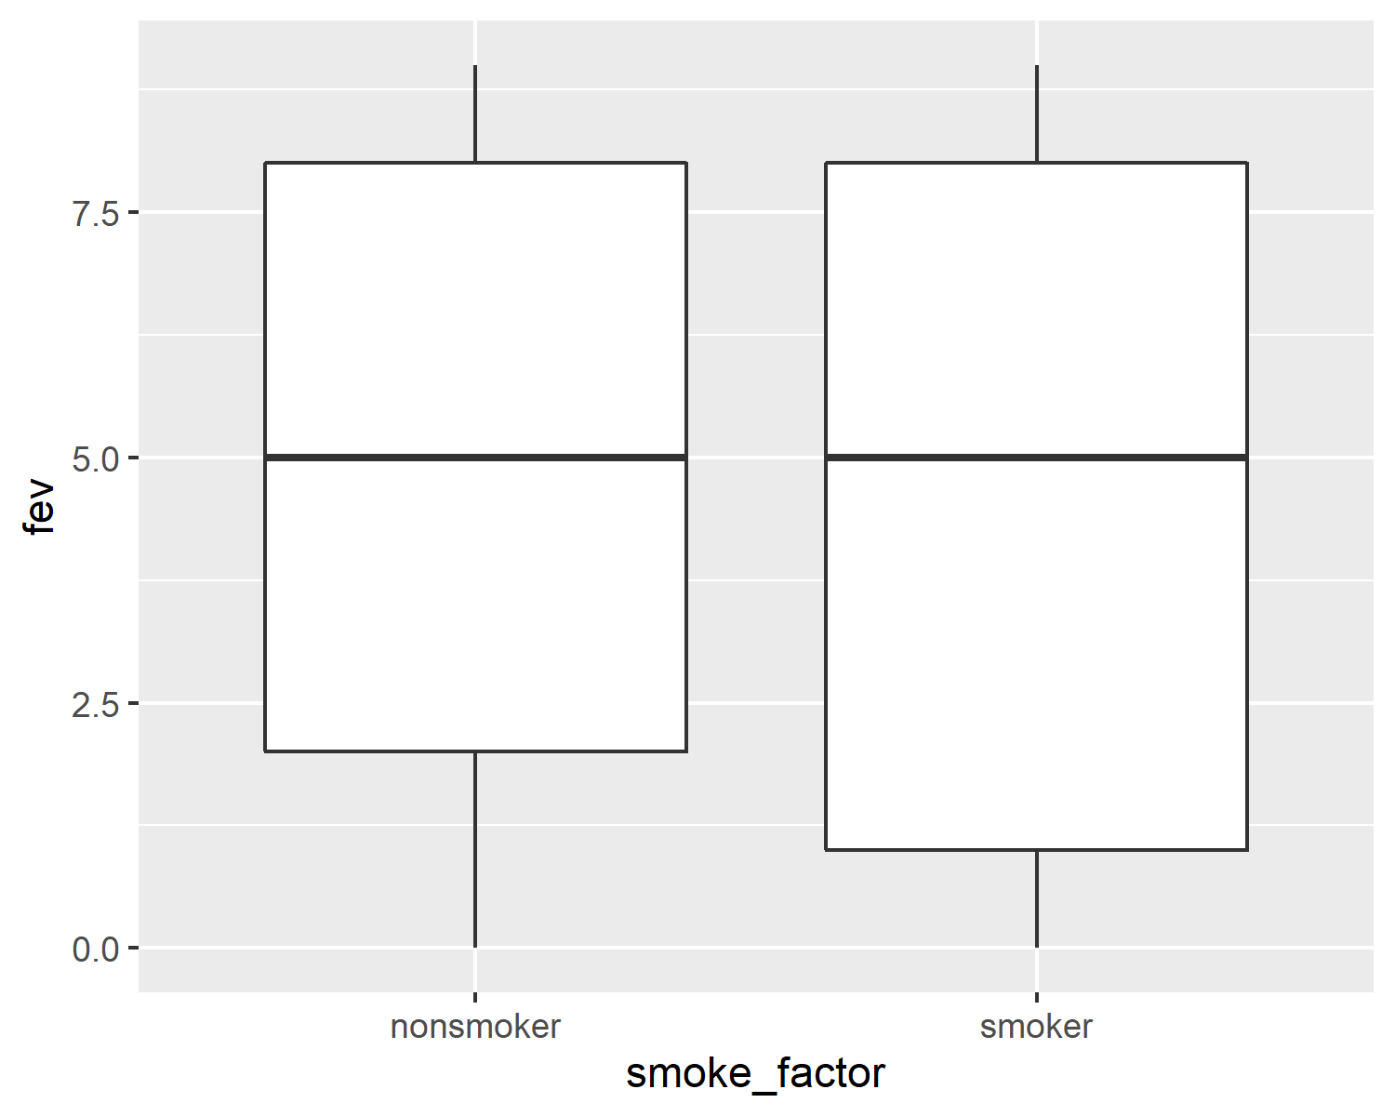
Boxplots
Boxplots comparing FEV values for smokers and non-smokers
Notes:
Here is the boxplot. The results are very odd. Smokers tend to have higher FEV values than non-smokers.
You can get a hint as to why smokers might have higher fev values than non-smokers by looking at how age and smoking status are related.

Slide 21
Boxplots
plot3 <- ggplot(fev, aes(smoke_factor, age)) + geom_boxplot() ggsave("../images/smoke-by-age.png", plot3, height=4, width=4)
## Warning: Removed 309 rows containing non-finite ## values (stat_boxplot).
Notes:
This is the code to draw a boxplot of the ages for smokers and non-smokers

Slide 22
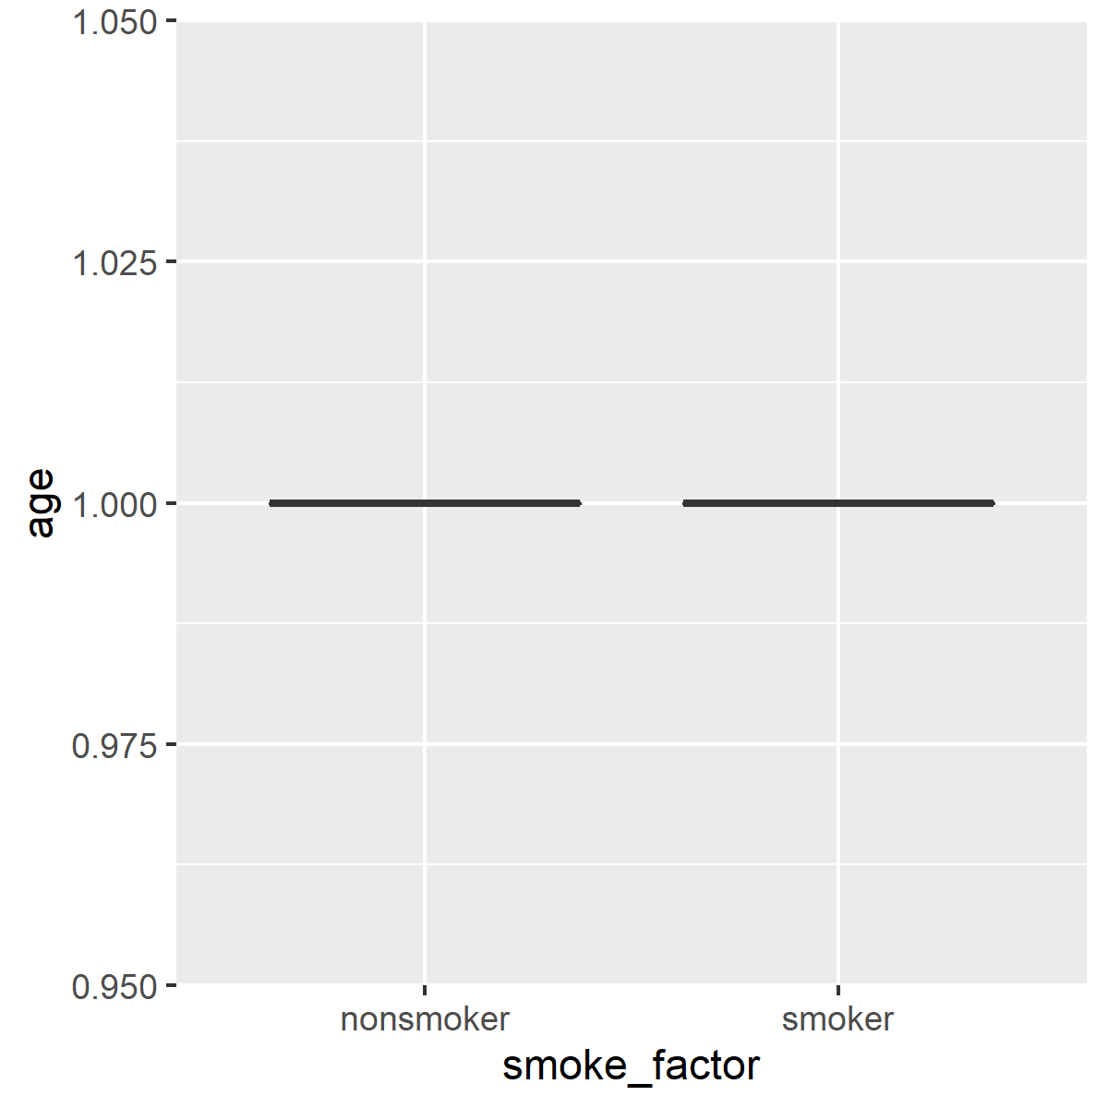
Boxplots
Boxplots comparing ages for smokers and non-smokers
Notes:
Here’s what’s happening. Older kids are more likely to be smokers, and older kids have bigger and more mature lungs. This a classic case of confounding.

Slide 23
Break #2
What have you learned?
Boxplots
What’s coming up next?
Group means and standard deviations
Notes:
Time for another break. You saw how to use boxplots to visually compare a continuous variable across different levels of a categorical variable.
Coming up next is the calculation of group means and standard deviations.

Slide 24
Group means
fev_means <- by(fev$fev, fev$smoke_factor, mean, na.rm=TRUE) fev_means
## fev$smoke_factor: nonsmoker ## [1] 4.716981 ## ------------------------------- ## fev$smoke_factor: smoker ## [1] 4.598214
Notes:
Here are the group means.

Slide 25
Group standard deviations
fev_stdev <- by(fev$fev, fev$smoke_factor, sd, na.rm=TRUE) fev_stdev
## fev$smoke_factor: nonsmoker ## [1] 3.196276 ## ------------------------------- ## fev$smoke_factor: smoker ## [1] 3.251984
Notes:
Here are the group standard deviations.
The output is not labelled all that clearly, but you can use the paste function to make things look nicer.

Slide 26
Group means
colon <- ": " plus_minus <- "+/-" paste( names(fev_means), colon, round(fev_means, 1), plus_minus, round(fev_stdev, 1), sep="")
## [1] "nonsmoker: 4.7+/-3.2" ## [2] "smoker: 4.6+/-3.3"
Notes:
You don’t need to use this extra level of effort for your homework. It’s just an attempt by me to show again a common pattern in R. Simple functions produce simple results and these can be combined in a variety of different ways.

Slide 27
Group means
age_means <- by(fev$age, fev$smoke_factor, mean, na.rm=TRUE) age_stdev <- by(fev$age, fev$smoke_factor, sd, na.rm=TRUE) colon <- ": " plus_minus <- "+/-" paste( names(age_means), colon, round(age_means,1), plus_minus, round(age_stdev,1), sep="")
## [1] "nonsmoker: 1+/-0" "smoker: 1+/-0"
Notes:
Let’s calculate mean ages for smokers and nonsmokers. Notice that smokers are 4 years older on average than nonsmokers.

Slide 28
Break #3
What have you learned?
Review earlier material
Boxplots
Group means and standard deviations
What’s coming up next?
Datasets needed for your homework
Notes:
Time for another break. You saw how to use boxplots to visually compare a continuous variable across different levels of a categorical variable.
Coming up next is the calculation of group means and standard deviations.

Slide 29
The Albuquerque dataset
Housing data dictionary
http://www.pmean.com/introduction-to-r/data/albuquerque-data-dictionary.txt
Housing dataset
http://www.pmean.com/introduction-to-r/data/albuquerque-housing.txt
Notes:
The first file you will need for your homework is the Albuquerque dataset. It has information on 117 housing resales in the city of Albuquerque, New Mexico back in 1993. The dataset includes information on the size and age of the house, among other things, that might be predictive of the sales price.

Slide 30
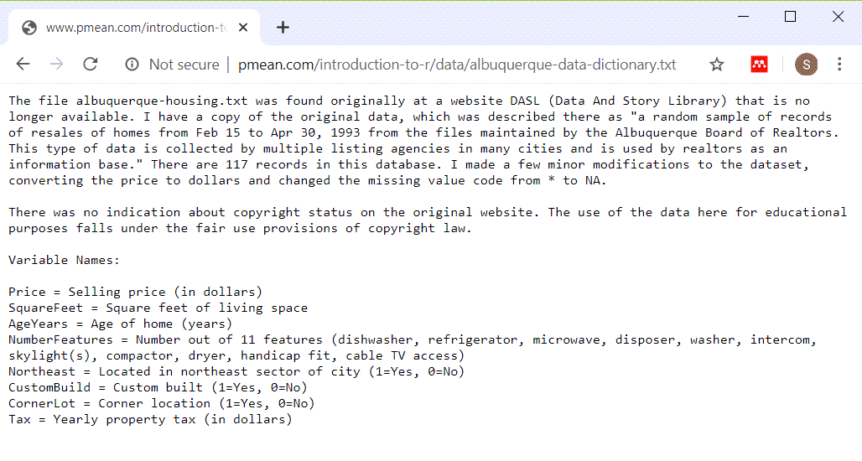
The Albuquerque dataset
Data dictionary for the Albuquerque dataset
Notes:
This is the data dictionary. Notice that there are several categorical variables.
Northeast is an indicator variable for whether the house was located in the Northeast part of the city, which is believed to be slightly more upscale than the other parts of the city.
CustomBuild is an indicator variable for whether the house was built using special (custom) plans or if it was built using standard plans.
CornerLot is an indicator variable for whether the house sat on a corner lot (a lot at the intersection of two streets). There are reasons to believe that houses on corner lots should be more expensive than other houses, but also reasons to believe that these houses should be less expensive.

Slide 31
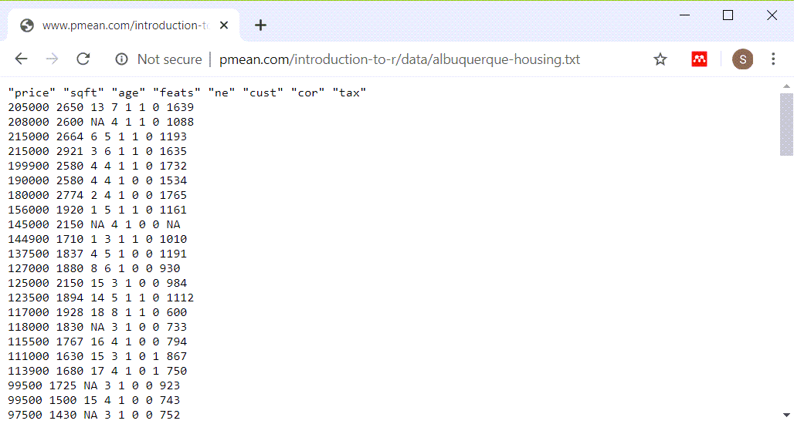
The Albuquerque dataset
A peek at the raw data for the Albuquerque dataset
Notes:
There is only a single blank between each data value. Use a blank as a delimiter.

Slide 32
The Diamond dataset
Diamond data dictionary
http://jse.amstat.org/v9n2/4C.txt
Diamond dataset
http://jse.amstat.org/v9n2/4Cdata.txt
Notes:
Note that the data dictionary describes two different datasets. You will be using the first dataset, the one with a smaller number of variables.

Slide 33
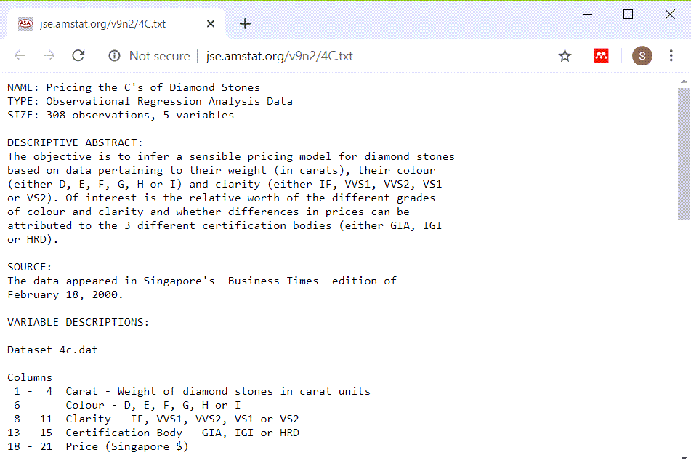
The Diamond dataset
Data dictionary for the Diamond dataset
Notes:
This is the data dictionary.

Slide 34
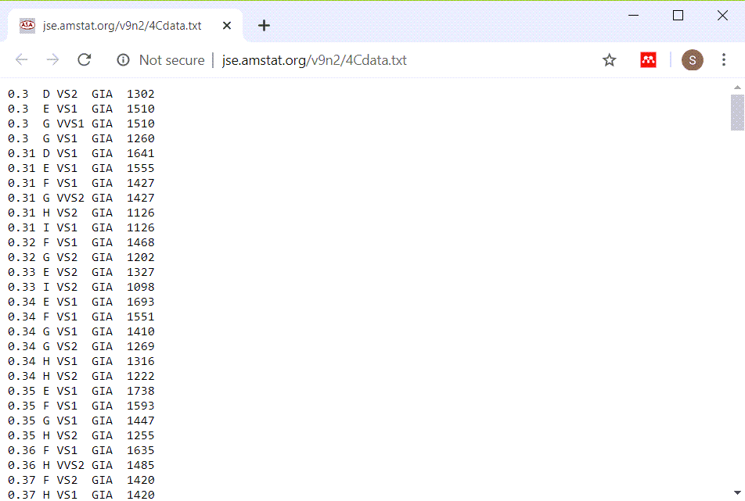
The Diamond dataset
A peek at the raw data for the Diamond dataset
Notes:
This could either be a tab delimited file or a fixed width file. If you scroll through enough of the data, you will see that most of the variables are left justified, but the price is right justified. Tab delimited files almost always have left justification for all data. So try a fixed width format.

