Slide 1
Introduction to R, module06
Steve Simon

Slide 2
Introduction
suppressMessages( suppressWarnings( library(tidyverse))) R.version.string
## [1] "R version 4.1.2 (2021-11-01)"
Sys.Date()
## [1] "2022-05-05"
Notes:
This Powerpoint presentation was created using an R Markdown file. This slide shows the version of R that I used and when it was last modified.

Slide 3
What is longitudinal data
Definition
Measurements taken at different times
Closely related datasets
Crossover
Pre-test/post-test
Repeated measures
Split plot
Notes:
I’m going to use the term “longitudinal” data to designate data sets where a patient is measured at multiple different time points. This encompasses certain other data sets, such as from a crossover, pre-test/post-test, repeated measures, and split plot.
Don’t worry about the technical distinctions among these terms. The important thing to know for now is that longitudinal data represents one of the biggest challenges in data management and we will spend most of this section discussing these challenges.

Slide 4
Two formats for longitudinal data
Short and fat format
Many columns
Not so many rows
Tall and thin format
Not so many columns
Many rows
Notes:
Longitudinal data usually come in one of two specific formats. The first is the short and fat format and the second is the tall and thin format.

Slide 5
Example: effect of surface and vision on balance
Repeated measures experiment
Vision has 3 levels
Eyes open, eyes closed, dome
Surface has 2 levels
Normal or foam
Two replications of each format
There are 3*2*2=12 measurements
Look here for more details
www.statsci.org/data/oz/ctsib.html
Notes:
Normally, you can only find a dataset stored in one of the two formats, but I did find an example of the same dataset being stored in both formats.

Slide 6
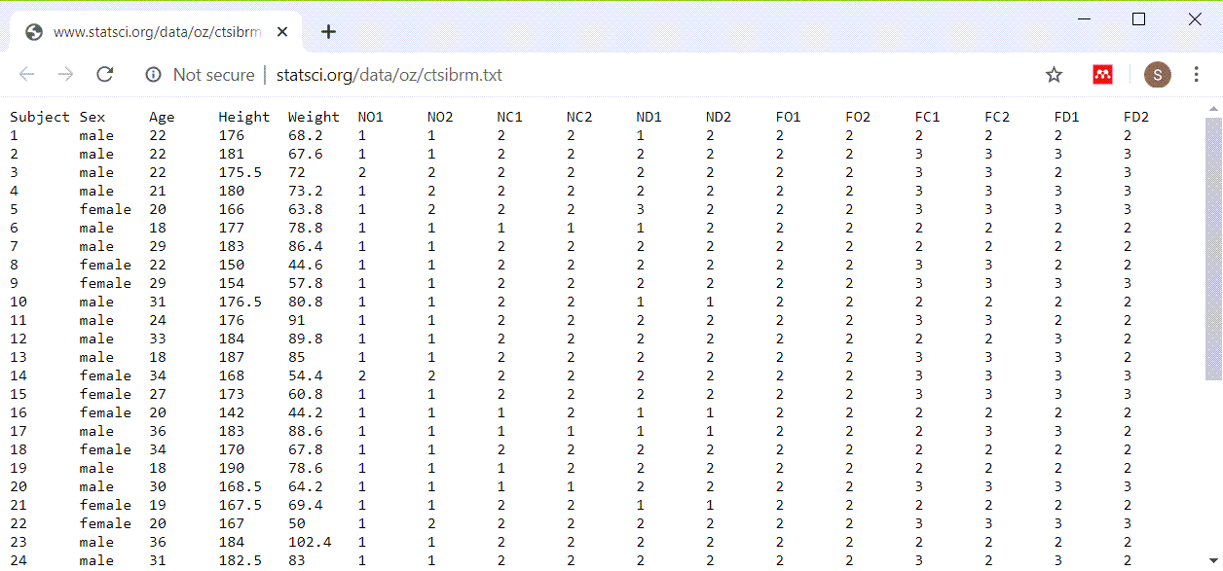
Short and fat example
Longitudinal data stored one row per subject
Notes:
The short and fat format has one row per patient and each successive patient encounter is strung out horizontally.

Slide 7
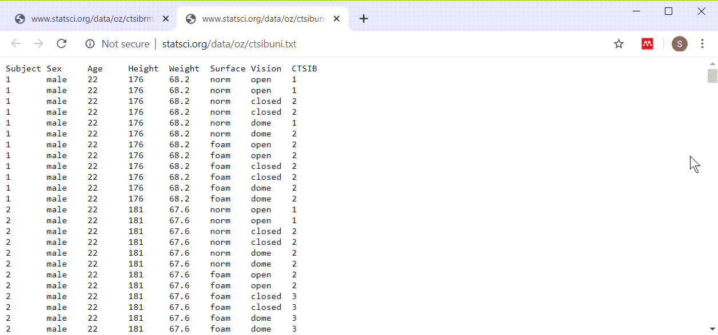
Tall and thin example
Longitudinal data stores with multiple rows per patient
Notes:
The tall and thin format has one row per patient encounter and therefore multiple rows per patient.

Slide 8
Which format is better? (1/2)
Short and fat advantages:
easy to compute change scores
easy to examine correlations over time
easy to insure consistency of demographic data
Short and fat disadvantages:
hard to read
excessive need to scroll left and right
Notes:
Both formats have advantages and disadvantages, and you need to know how to create a longitudinal file in either format and how to transform from one format to another.
The short and fat format makes it easy to compute change scores, the difference between a later measurementn and an earlier one. Correlations are also easier.
Because the short and fat format stretches each visits data out to the right, you end up doing a lot of left/right scrolling with this type of file.

Slide 9
Which format is better? (2/2)
Tall and thin advantages:
easy to plot longitudinal trends
less need for missing value codes
easy to read because most scrolling is up and down
Tall and thin disadvantages
hard to maintain consistency of demographic variables
Notes:
While some statistical tasks are easier with the short and fat format, the one that is usually easier with the tall and thin format is plotting.
If a subject misses a visit, the short and fat visit format makes you put in missing value codes for all the data that was not collected at that time. A tall and thin format is easier because you just leave out the row that corresponds to the missing visit.
The problem with this format is in the repetition that occurs. If you have demographic variables like gender and race, those are listed on each row. This allows an opportunity for mischief, where a patient can have a different gender on different rows.

Slide 10
Break #1
What have you learned
Two formats for longitudinal data
What is coming next
Converting to tall and thin format
Notes:
I want to keep these videos short, so let’s stop here.

Slide 11
Energy dataset (short and fat format)
Completely randomized block design
Blocks are subjects (8 total)
Treatment are exercise
Running, walking, cycling
There are 3*8=24 measurements
Look here for more details
www.statsci.org/data/general/energy.html
Notes:
Here’s another interesting data set that you can work with. It comes in a short and fat format.

Slide 12
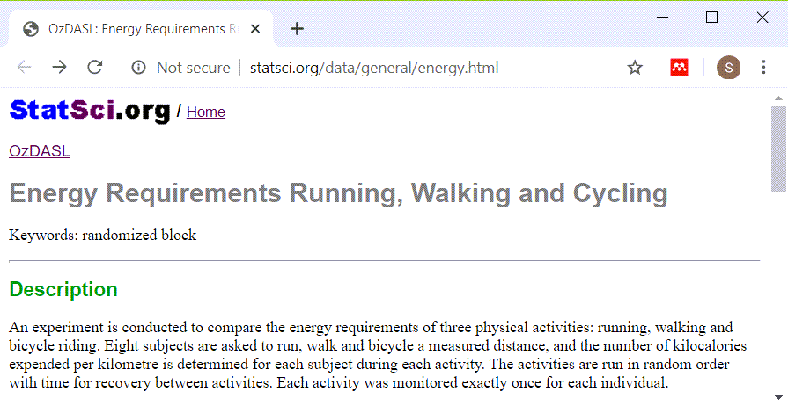
Energy dataset (short and fat format)
Notes:
This is a description of the data set.

Slide 13
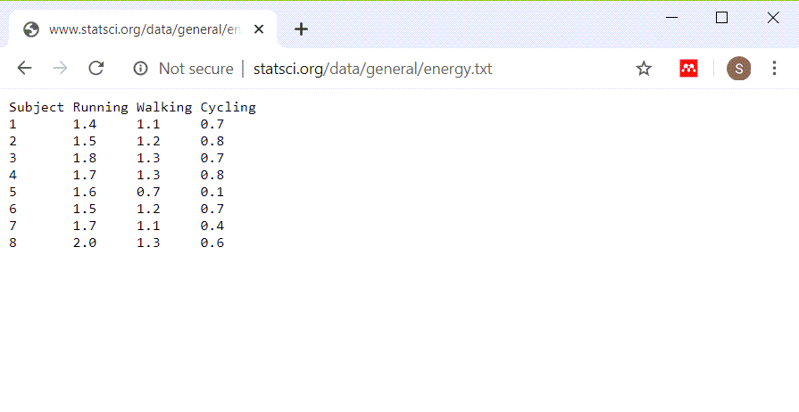
Energy dataset (short and fat format)
Notes:
Here is the data in the short and fat format. It’s a small dataset so it doesn’t look very fat. But we can make it taller and thinner.

Slide 14
Import energy dataset (short and fat format)
fi <- "../data/energy.txt" en <- read_table(fi, col_types="nnnn")
Notes:
This is the code to read in the data. With multiple spaces between data values, the read_table function is a good choice.

Slide 15
Energy dataset, glimpse
glimpse(en)
## Rows: 8 ## Columns: 4 ## $ Subject <dbl> 1, 2, 3, 4, 5, 6, 7, 8 ## $ Running <dbl> 1.4, 1.5, 1.8, 1.7, 1.~ ## $ Walking <dbl> 1.1, 1.2, 1.3, 1.3, 0.~ ## $ Cycling <dbl> 0.7, 0.8, 0.7, 0.8, 0.~
Notes:
This is the structure of the data. Eight rows, one for each subject. The values are stretched horizontally across three columns, and there is an additional column to indicate which subject is which. This column is not really needed for the short and fat format, but it becomes important when you convert it to a tall and thin format.
You can convert this to a tall and thin format by stacking the running, walking, and cycling values in a single column. You’ll need a new variable to remind you whether the value you are converting comes from the first row, second row, etc.

Slide 16
Converting to tall and thin, code
en_tall <- pivot_longer(en, c(Running, Walking, Cycling), names_to="activity", values_to="energy")
Notes:
The pivot_longer function does the conversion. The first argument is the name of the dataset. The second is the names of the columns that you wish to re-arrange. The names_to argument provides a name to the new column that indicates what type of activity is represented by a particular row. The values_to argument provides a name to the new column that holds the data.

Slide 17
Converting to tall and thin, output
glimpse(en_tall)
## Rows: 24 ## Columns: 3 ## $ Subject <dbl> 1, 1, 1, 2, 2, 2, 3, ~ ## $ activity <chr> "Running", "Walking",~ ## $ energy <dbl> 1.4, 1.1, 0.7, 1.5, 1~
Notes:
This is the structure of the new data. The “activity” variable is the name of the column where the data value came from and “energy” variable is the data value itself. Any variable or variables left out of the list are treated like an identifier for a particular row.
Notice that the tall and thin format has 24 rows, not 8, because each of the 8 subjects now have three rows of data.

Slide 18
Lineplot
activity_lineplot <- ggplot(en_tall, aes(x=activity, y=energy, group=Subject)) + geom_line() ggsave("../images/activity-by-energy.png", activity_lineplot, width=4, height=4)
Notes:
One possible graph that could not have done in the short and fat format is a lineplot. The group parameter in the aes function tells R that separate lines are defined for each subject.

Slide 19
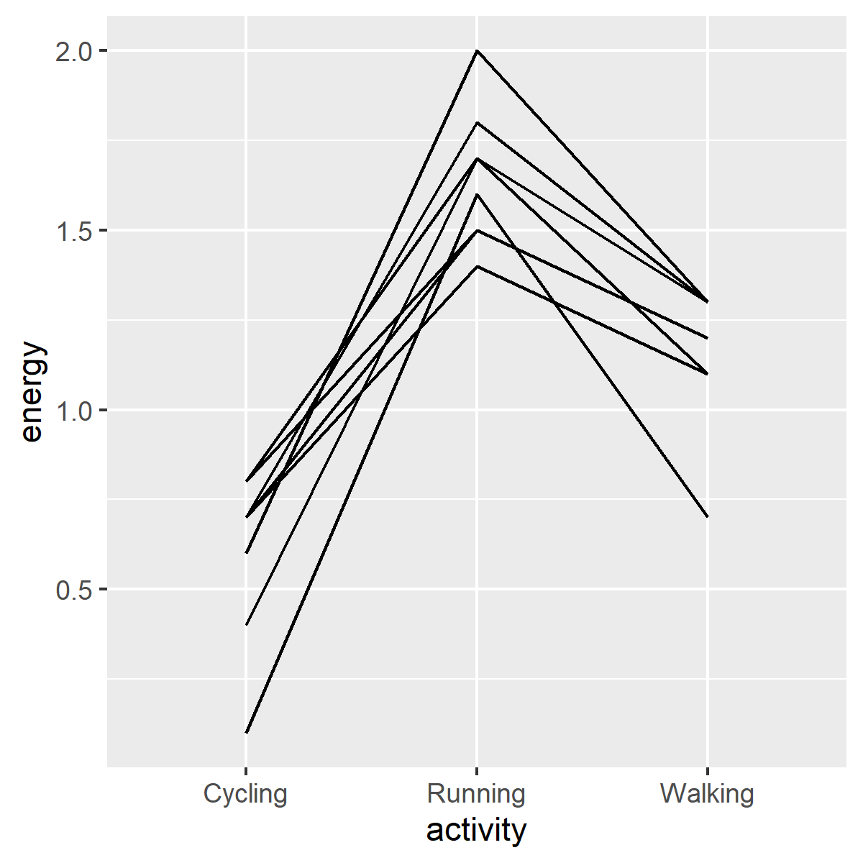
Lineplot
Plot showing activity levels by activity
Notes:
Here is the graph. Notice the inverted V shape for each line. This shows that running uses the most energy for any individual subject.

Slide 20
Earthquake dataset
Longitudinal study of stress
Study started two weeks prior to major earthquake (Week0)
Researchers added extra stress measurments
Week3, Week6, Week9, Week12
There are 26 subjects
There are 5*26=130 measurements
For more information
www.statsci.org/data/general/lomaprie.txt
Notes:
Here is a dataset stored in the short and fat format. This dataset will serve as a second example of how to convert from a short and fat format to a tall and thin format.

Slide 21
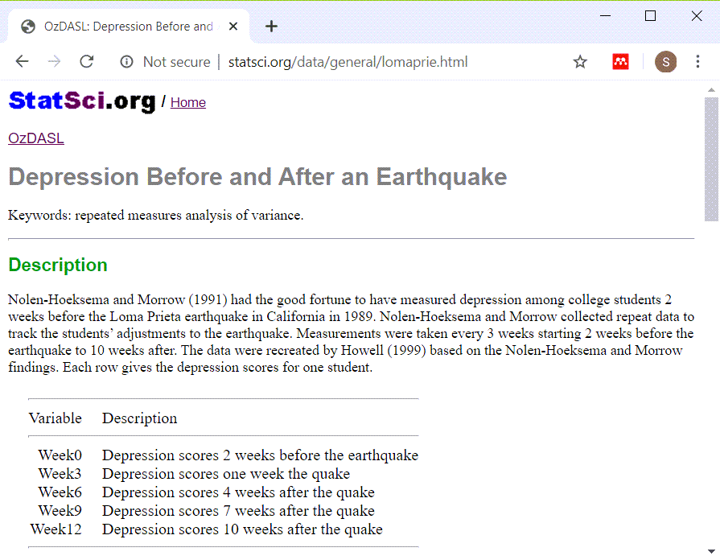
Earthquake dataset
Screenshot of data dictionary website
Notes:
Here is the data dictionary

Slide 22
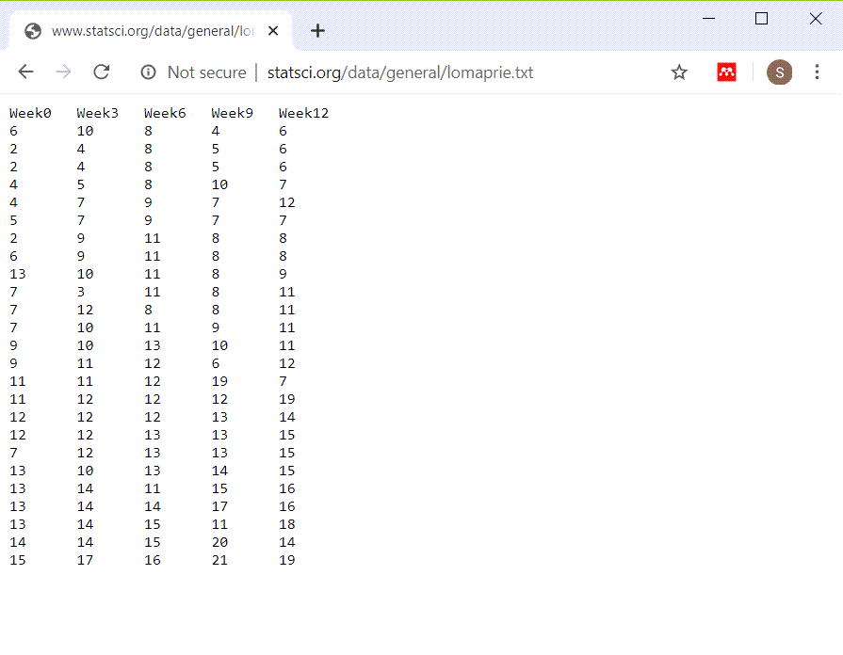
Earthquake dataset
View of the earthquake dataset
Notes:
This is clearly a tab delimited file. All of the fields are left justified.

Slide 23
Read in the earthquake data
fn <- "../data/quake.txt" qu <- read_table(fn, col_types="nnnnn")

Slide 24
Check structure of the earthquake data
glimpse(qu)
## Rows: 25 ## Columns: 5 ## $ Week0 <dbl> 6, 2, 2, 4, 4, 5, 2, 6,~ ## $ Week3 <dbl> 10, 4, 4, 5, 7, 7, 9, 9~ ## $ Week6 <dbl> 8, 8, 8, 8, 9, 9, 11, 1~ ## $ Week9 <dbl> 4, 5, 5, 10, 7, 7, 8, 8~ ## $ Week12 <dbl> 6, 6, 6, 7, 12, 7, 8, 8~
Notes:
There are measurements at weeks 0, 3, 6, 9, and 12.

Slide 25
Convert to tall and thin format
qu$id <- 1:25 qu_tall <- pivot_longer(qu, contains("Week"), names_to="time", values_to="depression")
Notes:
There is no subject id for each row of the data set. That’s okay for the short and fat format. But for the tall and thin format, where there are multiple rows for each subject, you need an id variable.
The contains function creates a variable list of any variable that has the text “Week”. That’s a lot shorter than typing c(Week0, Week3, Week6, Week9, Week12). The “time” variable identifies which column (Week0, Week3, etc.) that data originally came from and the “depression” variable contains the actual data.

Slide 26
Display new structure
glimpse(qu_tall)
## Rows: 125 ## Columns: 3 ## $ id <int> 1, 1, 1, 1, 1, 2, 2~ ## $ time <chr> "Week0", "Week3", "~ ## $ depression <dbl> 6, 10, 8, 4, 6, 2, ~
Notes:
Here’s the structure of the tall and thin format.

Slide 27
Boxplot, code
depression_boxplot01 <- ggplot(qu_tall, aes(x=time, y=depression)) + geom_boxplot() ggsave( "../images/time-by-depression01.png", depression_boxplot01, width=4, height=4)
Notes:
This is the code to produce a set of boxplots.

Slide 28
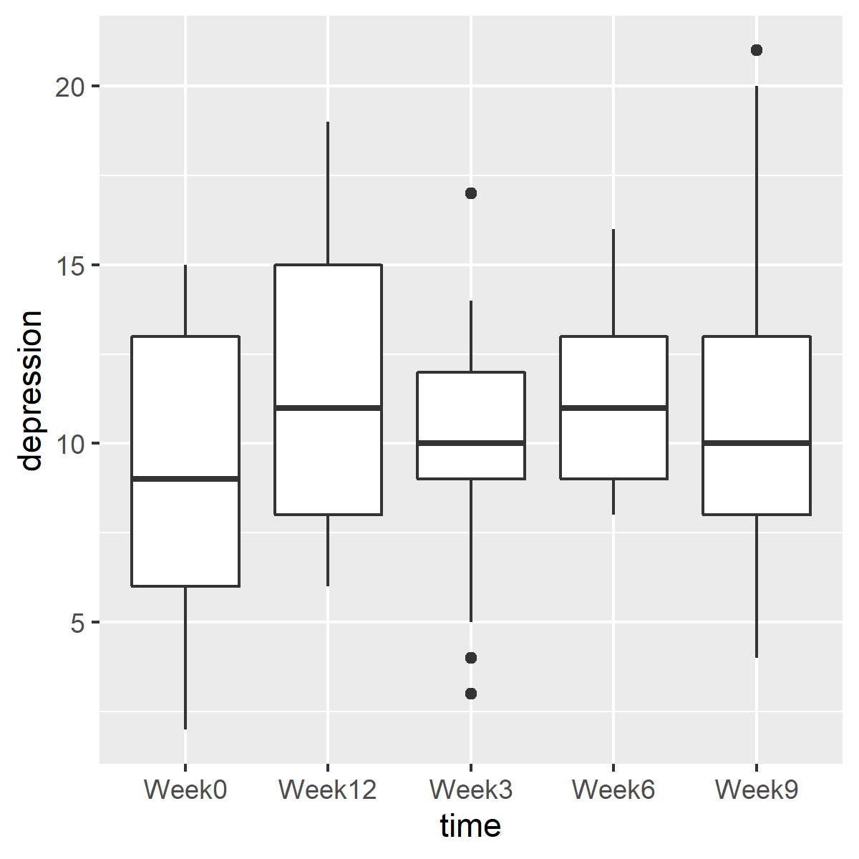
Boxplot, output
Boxplots showing depression levels over time
Notes:
Here is the plot. The order of the weeks is not correct, because week12 appears between week0 and week3.
There are several ways to fix this.

Slide 29
Boxplot, revised code (1/2)
qu_tall$time <- case_when( qu_tall$time=="Week0"~"week00", qu_tall$time=="Week3"~"week03", qu_tall$time=="Week6"~"week06", qu_tall$time=="Week9"~"week09", qu_tall$time=="Week12"~"week12")
Notes:
The case_when function allows you to insert a leading zero for the single digit weeks.

Slide 30
Boxplot, revised code (2/2)
depression_boxplot02 <- ggplot(qu_tall, aes(x=time, y=depression)) + geom_boxplot() ggsave("../images/time-by-depression02.png", depression_boxplot02, width=4, height=4)
Notes:
This is the code for boxplots with the modified names.

Slide 31
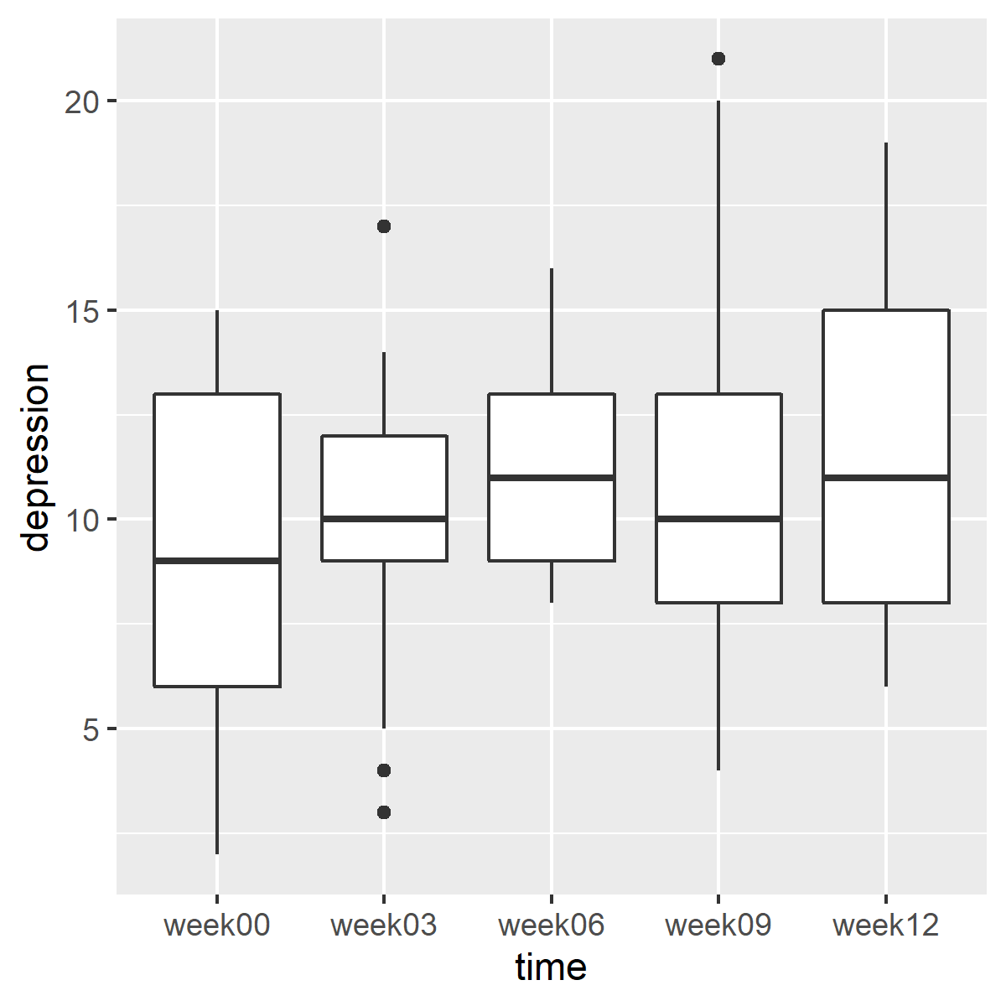
Boxplot, revised
Modified boxplots showing depression levels over time
Notes:
Here are the boxplots in the proper order. There are changes in depression levels across time, but these changes are small.

Slide 32
Break #2
What have you learned
Converting to tall and thin format
What is coming next
Converting to short and fat format
Notes:
I want to keep these videos short, so let’s stop here.

Slide 33
Backpain dataset
Matched case-control study
Study of 11 runners with back pain
Two control groups
Runners without pain, Sedentary volunteers
Matched by age, height, weight
Outcome variables
Flexibility and length of various muscle groups
Also collected covariates
Type of running, number of years running
Our focus: quality of matching
There are 3*11=33 measurements
For more information
http://www.statsci.org/data/oz/backpain.html
Notes:
Now let’s read in a tall and thin format and convert it to a short and wide format.

Slide 34
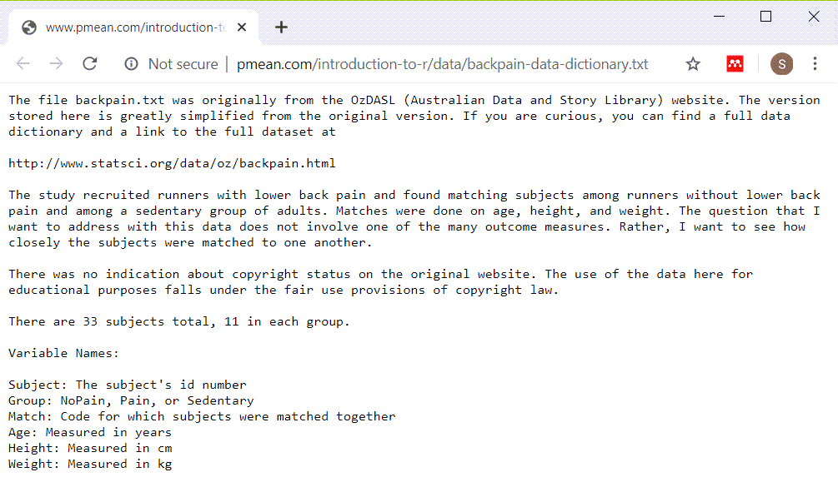
Backpain overview
Data dictionary for backpain dataset
Notes:
Here is the data dictionary for the backpain dataset.

Slide 35
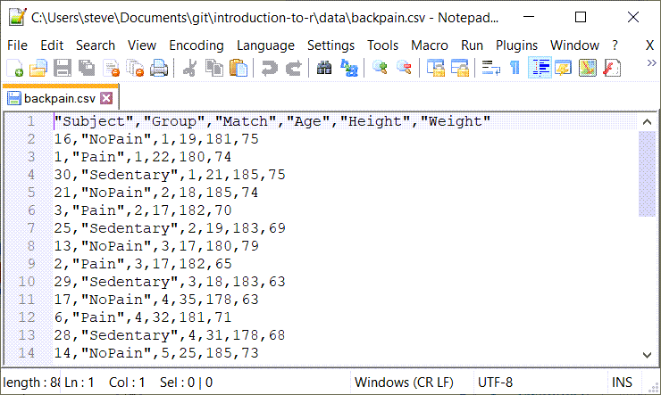
Backpain dataset
Partial view of backpain raw data
Notes:
No question here. This is a comma separated value dataset.

Slide 36
Reading in the backpain dataset
fn <- "../data/backpain.csv" pain <- read_csv(fn, col_types="ncnnn")
Notes:
Here is the code for reading in the backpain data. The second column of data is character and the other columns are numeric.

Slide 37
Display
glimpse(pain)
## Rows: 33 ## Columns: 6 ## $ Subject <dbl> 16, 1, 30, 21, 3, 25, ~ ## $ Group <chr> "NoPain", "Pain", "Sed~ ## $ Match <dbl> 1, 1, 1, 2, 2, 2, 3, 3~ ## $ Age <dbl> 19, 22, 21, 18, 17, 19~ ## $ Height <dbl> 181, 180, 185, 185, 18~ ## $ Weight <dbl> 75, 74, 75, 74, 70, 69~
Notes:
This shows the structure of the data.

Slide 38
Converting to short and fat
pain_wide <- pivot_wider(pain, id_cols=Match, names_from=Group, values_from=c(Age, Height, Weight))
Notes:
The pivot_wider function converts a tall and thin format into a short and fat format. Notice that there is a “names_from” argument instead of “names_to” and a “values_from” instead of “values_to”.

Slide 39
Display new structure
glimpse(pain_wide)
## Rows: 11 ## Columns: 10 ## $ Match <dbl> 1, 2, 3, 4, 5~ ## $ Age_NoPain <dbl> 19, 18, 17, 3~ ## $ Age_Pain <dbl> 22, 17, 17, 3~ ## $ Age_Sedentary <dbl> 21, 19, 18, 3~ ## $ Height_NoPain <dbl> 181, 185, 180~ ## $ Height_Pain <dbl> 180, 182, 182~ ## $ Height_Sedentary <dbl> 185, 183, 183~ ## $ Weight_NoPain <dbl> 75, 74, 79, 6~ ## $ Weight_Pain <dbl> 74, 70, 65, 7~ ## $ Weight_Sedentary <dbl> 75, 69, 63, 6~
Notes:
Here is the structure of the modified data in short and fat format.

Slide 40
Remaining variables
names(pain_wide)[7:10]
## [1] "Height_Sedentary" ## [2] "Weight_NoPain" ## [3] "Weight_Pain" ## [4] "Weight_Sedentary"

Slide 41
Backpain plot code (1 of 3)
age_range <- range(c( pain_wide$Age_Pain, pain_wide$Age_NoPain, pain_wide$Age_Sedentary))

Slide 42
Backpain plot code (2 of 3)
agreement_age <- ggplot(pain_wide, aes(x=Age_Pain, y=Age_NoPain, label=Match)) + geom_text(color="darkgreen") + geom_text(aes(y=Age_Sedentary), color="red") + ylab("Age_Sedentary (red) and Age_NoPain (green)" )

Slide 43
Backpain plot code (3 of 3)
agreement_age <- agreement_age + expand_limits( x=age_range, y=age_range) + geom_segment( x=age_range[1], y=age_range[1], xend=age_range[2], yend=age_range[2]) ggsave( "../images/agreement_age.png", agreement_age, width=4, height=4)
Notes:
This code shows the agreement between the ages of the patients in the NoPain group and the patients in the Pain group.

Slide 44
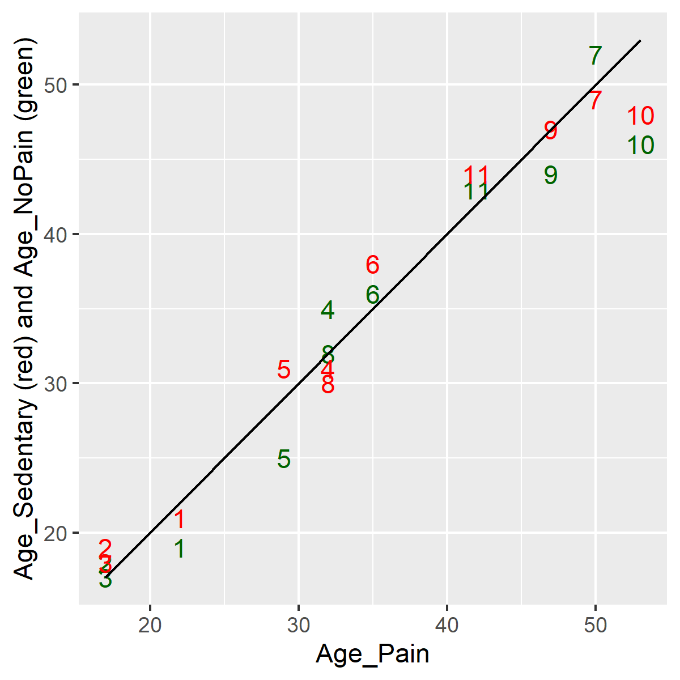
Plots of agreement
Plot showing agreement in ages
Notes:
The agreement is quite good. There is a bit less agreement for older subjects.

Slide 45
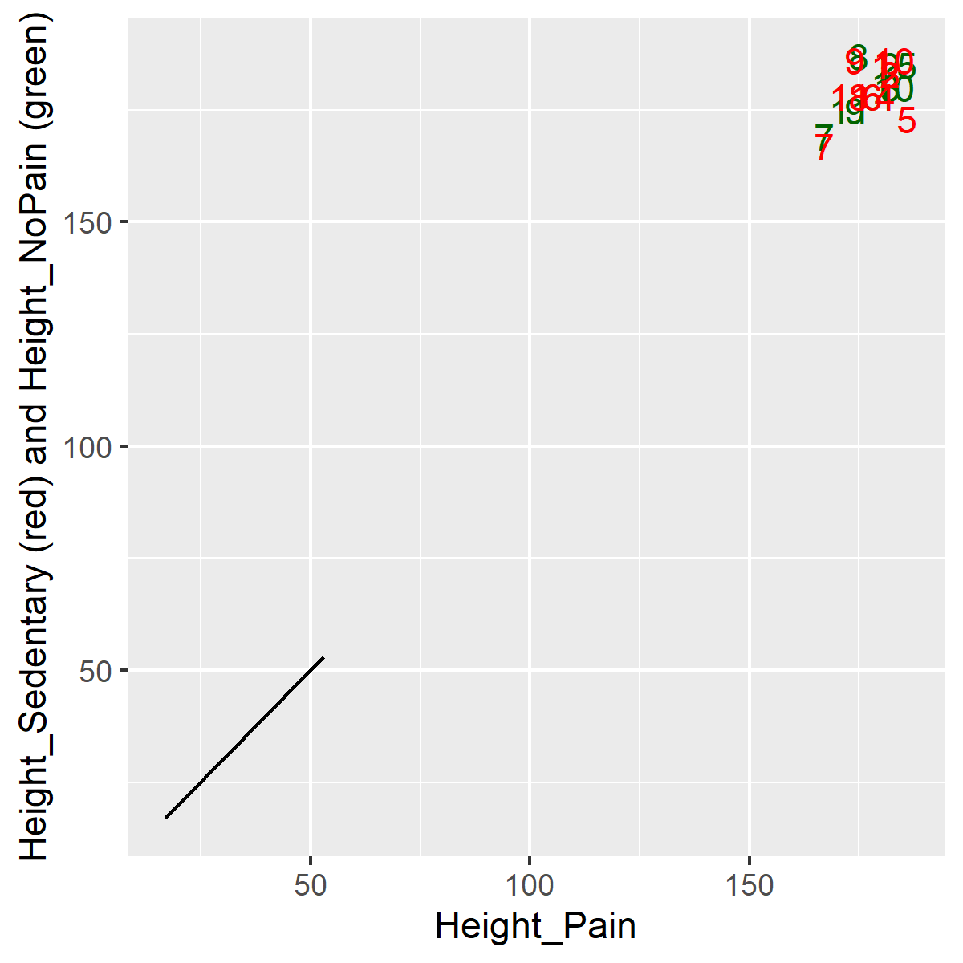
Backpain plot for height
Plot showing agreement in heights
Notes:
This code shows the agreement between the height of the patients in the NoPain group and the patients in the Pain group.

Slide 46
Plots of agreement
Notes:
The agreement is quite good. There is a bit less agreement for older subjects.

Slide 47
Break #2
What have you learned
Converting to short and fat format
What is coming next
Separating into time constant/time varying tables
Notes:
I want to keep these videos short, so let’s stop here.

Slide 48
One last recommendation
Both formats have problems
Tall and thin: repetition of demographic information
Short and fat: poor handling of missing value
Ideal solution: normalization
Put time constant data in first table
Put time varying data in second table

Slide 49
Balance data set: Short and fat format
Longitudinal data stored one row per subject
Notes:
Here is the short and fat format again. It has one row per patient and each successive patient encounter is strung out horizontally.

Slide 50
Tall and thin example
Longitudinal data stores with multiple rows per patient
Notes:
Here is the tall and thin format again. It has one row per patient encounter and therefore multiple rows per patient.

Slide 51
Read balance in short and fat structure
fn <- "../data/balance1.txt" short_and_fat_data <- read_tsv(fn, col_types="ncnnnnnnnnnnnnnnnnnn")

Slide 52
Display balance short and fat structure
glimpse(short_and_fat_data)
## Rows: 40 ## Columns: 17 ## $ Subject <dbl> 1, 2, 3, 4, 5, 6, 7, 8~ ## $ Sex <chr> "male", "male", "male"~ ## $ Age <dbl> 22, 22, 22, 21, 20, 18~ ## $ Height <dbl> 176.0, 181.0, 175.5, 1~ ## $ Weight <dbl> 68.2, 67.6, 72.0, 73.2~ ## $ NO1 <dbl> 1, 1, 2, 1, 1, 1, 1, 1~ ## $ NO2 <dbl> 1, 1, 2, 2, 2, 1, 1, 1~ ## $ NC1 <dbl> 2, 2, 2, 2, 2, 1, 2, 2~ ## $ NC2 <dbl> 2, 2, 2, 2, 2, 1, 2, 2~ ## $ ND1 <dbl> 1, 2, 2, 2, 3, 1, 2, 2~ ## $ ND2 <dbl> 2, 2, 2, 2, 2, 2, 2, 2~ ## $ FO1 <dbl> 2, 2, 2, 2, 2, 2, 2, 2~ ## $ FO2 <dbl> 2, 2, 2, 2, 2, 2, 2, 2~ ## $ FC1 <dbl> 2, 3, 3, 3, 3, 2, 2, 3~ ## $ FC2 <dbl> 2, 3, 3, 3, 3, 2, 2, 3~ ## $ FD1 <dbl> 2, 3, 2, 3, 3, 2, 2, 2~ ## $ FD2 <dbl> 2, 3, 3, 3, 3, 2, 2, 2~

Slide 53
Additional variables
names(short_and_fat_data)[7:17]
## [1] "NO2" "NC1" "NC2" "ND1" "ND2" "FO1" ## [7] "FO2" "FC1" "FC2" "FD1" "FD2"

Slide 54
Create time constant data
time_constant_list <- c("Subject", "Sex", "Age", "Height", "Weight") time_constant_data <- short_and_fat_data[ , time_constant_list]

Slide 55
Structure of time constant data
glimpse(time_constant_data)
## Rows: 40 ## Columns: 5 ## $ Subject <dbl> 1, 2, 3, 4, 5, 6, 7, 8~ ## $ Sex <chr> "male", "male", "male"~ ## $ Age <dbl> 22, 22, 22, 21, 20, 18~ ## $ Height <dbl> 176.0, 181.0, 175.5, 1~ ## $ Weight <dbl> 68.2, 67.6, 72.0, 73.2~
Notes:
The time constant variables are sex, age, height, and weight. You must keep the subject id in this dataset as well because you will need it to link with the time variable data.

Slide 56
Read balance in tall and thin format
fn <- "../data/balance2.txt" tall_and_thin_data <- read_table(fn, col_types="ncnnnccn")

Slide 57
Balance data, tall and thin structure
glimpse(tall_and_thin_data)
## Rows: 480 ## Columns: 8 ## $ Subject <dbl> 1, 1, 1, 1, 1, 1, 1, 1~ ## $ Sex <chr> "male", "male", "male"~ ## $ Age <dbl> 22, 22, 22, 22, 22, 22~ ## $ Height <dbl> 176, 176, 176, 176, 17~ ## $ Weight <dbl> 68.2, 68.2, 68.2, 68.2~ ## $ Surface <chr> "norm", "norm", "norm"~ ## $ Vision <chr> "open", "open", "close~ ## $ CTSIB <dbl> 1, 1, 2, 2, 1, 2, 2, 2~

Slide 58
Additional variables
names(tall_and_thin_data)[7:8]
## [1] "Vision" "CTSIB"

Slide 59
Create time varying table
time_variable_list <- c("Subject", "Surface", "Vision", "CTSIB") time_variable_data <- tall_and_thin_data[ , time_variable_list]

Slide 60
Display structure of time varying table
glimpse(time_variable_data)
## Rows: 480 ## Columns: 4 ## $ Subject <dbl> 1, 1, 1, 1, 1, 1, 1, 1~ ## $ Surface <chr> "norm", "norm", "norm"~ ## $ Vision <chr> "open", "open", "close~ ## $ CTSIB <dbl> 1, 1, 2, 2, 1, 2, 2, 2~
Notes:
Pull the time variable data from the tall and thin format.
Update the time constant table only once. Update the time varying table each time you get information at a new patient visit.
Note that this is what you should do before the data is collected. If the data is already collected by someone else, then you have to live with the limitations of whatever format they chose.

Slide 61
Summary
Two formats
Short and fat
Tall and thin
pivot_longer
converts to tall and thin
pivot_wider
converts to short and fat
Alternative approach
Time constant table
Time variable table
Notes:
We’ve covered a lot in these videos. There are two formats for longitudinal data. The short and fat format has one row per patient and strings out the data far to the right. The tall and thin format has one row per time point and strings out the data far down.
Use the gather function in the tidyr library to convert from a short and fat format into a tall and thin format. Use the spread function to convert from a tall and thin format to a short and fat format.
From a data management approach, you should consider a database term called normalization. In a longitudinal setting, this simply means putting your time constant data (usually the demographic variables) in a table using the short and fat format (one row per patient). Then put your time varying data in a different table using the tall and thin format (one row per time point).

