Slide 1
Video 5 - Experimental and Quasi-experimental studies
Steve Simon

Slide 2
Learning objectives
To describe the differences between different research approaches
To describe what defines a randomized experimental design
To distinguish a randomized experimental design from a quasi-experimental design

Slide 3
Required reading
Chapters 4, 5
Canvas â€“ Leaf article

Slide 4
Optional reading
Simon. â€œThe problem with alternating assignmentâ€
Tucker et al. â€œUtility of an interactive voice response system to assess antiretroviral pharmacotherapy adherence among substance users living with HIV/AIDS in the rural southâ€
Simon. â€œSome quasi-experimental alternatives to randomizationâ€
De Bruin et al. â€œElectronic monitoring-based counseling to enhance adherence among HIV-infected patients: A randomized controlled trialâ€
Ioannidis. â€œContradicted and initially stronger effects in highly cited clinical researchâ€

Slide 5
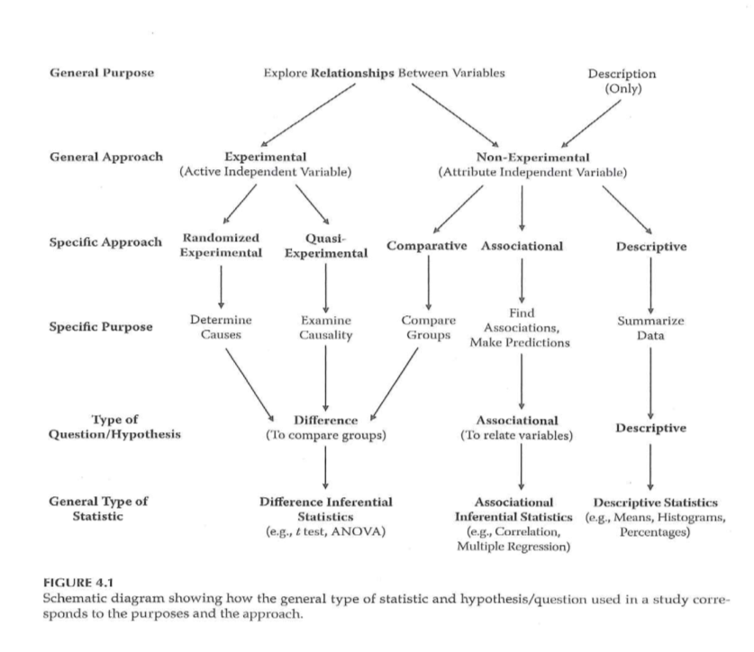
Research Approaches

Slide 6
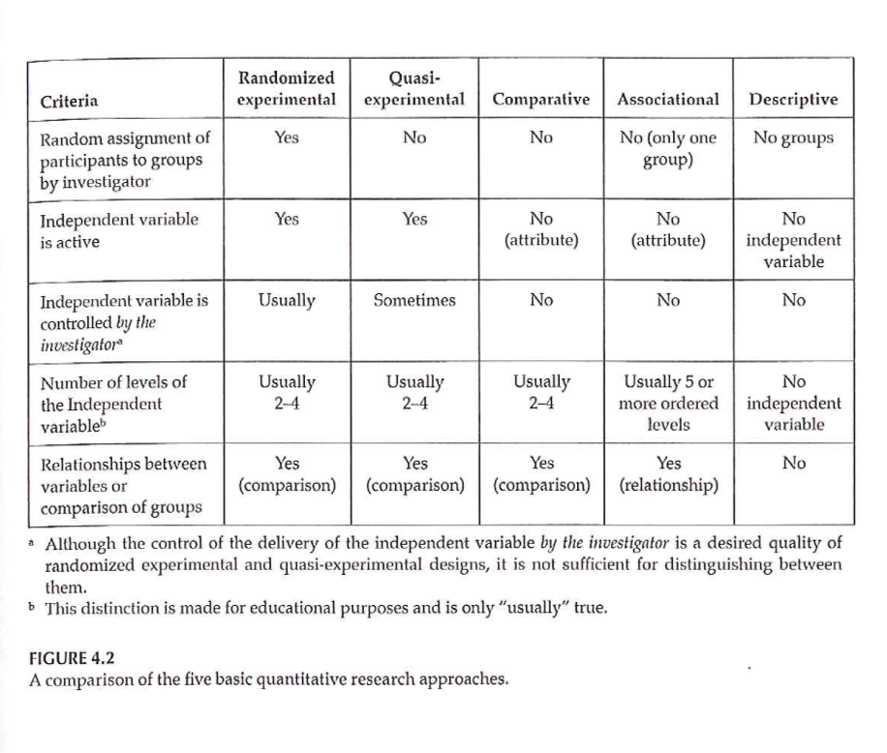
Research Approaches

Slide 7
Research Approaches
Randomized Experimental
Criteria
Random assignment
Active independent variable
(Experimenter control of active independent variable)
What is “treatment”
When it will be given
Who it will be given to

Slide 8
Research Approaches
Randomized Experimental
Importance of random assignment
Bias
Equivalence of groups before treatment
Random selection (sampling)
What does this mean?
How does it relate to random assignment?
Value of random selection?

Slide 9
Research Approaches
Quasi-Experimental
What criteria of Experimental not met?
Categories of Q-E approach
Q-E with major limitations
Pretest-Posttest designs
Time-series designs
Single-subject designs

Slide 10
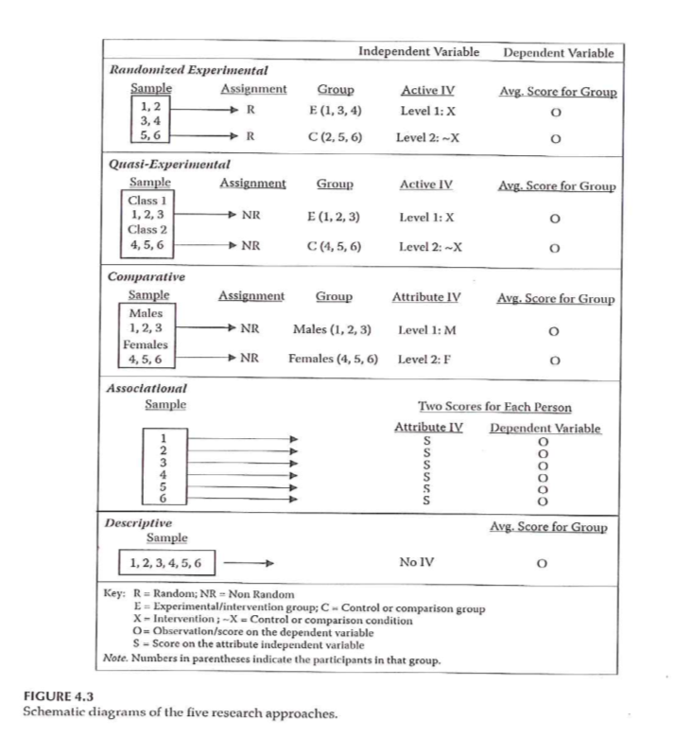
Research Approaches

Slide 11
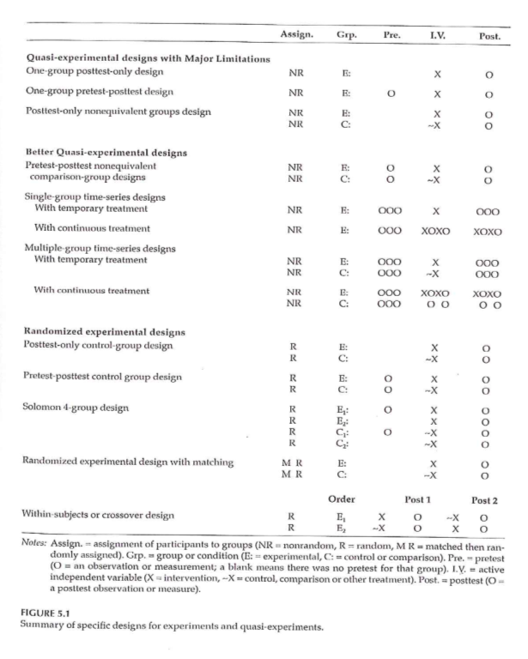
Randomized Experimental and Q-E Designs

Slide 12
Quasi-Experimental Designs
Categories of Q-E approach
Q-E with major limitations
Pretest-Posttest designs
Time-series designs
Single-subject designs

Slide 13
Quasi-Experimental Designs
Q-E with major limitations
Also called Pre-experimental
One-Group Posttest-Only
NR E: X O

Slide 14
Quasi-Experimental Designs
Q-E with major limitations
Also called Pre-experimental
One-Group Pretest-Posttest
NR E: O1 X O2
Improvement - Wait-List Comparison Group
Immediate Group O1 X O2
Wait-List Group O1 ~X O2 X O3

Slide 15
Quasi-Experimental Designs
Q-E with major limitations
Also called Pre-experimental
Posttest-Only Nonequivalent Groups
NR E: X O
NR C: ~X O

Slide 16
Quasi-Experimental Designs
Better Q-E Designs
Pretest-Posttest Nonequivalent Comparison Group
NR E: O1 X O2
NR C: O1 ~X O2
3 strengths based on
How participants got into the groups/conditions
How much control investigator has over IV
Strong
Moderate-strength
Weak

Slide 17
Quasi-Experimental Designs
Better Q-E Designs
Single-Group Time-Series
Characteristics
Temporary treatment vs Continuous treatment
Multi-Group Time-Series
Characteristics
Temporary treatment vs Continuous treatment

Slide 18
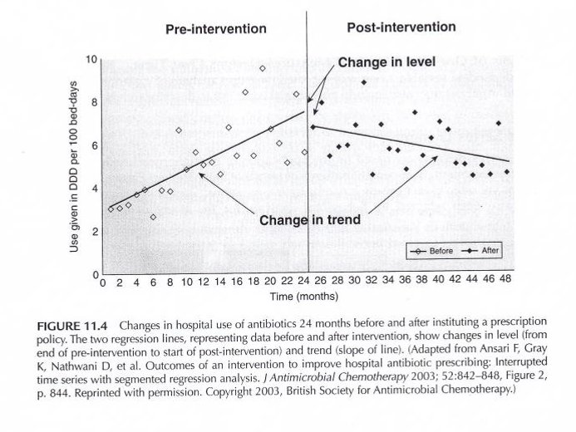
Q-E Time Series Designs
Portney & Watkins, 2009

Slide 19
Q-E Time Series Designs
Portney & Watkins, 2009

Slide 21
Quasi-Experimental Designs
Typical examples of Q-E designs
Case-control study
Cohort study
Non-equivalent control group design
Interrupted time-series design
Single system design

Slide 22
Randomized Experimental Designs
Characteristics
Assignment
Type of IV
Control of IV
Purpose

Slide 23
Randomized Experimental Designs
Posttest-Only Control Group
R E: X O
R C: X O
Strengths
Weaknesses

Slide 24
Randomized Experimental Designs
Pretest-Posttest Control Group
R E: O1 X O2
R C: O1 ~X O2
Strengths
Weaknesses

Slide 25
Randomized Experimental Designs
Solomon Four-Group
R E1: O1 X O2
R E2: X O2
R C1: O1 ~X O2
R C2: ~X O2
Strengths
Weaknesses

Slide 26
Randomized Experimental Designs
Randomized Experimental Design with Matching
M R E: X O
M R C: ~X O
Strengths
Weaknesses

Slide 27
Randomized Experimental Designs
Within-Subjects Randomized Experimental (Crossover) Design
R Order 1 X O1 ~X O2
R Order 2 ~X O1 X O2
Strengths
Weaknesses

Slide 28
Randomized Experimental and Q-E Designs

Slide 29
Research Design
Sim & Wright. Research in Health Care . 2000. Table 4.2

Slide 30
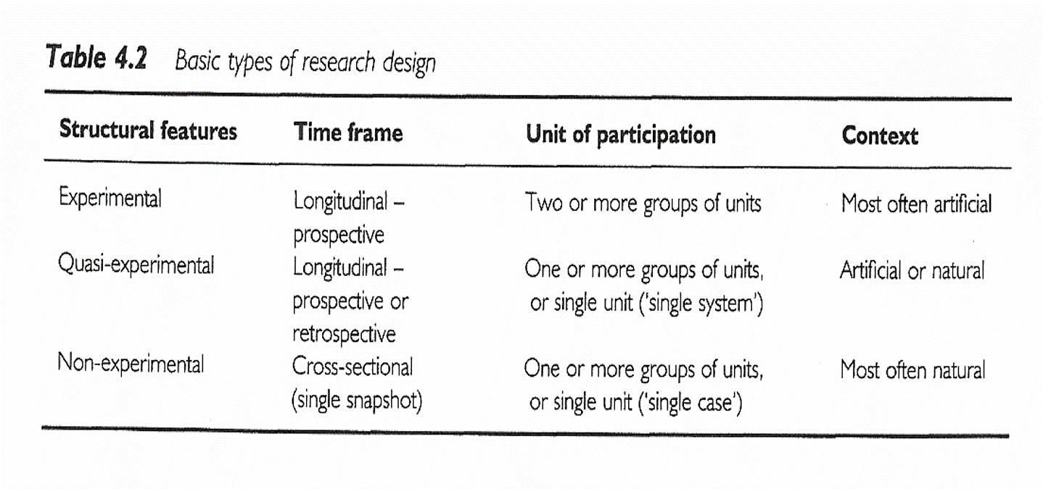

Slide 31
Research Design
Sim & Wright. Research in Health Care . 2000. Table 4.3

Slide 32
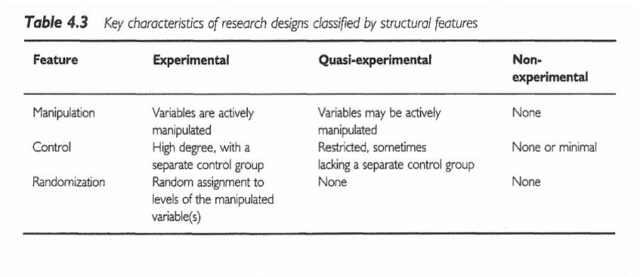

Slide 33
Assignment #3
Prepare a brief description of the topic you are planning to focus on for your research proposal. (Introduction)

Slide 34
Assignment
Prepare a brief description of the topic you are planning to focus on for your research proposal. This assignment serves as a start point for the Introduction of your research proposal.
Prepare for next weekâ€™s session

Slide 35
Discussion questions
What kind of clinical research questions are you interested in pursuing?
Do you have previous experiences that factor into the research questions you are interested in?
What kind of design do you think would be most appropriate for the topic you are interested in?

Slide 36
Additional slides

