Slide 1
Video 7 - Internal and external validity
Steve Simon

Slide 2
Learning objectives
To define internal validity
To define external validity
To discuss factors that determine the appropriate sample for a research project
Notes:
Here are the objectives for this week’s class.

Slide 3
Required reading
Chapters 8, 9
Notes:
This is what you should have read already. If you haven’t done the reading yet, pause this video and read this material. You’ll get more out of the video if you do so.

Slide 4
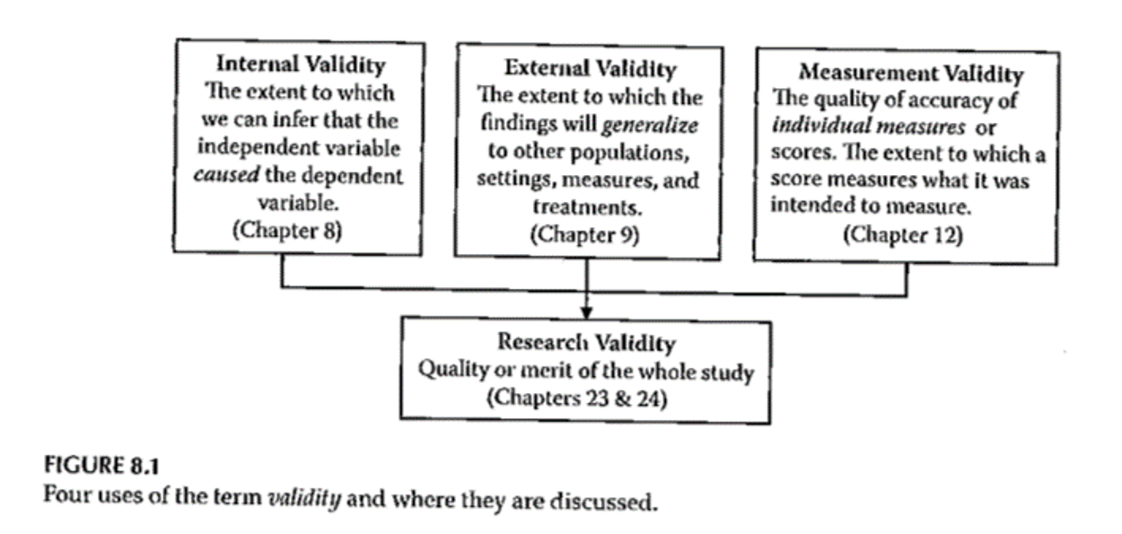
Validity
Notes:
Figure 8.1 has a very concise presentation. Three different types of validity that feed into what a study does. This lecture is just about internal validity. The extent to which you can infer that the independent variable caused the dependent variable.

Slide 5
Internal Validity
“The extent to which we can infer that the independent variable caused the dependent variable.”
For non-experimental studies –
How “well designed and conducted” was the study?
Three criteria for causality
Notes:
It’s really only randomized trials that can establish causality. But even in quasi-experimental and non-experimental studies, you can still talk about internal validity.
The cause has to precede the effect, it must be connected to the effect, and there must be no other variables that could explain why the cause is related to the effect.

Slide 6
Internal Validity
“The extent to which we can infer that the independent variable caused the dependent variable.”
Three criteria for causality
IV must precede the outcome variable
IV must be related to the outcome
There must be no other variables that could explain why the IV is related to the outcome

Slide 7
Internal Validity
Three criteria for causality –
IV must precede the outcome variable
IV must be related to the outcome
There must be no other variables that could explain why the IV is related to the outcome
By Research Approach –
Randomized Exp
Quasi- Exp
Comparative
Associational
Descriptive

Slide 8
Internal Validity
Notes:
For randomized designs, the cause precedes the effect, the cause is related to the outcome and there are no other variables that could explain the relationship.

Slide 9
Internal Validity
Meeting the 3 causality criteria based on –
Strength of the research design
Internal validity
Notes:
The strength of the research design and the internal validity determine whether you can claim causality. Try to design the study to maximize internal validity.

Slide 10
Internal Validity
Internal validity -
Most often discussed with reference to randomized experimental and quasi-experimental designs
Can also be applied to non-experimental studies

Slide 11
Internal Validity
Evaluating the internal validity of a study –
Equivalence of the groups on participant characteristics
Control of extraneous experiences and environmental variables
Notes:
There are two aspects of internal validity, equivalence and control.

Slide 12
Internal Validity
Equivalence of the groups on participant characteristics –
Are groups equivalent prior to introduction of IV?
Randomized experimental design –
Random assignment
Quasi-experimental design –
Random assignment of treatments
Matching
Checking pretest scores
Notes:
Random assignment assures equivalence of the two groups on average. A rule of thumb is 30 people assigned to each group should give you confidence that random assignment will assure equivalence. If you are using random assignment, you should not need to test for baseline equivalence. We feel that random assignment is the best way to achieve equivalence.
In quasi-experimental design, you don’t have random assignment, but you can randomly assign between the two groups. You can also use matching to achieve equivalence. Finally, you can check baseline scores for equivalence.

Slide 13
Internal Validity
Equivalence of the groups on participant characteristics –
Are groups equivalent prior to introduction of IV?
Comparative design –
Statistical adjustment (ANCOVA) to adjust DV scores to make groups more nearly equivalent
Matching participants on variables other than the primary IV
E.g. Case-control study
Check after the study for comparability
Notes:
Since non-randomized trials have an attribute variable, you need to rely on statistical adjustment or matching. You can also check after the study for comparability.

Slide 14
Internal Validity
Equivalence of the groups on participant characteristics –
Are groups equivalent prior to introduction of IV?
Associational design –
Only 1 group
Not able to provide evidence of causation
“Equivalence” – “… whether those who score high on the IV … are similar to those … who score low in terms of other attributes that may be related to the DV.”
May be able to provide some statistical control
Notes:
Equivalence when you have a continuous independent variable means that those who score high on the variable are similar to those who score low.

Slide 15
Internal Validity
Control of extraneous experiences and environmental variables –
Extraneous variables – variables other than the IV and DV
Environmental variables – conditions/variables that occur during the study
Contamination
Issue – Is one group affected more than the other(s)?
Less of an issue with a more controlled research setting
Notes:
Your study could be contaminated by other variables. These variables might be out of your control but which can influence the outcome.
Contamination: people in the intervention group are friends with the control group and share information.
The key issue is whether one group is more affected by extraneous variables.
In a controlled setting, there are fewer extraneous variables, but this changes in a field setting.

Slide 16
Internal Validity
Rating the dimensions of internal validity
Figure 8.2
Evaluating Research Validity framework
“Good” study – moderate to high internal validity on both dimensions
Notes:
Internal validity is measured by whether the two dimensions are addressed.

Slide 17
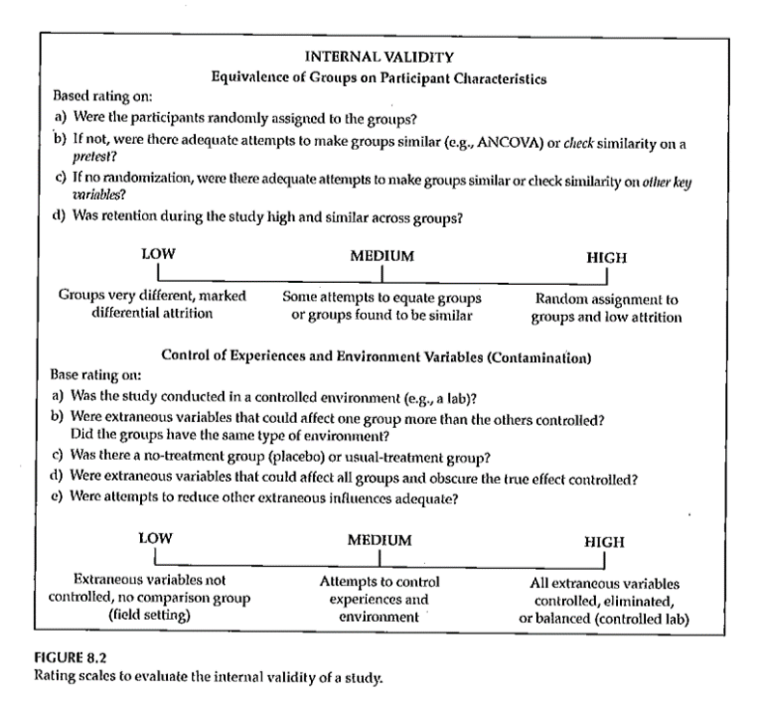
Internal Validity
Rating the dimensions of internal validity
Notes:
Figure 8.2.

Slide 18
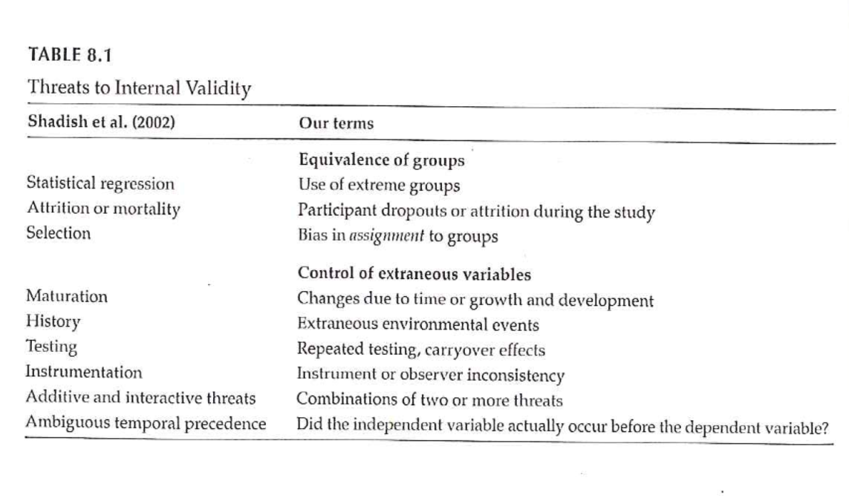
Threats to Internal Validity
Notes:
Table 8.1 relates statistical terminology to identify threats to internal validity. This table tries to take those technical terms and express them
Extreme groups have issues with regression to the mean. Even without any intervention, the extremities will tend to lessen.
Dropouts or attrition means that you’ve designed a setting that is so difficult that no one can stay in. Differential attrition is especially troublesome.
Bias in assignment occurs when patients or their physicians directly or indirectly influence the assignment. Random assignment eliminates this bias.
Cook and Campbell.

Slide 19
Threats to Internal Validity
Equivalence of Groups
Use of extreme groups
Participant dropouts or attrition during the study
Bias in assignment to groups

Slide 20
Threats to Internal Validity
Control of extraneous/environmental variables
Changes due to time or growth and development
Extraneous environmental events
Repeated testing, carryover effects
Instrument or observer inconsistency
Combinations of two or more threats
Did the IV actually occur before the DV?
Notes:
Here are some of the sources of extraneous variables.
Maturation.
History. Something that occurs between the pre and post measurements that is independent of the intervention but which can influence the outcome.
Worry about sensitization to the issue in the baseline measurement that causes people to go out and find more.
Long studies have problems with instrumentation or observers (e.g., because of turnover).
There are also combinations of these events where one magnifies the other.
Temporal order of the variables. If you can’t assure that the independent variable occurs before the dependent variable, you can’t establish causation.

Slide 21
Threats to Internal Validity
Other threats
Effects of being in the control group
Expectation effect
Control for expectation
Observer / experimenter bias
Notes:
Control group contamination. Demoralization.
Hawthorne effect.
Blinding helps control for expectation effects and observer bias.

Slide 22
Validity
Notes:
Here is figure 8.1 again. The next part of this lecture talks about sampling and external validity.

Slide 23
Validity
Notes:
Here is figure 8.1 again. The extent to which results will generalize.

Slide 24
Sampling
“… process of selecting part of a larger group of participants with the intent of generalizing from the sample (the smaller group) to the population (the larger group).”
“… representativeness of the sample is more important than its size …”
Notes:
Critically important in sampling is for the sample to be representative. That’s even more important than the actual size of the sample.
College students are not representative of young adults.

Slide 25
Sampling
Reasons for sampling
Expense
Time
Quality control
Notes:
A small sample allows you to spend more time on quality control.

Slide 26
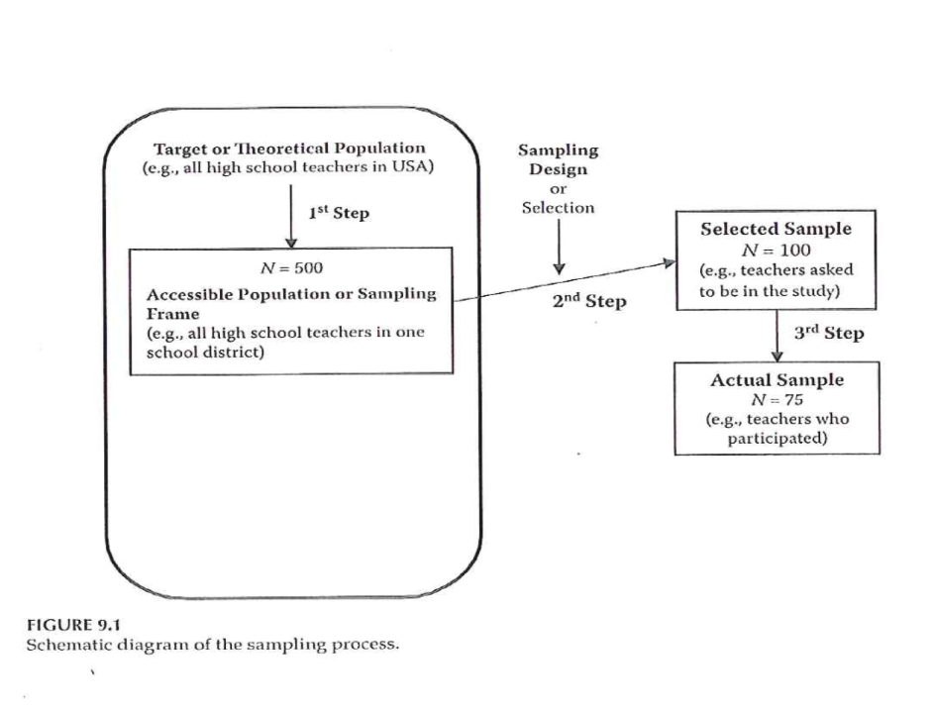
Sampling
Notes:
Figure 9.1.
Target or theoretical population. From this, develop a sampling frame. Next select a sample. What you end up with are those who are selected, who agree to participate and who provide sufficient information to allow evaluation.
Response rate. A good value is context specific.
How much attrition occured and very importantly whether attrition differs between the two groups.

Slide 27
Sampling
Sampling designs – Probability sampling
Simple random sampling
Systematic random sampling
Stratified random sampling
Cluster (random) sampling

Slide 28
Sampling
Sampling designs – Nonprobability sampling
Quota sampling
Purposive sampling
Purposeful sampling
Convenience sampling

Slide 29
Sampling
Sample size
General rules
Representativeness vs number
Impact of having very large sample sizes
Generally –
Need sample to be large enough so you don’t miss important findings
If very large sample, need to distinguish statistical significance vs clinically important

Slide 30
External Validity
Generalizability
Fig. 9.3
Evaluating Research Validity Framework
Two main aspects
Population external validity
Ecological external validity

Slide 31
External Validity
Population external validity
How participants were selected for the study?
Is sample representative of the target population?
Validity framework

Slide 32
External Validity
Ecological external validity
Whether the results can be generalized to real-life outcomes
Trade-off with control of study
Validity framework

Slide 33
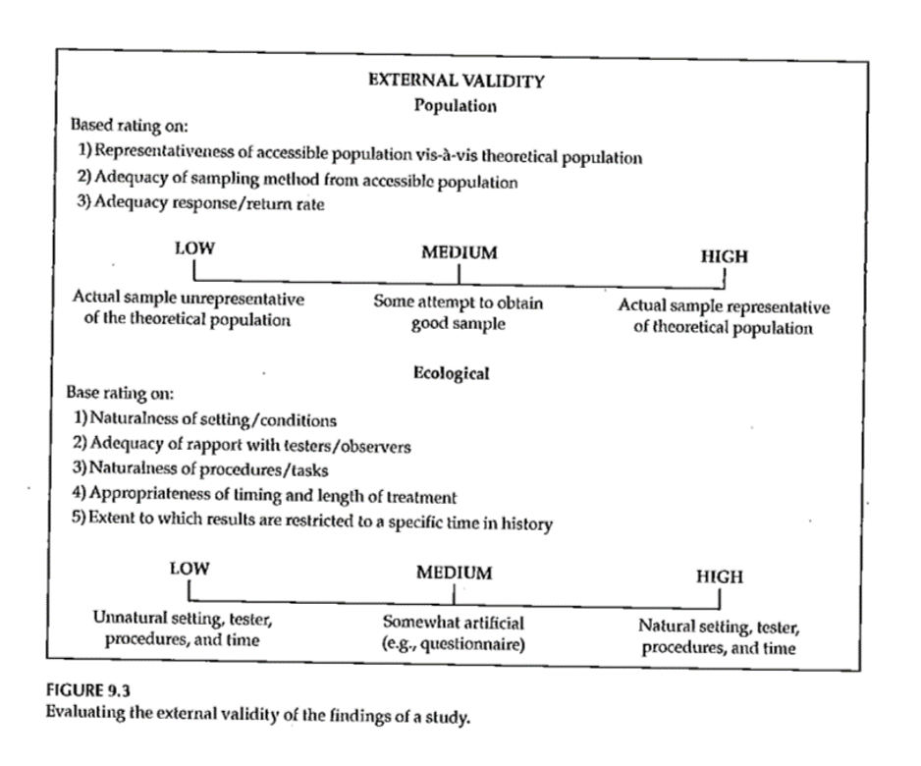
External Validity

Slide 34
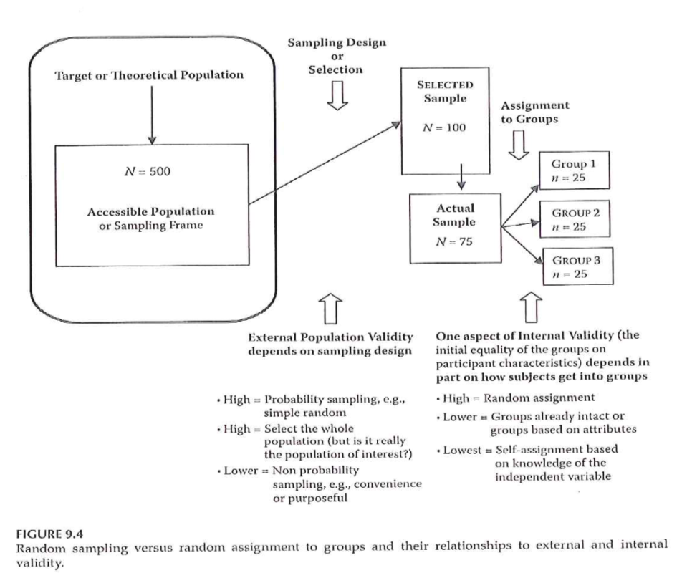
Sampling and Validity

Slide 35
Sampling
Portney & Watkins (2009)

Slide 36
Assignment #5
Prepare a first draft of the literature review that supports your research topic and provides evidence of the significance of the topic. Submit this assignment using “ Turnitin ” through Blackboard.

Slide 37
Assignment
Prepare a first draft of the literature review that supports your research topic and provides evidence of the significance of the topic. This assignment will be the starting point for the Review of the Literature section of your research proposal. This assignment will be submitted using “Turnitin” through Canvas.
Prepare for next weekâ€™s session

Slide 38
Discussion questions
What can be done to address different threats to internal validity?
How would you evaluate the external validity of your research project?
How will you define the appropriate sample for your research project?

Slide 39
Additional slides

