Slide 1
Video 8 - Measurement and descriptive statistics
Steve Simon

Slide 2
Learning objectives
To describe different manners in which data are measured
To discuss advantages and disadvantages of different measurement scales
To describe how data can be summarized

Slide 3
Required reading
Chapter 10

Slide 4
Optional reading
L.G. Portney & M.P. Watkins. Chapter 4 â€œPrinciples of measurement.â€ Foundations of Clinical Research: Applications to Practice, 3rd ed. Upper Saddle River, New Jersey: Pearson Prentice Hall.
Cummings, S.R. & Hulley, S.B. (2007). Chapter 15 â€œDesigning questionnaires and interviews.â€ In S.B. Hulley, S.R. Cummings, W.S. Browner, D. Grady, & T.B. Newman (eds), Designing Clinical Research, 3rd edition. Philadelphia: Lippincott Williams & Wilkins.

Slide 5
Measurement
What do we mean “ measurement ” ?
assignment of numbers or symbols to the different levels or values of variables according to rules. ”

Slide 6
Measurement
Assigning a number to represent …
Continuous value
Discrete value
Precision of measurement
Continuous variable …
Discrete variable …

Slide 7
Measurement
What is the measurement representing?
Actual measurement …
Length, time, …
Indirect measurement
Constructs
Whatever you are trying to measure ..
Must be able to define it!

Slide 8
Measurement
Traditional levels (scales) of measurement
Nominal
Ordinal
Interval
Ratio

Slide 9
Measurement
Authors categorization of levels of measurement
Nominal
Dichotomous
Ordinal
Normally distributed
Table 10.1

Slide 10
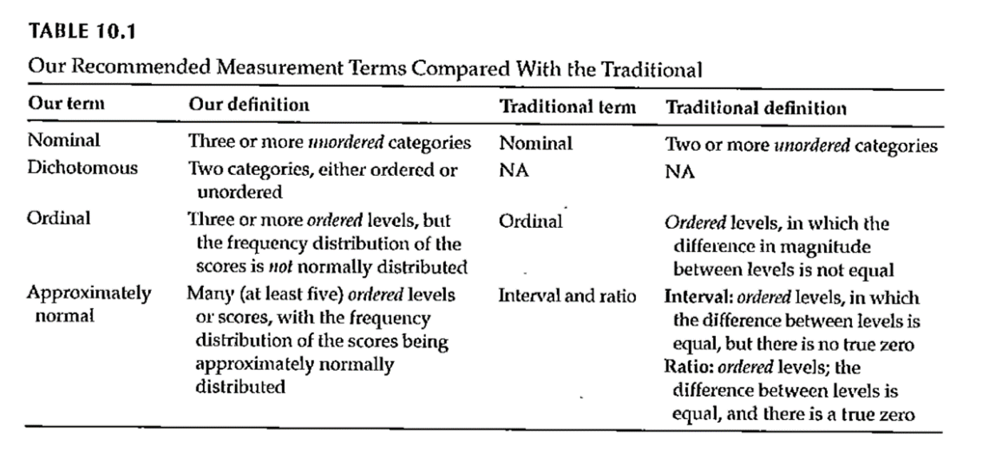
Measurement

Slide 11
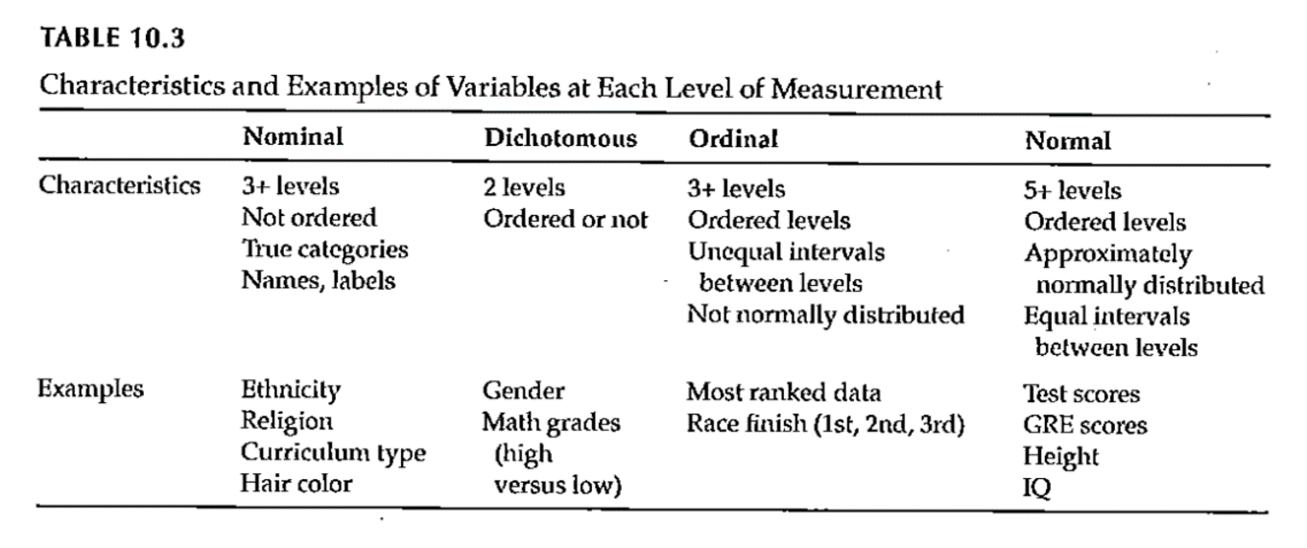
Measurement

Slide 12
Measurement
Why does the scale of measurement matter?
How it reflects your design and your research question
How it determines the types of statistical analyses you will do
How it defines what you can say about your results

Slide 13
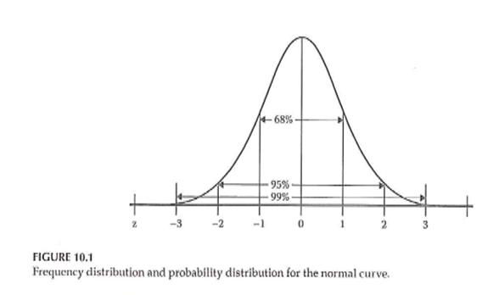
Descriptive Statistics

Slide 14
Descriptive Statistics
Descriptive graphs
How to look at your data
Options for viewing your data
Frequency polygons
Histograms
Bar charts

Slide 15
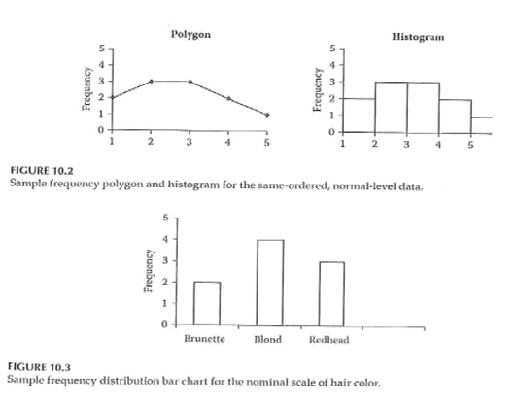
Descriptive Statistics

Slide 16
Descriptive Statistics
Measures of central tendency
Mean
Median
Mode

Slide 17
Descriptive Statistics
Measures of variability
Range
Standard deviation
Interquartile range
How many categories

Slide 18
Descriptive Statistics
Measures of association between 2 variables
Correlation
Pearson
Spearman
Cross-tabulation
Scatterplot

Slide 19
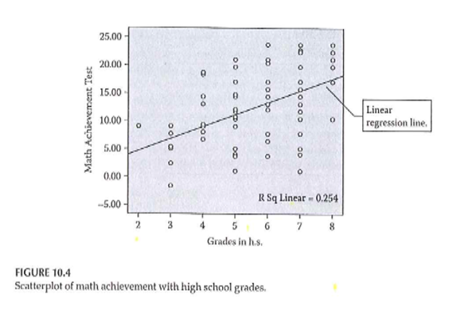
Descriptive Statistics

Slide 20
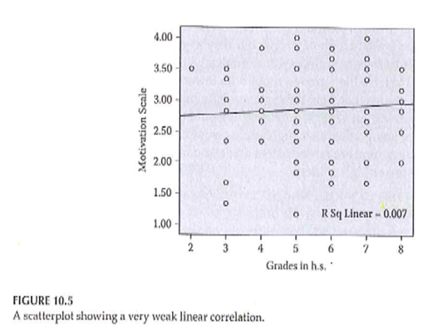
Descriptive Statistics

Slide 21
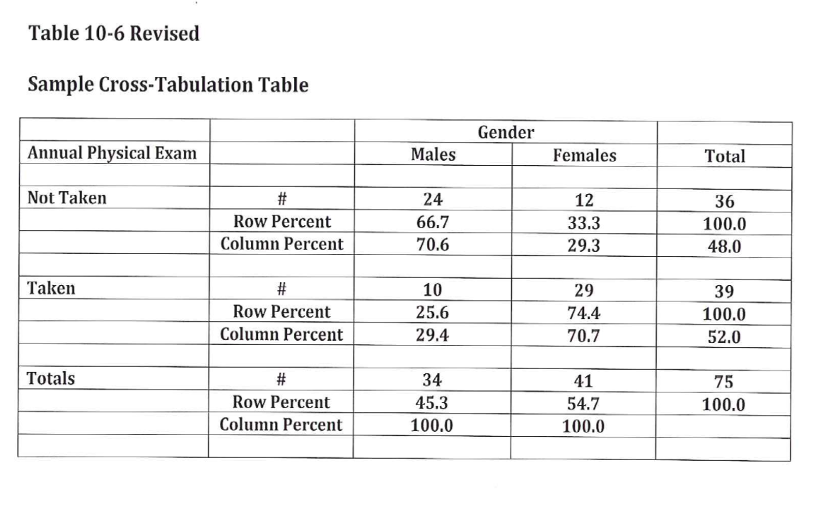
Descriptive Statistics

Slide 22
Descriptive Statistics
Properties of the normal curve
Unimodal
Mean, median, and mode are equal
Symmetric curve (skew)
Range is infinite
Shape – not too peaked or flat (kurtosis)

Slide 23

Descriptive Statistics

Slide 24
Descriptive Statistics
Standard normal curve
Definition
How to compute
Effect size

Slide 25
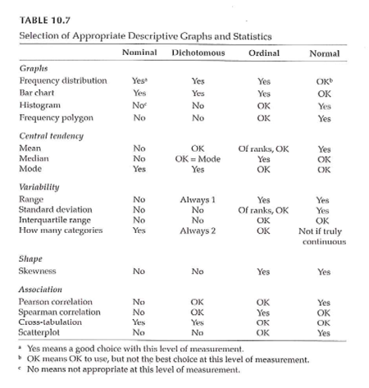
Measurement & Descriptive Statistics

Slide 26
Assignment #6
Prepare a brief paragraph that describes the research design you are using for your research proposal. This is the information that will probably appear in the Methods section of your proposal.

Slide 27
Assignment
Prepare a brief paragraph that describes the research design you are using for your research proposal. This assignment will be used to describe the study design in the Methods section of your research proposal.
Prepare for next weekâ€™s session

Slide 28
Discussion questions
What kind of measurements will you use to collect data?
If you would need to use a survey or questionnaire to do your own research study, what topics would you need to cover? Are there existing measures that could be used?

Slide 29
Additional slides

