Slide 1
Video 12 - Data analysis
Steve Simon

Slide 2
Learning objectives
To discuss the goal of data analysis and interpretation in research projects
To discuss statistical power and how to determine it
To describe what is needed in order to determine sample size for a research project
Notes:
Here are the objectives for this week.

Slide 3
Required reading
Chapters 16, 17
Cohen. â€œA power primerâ€
Notes:
This is what you should have read already. If you haven’t done the reading yet, pause this video and read this material. You’ll get more out of the video if you do so.

Slide 4
Making Inferences - NHST
Populations versus Samples
Use inferential statistics
Sample statistics (M, SD) <U+F0E8>
Population parameters (mu, sigma)
Null Hypothesis Significance Testing (NHST)
Null hypothesis (H 0 )
Alternative hypothesis (H 1 )
AKA research hypothesis
Directional
Non-directional
Notes:
We are talking about data analysis and interpretation. Planning. Some of this will be familiar to you. This is not a full statistical coverage of the topic.
Take the data from the sample and make inferences about the population. The sample is a subset. Inferential statistics is the process by which you infer information about the population.
NHST is the traditional way that a huge amount of research relies on.
Null hypothesis is no difference or no relationship. The alternative is often called the research hypothesis.

Slide 5
Making Inferences - NHST
NHST – Goal of research –
Reject the H 0 in favor of H 1
“Reject” the null hypothesis
Practically – “reject” means difference / relationship greater than just random variability
Alternative hypothesis –
3 versions
Non-directional
Directional positive
Directional negative
Notes:
Does the data allow us to reject the null hypothesis. Rejecting means the difference or relationship is greater than what you’d expect due to sampling error.
[[Directional only for two group comparisons or bivariate relationships]]
never talk about proving the null hypothesis. A large p-value does not mean that you proved the null hypothesis. There might be sources of error that lead to failure to reject the null hypothesis.

Slide 6
Making Inferences - NHST
Directional vs Non-directional H 1
Comparing treatment to control
Comparing different treatments
Choosing directional vs non-directional
Basis for choice
Consequences
Statistical analysis
Interpretation
Notes:
Directional is more likely when comparing a treatment to a control [[placebo]]. When comparing two different treatments, you would have to use a non-directional hypothesis.
Is there existing evidence to support a directional hypothesis.
If you use a directional hypothesis, and you get an extreme result in the opposite direction, you can’t claim statistical significance.
Some people think that directional hypotheses are “cheating”.

Slide 7
Making Inferences - NHST
Sampling review
Target / theoretical population
Accessible population
Sample
Inference from the study sample to the population
Notes:
So how well does your sample reflect the population?

Slide 8
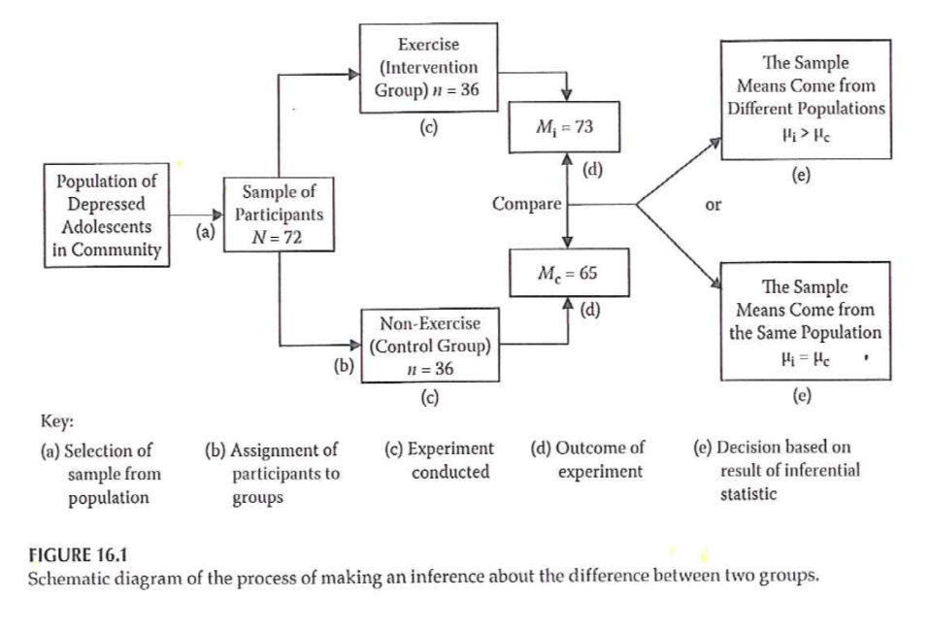
Making Inferences - NHST
Notes:
Example
Figure 16.1 from your book.
Flow chart of selecting from a population, randomizing to two groups, and then comparing the results in each group, and choosing between two hypotheses.

Slide 9
Making Inferences - NHST
Accessible population -> Sample
Random assignment to groups
Conduct study and collect data
Conduct statistical analysis
Intervention group: mean = 73
Control group: mean = 65
Notes:
[[This is a re-iteration of Figure 16.1]]
From your basic Statistics class, you may recognize that this setting would require a two-sample t-test.
[[Knowing which statistic to use in what setting is one of the most difficult tasks that you will encounter.]]

Slide 10
Making Inferences - NHST
Significant difference or not?
Inferential statistics – allow you to determine this
Reject the null ->
The observed difference is highly unlikely if the null hypothesis is actually true
Fail to reject the null ->
We can not say that the observed difference is highly unlikely
Do NOT “accept” the null hypothesis
Notes:
[[If a particular sample result is unlikely under the null hypothesis, this causes you to question the null hypothesis.]]
Reasons why you failed to reject the null hypothesis. A poorly implemented intervention, failure to use valid and reliabile measures, quality problems during the study.
Why never say that we accept the null.

Slide 11
Making Inferences - NHST
( Portney & Watkins, 2009)
Notes:
This is a table of possible outcomes H0 true, H0 false versus reject H0, accept H0.
Define power as the probability of rejecting the null hypotheis when the alternative hypothesis is true. [[Since the ]]

Slide 12
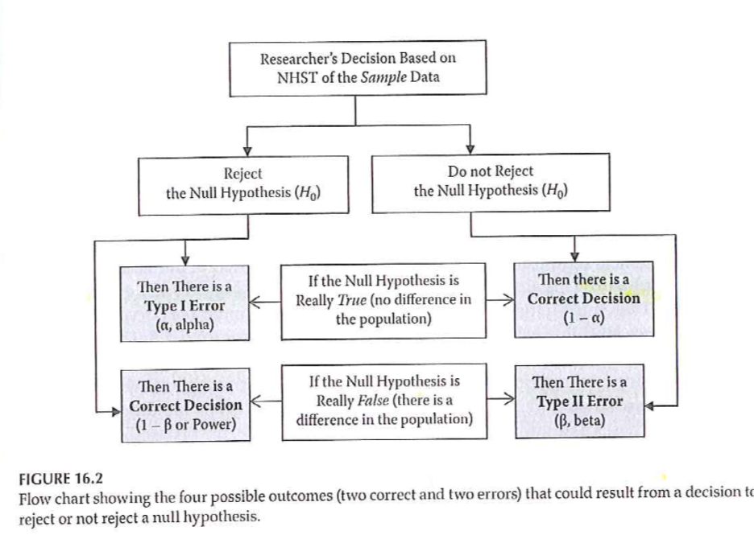
Making Inferences - NHST
Notes:
Statistical testing – possible outcomes
Figure 16.2 provides a different way of displaying Type I and Type II errors in a two by two table.

Slide 13
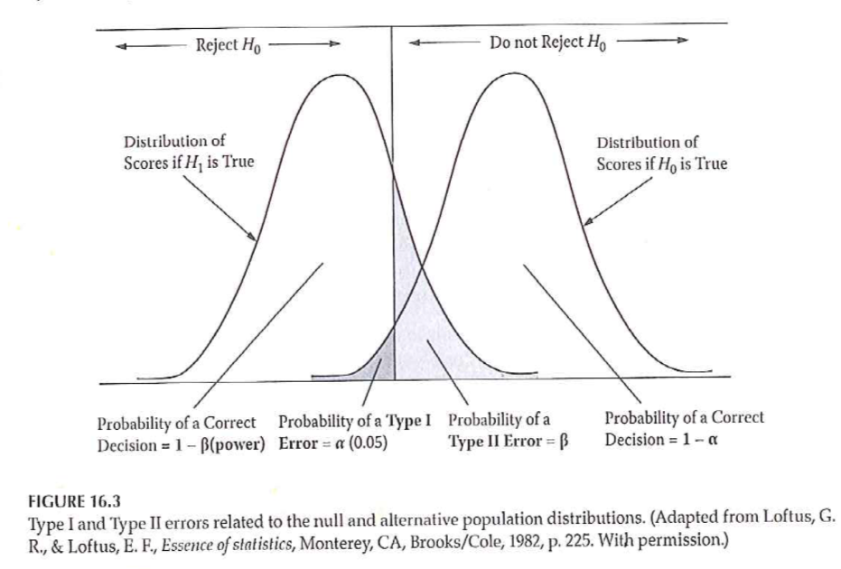
Making Inferences - NHST
Notes:
Statistical testing – possible outcomes
Two normal distributions and bell shaped curves.
Figure 16.3 from your book. Directional negative hypothesis. Example an intervention that results in a reduction in symptoms/pain.

Slide 14
Making Inferences - NHST
Statistical testing
Fig 16.3 – Directional negative
Example – hypothesize that intervention will result in reduction of symptoms
If you made a directional positive alternative hypothesis …. ?
Notes:
[[This is a rehash of Figure 16.3.]]

Slide 15
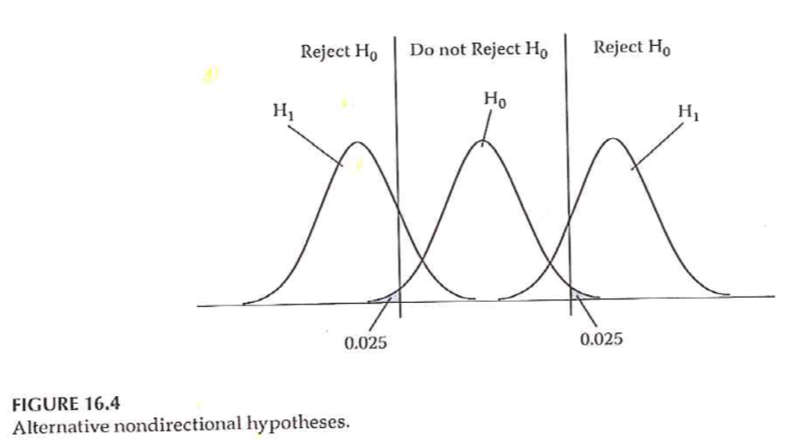
Making Inferences - NHST
Notes:
Statistical testing
Fig 16.4 – Non-directional

Slide 16
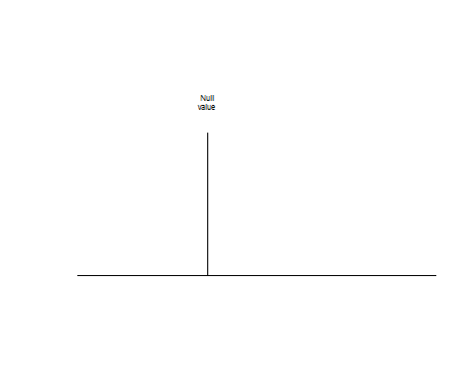
Null value

Slide 17
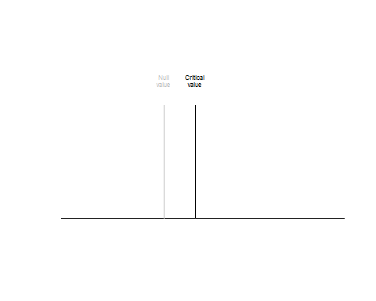
Critical value

Slide 18
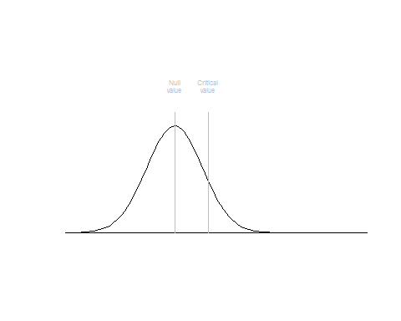
Alpha level

Slide 19
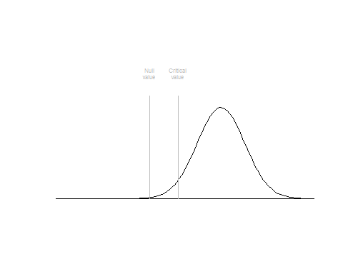

Slide 20
Power Analysis
Probability of rejecting a false H 0
This is a GOOD thing!
Want to maximize this (within reasonable limits!)
What is power analysis
“… the probability that his investigation would lead to statistically significant results.”

Slide 21
Power Analysis
( Portney & Watkins, 2009)

Slide 22
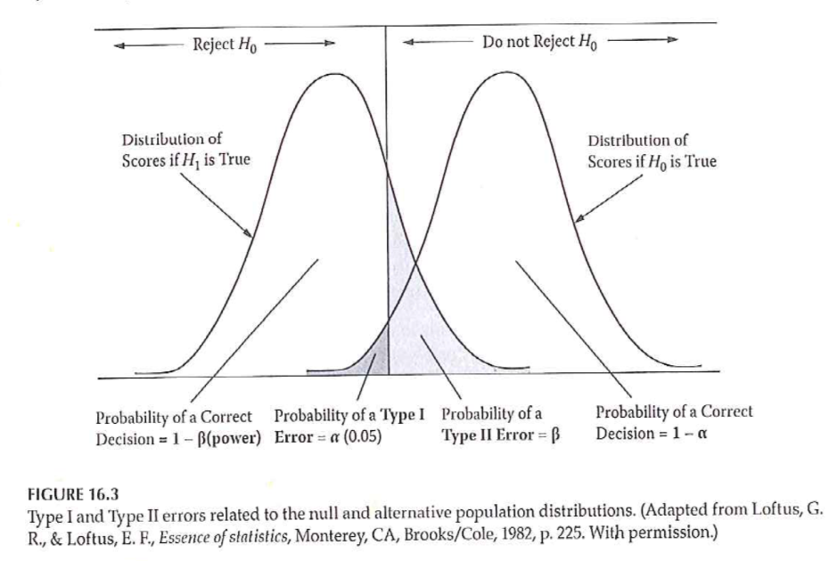
Power Analysis
Notes:
Power of a study – probability of rejecting a false null hypothesis

Slide 23
Power Analysis
Statistical power analysis concepts (Cohen)
Significance criterion – alpha
Power – desired level
Sample size
Effect size
Power analysis method depends on research design

Slide 24
Power Analysis
Performing a power analysis when planning a study
What is the study design?
What do you already know about the measure you are interested in?
What significance level to you want to use for hypothesis testing?
What level of power do you want to achieve?

Slide 25
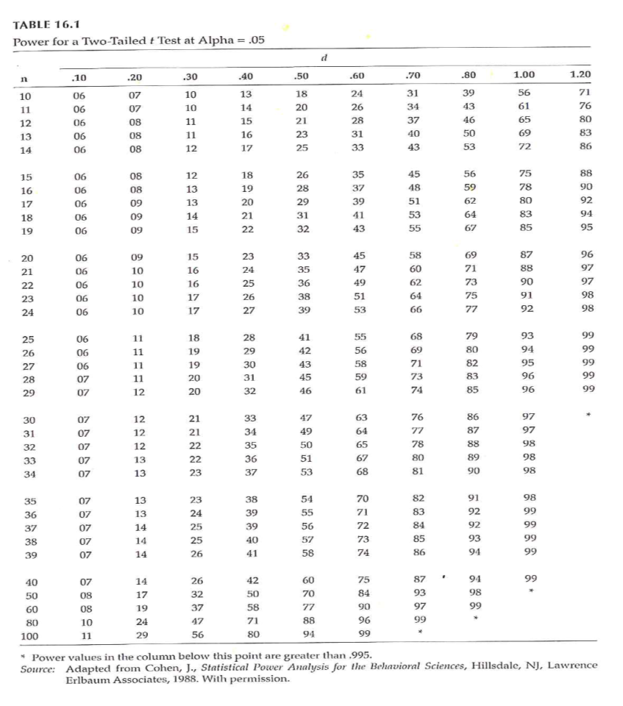
Power Analysis
Notes:
Determining power (Fig 16.1)

Slide 26
Power Analysis
Increasing power –
Alpha level
Formulation of hypothesis
Decrease variability / increase precision
Groups
Outcome measure(s)
Increase sample size

Slide 27
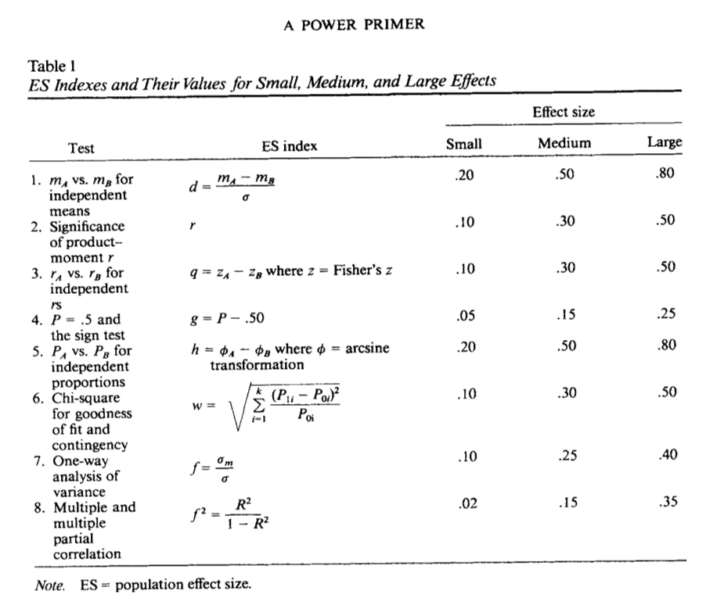
Power Analysis

Slide 28
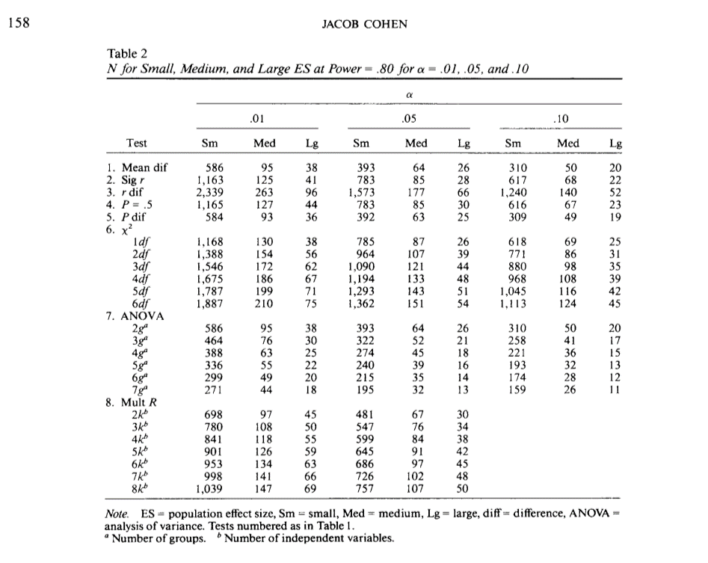
Power Analysis

Slide 29
Problems with NHST
Knowledge based on outcome of single study
Interpretation of statistical significance
Complications
H 0 is rarely true – in a strict sense
Too large of a sample size – hard NOT to get statistical significance
Significance testing as a dichotomous decision
Interpretation of changes in the p value
Statistical significant versus clinical/ substative meaningfulness

Slide 30
Improving NHST
Propose specific alternative hypotheses
Use a random sample if possible
Use an outcome variable that has good reliability and validity
Have a good idea of the level of difference that will be clinically important

Slide 31
Making Inferences - EBA
EBA – Evidence-Based Approach
Reliability of findings
Accumulation of evidence
Premise – “… a single study is not sufficient to use as evidence to substantiate a hypothesis or theory.”
Methods
Confidence intervals
Effect sizes
Meta-analysis

Slide 32
Making Inferences - EBA
Confidence Intervals (CI)
Range of scores that should contain the true population score
CI <U+F0E8> An interval around the point estimate
CI <U+F0E8> “… range of the dependent variable scores that should contain the true population difference between means .”
CI computed using sample mean and standard deviation

Slide 33
Making Inferences - EBA
Interpretation of CI –
95% CI most common
95% CI – with infinite studies and computed CI, the true population difference would be found within 95% of the intervals
NOT – .95 probability that true population difference is within the CI computed from our single study
Option – 95% CI for a given study “… estimates the population mean difference with 95% confidence.”

Slide 34
Making Inferences - EBA
Why compute and report CI?
Part of philosophy to encourage replication
Size of interval – “… how much of the estimate might be due to sampling error.”

Slide 35
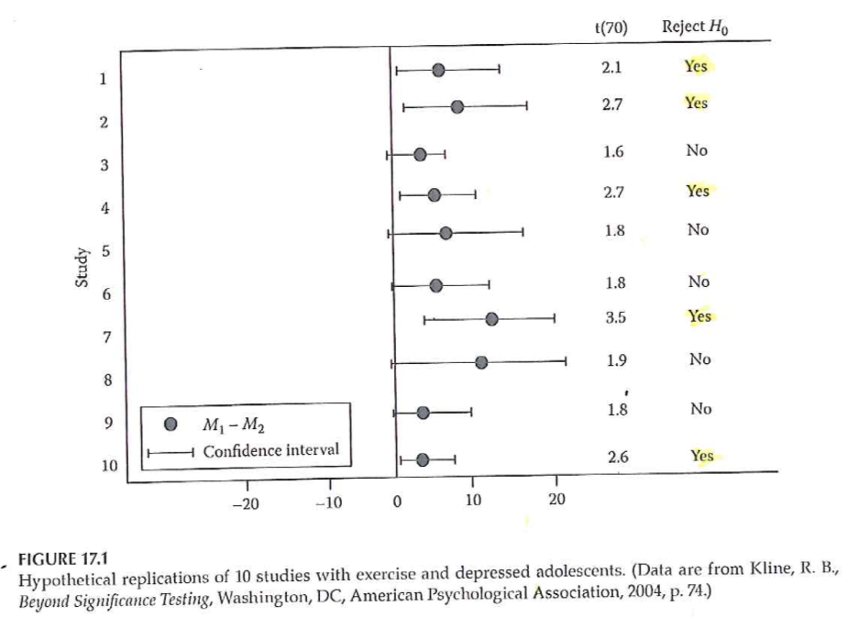
Making Inferences - EBA
Notes:
Interpreting 95% CI (Fig 17.1)

Slide 36
Making Inferences – EBA
Effect size –
Strength of relationship between IV & DV
Magnitude of the difference between levels of the IV with respect to the DV
3 types of effect size measures
r family
d family
Measures of risk potency

Slide 37
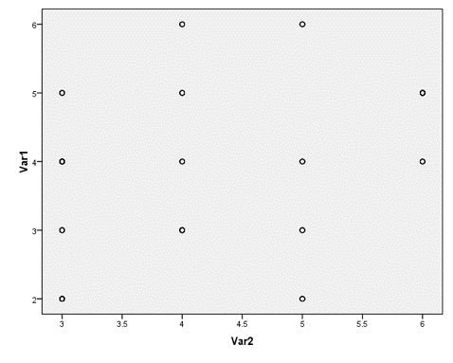
Making Inferences – EBA
Notes:
Why is effect size at least as important as significance level?
Influence of sample size on results

Slide 38
Making Inferences – EBA
Effect sizes –
Unstandardized – in the units of the raw DV
Standardized –
Standardized using pooled standard deviation of the groups
Measure that can be used to compare to other studies with different DVs

Slide 39
Making Inferences – EBA
Types of effect sizes –
R family – strength of association
D family – magnitude of differences
Measures of risk potency – when both IV and DV are dichotomous
Odds ratio
Relative risk
Risk difference

Slide 40
Making Inferences – EBA
R family of effect sizes – association
r 2 vs r
Cohen’s guidelines
Weak approx +/- .1
Medium approx +/- .3
Strong approx +/- .5
Authors labeling
Less than typical
Typical
Greater than typical
Also rho, phi, eta, R

Slide 41
Making Inferences – EBA
D family of effect sizes – differences
d <U+F0E8> Two group comparison
Treatment group mean – Comparison group mean
Divided by pooled standard deviations from both samples
eta 2 <U+F0E8> Multiple group comparison
Statistics packages will compute
Interpret like r 2 (amount of variance in DV accounted for by IV)

Slide 42
Making Inferences – EBA
Risk family of effect sizes – When both IV and DV are dichotomous
Phi – measure of association / correlation
Clinical / medical research – the risk of clinical outcomes
Relative risk – ratio that compares the risk of an outcome between groups
Risk difference – percentage difference that compares risk of an outcome between groups
Odds ratio – Odds of outcome in control group compared to odds in treatment group

Slide 43
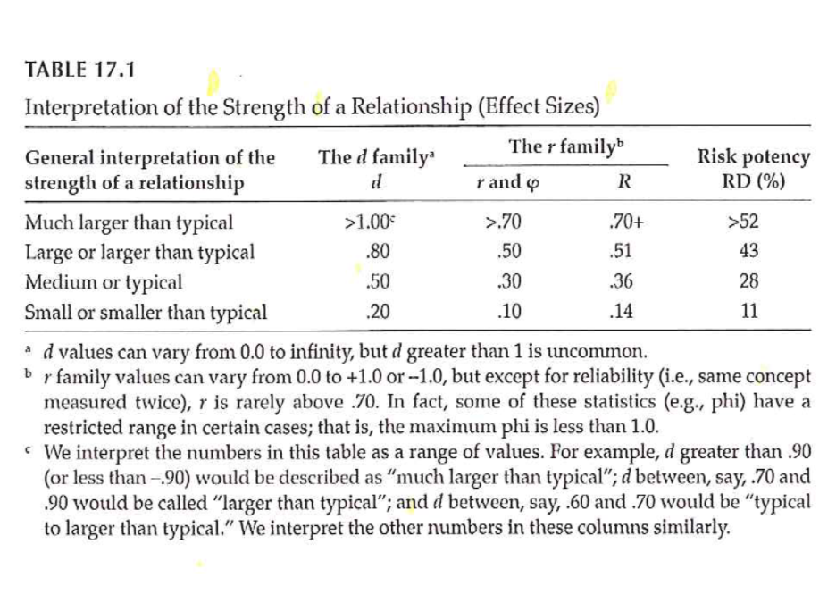
Making Inferences – EBA
Notes:
Interpretation of effect sizes –

Slide 44
Making Inferences – EBA
Value of effect sizes –
Indicates the strength of a relationship or a difference
Allows you
Combine results from studies with dissimilar outcome measures
Use findings of previous study to plan study with different outcome measure
Online source to perform power analysis –
Sample Power (part of SPSS)
Russell Lenth – U of Iowa

Slide 45
Making Inferences – EBA
Meta-Analysis
Research synthesis of multiple studies
Uses effect size value from each study
Advantage over systematic review – compute a summary statistic that represents overall estimate
Provides evidence of reliability of research finding
Include findings from studies that failed to find statistical significance
Increased external validity

Slide 46
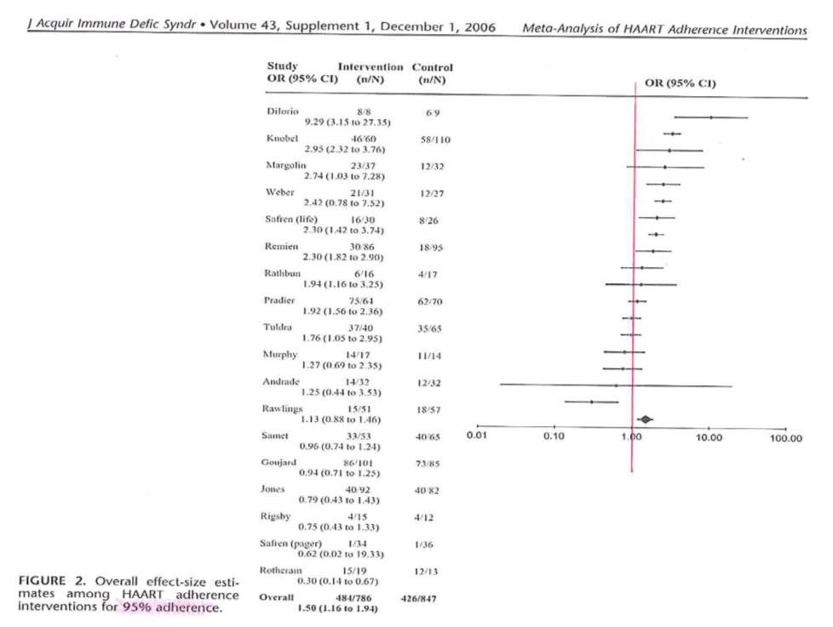
Making Inferences – EBA
Notes:
Simoni et al., 2006

Slide 47
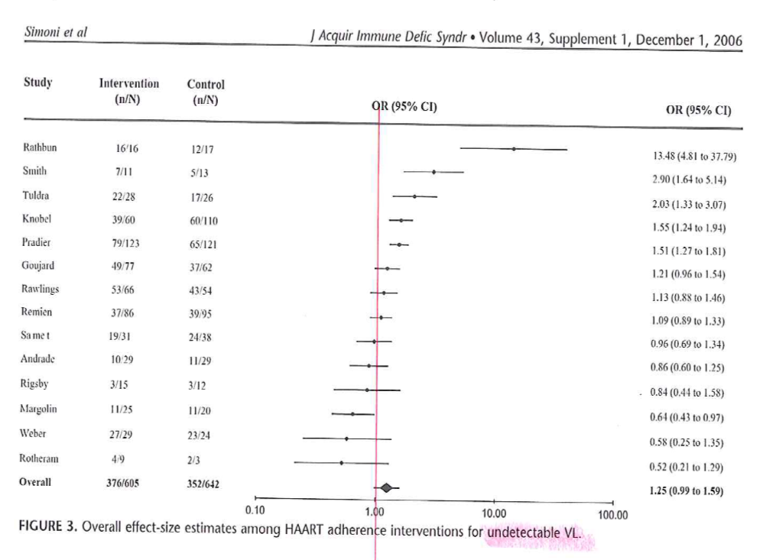
Making Inferences – EBA
Notes:
Simoni et al., 2006

Slide 48
Assignment #9
Complete an “outline” of your written proposal. Refer to the “Research Proposal Structure Overview/Structure” document in the Course Content folder on Blackboard. This “outline” should reflect a substantial amount of detail including sub-headings in the literature review section and methods section. Sections that reflect earlier assignments should contain near-complete drafts of the information that is relevant to your proposed project.
Available resource –
Research Proposal Structure Information document
Week by Week / General Information

Slide 49
Assignment
Prepare an “outline” for your written research proposal that is the final project. The outline should include the various sections that should be in the Methods section of the proposal. Given the work done on the previous assignments, this outline should include a substantial amount of detail.
Prepare for next weekâ€™s session

Slide 50
Discussion questions
What is meant by the â€œnull hypothesisâ€ versus a â€œresearch hypothesisâ€; which is being tested by the statistical analysis of the data; and can you â€œproveâ€ a null hypothesis?
Will you include research questions or research hypotheses in your research proposal?
Do you have information available that is needed to determine sample size for your planned research project?
What outcome variables will be the focus of your research questions/hypotheses?

Slide 51
Additional slides

