Slide 1
Introduction to R, module04
Steve Simon

Slide 2
Introduction
This Powerpoint presentation was created using an R Markdown file. It is always a good idea to print the version of R and the current date as the very first few lines of any R program.
R.version.string
## [1] "R version 4.0.0 (2020-04-24)"
Sys.Date()
## [1] "2021-03-07"
Notes:
The version of R is stored in an internal constant, R.version.string. You can find the current data with the Sys.Date() function.

Slide 3
The Titanic dataset
Titanic dataset
http://www.statsci.org/data/general/titanic.txt
Titanic data dictionary
http://www.statsci.org/data/general/titanic.html
Notes:
You should find the data file on mortality among passengers of the Titanic at the website listed here. There is a pretty good data dictionary as well.

Slide 4
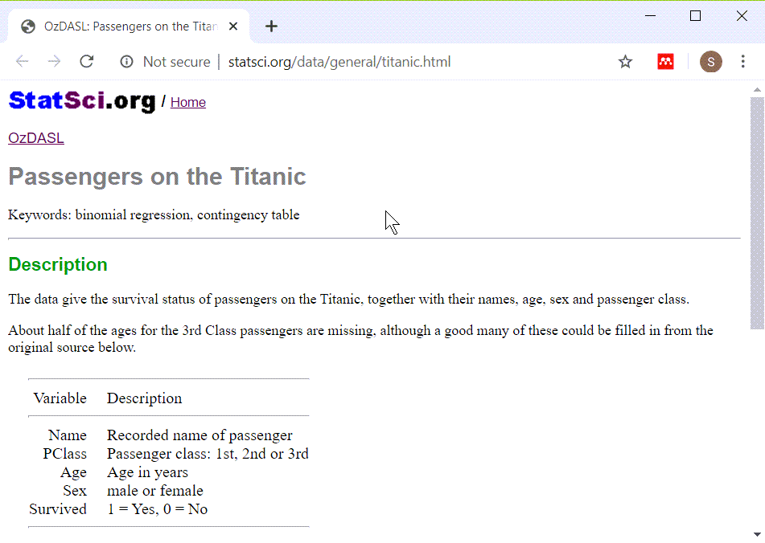
Titanic data dictionary
Screenshot from Titanic data dictionary
Notes:
There are five variables in this data set, the name of the passenger, the passenger class, the passenger age, sex, and whether they survived.

Slide 5
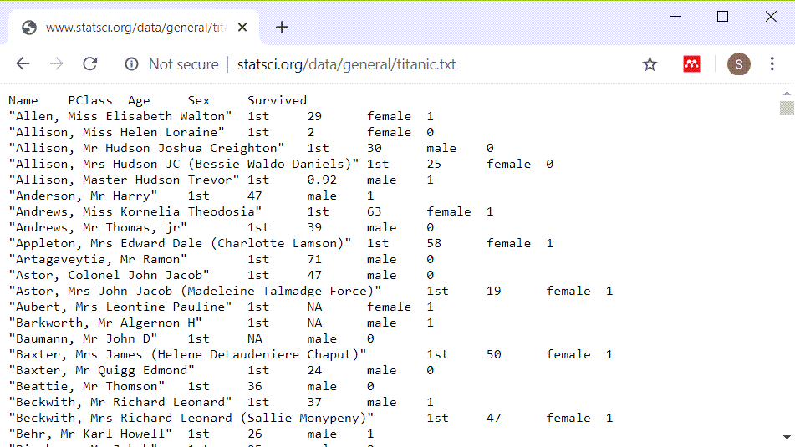
What the file looks like
Image of original dataset
Notes:
There are several hints that you may notice as you look at this file. Pssengers with longer name seem to be misaligned. Everything is left justified. It looks like when things do line up it is columns eight characters apart.
So let’s try reading it in as a tab delimited file.

Slide 6
Reading in the Titanic data set
fn <- "http://www.statsci.org/data/general/titanic.txt" ti <- read.table( file=fn, header=TRUE, stringsAsFactors=FALSE, sep="\t") head(ti, n=4)
## Name PClass Age Sex Survived ## 1 Allen, Miss Elisabeth Walton 1st 29 female 1 ## 2 Allison, Miss Helen Loraine 1st 2 female 0 ## 3 Allison, Mr Hudson Joshua Creighton 1st 30 male 0 ## 4 Allison, Mrs Hudson JC (Bessie Waldo Daniels) 1st 25 female 0
Notes:
It reads in fairly well, it seems. The first few lines of data are hard to read because the passenger names are so long.

Slide 7
Displaying without the names
head(ti[ , -1])
## PClass Age Sex Survived ## 1 1st 29.00 female 1 ## 2 1st 2.00 female 0 ## 3 1st 30.00 male 0 ## 4 1st 25.00 female 0 ## 5 1st 0.92 male 1 ## 6 1st 47.00 male 1
Notes:
Notice how much nicer things look when you take out the column of names.

Slide 8
Peek at the bottom also
tail(ti[ , -1])
## PClass Age Sex Survived ## 1308 3rd NA female 0 ## 1309 3rd 27 male 0 ## 1310 3rd 26 male 0 ## 1311 3rd 22 male 0 ## 1312 3rd 24 male 0 ## 1313 3rd 29 male 0
Notes:
It’s also a good idea to peek at the bottom of a data set right after you read it in. Sometimes a line in the middle gets out of sync and it throws the rest of the data off. If that happens then you will see weird things at the bottom of the data.
Notice that Miss Tamini Zabour has an “NA” for age. We’ll take a careful look at this.

Slide 9
Descriptive statistics on age
summary(ti$Age)
## Min. 1st Qu. Median Mean 3rd Qu. Max. NA's ## 0.17 21.00 28.00 30.40 39.00 71.00 557
Notes:
You learned how to get descriptive statistics for continuous variables in a previous module. The youngest passenger is 0.17 years old and the oldest is 71 years old. Let’s peek at their data values.

Slide 10
Print out information on youngest and oldest
ti[which.min(ti$Age), ]
## Name PClass Age Sex Survived ## 764 Dean, Miss Elizabeth Gladys (Millvena) 3rd 0.17 female 1
ti[which.max(ti$Age), ]
## Name PClass Age Sex Survived ## 10 Artagaveytia, Mr Ramon 1st 71 male 0
Notes:
The which.min and which.max functions simplify the task of finding the row or rows where a data value reaches its minimum or maximum.
Notice that the little baby survived, but not the old man.

Slide 11
First break
What have you learned
Reading in the Titanic dataset
What’s next
Categorical versus continuous variables
Counts, proportions, and percentage
Factors
Crosstabulations
Barplots
New categorical variables

Slide 12
Categorical versus continuous variables
Categorical
Small number of possible values
Each value has a name or label
Continuous
Large number of possible values
Potentially any value in a range.
Notes:
A categorical variable is defined (loosely) as a variable that has a small number of possible values. Each value is usually associated with a particular category or label. In contrast, a continuous variable is defined as a variable that has a large number of possible values, potentially any value in a particular interval.
In a previous module, almost all of the variables that you used were continuous. Today, almost all of the variables that you will use will be categorical.
The distinction between continuous and categorical variables is important in deciding what types of descriptive and inferential statistics you should use. But, there is often gray and fuzzy line between categorical and continuous variables. Don’t worry too much about this today. If you’re not sure whether a variable is categorical or continuous, try some simple descriptive statistics and graphs appropriate for categorical data and then try some simple descriptive statistics and graphs for continuous data. You will usually figure out quickly whehther treating your variable as categorical or continuous makes the most sense.
There are other types of variables also, such as count variables, that have their own special features.

Slide 13
Freqency counts
PClass_counts <- table(ti$PClass) PClass_counts
## ## 1st 2nd 3rd ## 322 280 711
Notes:
For categorical variables, you should first get frequency counts. A mean and standard deviation are usually meaningless for categorical data.
Unlike most other statistical packages, R tends to have a minimalist approach to statistics. If you asked for frequency counts in SAS or SPSS, these systems would automatically add percentages. R doesn’t add percentages automatically.
This is something that you will either love or hate. You might think that SAS and SPSS are more thoughtful because almost every time you want a count, you’d also want the corresponding percentage. Or you might find it annoying to tell those programs to not clutter up your output with information you didn’t want.
Personally, I don’t like software deciding for me what I want. I’d rather ask for percentages explicitly when I need them rather than have them come as the default.
Now this is a rather trivial issue, but it does illustrate an important difference in philosophy. R makes you ask for the extras that you might need. SAS and SPSS force you to ask to NOT include things that they think are important.
So the table function produces only counts.

Slide 14
Proportions
PClass_proportions <- prop.table(PClass_counts) PClass_proportions
## ## 1st 2nd 3rd ## 0.2452399 0.2132521 0.5415080
Notes:
If you want percentages in addition to counts, there are several approaches.
The prop.table function takes a frequency table and converts it to a proportion.

Slide 15
Percentages
PClass_percents <- round(100*PClass_proportions) PClass_percents
## ## 1st 2nd 3rd ## 25 21 54
Notes:
Multiply by 100 and round to get percentages.

Slide 16
Percentages
pct.sign <- "%" PClass_nice_percents <- paste(PClass_percents, pct.sign) PClass_nice_percents
## [1] "25 %" "21 %" "54 %"
Notes:
You can get even fancier. The paste function concatenates several string variables and if something is not a string, R will convert it to a string before concatenating.

Slide 17
Percentages
PClass_nicer_percents <- paste(PClass_percents, pct.sign, sep="") PClass_nicer_percents
## [1] "25%" "21%" "54%"
Notes:
The “sep” parameter tells R what to put between the two values you are pasting together. By default it is a single blank character, but we don’t want a blank between the number and the percent sign.

Slide 18
Percentages
colon <- ": " PClass_nicest_percents <- paste( names(PClass_percents), colon, PClass_percents, pct.sign, sep="") PClass_nicest_percents
## [1] "1st: 25%" "2nd: 21%" "3rd: 54%"
Notes:
Somehow, the names of the passenger class got lost. So let’s add them back in. A colon and a space between the names and the numbers helps as well.

Slide 19
Fractions and percentages
n <- sum(PClass_counts) slash <- "/" comma <- ", " percents_and_fractions <- paste( PClass_nicest_percents, comma, PClass_counts, slash, n, sep="") percents_and_fractions
## [1] "1st: 25%, 322/1313" "2nd: 21%, 280/1313" "3rd: 54%, 711/1313"
Notes:
Finally, you can combine the counts and the total with the percents to make things look really nice.
This shows how I like to program in R. First, get something simple. Then slowly add layers to it until you get a nice polished product.
In contrast, most other statistical packages try to produce polished results right from the start. This has some advantages, but the approach used by R, where many of the functions do something simple and basic, allows you to polish the results the way you want them.

Slide 20
Tables that include counts of missing values.
table(ti$PClass, useNA="always")
## ## 1st 2nd 3rd <NA> ## 322 280 711 0
Notes:
The default option in the table function is to not list missing values. During the intitial data screening, you should always look for missing values. This is done with the useNA parameter.

Slide 21
Total count
addmargins(table(ti$PClass, useNA="always"))
## ## 1st 2nd 3rd <NA> Sum ## 322 280 711 0 1313
Notes:
You can add a total count to the frequency table with the addmargins function.

Slide 22
Second break
What have you learned
Reading in the Titanic dataset
Categorical versus continuous variables
Counts, proportions, and percentage
What’s next
Factors
Crosstabulations
Barplots
New categorical variables

Slide 23
Factors
ti$surv_factor <- factor(ti$Survived, levels=0:1, labels=c("No","Yes")) table(ti$surv_factor)
## ## No Yes ## 863 450
Notes:
The factor function is similar to the variable label in SPSS and the format statement in SAS. It assigns category names (No and Yes) to numeric codes (0 and 1). It also has other features that are helpful in linear and logistic regression models, such as the ability to specify contrasts.

Slide 24
Crosstabulation
pclass_by_gender <- table(ti$PClass, ti$Sex) pclass_by_gender
## ## female male ## 1st 143 179 ## 2nd 107 173 ## 3rd 212 499
Notes:
A crosstabulation shows counts across the combination of two different categorical variables. This table shows that there are 143 female first class passengers, 179 male first class passengers, 107 female second class passengers, etc.

Slide 25
Row proportions
row_proportions <- prop.table(pclass_by_gender, margin=1) row_proportions
## ## female male ## 1st 0.4440994 0.5559006 ## 2nd 0.3821429 0.6178571 ## 3rd 0.2981716 0.7018284
Notes:
The prop.table function converts counts into proportions. Here is an example of row proportions.

Slide 26
Row percentages
row_pcts <- round(100*row_proportions) row_pcts
## ## female male ## 1st 44 56 ## 2nd 38 62 ## 3rd 30 70
Notes:
It is a lot easier to read if you convert the proportions into percentages and then round. In first class, 44% of the passengers are female. In second class, 38% are female, and so forth.

Slide 27
Column percentages
col_proportions <- prop.table(pclass_by_gender, margin=2) col_pcts <- round(100*col_proportions) col_pcts
## ## female male ## 1st 31 21 ## 2nd 23 20 ## 3rd 46 59
Notes:
Setting the margin parameter to 2 gives column proportions. Column proportions add up to 1 within each column. Again, converting to percents and rounding helps a lot. Among the female passengers, 31% traveled in first class, 23% in second class, and 46% in third class.

Slide 28
Column percentages
cell_proportions <- prop.table(pclass_by_gender) cell_pcts <- round(100*cell_proportions) cell_pcts
## ## female male ## 1st 11 14 ## 2nd 8 13 ## 3rd 16 38
Notes:
If you omit the margin parameter, R produces cell proportions. Cell proportions add up to 1 across all the cells in the table. Converting to percents, you can see that 11% of the passengers were first class femles, 14% were first class males, 8% were second class females, etc.

Slide 29
Which percentages should you use
General guidance
Set the rows to your treatment/exposure
Set the columns to your outcome
Compute row percentages
why not try several formats
Revised your tables as often as you revise your writing
Notes:
It’s beyond the scope of this class, but with crosstabulations, you have choices as to what should be the rows and what should be the columns. Then you can compute row, column, or cell percentages.
I’ve found that nine times out of ten, the best choice depends on what is your treatment variable and what is your outcome. It usually works best if you place the treatment variable in the rows and the outcome in the columns and compute row percentages. That shows how often you see a particular outcome in the treatment group and the percentage in the control group is right beneath it.
That being said, I would also encourage you to try several different approaches.

Slide 30
Practical example
gender_by_survival <- table(ti$Sex, ti$surv_factor) survival_proportions <- prop.table(gender_by_survival, margin=1) survival_percents <- round(100*survival_proportions) survival_percents
## ## No Yes ## female 33 67 ## male 83 17
Notes:
The key question in the Titanic dataset is survival. Who lived and who died. Kate Winslet lived, but sad to say, Leonardo diCaprio didn’t. So what was the survival rate for all women? For all men?
Using the rules shown on the previous slide, survival is obviously the outcome. Make that the columns and gender the rows. Then compute row percentages (margin=1).
For this, you can see that only 0.6666667% of the women survived, but 0.1668625% of the men did.

Slide 31
Third break
What have you learned
Reading in the Titanic dataset
Categorical versus continuous variables
Counts, proportions, and percentage
Factors
Crosstabulations
What’s next
Barplots
New categorical variables

Slide 32
Barplot of counts, code only
library(ggplot2) simple_barplot <- ggplot(ti, aes(x=PClass)) + geom_bar() ggsave("../images/barplot1.png", simple_barplot, width=4, height=4)
Notes:
I’m not a big fan of bar plots, but they sometimes have their uses. You can get a barplot for the frequency count.
Because of the way Rmarkdown displays graphs, I have to put the code on a separate slide from the graph.

Slide 33
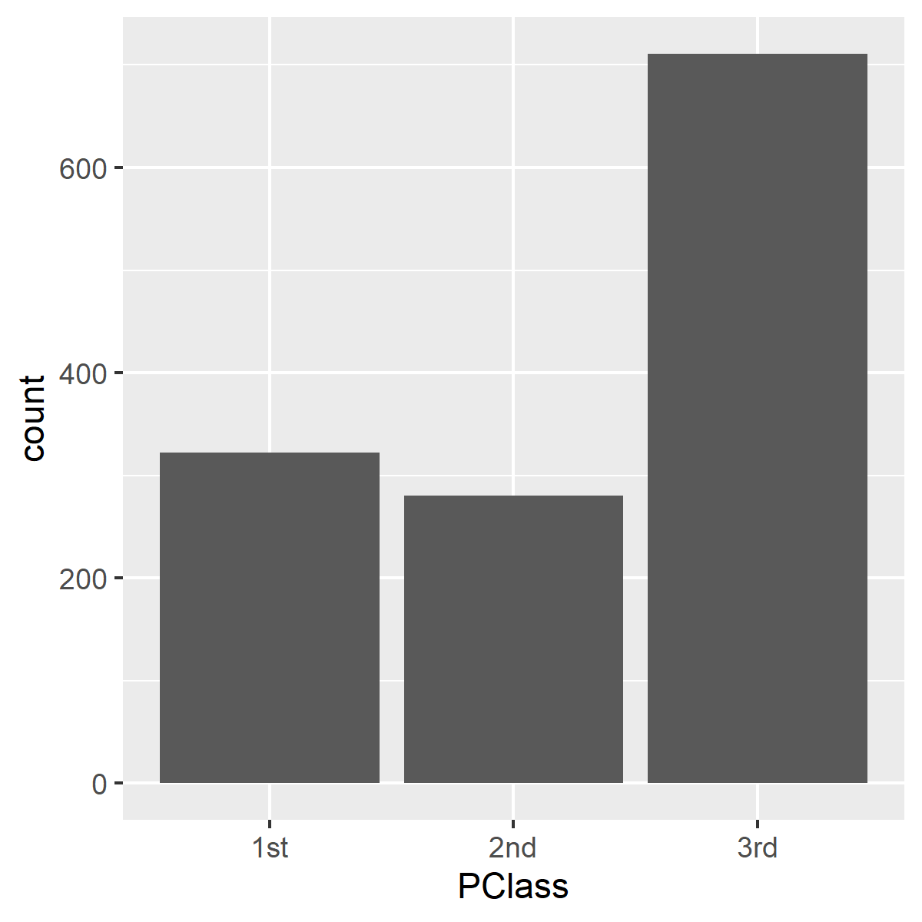
Barplot of counts, graph only
Barplot of counts
Notes:
Here is what the plot looks like.

Slide 34
Barplot of proportions, code only
proportions_barplot <- ggplot(ti, aes(x=PClass)) + geom_bar(aes(weight=1/n)) + scale_y_continuous("Proportion") ggsave("../images/barplot2.png", proportions_barplot, width=4, height=4)
Notes:
Use weights to get a bar chart of proportions.

Slide 35
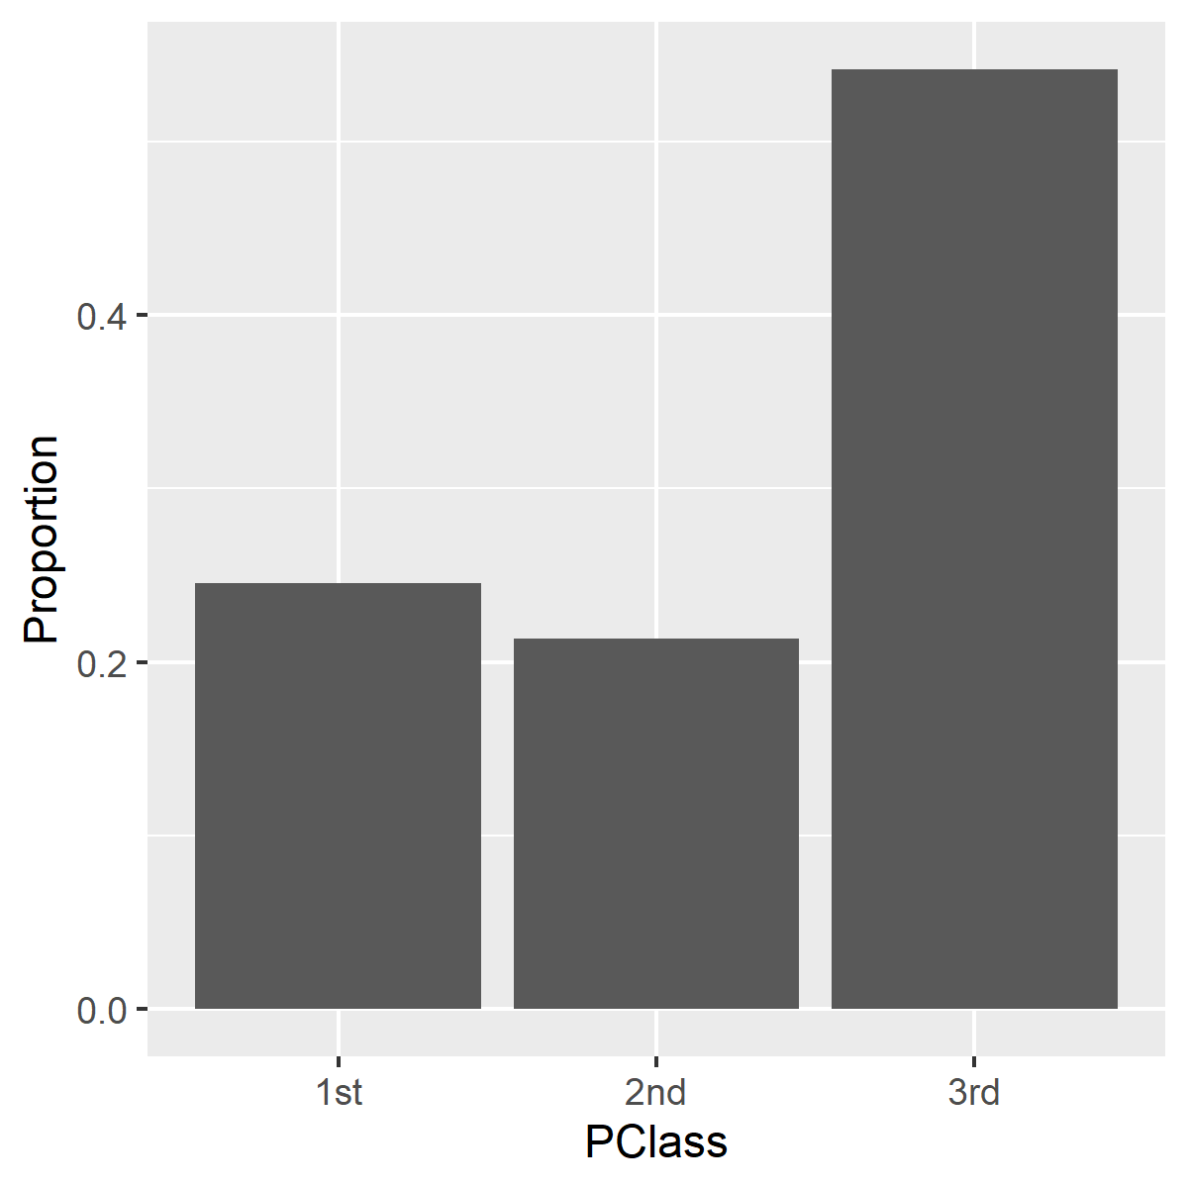
Barplot of proportions, graph only
Barplot of proportions
Notes:
Here is what the plot looks like.

Slide 36
Barplot of percentages, code only
proportions_barplot <- ggplot(ti, aes(x=PClass)) + geom_bar(aes(weight=100/n)) + scale_y_continuous("Percent", breaks=c(0, 20, 40), labels=c("0%", "20%", "40%")) ggsave("../images/barplot3.png", proportions_barplot, width=4, height=4)
Notes:
Use different weights to get a bar chart of proportions.

Slide 37

Barplot of counts, graph
Barplot of counts
Notes:
Here is what the plot looks like.

Slide 38
Fourth break
What have you learned
Reading in the Titanic dataset
Categorical versus continuous variables
Counts, proportions, and percentage
Factors
Crosstabulations
Barplots
What’s next
New categorical variables

Slide 39
New categorical variables
ti$child <- as.numeric(ti$Age<18) table(ti$child, useNA="always")
## ## 0 1 <NA> ## 660 96 557
Notes:
There are several ways to create a new categorical variable in R, but the easiest way is through the use of logical comparisons.
Suppose you wanted to compute a categorical variable called “child” which is equal to 1 if a passenger is less than 18 years old and 0 if a passenger is 18 or older. Here’s one way to do it.

Slide 40
Quality check
range(ti[which(ti$child==1), "Age"])
## [1] 0.17 17.00
range(ti[which(ti$child==0), "Age"])
## [1] 18 71
Notes:
Anytime you create a new categorical variable, you should run a quality check to make sure nothing is wrong. The range function is useful for this.

Slide 41
Quality check
chk <- table(ti$Age,ti$child,useNA="always") head(chk)
## ## 0 1 <NA> ## 0.17 0 1 0 ## 0.33 0 1 0 ## 0.8 0 1 0 ## 0.83 0 2 0 ## 0.92 0 1 0 ## 1 0 5 0
Notes:
An alternative is to run a crosstabulation. I am only showing the first few rows, but if you print the entire crosstabulation, you will see the switch over from child=1 to child=0 at 18 years of age.

Slide 42
More on recoding
ti$lower.class <- as.numeric(ti$PClass=="2nd" | ti$PClass=="3rd") ti$lower.class <- factor(ti$lower.class, levels=c(0,1), labels=c("No", "Yes")) table(ti$PClass, ti$lower.class)
## ## No Yes ## 1st 322 0 ## 2nd 0 280 ## 3rd 0 711
Notes:
Sometimes you want to combine two or more of the categories together. Here is how you might create a new passenger class variable with values of 1 for second and third class and 0 for first class.
The vertical bar (|) is the R symobl for logical OR.
As before, it’s a good a idea to run a crosstabulation to verify that the new coding was done properly.

Slide 43
Creating multi-level categories
cut_points <- c(0, 1.5, 12, 19, 99) ti$age_groups <- cut(ti$Age, breaks=cut_points) table(ti$age_groups, useNA="always")
## ## (0,1.5] (1.5,12] (12,19] (19,99] <NA> ## 13 47 89 607 557
Notes:
You can create multi-level categories using a complex logic system, but you can do it simpler and faster with the cut function.
If you are familiar with math notation, the square bracket means that the value on the boundary belongs in the set, and a parentheses means that it does not belong in the set. So (1.5, 12] means don’t include the 1.5 in this set, but do include the 12.

Slide 44
Creating multi-level categories
lb <- c("Infant", "Child", "Teenager", "Adult") ti$age_groups <- cut(ti$Age, breaks=cut_points, labels=lb) table(ti$age_groups, useNA="always")
## ## Infant Child Teenager Adult <NA> ## 13 47 89 607 557
Notes:
It might be better to include labels to describe the age groups.

Slide 45
Quality check
range(ti$Age[which(ti$age_groups=="Infant")])
## [1] 0.17 1.50
range(ti$Age[which(ti$age_groups=="Child")])
## [1] 2 12
range(ti$Age[which(ti$age_groups=="Teenager")])
## [1] 13 19
range(ti$Age[which(ti$age_groups=="Adult")])
## [1] 20 71

Slide 46
Summary
What have you learned
Reading in the Titanic dataset
Categorical versus continuous variables
Counts, proportions, and percentage
Factors
Crosstabulations
Barplots
New categorical variables

