Slide 1
Introduction to R, module07
Steve Simon

Slide 2
Setup
Notes:
Here are some options that I set to make the Powerpoint slides look nice.

Slide 3
Introduction
This Powerpoint presentation was created using an R Markdown file.
R.version.string
## [1] "R version 4.0.0 (2020-04-24)"
Sys.Date()
## [1] "2021-03-08"
Notes:
Like the earlier presentations, this Powerpoint file was created using Rmarkdown.

Slide 4
Some simple hypothesis tests
t.test
regression
ANOVA
Notes:
I want to illustrate some simple hypothesis tests that you can run in R.

Slide 5
FEV data
FEV dataset
http://www.amstat.org/publications/jse/datasets/fev.dat.txt
FEV data dictionary
http://ww2.amstat.org/publications/jse/datasets/fev.txt
Notes:
I will illustrate these tests using a publicly available data set looks at pulmonary function in a group of children. The acronym FEV stands for Forced Expiratory Volume and represents how air you can blow out of your lungs.

Slide 6
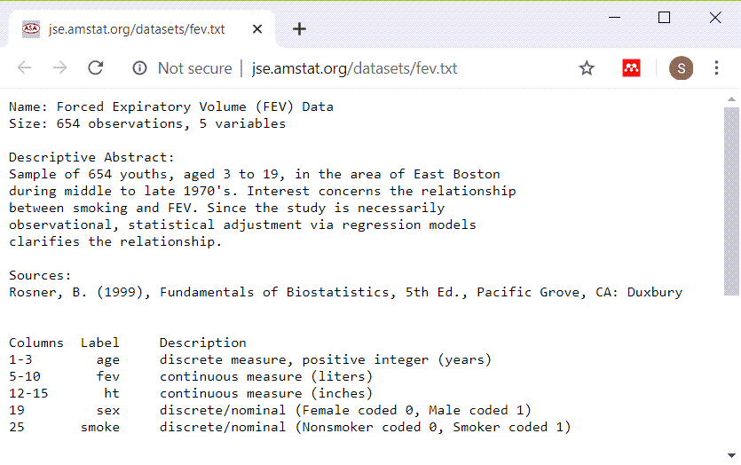
FEV data dictionary
Screenshot of data dictionary page
Notes:
This dataset has 654 rows and 5 variables: age (in years), fev (in liters), height (in inches), sex, and smoking status. Both sex and smoking status are categorical and use number codes.

Slide 7
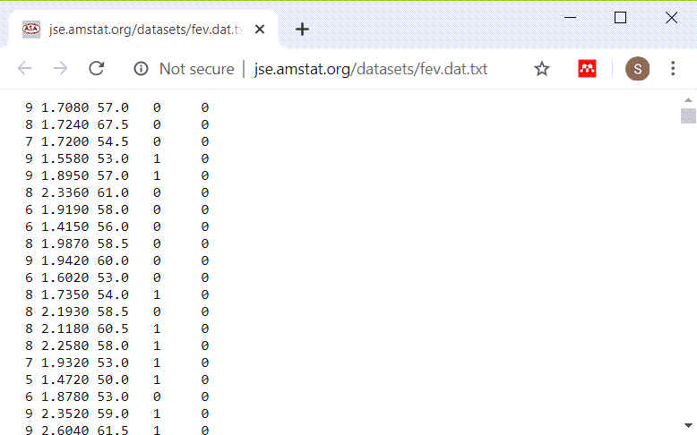
Peek at FEV dataset
Listing of first few lines of data
Notes:
This is a listing of the first few rows. It could be a tab delimited file or a fixed width file. If you look carefully at the data, you will see that there are blanks and no tabs. So this is a file that you can read in most easily using a fixed width format.

Slide 8
read in the FEV data set
fn <- "http://www.amstat.org/publications/jse/datasets/fev.dat.txt" fev <- read.fwf(file=fn, widths=c(3, 7, 5, 4, 6), header=FALSE, stringsAsFactors=FALSE) names(fev) <- c("age","fev","ht","sex","smoke") head(fev)
## age fev ht sex smoke ## 1 9 1.708 57.0 0 0 ## 2 8 1.724 67.5 0 0 ## 3 7 1.720 54.5 0 0 ## 4 9 1.558 53.0 1 0 ## 5 9 1.895 57.0 1 0 ## 6 8 2.336 61.0 0 0
Notes:
If you count carefully, you will see that the first three columns represent the first variable, you need seven more columns for the second variable, and so forth. Print out the first few lines of data to be sure.

Slide 9
Display the bottom of FEV data
tail(fev)
## age fev ht sex smoke ## 649 16 4.872 72.0 1 1 ## 650 16 4.270 67.0 1 1 ## 651 15 3.727 68.0 1 1 ## 652 18 2.853 60.0 0 0 ## 653 16 2.795 63.0 0 1 ## 654 15 3.211 66.5 0 0
Notes:
It’s always good to view the last few lines of data as well.

Slide 10
t-tests
Does average fev differ between smokers and non-smokers?
Use the t.test function
First, calculate univariate statistics
Second, draw boxplots
Only then use t.test
Notes:
The first question of interest is whether lung function, as measured by FEV, is different between smokers and non-smokers. Before you run any tests, you should look at some univariate statistics and draw a boxplot. Only after that, should you consider running a t-test.

Slide 11
Descriptive statistics for fev
mean(fev$fev)
## [1] 2.63678
sd(fev$fev)
## [1] 0.8670591
range(fev$fev)
## [1] 0.791 5.793
Notes:
For the continous variables, fev, calculate the mean, standard deviation, and range. I am not a medical expert, but I can calculate these values and ask an expert in Pulmonology if these are reasonable values.

Slide 12
Descriptive statistics for age
mean(fev$age)
## [1] 9.931193
sd(fev$age)
## [1] 2.953935
range(fev$age)
## [1] 3 19
Notes:
Do the same for age. Notice that we are working with a pediatric population.

Slide 13
Descriptive statistics for ht
mean(fev$ht)
## [1] 61.14358
sd(fev$ht)
## [1] 5.703513
range(fev$ht)
## [1] 46 74
Notes:
Finally, get the descriptive statistics on height. The units of measure are inches and all the values seem reasonable for a pediatric population.

Slide 14
Descriptive statistics for smoker
fev$smoke_factor <- factor( fev$smoke, levels=0:1, labels=c("nonsmoker", "smoker")) table(fev$smoke_factor)
## ## nonsmoker smoker ## 589 65
Notes:
Get counts for your categorical variables. Notice that most of the patients are non-smokers.

Slide 15
Descriptive statistics for sex
fev$sex_factor <- factor( fev$sex, levels=0:1, labels=c("female", "male")) table(fev$sex_factor)
## ## female male ## 318 336
Notes:
Also get counts for sex. There are roughly the same number of boys and girls.

Slide 16
Boxplot
library(ggplot2) plot1 <- ggplot(fev, aes(x=smoke_factor, y=fev)) + geom_boxplot() ggsave("../images/smoke-by-fev.png", plot1, width=4, height=4)
Notes:
There are several graphical displays that are worth considering as a preliminary to running a t-test. I like using boxplots. Here is the code to draw a boxplot.

Slide 17
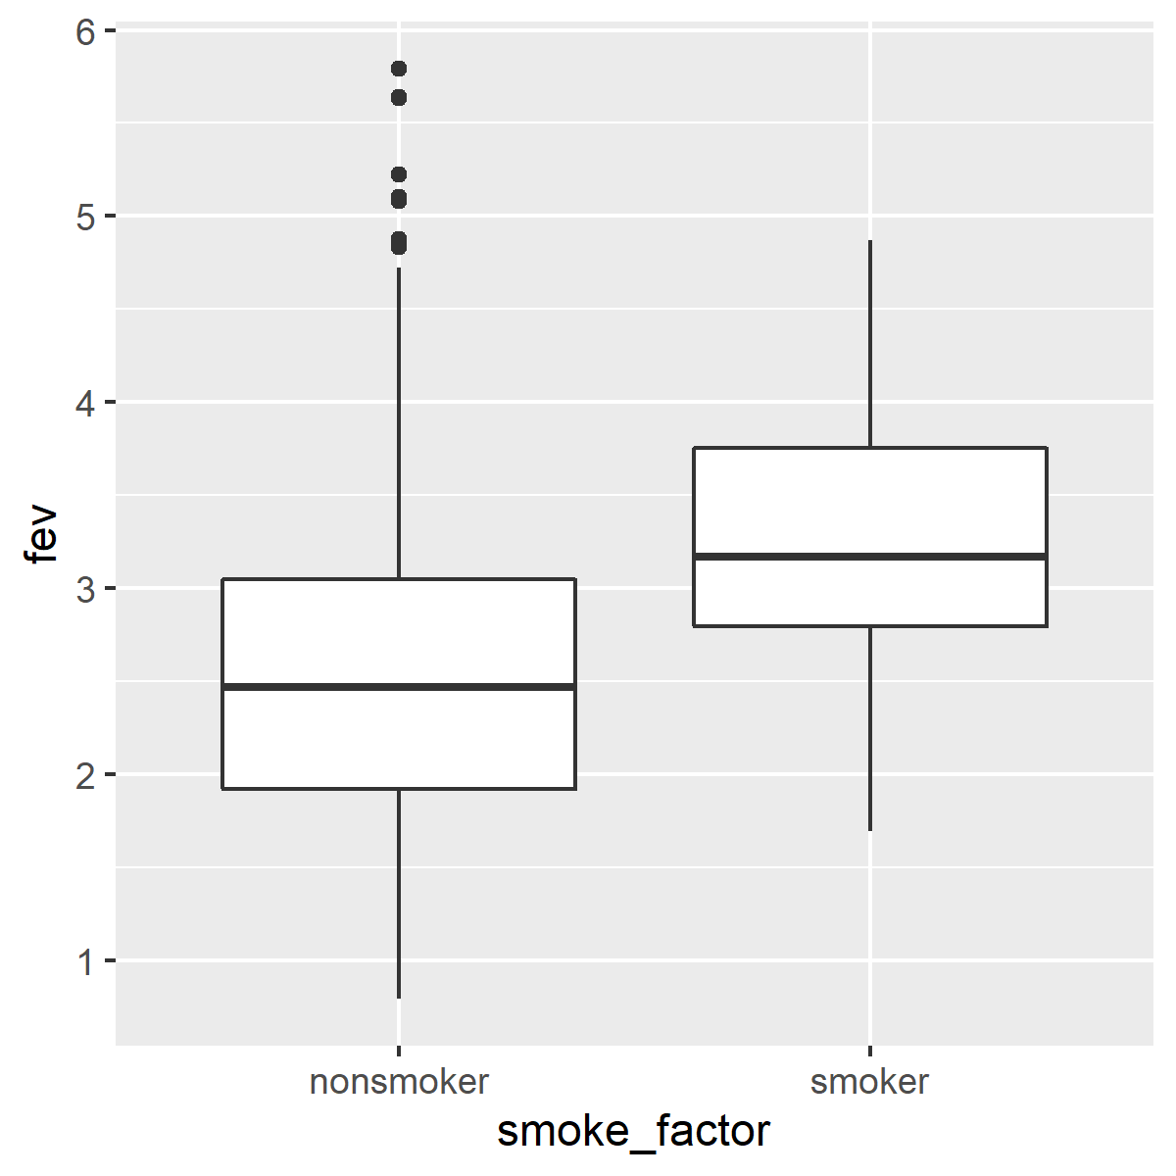
Boxplot
Notes:
Here is what the boxplot looks like. Notice that smokers tend to have higher FEV values, which is surprising.

Slide 18
t-test
smoke_test <- t.test( fev~smoke_factor, data=fev, alternative="two.sided", paired=FALSE, var.equal=TRUE, conf.level=0.99) names(smoke_test)
## [1] "statistic" "parameter" ## [3] "p.value" "conf.int" ## [5] "estimate" "null.value" ## [7] "stderr" "alternative" ## [9] "method" "data.name"
Notes:
Here is the code to run a t-test. The t.test function produces an object with all the details that you need. The var.equal option produces the traditional t-test, but you also have an option to produce a test that does not assume equal variances. This is known as the Welch test and it uses the Satterthwaite approximation to the degrees of freedom.

Slide 19
t-test
print(smoke_test)
## ## Two Sample t-test ## ## data: fev by smoke_factor ## t = -6.4645, df = 652, p-value = ## 1.993e-10 ## alternative hypothesis: true difference in means is not equal to 0 ## 99 percent confidence interval: ## -0.9947437 -0.4266942 ## sample estimates: ## mean in group nonsmoker ## 2.566143 ## mean in group smoker ## 3.276862
Notes:
While the list is organized in a certain order, the print function will recognize this list as a particular object and apply a special print method to make the output more readable and interpretable.

Slide 20
t-test
print.default(smoke_test[1:3])
## $statistic ## t ## -6.464453 ## ## $parameter ## df ## 652 ## ## $p.value ## [1] 1.992846e-10
Notes:
You can list the list as it is stored by R using the print.default function.

Slide 21
t-test
print.default(smoke_test[4:6])
## $conf.int ## [1] -0.9947437 -0.4266942 ## attr(,"conf.level") ## [1] 0.99 ## ## $estimate ## mean in group nonsmoker ## 2.566143 ## mean in group smoker ## 3.276862 ## ## $null.value ## difference in means ## 0
Notes:
Here are some more pieces of the list.

Slide 22
t-test
print.default(smoke_test[7:10])
## $stderr ## [1] 0.1099426 ## ## $alternative ## [1] "two.sided" ## ## $method ## [1] " Two Sample t-test" ## ## $data.name ## [1] "fev by smoke_factor"
Notes:
Here is the last bit.

Slide 23
t-test
round(smoke_test$conf.int, 2)
## [1] -0.99 -0.43 ## attr(,"conf.level") ## [1] 0.99
rounded_p_value <- round(smoke_test$p.value, 4) ifelse( rounded_p_value==0, "<0.0001", rounded_p_value)
## [1] "<0.0001"
Notes:
You can pull individual items out of the list and manipulate them. I strongly encourage the use of rounding when presenting these results. I do not like rounding the p-value down to zero, however, and would report this p-value instead as 0.0001.

Slide 24
Two factor ANOVA
Effect of sex, smoking, and the interaction on FEV.
First, do a crosstabulation
Notes:
If you want to look at two factos that influence FEV, you need a more complex model. There are several that work here, but I want to illustrate two factor analysis of variance.

Slide 25
Two factor ANOVA
sex_and_smoke_anova <- aov(fev~sex_factor*smoke_factor, data=fev) names(sex_and_smoke_anova)
## [1] "coefficients" "residuals" ## [3] "effects" "rank" ## [5] "fitted.values" "assign" ## [7] "qr" "df.residual" ## [9] "contrasts" "xlevels" ## [11] "call" "terms" ## [13] "model"
Notes:
I want to illustrate the aov function, but the help file includes the warning that interpretation is difficult for unbalanced data.

Slide 26
Two factor ANOVA
print(sex_and_smoke_anova)
## Call: ## aov(formula = fev ~ sex_factor * smoke_factor, data = fev) ## ## Terms: ## sex_factor smoke_factor ## Sum of Squares 21.3240 33.6815 ## Deg. of Freedom 1 1 ## sex_factor:smoke_factor ## Sum of Squares 2.5127 ## Deg. of Freedom 1 ## Residuals ## Sum of Squares 433.4017 ## Deg. of Freedom 650 ## ## Residual standard error: 0.816561 ## Estimated effects may be unbalanced
Notes:
The print function produces a nice output, though the last bit of it does not fit on this slide.

Slide 27
Two factor ANOVA
summary(sex_and_smoke_anova)
## Df Sum Sq Mean Sq ## sex_factor 1 21.3 21.32 ## smoke_factor 1 33.7 33.68 ## sex_factor:smoke_factor 1 2.5 2.51 ## Residuals 650 433.4 0.67 ## F value Pr(>F) ## sex_factor 31.981 2.33e-08 *** ## smoke_factor 50.514 3.12e-12 *** ## sex_factor:smoke_factor 3.768 0.0527 . ## Residuals ## --- ## Signif. codes: ## 0 '***' 0.001 '**' 0.01 '*' 0.05 '.' 0.1 ' ' 1
Notes:
The summary function provides a different set of output.

Slide 28
Difference in proportions
Test of two independent proportions
Frequently called a chi-squared test.
Run crosstabs first
Treatment/exposure variable as the rows
Outcome variable as the columns
Calculate row percentages.
Notes:
Now let’s look at the comparison of two independent proportions. This is often called a chi-squared test, but I dislike that terminology, because chi-squared test could refer to a lot of other tests as well.
Before you run this test, look at crosstabs. There are different ways of organizing the crosstabs, but I like to orient mine with the intervention or exposure variable as the rows. And then I like to calculate row percentages. Row percentages are percentages that add up to 100% within each row.

Slide 29
Difference in proportions
ctable <- table(fev$sex_factor, fev$smoke_factor) ctable
## ## nonsmoker smoker ## female 279 39 ## male 310 26
prop.table(ctable, margin=1)
## ## nonsmoker smoker ## female 0.87735849 0.12264151 ## male 0.92261905 0.07738095
Notes:
Here is the code to produce a crosstabulation looking first at counts and then at row percentage.

Slide 30
Difference in proportions
diff_in_proportions <- prop.test( table(fev$sex, fev$smoke), correct=FALSE) names(diff_in_proportions)
## [1] "statistic" "parameter" "p.value" ## [4] "estimate" "null.value" "conf.int" ## [7] "alternative" "method" "data.name"
Notes:
The prop.test function computes a test statistic for comparing the difference in two propo rtions. In this case, we are looking at the difference in proportion of smokers among male and female patients.
Notice that the names are the same as the object produced by the t.test function, except there is no standard error listed.

Slide 31
Difference in proportions
print(diff_in_proportions)
## ## 2-sample test for equality of ## proportions without continuity ## correction ## ## data: table(fev$sex, fev$smoke) ## X-squared = 3.739, df = 1, p-value = ## 0.05316 ## alternative hypothesis: two.sided ## 95 percent confidence interval: ## -0.0912611312 0.0007400171 ## sample estimates: ## prop 1 prop 2 ## 0.8773585 0.9226190
Notes:
If you print this object, you will get nicely documented output for this test.

Slide 32
Difference in proportions
print.default(diff_in_proportions[1:3])
## $statistic ## X-squared ## 3.738998 ## ## $parameter ## df ## 1 ## ## $p.value ## [1] 0.0531563
Notes:
Here’s a peek at the actual values stored by R. It all does not fit easily on one slide, so I am splitting it up into pieces.

Slide 33
Difference in proportions
print.default(diff_in_proportions[4:6])
## $estimate ## prop 1 prop 2 ## 0.8773585 0.9226190 ## ## $null.value ## NULL ## ## $conf.int ## [1] -0.0912611312 0.0007400171 ## attr(,"conf.level") ## [1] 0.95
Notes:
Here is the second part of the list.

Slide 34
Difference in proportions
print.default(diff_in_proportions[7:9])
## $alternative ## [1] "two.sided" ## ## $method ## [1] "2-sample test for equality of proportions without continuity correction" ## ## $data.name ## [1] "table(fev$sex, fev$smoke)"
Notes:
Here is the rest of the list.

Slide 35
Difference in proportions
names(diff_in_proportions)
## [1] "statistic" "parameter" "p.value" ## [4] "estimate" "null.value" "conf.int" ## [7] "alternative" "method" "data.name"
rounded_p_value <- round(diff_in_proportions$p.value, 4) ifelse( rounded_p_value==0, "<0.0001", rounded_p_value)
## [1] 0.0532
Notes:
As before, you can pull out individual parts of the list and manipulate them.

Slide 36
Simple linear regression
Use the lm function
First graph your data!
Notes:
If you want to run a linear regression model, use the lm function. But first, graph your data!

Slide 37
Simple linear regression
age_by_fev_plot <- ggplot(fev, aes(age, fev)) + geom_point() ggsave(age_by_fev_plot, filename="../images/age_by_fev_plot.png")
## Saving 5 x 4 in image

Slide 38
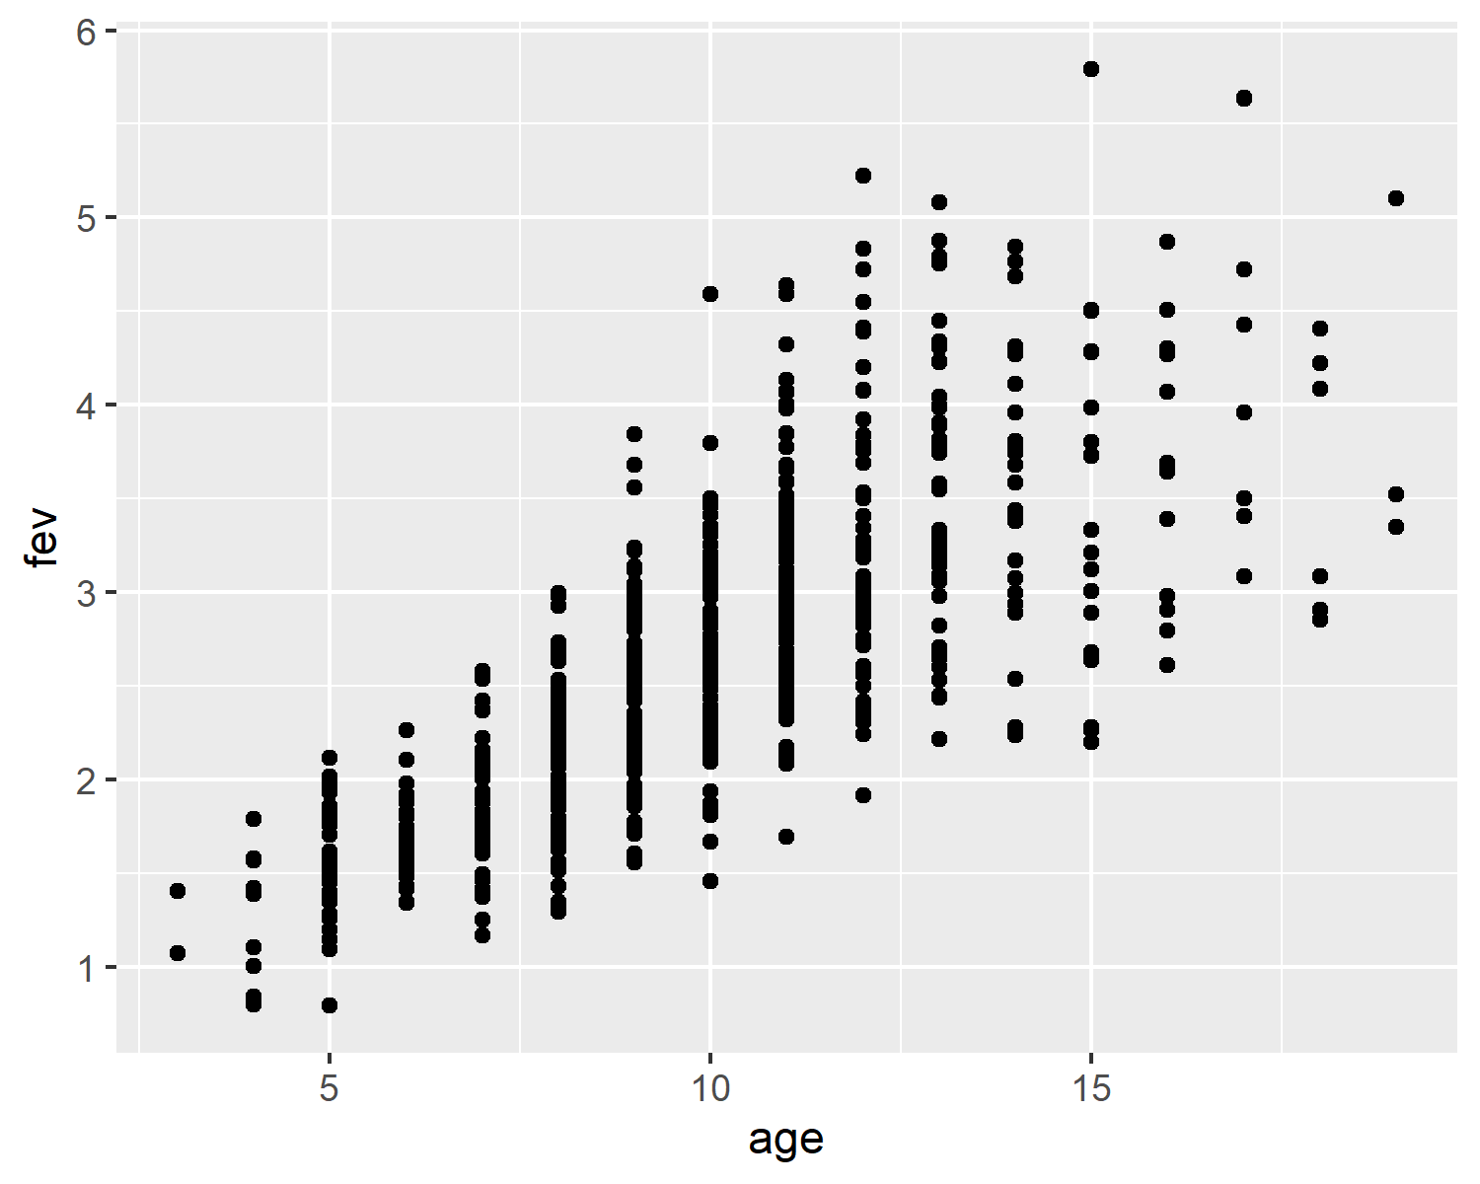
Simple linear regression
Scatterplot of age by fev
Notes:
The graph shows a few issues with unequal variances, but this is not too serious a problem. There is a trend for older patients to have larger FEV values, which is what we expected.

Slide 39
Simple linear regression
age_regression <- lm(fev~age, data=fev) names(age_regression)
## [1] "coefficients" "residuals" ## [3] "effects" "rank" ## [5] "fitted.values" "assign" ## [7] "qr" "df.residual" ## [9] "xlevels" "call" ## [11] "terms" "model"
Notes:
The lm function creates an object of type lm. It is a list like everything else we’ve seen so far.

Slide 40
Simple linear regression
print(age_regression)
## ## Call: ## lm(formula = fev ~ age, data = fev) ## ## Coefficients: ## (Intercept) age ## 0.4316 0.2220

Slide 41
Simple linear regression
summary(age_regression)
## ## Call: ## lm(formula = fev ~ age, data = fev) ## ## Residuals: ## Min 1Q Median 3Q Max ## -1.57539 -0.34567 -0.04989 0.32124 2.12786 ## ## Coefficients: ## Estimate Std. Error t value ## (Intercept) 0.431648 0.077895 5.541 ## age 0.222041 0.007518 29.533 ## Pr(>|t|) ## (Intercept) 4.36e-08 *** ## age < 2e-16 *** ## --- ## Signif. codes: ## 0 '***' 0.001 '**' 0.01 '*' 0.05 '.' 0.1 ' ' 1 ## ## Residual standard error: 0.5675 on 652 degrees of freedom ## Multiple R-squared: 0.5722, Adjusted R-squared: 0.5716 ## F-statistic: 872.2 on 1 and 652 DF, p-value: < 2.2e-16

Slide 42
The broom package to the rescue!
Chaos among statistical functions
Different names
Inconsistent order
Unwieldy size and shape
Broom package
Uses reasonably consistent names
Stored in data frame rather than a list
Notes:
R has evolved over time and different authors have developed different approaches. This has led to chaos. The objects created by these statistical functions have different names, an inconsistent ordering, and an unwieldy size and shape.
The broom package seeks to create order from this chaos. It uses reasonably consistent names across the various statistical functions and stores results in a data frame. The rectangular format of the data frame makes things easier to work with.
The variety of statistical models make it impossible to make things perfectly consistent, but the broom package does come close.

Slide 43
broom for lm
library(broom) library(knitr) tidy_age_regression <- tidy(age_regression) kable(tidy_age_regression)
Notes:
Here is the code for using broom for the simple linear regression. The kable function makes the table fit better on a PowerPoint slide.

Slide 44
term | estimate | std.error | statistic | p.value
(Intercept) | 0.4316481 | 0.0778954 | 5.541382 | 0
age | 0.2220410 | 0.0075185 | 29.532766 | 0
Notes:
The output is organized nicely. You should use some rounding here, but the table is close to what you might use in a research publication.

Slide 45
broom for the two factor anova
tidy_sex_and_smoke_anova <- tidy(sex_and_smoke_anova) kable(tidy_sex_and_smoke_anova)
Notes:
Here is the code for using broom for the two factor anova.

Slide 46
broom for the two factor anova
term | df | sumsq | meansq | statistic | p.value
sex_factor | 1 | 21.32398 | 21.3239844 | 31.980929 | 0.0000000
smoke_factor | 1 | 33.68147 | 33.6814674 | 50.514229 | 0.0000000
sex_factor:smoke_factor | 1 | 2.51266 | 2.5126604 | 3.768396 | 0.0526616
Residuals | 650 | 433.40172 | 0.6667719 | NA | NA
Notes:
Here are the results of broom for the two factor anova

Slide 47
broom for the test of two independent proportions
tidy_diff_in_proportions <- tidy(diff_in_proportions) kable(tidy_diff_in_proportions)
Notes:
Here is the code for the test of two independent proportions.

Slide 48
broom for the test of two independent proportions
estimate1 | estimate2 | statistic | p.value | parameter | conf.low | conf.high | method | alternative
0.8773585 | 0.922619 | 3.738998 | 0.0531563 | 1 | -0.0912611 | 0.00074 | 2-sample test for equality of proportions without continuity correction | two.sided
Notes:
Here are the results of broom for the test of two independent proportions.

Slide 49
broom for the t-test
tidy_smoke_test <- tidy(smoke_test) kable(tidy_smoke_test)
Notes:
Here is the code for using broom for the two-sample t-test

Slide 50
broom for the t-test
estimate1 | estimate2 | statistic | p.value | parameter | conf.low | conf.high | method | alternative
2.566143 | 3.276861 | -6.464453 | 0 | 652 | -0.9947437 | -0.4266942 | Two Sample t-test | two.sided
Notes:
Here are the results of broom for the two-sample t-test

