Slide 1
Video 8 - Sampling
Steve Simon

Slide 2
Learning objectives
To describe different approaches to probability sampling
To discuss advantages and disadvantages of non-probability samples
Notes:
Here are the objectives for this week.

Slide 3
What is a population?
A group of people or objects that share one or more common features.
Demography
Geography
Occupation
Time
Care requirements
Diagnosis
Notes:
A population is a group of people or objects, but in this class, we’ll almost always talk about people. There are a few exceptions. Some of the problems that we study involve a population of hospital visits and that is not quite the same thing as a population of people who visit hospitals because some people visit a hospital more than once.
The population shares one or more common features. I got this list somewhere and I can’t remember where, but it is a great list of the common characteristics of a population, from the perspective of health care.

Slide 4
What is a sampling frame
Physical list
Ideally everyone or almost everyone in population
Used to draw your sample
Expensive, not always available.
Example: Master Address File.
Notes:
A sampling frame is a physical list associated with a population. It should include everyone (everything) in the population, but that’s an ideal that is often difficult to meet.
Because it is a physical list, you can draw a sample from it.
It costs a lot of money to compile a sampling frame, so if you have one, you should definitely take advantage of it.
As an example of a sampling frame, the U.S. Bureau of the Census maintains a database of every housing unit in the United States. It relies on the U.s. Postal Service and community based canvassing efforts to collect information for 278 million addresses in the United States.
I hope that any sampling frame that you develop isn’t quite as big as this.

Slide 5
What is a sample?
A sample is a subset of a population
Representativeness more important than size
Reasons for sampling
Expense
Time
Quality control
Notes:
A sample is a subset of a population. It is usually smaller and easier to manage than the entire population.
Critically important in sampling is for the sample to be representative. That’s even more important than the actual size of the sample.
College students are not representative of young adults. Volunteers in a clinical trial are not representative of everyone who has the disease.
The major reasons you sample are time and money. The population that id defined in most research studies is far too big for a complete enumeration. There are some exceptions, of course, but almost all studies have to work with a sample.
In fact, one definition of Statistics is the use of information from samples to make inferences about a population. That’s a bit narrow perhaps, but still a pretty good starting point if anyone asks you what Statistics really is.

Slide 6
Two major types of samples
Random sample
Everyone has known non-zero probability
Non-random sample
Different selection probabilities
Some may have zero selection probability
Notes:
A random sample is a sample where every individual (or every object) in the population has a known non-zero probabilitiy of being selected. In many random samples the probability of selection is the same for every subject, but not always.
A random sample is an ideal which is rarely met perfectly, but sometimes you can get pretty close to this ideal. A random sample requires a sampling frame that is a complete list within the population.
A non-random sample is a sample where the probability of selection varies. A few lucky people might have a higher probability of being selected than others. There may be others who have a lower selection probability. Maybe they are trying to hide from you. Maybe they have caller id and they try to screen their calls. Maybe they work odd hours and are difficult to track down.
For any sample, always ask yourself “Who was left out?” if certain people in your sample have a zero probability of being selected, think long and hard about what this means.

Slide 7
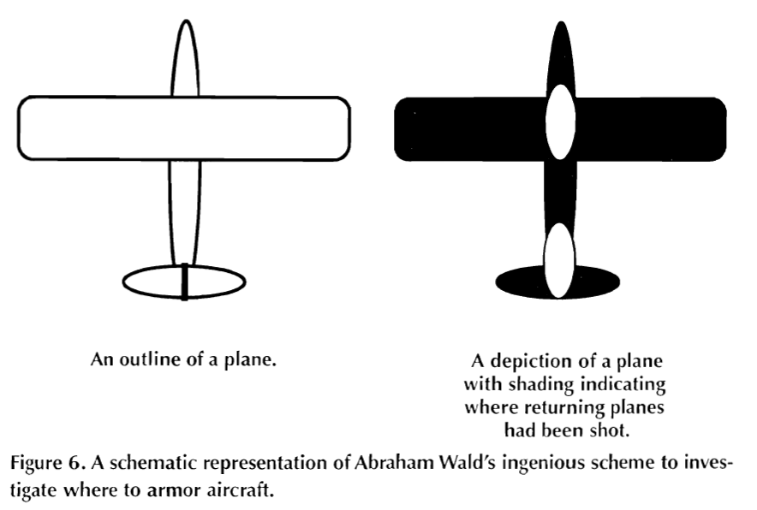
Extreme example: World War II bombers
Image of bomber with indication of damage
Notes:
There was a statistician, Abraham Wald, who was asked to help out during World War II with a sampling problem. A lot of bombers were not returning from their missions, so the Royal Air Force wanted to put armor on the bombers. But where to put it? They couldn’t put it everywhere because it would be too heavy to take off. Even a little bit of extra armor was troublesome because it would decrease the total wieght of bombs that they might carry.
So Dr. Wald looked at the planes that returned and noted where they had holes from enemy fire. These holes were distributed more or less randomly throughout the plane except for two regions where there was nothing. This image, which was taken from the 1998 Howard Wainer article that I mention in the recommended readings, shows where there was nothing: in the middle of the plane between the two wings and underneath the tail.
His recommendation was to place the armor only in those two areas. This seems counterintuitive, which is why it makes such a good puzzle. Dr. Wald hypothesized that any plane hit in those regions did not survive to return. The other areas could be hit and the plane could still limp back to safety. This is an example of selection bias. The bombers in the study were not a random sample of all bombers, they were a sample of bombers that returned safely.

Slide 8
Example: in school survey of drug use in teenagers
Who has lower selection probability?
Who has a zero selection probability?
Can you redefine your population?
Notes:
Suppose you are interested in a survey of teenagers in your community. You go to a high school and select a sample of students. Who has a lower selection probability? Students with a chronic illness, because they tend to miss a lot of days of school. Who has a zero selection probability? Home-schooled teenagers, for one, and dropouts for another.
Now is this a terrible thing? Students with a chronic illness probably have a different drug use pattern (both legal and illegal drugs) than most other studients. I’m not sure about home-schooled students, but students who have dropped out of high school almost certainly have a different drug use pattern.
But think about it from a high school principal’s perspective. He or she might be interested only in drug use patterns among students who attend school, so the omission of home schooled students and dropouts may not be an issue.
What you should do, perhaps, is to redefine your population more narrowly when you recognize problems with differential selection probabilities.

Slide 9
Example: prisoner IQ study
Hypothetical study
Calculate average IQ of prisoners
Lower than general public
Conclude: criminals less intelligent than honest people(???)
Notes:
This is a silly example, perhaps, but consider a hypothetical study where you give IQ tests to a random sample of prisoners. You find that the average IQ in this group is lower than the average IQ in the general public.
That seems reasonable enough, but what conclusion can you draw? You might be tempted to conclude that criminals have a lower IQ than honest people.
Maybe, but keep in mind that you won’t find every criminal in prison. A better conclusion might be that criminals who get caught are dumber than criminals who don’t get caught.

Slide 10
Break #1
What have we learned so far?
Definitions: population, sampling frame, sample
Distinction between random sample and a non-random sample
What is coming next?
Different types of probability samples
How to generate a random sample
Notes:
Let’s take a break here. You’ve learned a few basic definitions so far. Coming up next are different types of probability samples.

Slide 11
Sampling
Sampling designs – Probability sampling
Simple random sampling
Systematic sampling
Stratified sampling
Cluster sampling
Notes:
In a probability sample, every person in the population has a known non-zero probability of being in the sample. A sampling frame is an absolute requirement for a probability sample. If you do not have a sampling frame, you must rely on a non-probability sample.
In simple random sampling, each patient has an equal and independent probability of being selected.
I do not recommend a systematic sample. It is easy. If you want a sample that is one-tenth the size of the population, select every tenth observation from the sampling frame. Randomly choose whether you start. With ten percent systematic sample, that possible starting points are the first, second, third, … all the way through the tenth observation in the sampling frame. If you started with the eleventh value or later, you would be selecting less than 10% of the sampling frame.
For a stratified sample, you divide your sampling frame into layers or strata. You might do this by geographic regions, age groups, gender. Then select a simple random sample within each strata.
In some studies, the number of patients sampled from each strata is proportional to the number of patients within each strata. In other studies, certain strata are over sampled to insure a decent sample size for certain minority groups. If you encounter over sampling, you must, must, must use a weighting approach for your data analysis.
A cluster sample involves the division of the sample into discrete clusters. These clusters might represent clinics or hospitals. A specific number of clusters are sampled in their entirety and others are left behind. Within each cluster, you either conduct a simple random sample, or you get the records for every patient in that cluster.
A cluster sample is inefficient from a statistical perspective because two patients from the same clinic or hospital are likely to be positively correlated. This correlation increases your standard error, sometime substantially.
The reason you pick a cluster sample is that it save a lot of time. If you had to visit every single hospital in the United States to get a simple random sample or a stratified random sample, you would die of exhaustion.
Instead, select a small number of hospitals that are representative of all hospitals in the U.S. and then travel only to those locations.
There are variations on cluster sampling where you have a second layer of clusters beneath the first layer. So you might randomly select 50 school districts in the United States and then randomly select 5 elementary schools within each district for further sampling.

Slide 12
How to draw a simple random sample
List the sampling frame in a logical order
Attach a column of random numbers
Sort by the column of random numbers
Select your sample, starting at the top
Notes:
There are a lot of places, including your book, that make the actual process of drawing a random sample more complicated than it needs to be. Ignore what your book says and follow this algorithm.
List your sampling frame in a logical order. Then attach a column of random numbers and sort by that column. Sorting by a column of random numbers places your list in a random order.
Then just select your sample starting from the top of the randomly sorted list.

Slide 13
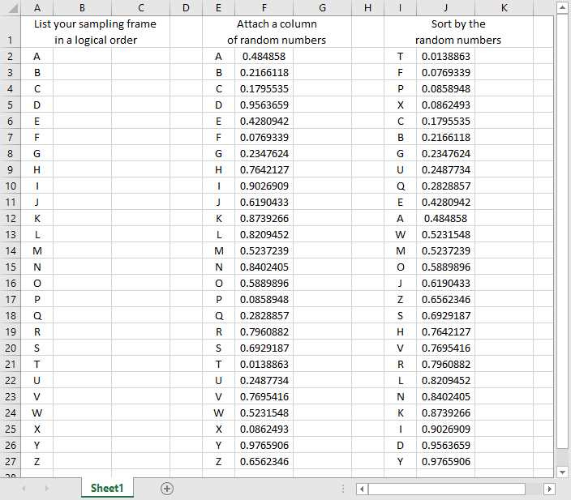
Simple random sample using Microsoft Excel
A spreadsheet illustrating simple random sampling
Notes:
This shows the random sampling process using Microsoft Excel. If the image is too smallfor you to view here, open up the file random01.xlsx from the Canvas website.
There are 26 patients in your sampling frame. Arrange them in a systematic order. Then attach a column of random numbers. Notice that the smallest random number (0.0138863) is associated with “T”. This letter goes to the top of the list when you sort the data and is the first person in your sample.
If you needed to select five people, your simple random sample would be T, F, P, X, and C.

Slide 14
How to draw a stratified random sample
List the sampling frame and strata in a logical order
Attach a column of random numbers
Sort by the strata and the column of random numbers
Select your sample, starting at the top
Notes:
The process of selecting a stratified random sample is similar. You have two columns. The first column is your sampling frame and the second column is your strata. Add a column of random numbers and sort first by the strata and then by the random numbers. This places the numbers in a random order within each strata.

Slide 15
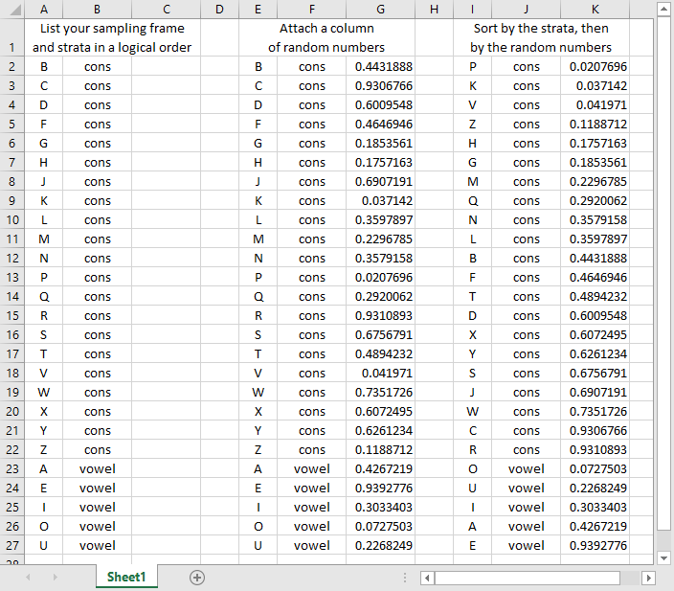
Stratified random sample using Microsoft Excel
A spreadsheet illustrating stratified random sampling
Notes:
This shows the stratified random sampling process using Microsoft Excel. If the image is too smallfor you to view here, open up the file random02.xlsx from the Canvas website.
Split your data into two strata: consonants and vowels. Arrange them systematically.
Attach a column of random numbers. Notice that “P” has the smallest random number among the consonants (0.0207696) and “O” has the smallest random number among the vowels (0.0727503). Then do a two level sort: first by the strata and then by the random numbers.
If you wanted a random sample of three consonants and two vowels, your stratified sample would be P, K, V among the consonants and O and U among the vowels.

Slide 16
Break #2
What have we learned so far?
Types of probability samples
How to draw a random sample
What is coming up next?
Different types of non-probability samples
How to allocate treatments randomly
Notes:
Let’s take another break. We’ve talked about some different types of probability samples: simple, systematic, stratified, and cluster. We’ll tackle non-probability samples next.

Slide 17
Sampling
Sampling designs – Nonprobability sampling
Convenience sampling
Quota sampling
Purposive sampling
Purposeful sampling
Snowball sampling
Notes:
In a non-probability sample, the probability of an person being selected is unknown. You use this approach because you have to (it is impossible to obtain a sampling frame) or because it takes too much time or too much money.
A convenience sample is a sample that is collected without any planned attempt to make the sample representative. You choose people for your sample because they are easy to find. When a drug company places an ad in the paper looking for volunteers, the sample that they get is a convenience sample. When a doctor recruits patients who just happen to be coming to his or her clinic that day, that is a convenience sample.
Sometimes researchers will make a feeble attempt to get a representative sample, such as asking physicians in urban, suburban, and rural setting to recruit patients. But it still represents a convenience sample.
A quota sample is like a convenience sample. It gives you flexibility in who to select as long as certain quotas are met. Back when shopping malls were popular, marketing research firms would take samples from the people strolling by the stores. They’d approach people and ask if they wanted to participate in a survey or a taste test or something similar. The people doing the sample had to get a certain number of people in each demographic group, and my demographic group (young male) was always the hardest to get. So these people would walk right past everyone else and pick me out for their sample because they already had enough older people and enough females.
In a purposive sample, you identify characteristics that you feel are important and search for for patients with those characteristics. In some qualitative studies, for example, researchers will try to find a few patients who representative of one extreme and a few who are representative of the opposite extreme and sometimes a few who are in the middle. This insures that you will hear a broad range of comments.
Purposeful sampling is also commonly used with qualitative research. You only have a limited amount of time and money and you want to select patients who are “information rich.”
Both purposive and purposeful samples require the use of subjective judgement. This sounds terrible, but there is at least some empirical evidence that a purposive sample can outperform a simple random sample. See the van Hoeven article under recommended readings for an example.
Snowball sampling is an attempt to get a decent number of patients in a population that is hard to sample from in the more traditional approaches. You ask the first few patients in your sample to recommend others. Then you get recommendations from these people. And so forth. This sampling technology got its name from the analogy of a snowball rolling downhil and getting bigger and bigger.
Snowball sampling has been used to identify drug addicts, for example, because these people are normally resistant to solicitation of information through more traditional channels.

Slide 18
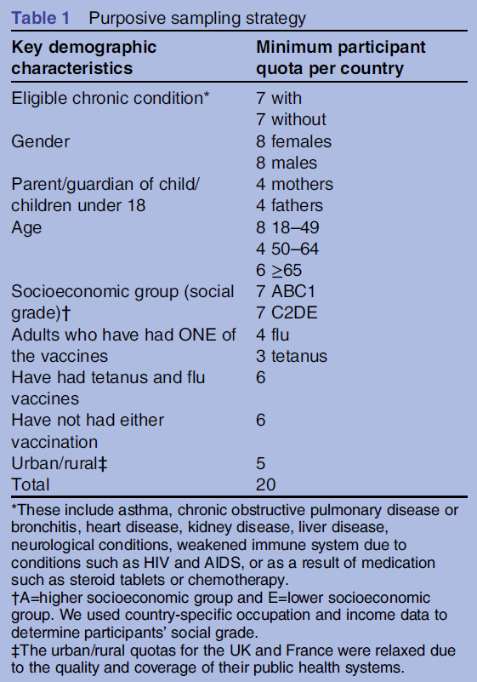
Example of a purposive sample
Table describing purposive sampling strategy
Notes:
This table, from the Wheelock artice in recommended readings, shows an example of a purposive sample. If you have trouble reading this table, open up the link to the Wheelock paper in the recommended readings for this week.
In each country, researchers had to select 20 patients and they had to make sure that some of these patients h ad and some did not have the eligible chronic condition. They also had to get a minimum number from particular demographic groups like gender, age, socioeconomic status, and vaccination status.
Now, if this sounds more like a quota sample than a purposive sample, I couldn’t disagree with you. There is a subtle distinction between many of these non-probability samples.

Slide 19
Randomizing treatments within a convenience sample
Many studies use a convenience sample, which may hamper external validity, but they randomly assign treatment or control conditions within the convenience sample, which helps with internal validity. The process works much like the process of drawing a simple random sample.
List your treatment groups in a logical order
Attach a column of random numbers
Sort by the column of random numbers
Allocate treatment groups, starting at the top of the list.
Notes:
Much research involves the use of convenience samples, with randomization to two or more treatment groups. The randomization after a convenience sample is not the same as using a random sample, and it does nothing for generalizability (or external validity). It does help with internal validity.
if you’ve never randomized treatment allocation before, the literature is a bit confusing. The simplest approach is to follow the same logic that you use for selecting a random sample. Please the treatment conditions in a systematic order, attach a column of random numbers and then sort by the random numbers. This places your treatment allocation in a random order. You assign your first patient to the treatment group listed at the top of the list. The second patient giets the next treatment group listed, and so forth.

Slide 20
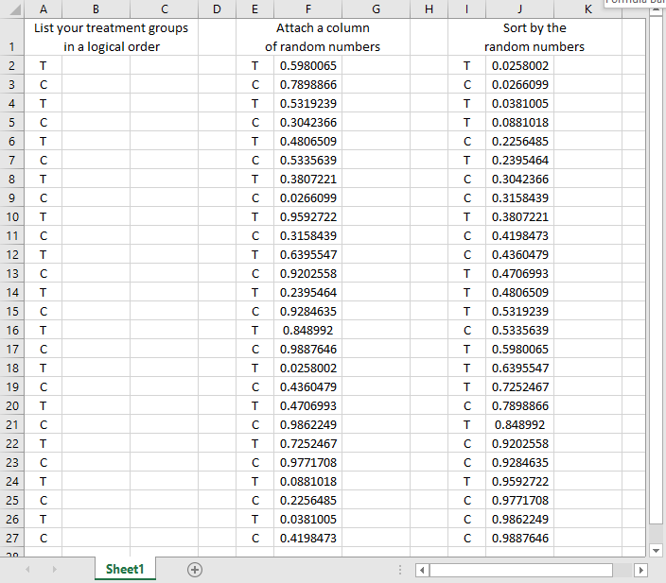
Randomizing treatment allocation using Microsoft Excel
A spreadsheet illustrating random treatment allocation
Notes:
This shows the randomized allocation of treatments using Microsoft Excel. If the image is too smallfor you to view here, open up the file random03.xlsx from the Canvas website.
Arrange your treatments systematically (T, C, T, C, etc.)
Attach a column of random numbers. Notice that the smallest random number (0.0258002) is associated with a “T”. This “T” goes to the top of the list. The first five patients get allocated to T, C, T, T, and C respectively.

Slide 21
Randomizing a crossover trial using Microsoft Excel
A spreadsheet illustrating random allocation of treatment order
Notes:
The process of sorting by a column of random numbers extends easily to more complex research designs. This screenshot from a Microsoft Excel spreadsheet shows the randomized allocation of treatment order in a crossover trials using Microsoft Excel.
Arrange the treatment and control values in pairs. Then attach a column of random numbers. When you sort by pair and then by the column of random numbers, you arrange the order of treatments randomly within each pair. The first pair has a smaller random number for C (0.652967) than for T (0.7492683), so the first subject gets a treatment followed by a control. The next three subjects get the control first.
Following this basic idea, you can just as easily randomize with three or more treatment groups, and randomize treatment order within strata.

Slide 22
Matching and pairing
Improved precision
Logistical issues
Works for both randomized and observational studies
Notes:
Matching and pairing can greatly improve the precision of your research study, but it can raise some difficulties as well.
You can use matching for randomized studies. Arrange your patient groups into pairs of patients with similar demographics (same race, same gender, same age plus or minus 3 years). Then randomly assign one of the patients in a pair to the treatment group and the other patient into the control group.
In a case control study, select your case and then find a control with similar demographics. The same idea works for a cohort study.

Slide 23
The logistics of matching
Not obvious
Simplest solution: greedy matching
Unpaired patients are lost to your analysis
Extra precision from pairing
Loss of precision from loss of the unpaired.
Notes:
The process of matching is trickier than it looks. If you have a single variable to match on, it is pretty easy. But with multiple matching variables, you have to sometimes make trade-offs. How important is it to match to the same gender? Would you rather be sure that the match is very close in age?
If you match, you need to face the fact that some of the precision and/or bias reduction that you get from matching will be reduced by the loss of some patients who you are unable to find a good match for. There’s a phrase about jumping from the frying pan into the fire, and with matching, you are not sure if the effort will end up hurting rather than helping.
I tried to work out a simple matching program, but it is messier than I had thought. If I can work out a simple example, I will let you know.

Slide 24
The cross-over trial
Only for some randomized trials
Each subject serves as own control
Randomize treatment order
Beware of carry-over
Notes:
A research design that takes matching to its ultimate extent is the cross-over trial. This only works for randomized studies, and then only for some of them, but when it does work, it’s great.
In a cross-over trial, each subject is given the treatment and also given the control. You randomize the order: some subjects get the treatment first and then the control. Some subjects get the control first and then the treatment.
You can’t use this design for an attribute variable. You can’t switch someone from one age group to another, for example.
Even with an independent variable that you can manipulate, the cross-over trial is sometimes problematic. You can’t switch from the treatment group to the control group for example, when the control is a masectomy and the treatment is a lumpectomy, because you can’t undo the effects of one surgery and try the different surgery.
Training interventions also don’t work. You can’t train someone one way, get them to unlearn things and then re-train them a different way.
Generally, you have to have a treatment that is short and easily reversible. You gain a lot of precision because all of the factors that are difficult to get perfect balance for in a normal trial disappear in a cross-over trial. Differences in demographics and differences in severity of illness completely disappear.
For drugs that have a carry-over effect, you should probably wait until the first drug is completely washed out of the body before starting the second drug. This can be a problem for certain drugs that have a long half-life.

Slide 25
What purpose does a methods section serve?
Assessment of the quality of your research
Brag here about your rigor
Save limitations for discussion
Allow others to replicate/extend
Non-obvious details
Notes:
When you write a methods section, keep the two set of readers in mind: those who want to evaluate your research and those who want to use your research as a model for their own replication or extension of your work.

Slide 26
What should not be included in the methods section
“The Methods section should include only information that was available at the time the plan or protocol for the study was being written; all information obtained during the study belongs in the Results section.”
Uniform requirements for manuscripts submitted to biomedical journals: Writing and editing for biomedical publication. J Pharmacol Pharmacother. 2010;1(1):42–58.
Exceptions
Patient counts, Dropout rates, Protocol changes
Notes:
There is a sharp dividing line, according to some, about what goes in methods and what does in the results section.
some people will put a few details like patient counts and dropout ratesin the methods section, but in general, you should only put information in methods if it was known prior to data collection. The one exception, perhaps, would be changes in the protocol that occur during the study. Ideally, you do not have this, but it happens and you must document these changes.

Slide 27
What belongs in the methods section
Every methods section is different
General structure
Participants
Materials
Procedures
Measures
Analysis
Notes:
There is no consensus on the organization of material in a methods section. Here is one strucure that I developed by synthesizing several of the structures that I liked.

Slide 28
Participants
Where you will find your participants
Inclusion/exclusion criteria
Efforts to insure representativeness
Notes:
Since clinical research almost always involves humans, tell us where you find those humans.

Slide 29
Materials/Procedures
Only document the non-routine
Materials
Chemicals
Include company and location
Procedures
Running complex equipment
Multiple step laboratory methods
Notes:
For materials and procedures, only document the stuff that is non-obvious. Anyone with a reasonable medical background knows how to take a blood pressure, so don’t mention any details, unless you are deviating from a common norm (e.g., taking blood pressure from a leg).

Slide 30
Measures
Outcome variables
Independent variables
Covariates
Validity/reliability
Notes:
Define your variables and classify them into outcomes, independent variables, and covariates. For those variables where it is appropriate, discuss what you already know about validity and reliability.

Slide 31
Analysis
Research hypotheses / questions
Sample size justification
Descriptive methods
Boilerplate: “Continuous variables were summarized as means and SDs, and categorical variables were summarized as percentages.” Saleem 2019.
Notes:
Boilerplate refers to text that is used so often and without any changes that you can safely use it in your publication without fear of being accused of plagiarism. The first boilerplate comes early in your data analysis methods, and describes how you are summarizing continuous variables using means and standard deviations and summarizing categorical variables using percentages. The second boilerplate mentions that all of your statistical tests are two sided (which they are 90% of the time) and that you use an alpha level of 0.05 to decide what is statistically significant (which you do 99.99% of the time).

Slide 32
Analysis
Statistical model
Adjustments for multiplicity
Handling missing values/dropout
Alpha level and one/two sided tests
Boilerplate: “All tests were two sided, and P values below the 5% level were regarded as significant.” Lokken 1995.

Slide 33
What goes in the methods section of a qualitative study
Recruitment process
Structure of the interview/focus group
Recording and transcription details
SoftWare used to create categories
Process to insure reliability
Multiple raters
Adjudication of disagreement
Other audits
Notes:
The methods that you document in a qualitative study are quite different than those you use for a qualitative study. Here are some of the elements that you need to talk about.

Slide 34
Conclusion
What have you learned?
Types of probability samples
How to draw a random sample
Different types of non-probability samples
How to allocate treatments randomly

