Slide 1
Introduction to cluster computing
Steve Simon, P.Mean Consulting

Slide 2
Abstract
This presentation will cover some of the historical background for cluster computing and describe a project to illustrate cluster computing in action using several Raspberry Pi computers connected to an Ethernet switch.
Notes:
Let me share some of my personal motivations for preparing this talk. I like to say that I was a data scientist before the term “data science” was even invented, but if truth be told, many of the data science tools that I used in the 1980s and 1990s are completely obsolete. Perhaps the data science tool that is used most often today is cluster computing or some variant of cluster computing.
I have not yet had the need for cluster computing, but I did want to learn the technology. The two ways most commonly suggested for learning cluster computing are to simulate a cluster on a single computer or to buy time on a cluster computer out in the cloud.
I disliked both of these ideas because they were largely opaque. I might be able to get the software that runs on a cluster working, but I wouldn’t really understand how it works.
So I bought three Raspberry Pi computers, an Ethernet switch, and a dog bone case and decided to build my own cluster. This is hardly an original idea of mine, but I still want to work on it, both for my own benefit, but then to use as a teaching tool for others who might also want to learn cluster computing.

Slide 3
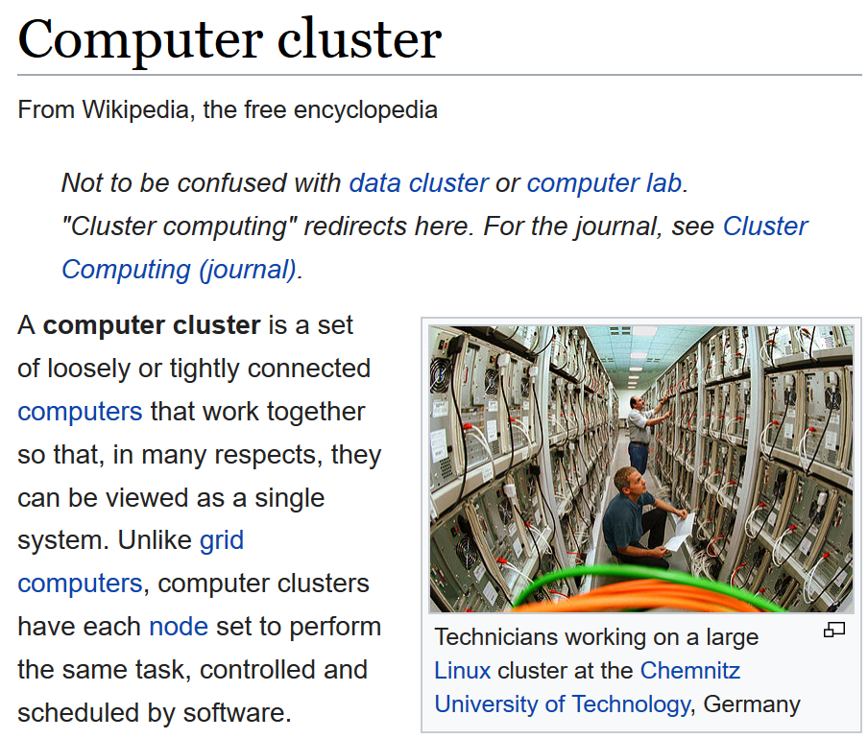
What is a computer cluster?
Wikipedia article on computer cluster
Notes:
The description found on Wikpedia is a pretty good one.
“A computer cluster is a set of loosely or tightly connected computers that work together so that, in many respects, they can be viewed as a single system. Unlike grid computers, computer clusters have each node set to perform the same task, controlled and scheduled by software.”
My term, “cluster computing” means “running programs on a computer cluster.” I like to use that term because it places the emphasis on the software side of things, and I’ve always been more of a software person than a hardware person.
Test1
This screenshot is of a web page that is licensed under the
Test2
This screenshot is of a web page that is licensed under the

Slide 4
Why would you want to use a computer cluster?
A cluster computer offers several advantages:
high availability
load balancing
scalability
parallel processing
Notes:
There are lots of reasons to use a computer cluster. In the next few slides, we’ll outline four of them.

Slide 5
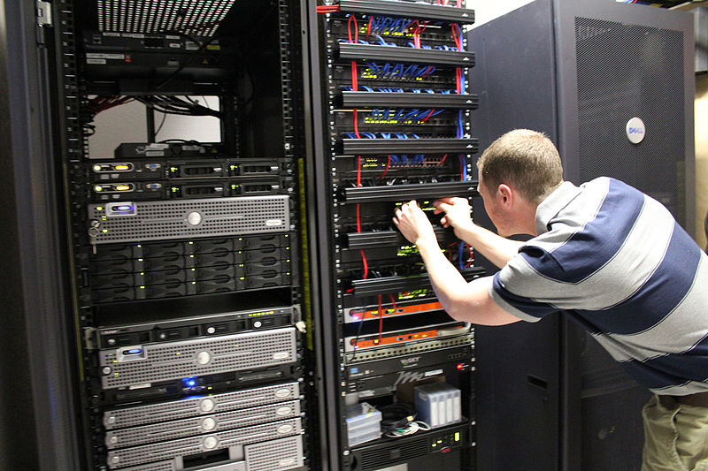
High availability
image of person working on a cluster computer
Notes:
Take notice of the number of components that appear multiple times in this picture of a computer cluster. With a bit of care, you can set up this system so that if one component within a computer cluster fails, the others components take over the work. In most systems, you can even swap in a new component for the one that fails without having to take the entire cluster down.
Has anyone in the audience actually seen a cluster computer? What does it look like? Has anyone actually performed maintenance on a cluster computer?
This image was found at Wikimedia Commons (https://en.wikipedia.org/wiki/File:InterWorksServer,jpg.jpg) and is licensed under the Creative Commons Attribution-ShareAlike 3.0 License.

Slide 6
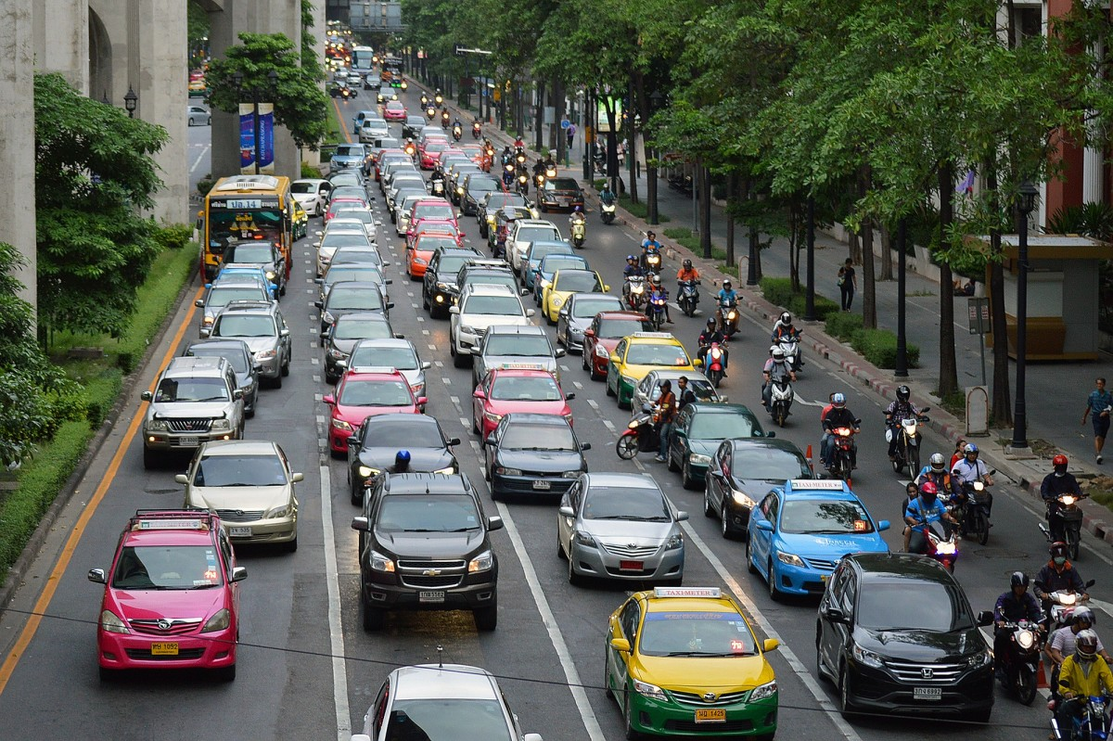
Load balancing
image of multiple lane road
Notes:
A cluster computer that receives and processes multiple requests for data can send the tasks to the components that are least busy. This is like multiple lanes on a road where you find the lane that is most open.
Load balancing is very important for websites that get a lot of traffic. A computer cluster devoted to serving web pages is known as a web farm.
This image was found at https://pxhere.com/en/photo/873405 and is licensed under the CC0 public domain license.

Slide 7
Scalability

