Slide 1
Software for cluster computing
Steve Simon, P.Mean Consulting

Slide 2
Abstract
This presentation will cover some of the software systems for cluster computing with an emphasis on R libraries that can work with these systems.
Notes:
There is a wide range of software systems for cluster computing. I wanted to provide a brief overview of these systems and some historical background to motivate why these systems were originally developed.
I am very interested in feedback from all of you. Have I summarized these software systems well? Are there other systems for cluster computing that I have neglected?

Slide 3
Common features of software systems for cluster computing
All of software systems described in this presentation are
distributed under open source licenses,
have lots of free documentation, and
run on any reasonable Unix based system.
Notes:
The nice thing about cluster computing is that the software used on computer clusters is easy to obtain and used. It uses liberal open source licenses. It has lots of high quality documentation and tutorials, most of which are free. These software systems run easily on any reasonable Unix based system including Raspbian, the system used commonly on the Raspberry Pi computer.
They also have, for the most part, versions for other operating systems like Windows. But if you are interested in learning about cluster computing, you are much better off if you learn it on a Unix-based system.

Slide 4
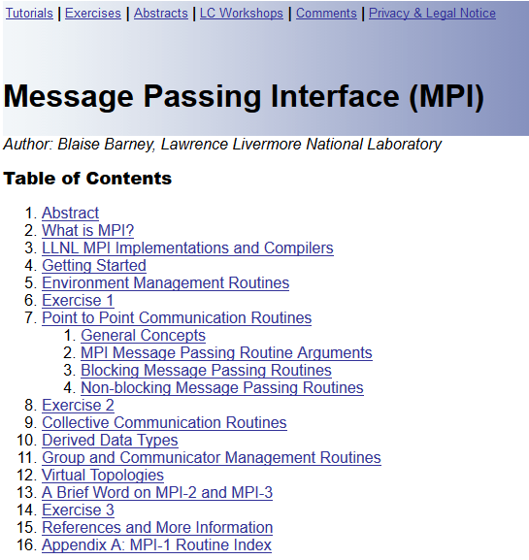
Message Passing Interface (MPI)
Screenshot from Blaise Barney’s MPI tutorial
Notes:
The oldest system for cluster computing, MPI, is still in use today. MPI stands for Message Passing Interface.
This is a screen shot from the Lawrence Livermore Naitonal Laboratory website, in a tutorial article on Message Passing Interface written by Blaise Barney (https://computing.llnl.gov/tutorials/mpi/). The article is copyrighted, and the excerpt used here is covered under the fair use provisions of copyright law.

Slide 5
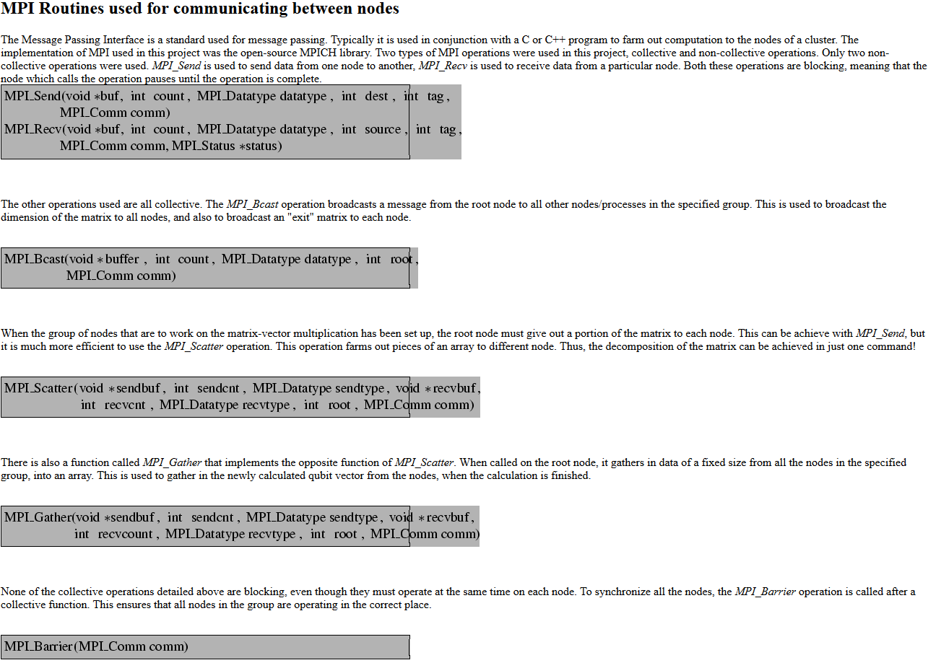
MPI is a routine library
Colm Ó hÉigeartaigh;’s website listing of MPI routines
Notes:
MPI is a collection of subroutines that you can call from old school programming languages like C++, or Fortran. But you can also run MPI in Python.
This is a screen shot from a tutorial on quantum computing written by Colm Ã“ hÃ‰igeartaigh (https://www.redbrick.dcu.ie/~hego/technicalmanual/node25.html). This webpage is copyrighted, and the excerpt used here is covered under the fair use provisions of copyright law.

Slide 6
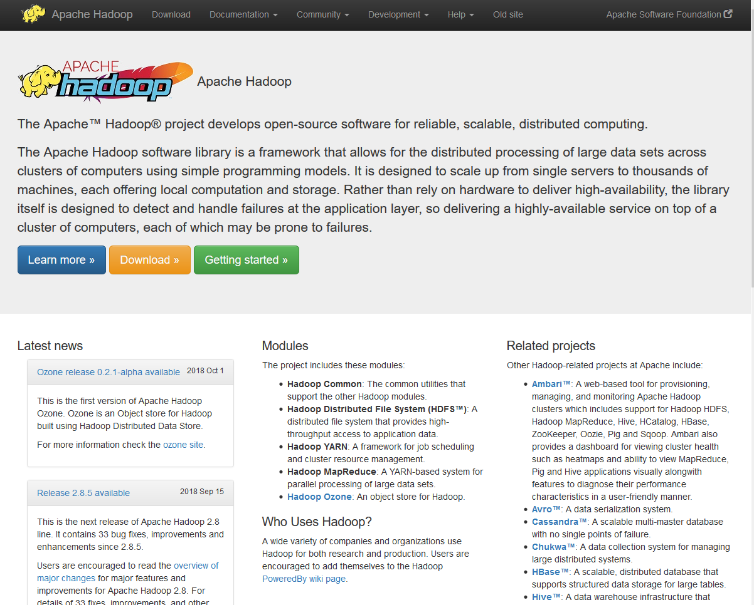
Hadoop
Screenshot from Apache Hadoop website
Notes:
Hadoop is a foundational tool upon which a large number of other cluster computing tools rely.
This is a screen shot from the home page of the Apache Hadoop website (https://hadoop.apache.org/). This webpage is copyrighted, and the excerpt used here is covered under the fair use provisions of copyright law.

Slide 7
Components of Hadoop
MapReduce
Hadoop Distributed File System (HDFS)
Hive
Pig

Slide 8
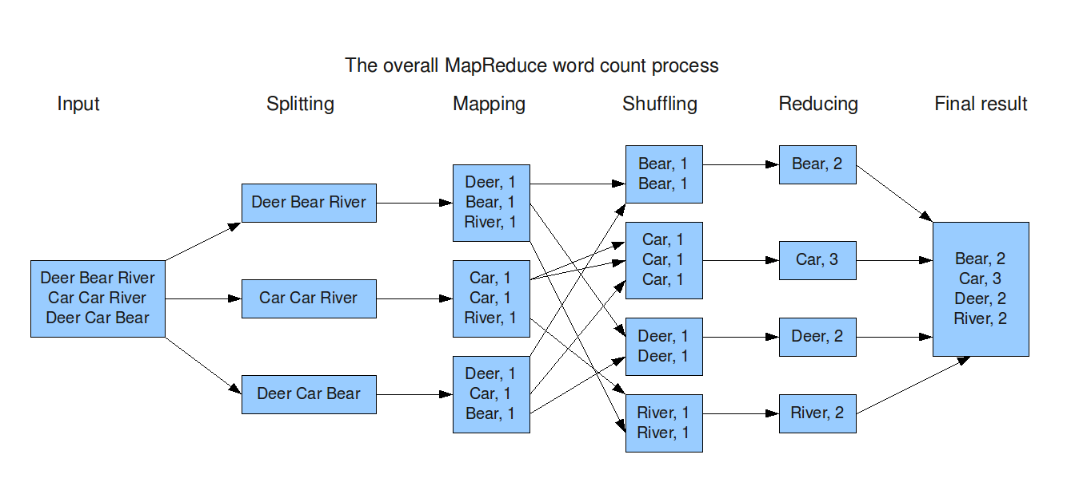
MapReduce
Mapreduce applied to a simple word count example
Notes:
Mapreduce is system for sending pieces of a programming problem to individual nodes of a cluster computer (the map part), having those nodes produce a summary (the reduce part), and then recombining the individual node summaries.
Although Mapreduce is at the heart and soul of Hadoop, it was originally developed by Google prior to the development of Hadoop. The term “mapreduce” has become a generic term for the algorithmic process.
This is an image from a blog posting on MapReduce written by Martijn van Groningen for the Trifork blog (https://blog.trifork.com/2009/08/04/introduction-to-hadoop/). This image is copyrighted, and is used here under the fair use provisions of copyright law.

Slide 9
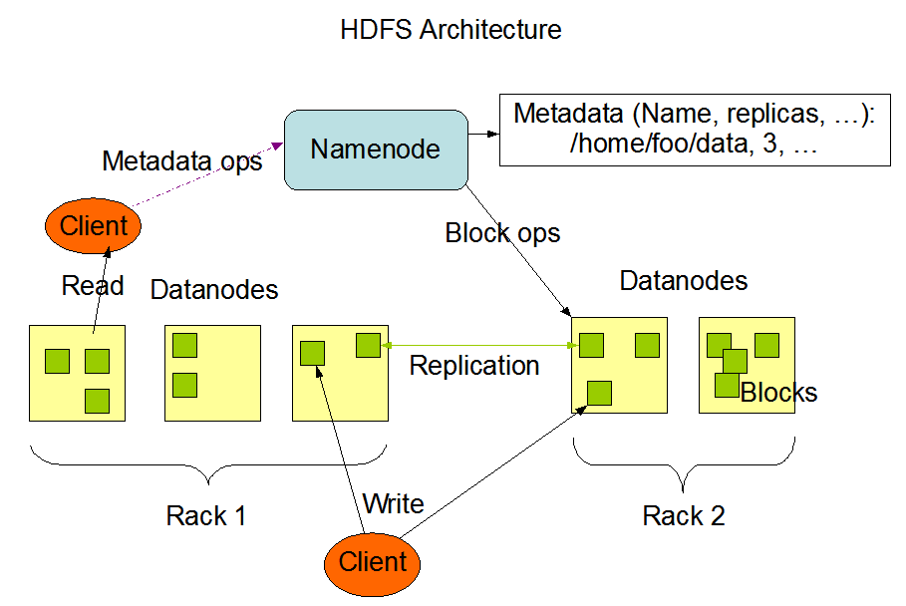
Hadoop Distributed File System (HDFS)
Illustration of HDFS architecture
Notes:
This is an image from a tutorial on HDFS on the Apache Spark website written (https://hadoop.apache.org/docs/r1.2.1/hdfs_design.html#NameNode+and+DataNodes). This image is copyrighted and is used under the fair use provisions of copyright law.

Slide 10
Pig

Slide 11
Hive

Slide 12
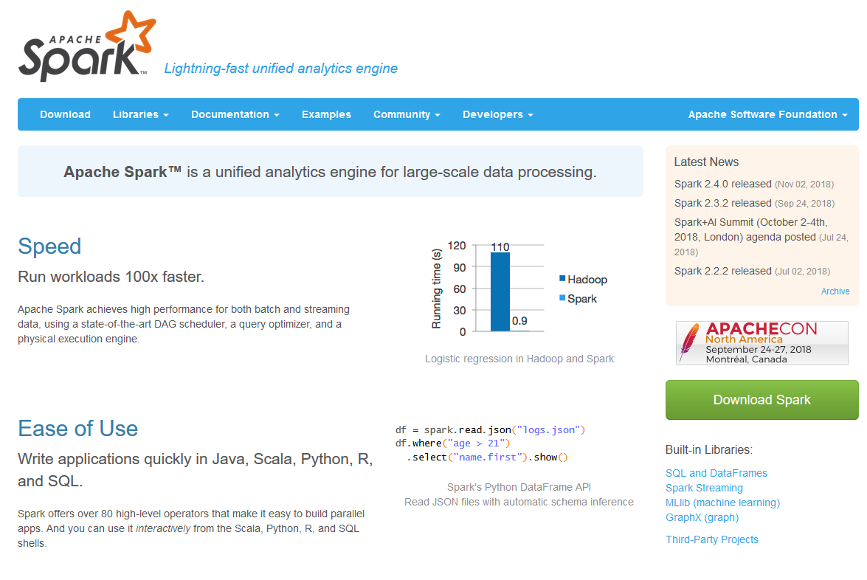
Spark
Screenshot of Apache Spark main web page
Notes:
This is a screen shot from the main page of the Apache Spark website (https://spark.apache.org/). This website is copyrighted, and this screenshot is used under the fair use provisions of copyright law.

Slide 13
Conclusion
This talk has covered
Message Passing Interface
Hadoop
MapReduce
HDFS
Pig
Hive
Spark
Notes:
In summary, …

