Slide 1
Data-viz=03, Tutorial on Gestalt principles
Steve Simon

Slide 2
More theory – The gestalt of graphics
How do you draw someone’s eye to quickly make certain associations?
These ideas drawn from the Bergen and Iverson workshop.
Gestalt definition
“The whole is greater than the sum of the parts”

Slide 3
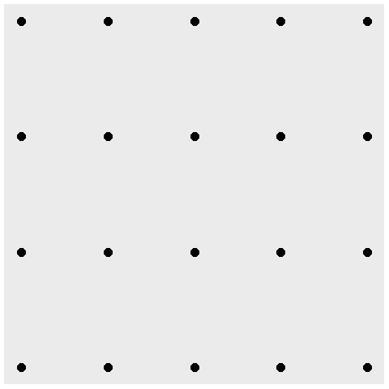
A block of points - no emphasis
Notes:
What you see in this graph is 20 individual points. When you design a graph, you want people to group things in a way to reveal patterns.

Slide 4
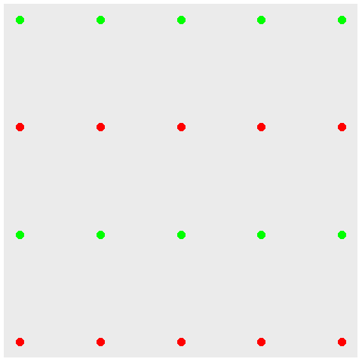
Color emphasizes rows

Slide 5
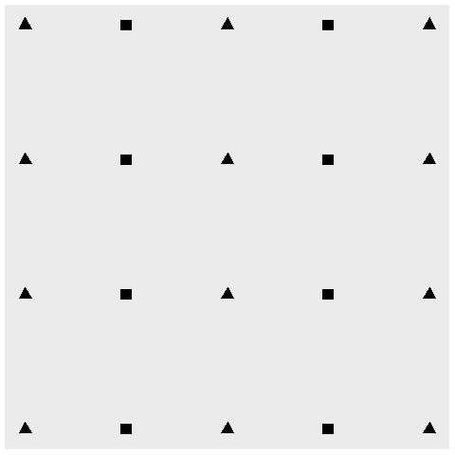
Shape emphasizes columns

Slide 6
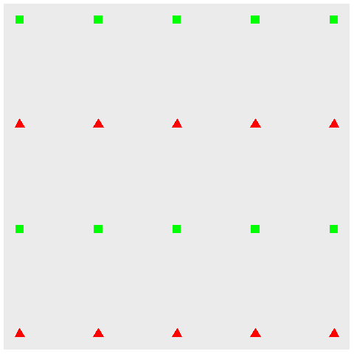
Double up for stronger emphasis

Slide 7
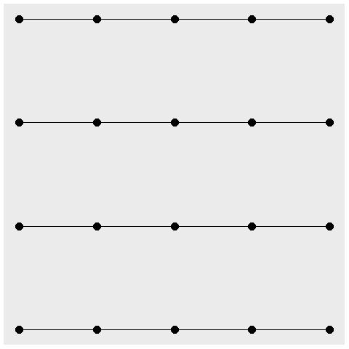
Connectedness emphasizes rows

Slide 8
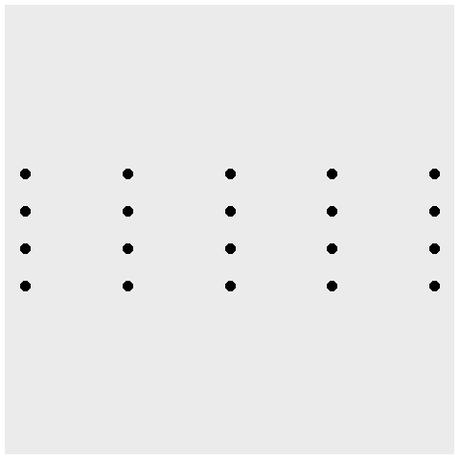
Proximity emphasize columns

Slide 9
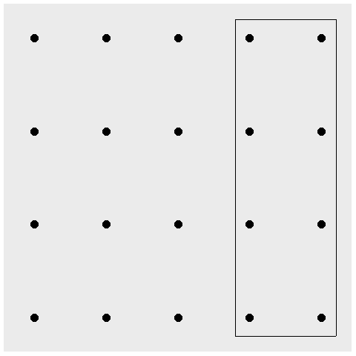
Enclosure for emphasis, eight special points

Slide 10
Continuity
((Show example of sloping text))

Slide 11
Changing your emphasis
((Recreate example from slides 47-50 of Bergen and Iverson))

