Slide 1
Exercise, connect averages
Steve Simon

Slide 2
Exercise, Connect individual averages
Draw a scatterplot showing
X = Bathrooms
Y = Age
Add a line connect the individual averages
Notes:
On your own, draw a similar plot. Put the number of bathrooms on the X axis and the age of the house on the Y-axis. Add a line conencting the individual averages.

Slide 3
Exercise, Python code
pts = alt.Chart(df).mark_point().encode( x='Bathrooms', y='Age' ) avg =alt.Chart(df).mark_line().encode( x='Bathrooms', y='mean(Age)' ) ch = pts+avg

Slide 4
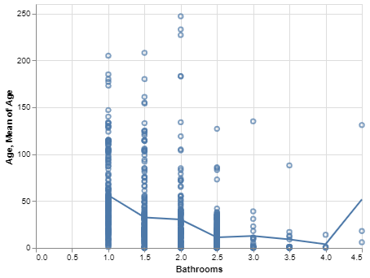
Exercise, Pyhton output
Python plot showing trend of age versus bathrooms

Slide 5
Exercise, R code
Here’s the R code
ggplot(saratoga_houses, aes(Bathrooms, Age)) + geom_point() + stat_summary(fun.y=mean, geom="line")
Notes:
The geom_point function creates the scatterplot and the stat_summary function adds the line.

Slide 6
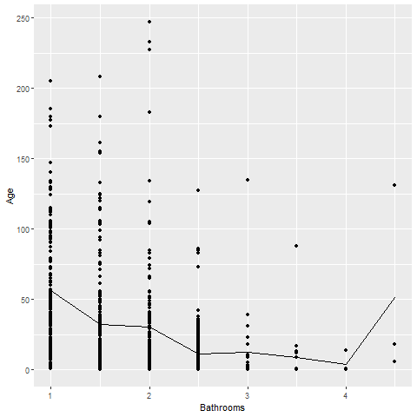
Exercise, R output
Notes:
There is a clear and consistent trend in the average age. The average age declines as the number of bathrooms increase. There is a blip at the end, but this is probably just an artefact due to the small sample size.

Slide 7
Exercise, Tableau steps

Slide 8
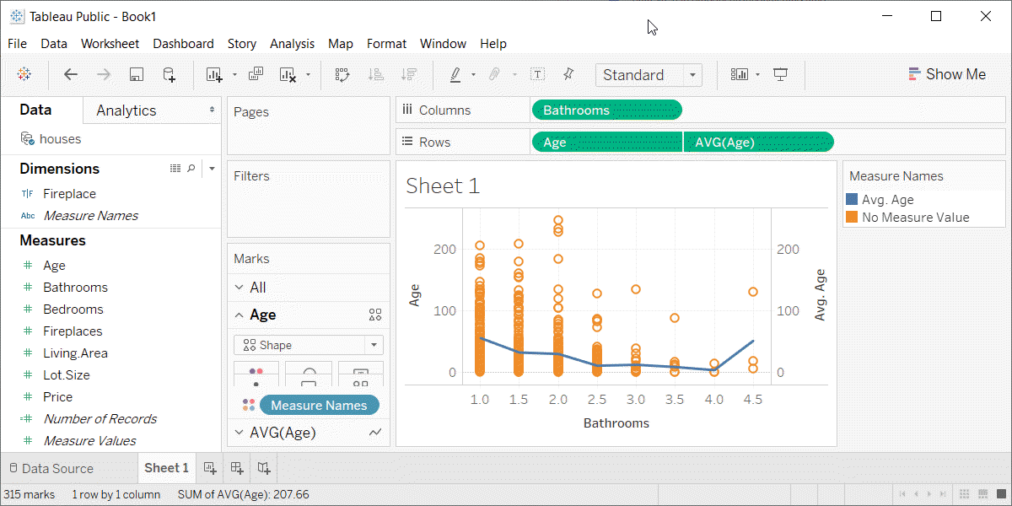
Exercise, Tabeleau output
Tableau plot showing trend in average age versus number of bathrooms

