Slide 1
Data visualization, line graphs
Steve Simon

Slide 2
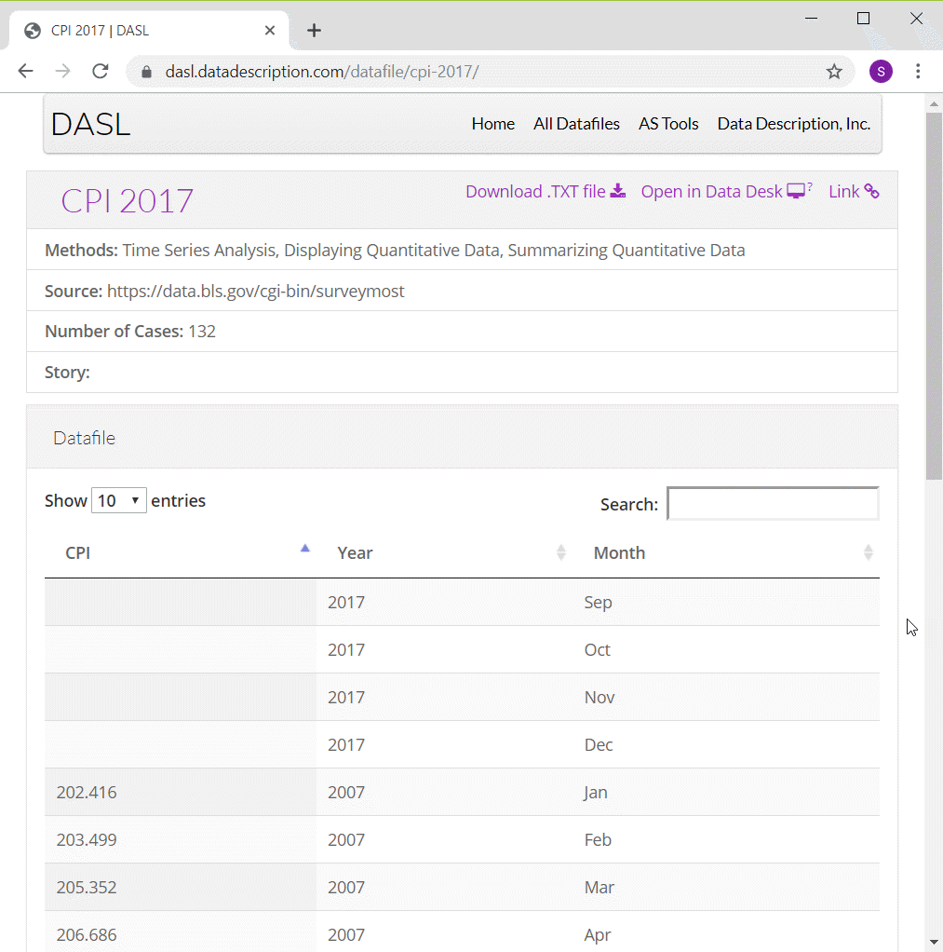
Preparation, DASL Consumer Price Index data
Screenshot of DASL website
Notes:
ONe of the data sets that I will use in this moldule on line graphs is monthly values of the Consumer Price Index from 2007 through 2016. I have to make some minor modifications to the data, adding a continuous variable for time and deleting four rows of data.
You can find information about this data set on the DASL website, but use the csv file that I created instead of the one from the DASL website.

Slide 3
Preparation, Pyhton code
Here’s the code in Python
import pandas as pd import altair as alt df = pd.read_csv("../../common-files/data/cpi.csv") ch = alt.Chart(df).mark_line().encode( x='t', y='CPI' ) ch.save("../images/python/basic-lineplot.html")
Notes:
Here is the Python code to read in the data and produce a simple line graph.

Slide 4
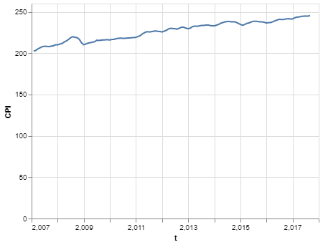
Preparation, Python graph
Line plot in Python

Slide 5
Preparation, R code
Here’s the code in R
cpi <- read.csv("../data/cpi.csv") ggplot(cpi, aes(x=t, y=CPI)) + geom_line()
Notes:
Here is the R code to read in the data and produce a simple line graph.

Slide 6
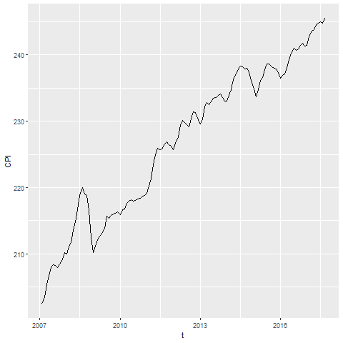
Preparation, R graph
Line graph showing increase over time of the consumer price index
Notes:
Here is what the graph looks like in R. See if you can reproduce it.

Slide 7
Preparation, Tableau steps
Import cpi.csv
Drag t to Columns
Change t to Dimension Continuous
Drag CPI to Rows
Chage CPI to Dimension Continuous
Change Marks to Line
Notes:
Here are the steps in creating a line graph in Tableau.

Slide 8
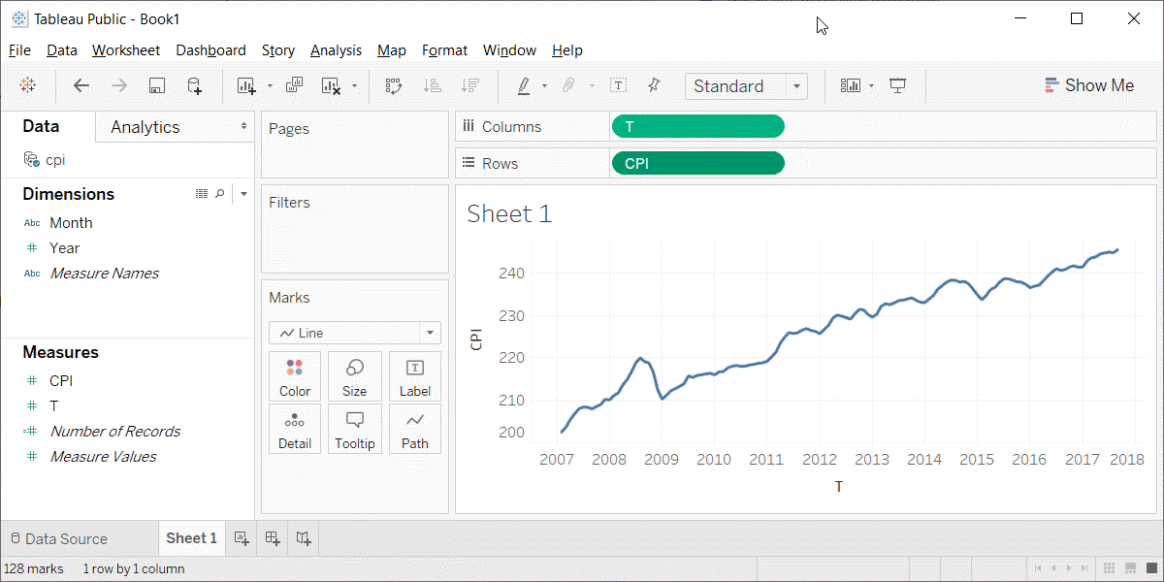
Preparation, Tableau graph
Line graph in Tableau

Slide 9
Group exercise
Review one of these graphs/newspaper articles
More Strikeouts Than Hits? Welcome to Baseball’s Latest Crisis.
Record shares of Americans now own smartphones, have home broadband.
F.D.A. Seeks Restrictions on Teens’ Access to Flavored E-Cigarettes and a Ban on Menthol Cigarettes.
What is the message? Summarize in 25 words or less.
Notes:
The following images are taken from various newspaper articles or press releases. Look at the graph and read/skim the article.
What message do you think the journalist is trying to convey with this graph. Summarize this message in 25 words or less.

Slide 10
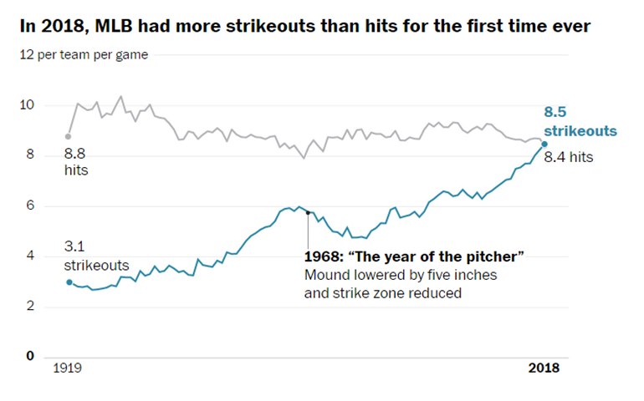
Graphs in the news, baseball strikeouts
Line graph of strikeouts and hits over time
Notes:
Tyler Kepner. More Strikeouts Than Hits? Welcome to Baseball’s Latest Crisis. The New York Times, Augst 16, 2018. Retrieved from https://www.nytimes.com/2018/08/16/sports/baseball-mlb-strikeouts.html.

Slide 11
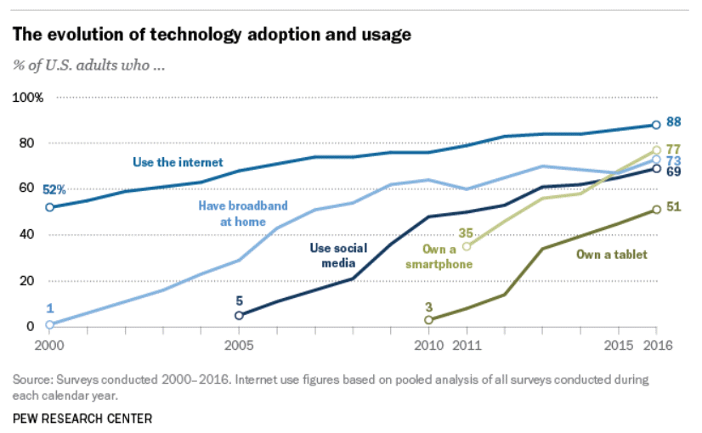
Graphs in the news, technology adaptation
Line graph of technology trends
Notes:
Aaron Smith, Record shares of Americans now own smartphones, have home broadband. Pew Research Center, January 12, 2017. Retrived August 14, 2019 from https://www.pewresearch.org/fact-tank/2017/01/12/evolution-of-technology/.

Slide 12
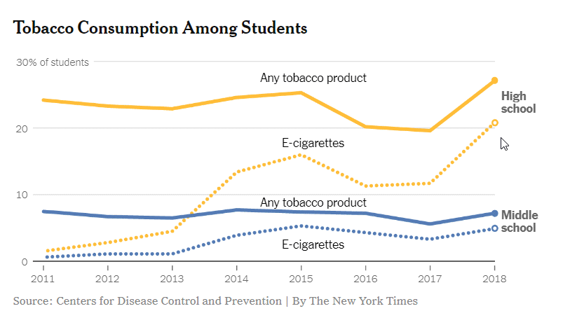
Graphs in the news, Tobacco and e-cigarette consumption
Line graph of tobacco and e-cigarette consumption
Notes:
Sheila Kaplan and Jan Hoffman, F.D.A. Seeks Restrictions on Teens’ Access to Flavored E-Cigarettes and a Ban on Menthol Cigarettes. The New York Times, November 15, 2018. Retrieved from http://nytimes.com/2018/11/15/health/ecigarettes-fda-flavors-ban.html

Slide 13
Graphs in the news, what is the message?
Your group will be assigned one particular graph and newspaper article
Read/skim the article and examine the graph
What is the message?
Summarize in 25 words or less.
Notes:
The following images are taken from various newspaper articles or press releases. Look at the graph and read/skim the article.
What message do you think the journalist is trying to convey with this graph. Summarize this message in 25 words or less.

Slide 14
Gestalt, introduction
These ideas drawn from the Bergen and Iverson workshop.
Gestalt definition
“The whole is greater than the sum of the parts”
How do you draw someone’s eye to quickly make certain associations?
Notes:
The Gestalt school of Psychology developed several principles that are very useful in helping to make an effective visualization. A simple definition of Gestalt is that the whole is more than just the individual items. There is a lot to Gestalt psychology, but the portion that is relevant to you is the ability to draw someone’s eye not to individual components of a graph, but to a group of related components that allow the viewer to see patterns or associations.

Slide 15
Gestalt theory in artistic design
Many lesssons in effective artistic design
The Gestalt Principles Spokane Falls Community College.
Gestalt Theory Sophia.
Gestalt Principles Applied to Design The Graybox blog, January 19, 2015.
Gestalt Principles Interaction Design Foundation.
Notes:
The field of artistic design is more commonly called graphic design, but I use the former term to distinguish it from statistical graphics. Artistic design is the use of typography, photography, and illustration to effectively convey a message. Artistic designers work on commercial logos, magazines and brochures, and product packaging.
These are interesting, and well worth some time viewing, even though they don’t speak directly to the process of developing effective visualizations.

Slide 16
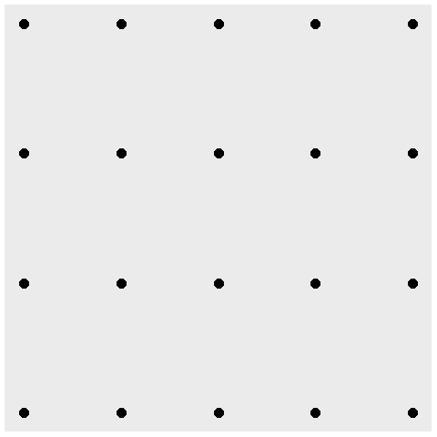
Gestalt, A block of points - no emphasis
Notes:
What you see in this graph is 20 individual points. When you design a graph, you want people to group things in a way to reveal patterns.

Slide 17
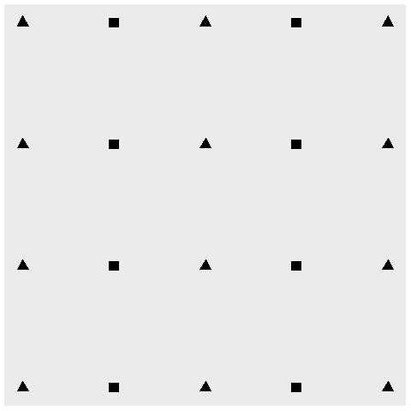
Gestalt, Similarity (shape)
Notes:
Items that are similar tend to be grouped together.
The use of common shapes causes you to see five columns rather than twenty individual data points.

Slide 18
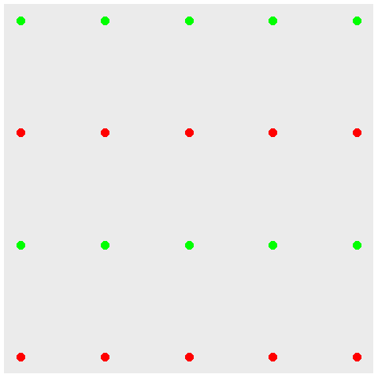
Gestalt, Similarity (color)
Notes:
Notice how the use of color tends to draw the eye in and see the graph as not 20 separate points, but rather four rows of points.
The effect of color is a lot stronger than the effect of shape.

Slide 19
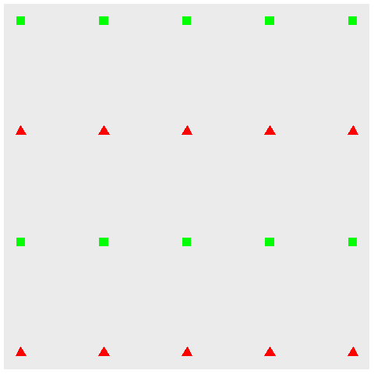
Gestalt, Double up for stronger emphasis
Notes:
You can double up by using a common shape AND a common color to develop an even stronger association.

Slide 20
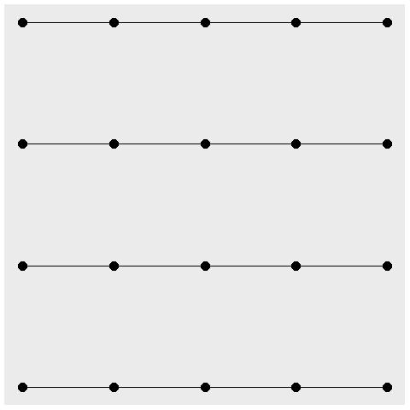
Gestalt, Connectedness
Notes:
A connection between individual points causes you to perceive those connected points as part of a single group. Here, you see four rows rather than five columns.

Slide 21
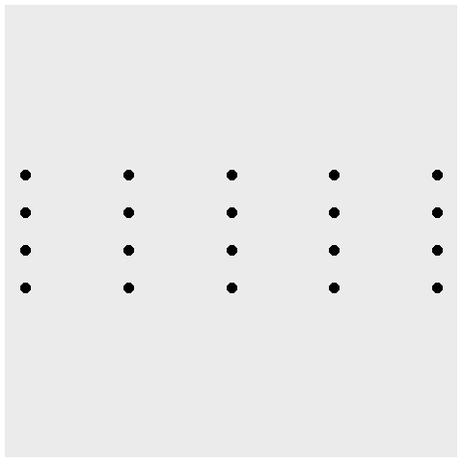
Gestalt, Proximity
Notes:
Points that are close to one another also tend to encourage their grouping. Notice that the scaling change caused the points within a column to be a lot closer than the points within a row. So you tend to see this as five columns rather than four rows.

Slide 22
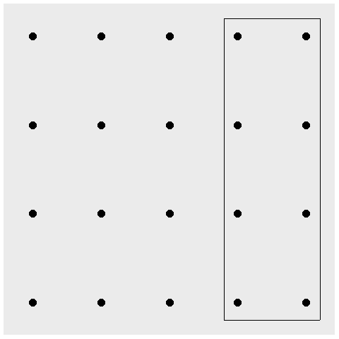
Gestalt, Enclosure for emphasis, eight special points
Notes:
An enclosure is a strong way to emphasize grouping. Here the box provides an emphasis on a special group of eight points.

Slide 23
Gestalt, contrast
(Show image of contrasts)
Notes:
The one pattern that deviates from the others tends to draw your eye toards it.

Slide 24
Gestalt, Continuity
(Show example of sloping text)
Notes:
A consistent trend or pattern between two elements of a graph will encourage you to group those elements together.

Slide 25
Gestalt, Common fate
(Show an image of five upward trends with two downward trends)

Slide 26
Fundamentals, how to produce a line graph
+The key step in Python
mark_line()
The key step in R
geom_line()
The key step in Tableau
Choose Line from the Marks pulldown list
Notes:
The basic steps to producing a line graph are fairly easy in each of the systems. In Tableau, you use the mark_line function. In R, you use the geom_line function. In Tableau, if you are lucky, the default graph choice will be a line graph. If not, select Line from the Marks list.

Slide 27
Fundamentals, Changing axis range
Python
alt.Y(scale=alt.Scale(zero=False))
or
alt.Y(scale=alt.Scale(domain=(200, 250)))
R code
expand_limits(y=0)
Tableau steps
(Add details)

Slide 28
Fundamentals, Show different types and locations of lines
((Show a curved line, a straight line, a line segment, a series of line segments, and a polygon. Show the code to create these.))

Slide 29
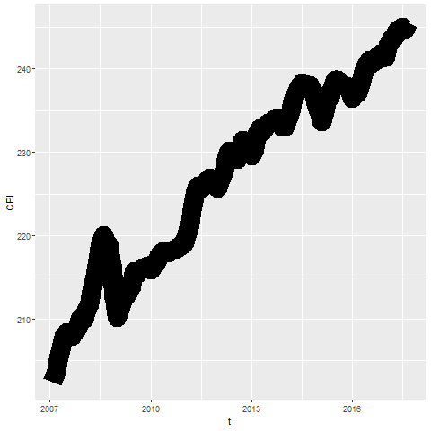
Fundamentals, Size
Notes:
Lines can change size, but some systems refer to this as line width rather than size.

Slide 30
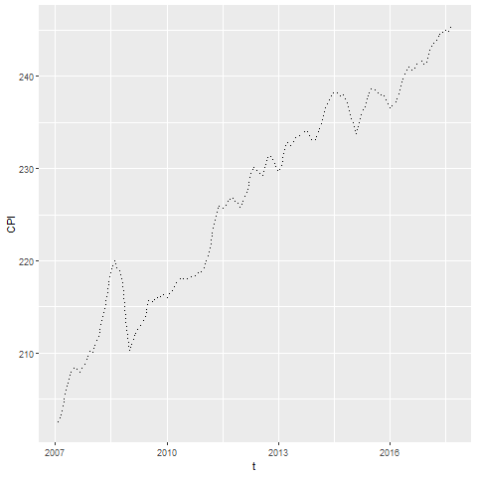
Fundamentals, Shape
Notes:
The shape of a line is not whether it is curved or straight. The shape of a line is whether it is represented using solid, dashed, or dotted lines. Most visualizations call this a line type rather than a line shape.

Slide 31
Exercise, change defaults
Draw a line graph with the cpi data
x=t
y=CPI
Change the defaults for the line
Use a dashed rather than a solid lineline to a dashed line.
Make the width equal to 3
Make the color green
Notes:
Take the CPI line graph and modify some of the default options. Make the line green and increase the thickness to three pixels. Use a dashed line instead of a dotted line.

Slide 32
Exercise, Python code
Here’s the Python code
ch = alt.Chart(df).mark_line( strokeDash=[5, 5, 2, 5] ).encode( alt.X('t'), alt.Y('CPI', scale=alt.Scale(domain=(200, 400))) )

Slide 33
Exercise, Python output

Slide 34
Exercise, R code
Here’s the R code
ggplot(cpi, aes(x=t, y=CPI)) + geom_line(size=3, linetype="dashed", color="green")

Slide 35
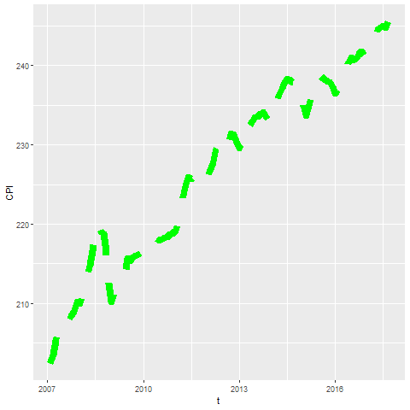
Exercise, R output

Slide 36
Exercise, Tableau steps

Slide 37
Exercise, Tableau output

Slide 38
Fundamentals, Adding lines to a scatterplot
Lines can emphasize patterns in a scatterplot
Connect means
Linear regression (not covered)
Moving average (not covered)
Smoothing splines (not covered)
Notes:
If you have a lot of data, a line can sometimes emphasize patterns or trends that you might miss with just a scatterplot.
You can do this by connecting lines between individual point means, a linear regression trend line, moving averages, or smoothing splines.
We will only cover the first approach connecting means. The other approaches are quite good and definitely worth talking about. Unfortunately, these alternative approaches are implemented inconsistently across the different programs.

Slide 39
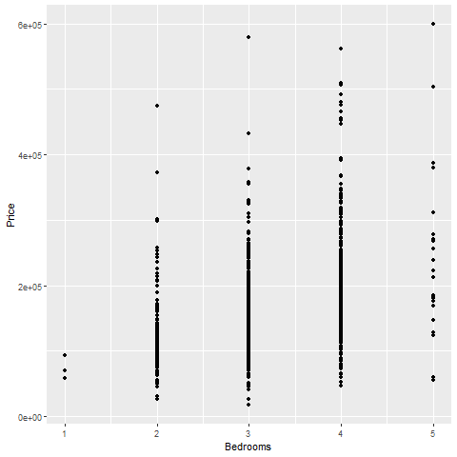
Fundamentals, Review an earlier scatterplot
Notes:
Here’s the housing data set that we looked at earlier. This scatterplot shows the relationship between number of bedrooms and price.

Slide 40
Fundamentals, Lines at individual averages, Python
Here’s the Python code
pts = alt.Chart(df).mark_point().encode( x='Bedrooms', y='Price' ) avg = alt.Chart(df).mark_line().encode( x='Bedrooms', y='mean(Price)' ) ch = pts + avg

Slide 41
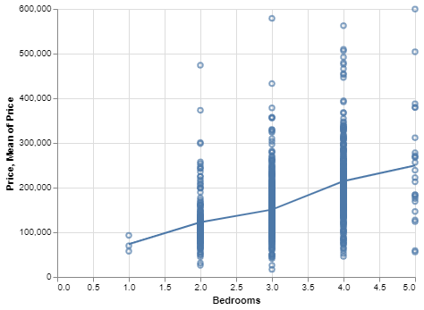
Python graph
Python graph with average summary line

Slide 42
Fundamentals, Lines at individual averages, R
Here’s the code in R
ggplot(saratoga_houses, aes(Bedrooms, Price)) + geom_point() + stat_summary(fun.y=mean, geom="line")
Notes:
Here is the R code. You need the stat_summary function to create averages for y at each discrete value of X.

Slide 43
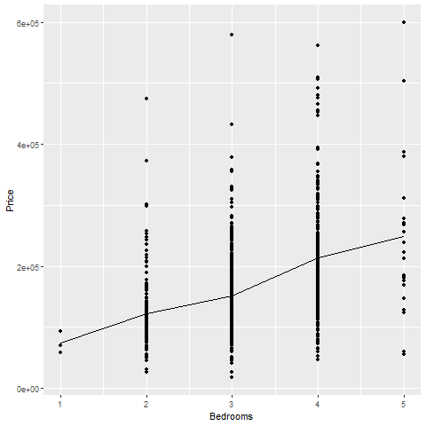
R output
Notes:
There is a clear and consistnet trend in the average price. As the number of bedrooms increase, the average price increases.

Slide 44
Fundamentals, Lines at individual averages, Tableau steps
Draw your normal scatterplot
Drag Price to opposite Y axis
Change to Measure(Average)
Change Marks for first plot to Shape
Right click on either Y axis
Select Synchronize Axis

Slide 45
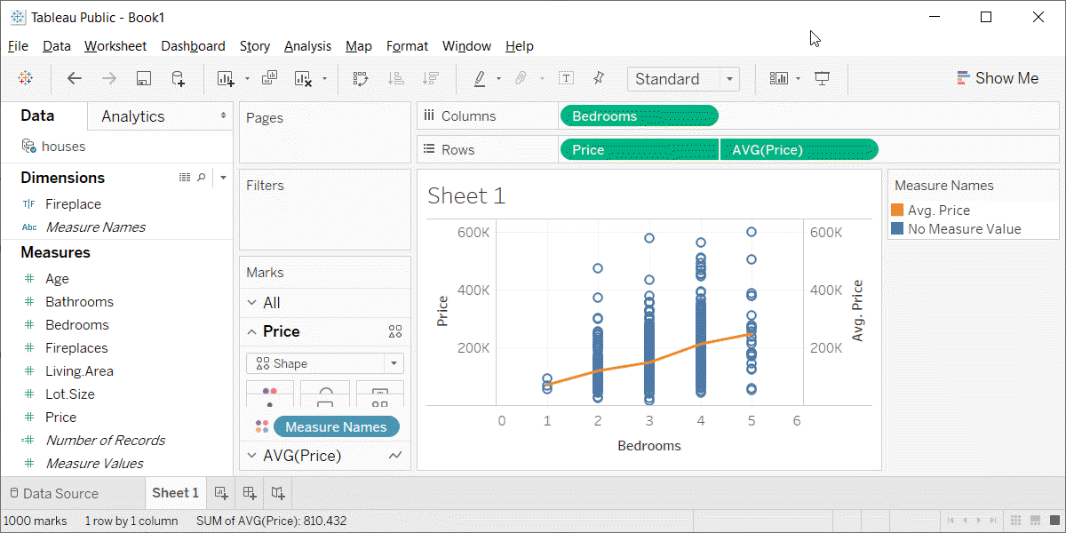
Fundamentals, Lines at individual averages, Tableau plot
Tableau plot with lines at individual averages

Slide 46
Exercise, Connect individual averages
Draw a scatterplot showing
X = Bathrooms
Y = Age
Add a line connect the individual averages
Notes:
On your own, draw a similar plot. Put the number of bathrooms on the X axis and the age of the house on the Y-axis. Add a line conencting the individual averages.

Slide 47
Exercise, Python code
pts = alt.Chart(df).mark_point().encode( x='Bathrooms', y='Age' ) avg =alt.Chart(df).mark_line().encode( x='Bathrooms', y='mean(Age)' ) ch = pts+avg

Slide 48
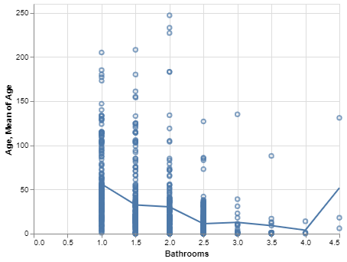
Exercise, Pyhton output
Python plot showing trend of age versus bathrooms

Slide 49
Exercise, R code
Here’s the R code
ggplot(saratoga_houses, aes(Bathrooms, Age)) + geom_point() + stat_summary(fun.y=mean, geom="line")
Notes:
The geom_point function creates the scatterplot and the stat_summary function adds the line.

Slide 50
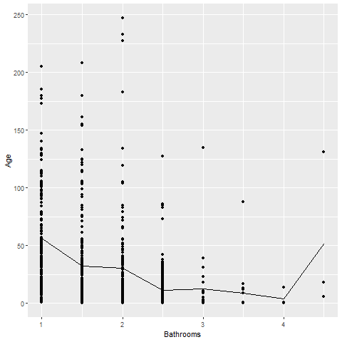
Exercise, R output
Notes:
There is a clear and consistent trend in the average age. The average age declines as the number of bathrooms increase. There is a blip at the end, but this is probably just an artefact due to the small sample size.

Slide 51
Exercise, Tableau steps

Slide 52
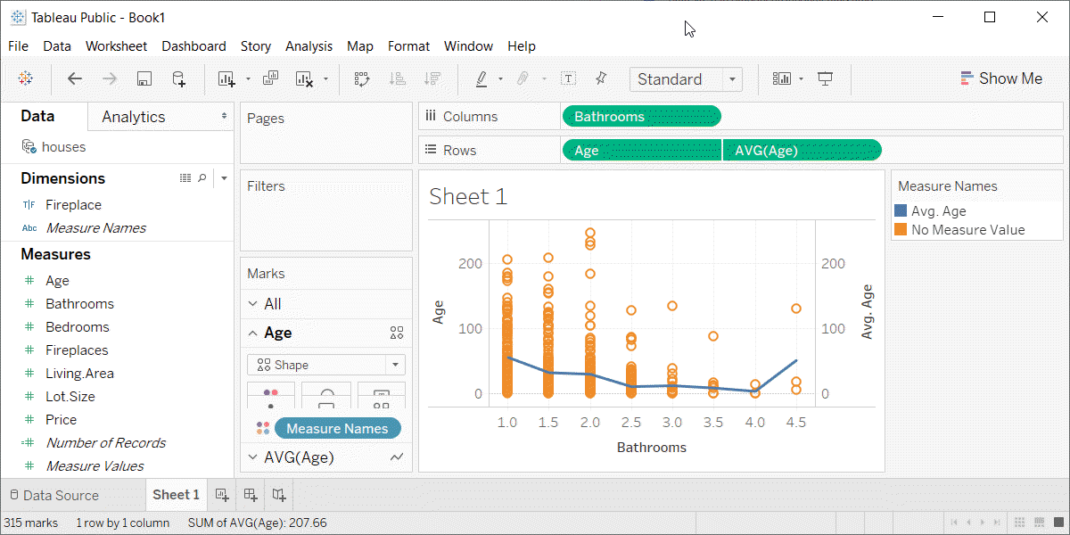
Exercise, Tabeleau output
Tableau plot showing trend in average age versus number of bathrooms

Slide 53
Families of lines
(Add three or four slides plus an exercise)

Slide 54
Experiment with gestalt principles
Some features are stronger than others
Different groupings lead to different messages
Limitations of high frequency data

Slide 55
Gestalt recommendations, Fictional data set
Ficitonal data on three individuals
## id name exam score ## 1 1 Able 1 80 ## 2 1 Able 2 50 ## 3 1 Able 3 20 ## 4 1 Able 4 22 ## 5 2 Baker 1 90 ## 6 2 Baker 2 70 ## 7 2 Baker 3 30 ## 8 2 Baker 4 28 ## 9 3 Charlie 1 20 ## 10 3 Charlie 2 30 ## 11 3 Charlie 3 70 ## 12 3 Charlie 4 73
Notes:
These ideas drawn from the Bergen and Iverson workshop. The data is purely fictional, but it is a great example of how you can emphasize different features of your data in a visualization.

Slide 56
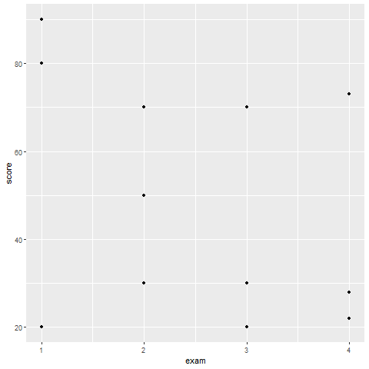
Gestalt recommendations, How do you establish groupings
Notes:
Here are the data points without any indication of which values belong to which individuals. How can you best show the individual values?

Slide 57
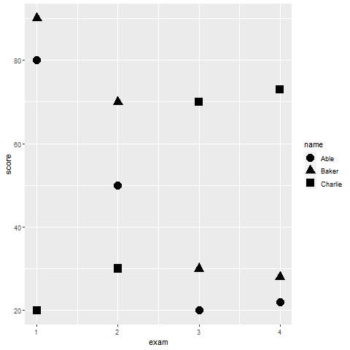
Gestalt recommendations, Using shape to establish groupings
Notes:
You are relying on the principle of similarity, and there needs to be sufficient dissimilarity in the different symbols to make this work. A closed circle, a closed square, and a closed triangle all loop pretty much alike. How can you get more contrast?

Slide 58
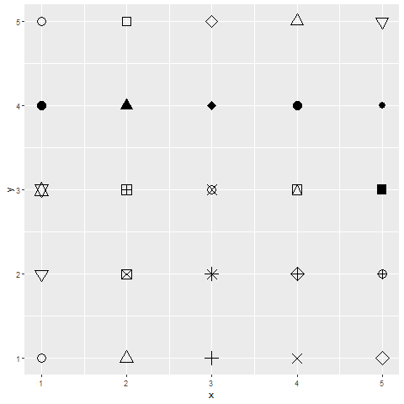
Gestalt recommendations, shape choices in R

Slide 59
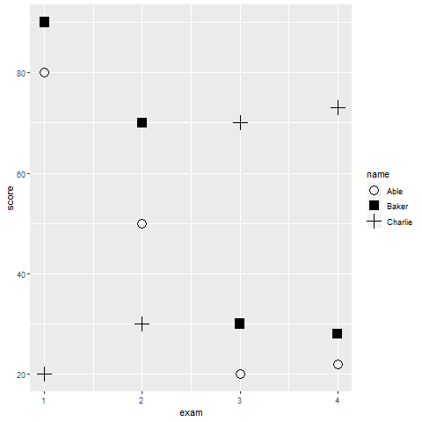
Gestalt recommendations, Better contrasting shapes
Notes:
You are relying on the principle of similarity, and there needs to be sufficient dissimilarity in the different symbols to make this work. A closed circle, a closed square, and a closed triangle all loop pretty much alike. How can you get more contrast?

Slide 60
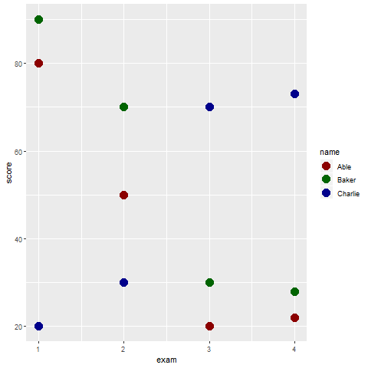
Gestalt recommendations, Color
Notes:
You are relying on the principle of similarity, and there needs to be sufficient dissimilarity in the different symbols to make this work. A closed circle, a closed square, and a closed triangle all loop pretty much alike. How can you get more contrast?

Slide 61
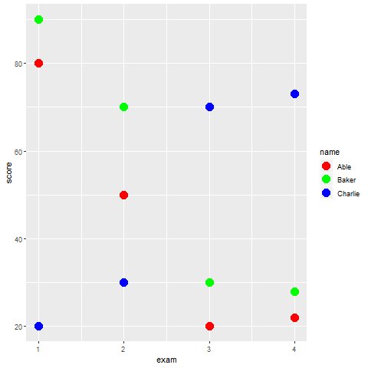
Gestalt recommendations, Color
Notes:
You are relying on the principle of similarity, and there needs to be sufficient dissimilarity in the different symbols to make this work. A closed circle, a closed square, and a closed triangle all loop pretty much alike. How can you get more contrast?

Slide 62
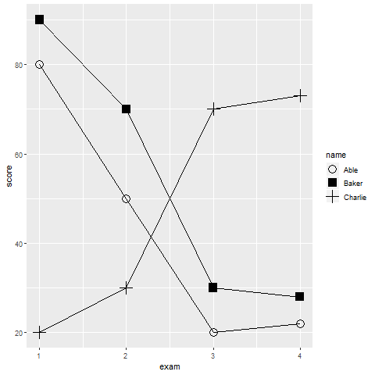
Gestalt recommendations, Connectedness
Notes:
Connectedness provides a much stronger sense of gestalt than similarity.

Slide 63
Gestalt, Text versus legend
Legends
Violates the rule of proximity
Use color cues, if possible
Replace with text labels on the graph
Use letter codes

Slide 64
Gestalt, Color cues
(Use color in legend names)

Slide 65
Gestalt, Letter codes
(Show text symbols A, B, and C)

Slide 66
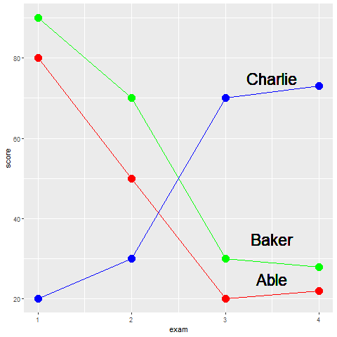
Gestalt, text labels
Notes:
By putting the labels directly on the graph, you minimize the distance that your eye has to travel. No more back and forth between the legend and the graph.
You can improve further on these labels. You might have had a moment of hesitation when you saw the label for Abel. Does it belong with the line just above or the line just below. It only slows you down for a second, because by process of elimination, you can quickly decide that it belongs with the line just below it.
But you can improve the sense of belongingness by using some of your Gestalt principles.

Slide 67
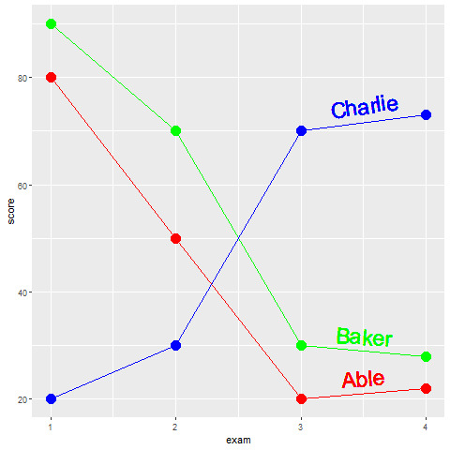
Gestalt, text labels
Notes:
Notice how the labels in this example have been moved closer to the lines. The exploits the Gestalt principle of proximity. Notice how the names have the same colors as the lines. Thie exploits the Gestalt principle of similarity. It would be very hard to incorrectly assign the red label of Abel with the green line of Baker. Notice further that the labels have a slope that roughly matches the lines they are attached to. This exploits the Gestalt principle of common fate.

Slide 68
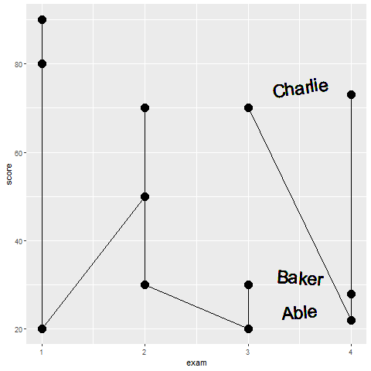
What patterns do you see in this graph?
Notes:
There are at least two messages hiding in this graph. What are they?

Slide 69
Recomendations, line graphs
High frequenct events
Avoid think lines, long dashes.
Notes:
High frequency events are sudden surges and dips in a line over a narrow range. If your data has high frequency events (think stock market prices), then avoid thick lines or long dashes. These can hide some of the high frequency events.

Slide 70
Recommendations, show variation
Original data
Error bars
Confidence bands
Boxplots

Slide 71
Graphs in the news, what are the aesthetics?
What aesthetics (location, shape, size, color) are used?
What aesthetics are not used?
What variables are mapped to which aesthetics?
Notes:
Review the same newspaper article and graph that you used earlier. Identify the various aesthetics that are used or are not used in your graph. What variables are associated with which aesthetics?

Slide 72
Quick quiz (1 of 4)
Data visualization is a mapping of data to the visual aesthetics of geometries/marks. Some examples of visual aesthetics include (choose all that apply)
Size
Points
Shapes
Notes:
Answer: 1 and 3 (size and shapes)

Slide 73
Quick quiz (2 of 4)
The log transformation works by (choose the best answer)
Stretching all data values equally.
Stretching the small values and squeezing the large values.
Stretching the large values and squeezing the small values.
Notes:
Answer: 2 (strethcing the small values and squeezing the large values)

Slide 74
Quick quiz (3 of 4)
Strategies that can sometimes help when you have a lot of problems with overprinting include (choose all that apply)
Using open circles
Using large size points
Using translucent points
Notes:
Answer: 1 and 3 (using open circles and translucent points)

Slide 75
Quick quiz (4 of 4)
The two visual aesthetics that doen’t work well together are (choose the best answer)
color and size
color and shape
size and shape
Notes:
Answer: 3 (size and shape)

Slide 76
Advanced exercise
There is a second data set on sleep in mammals. You can find a brief description of this data set at
http://www.statsci.org/data/general/sleep.html
You can download the actual data at
http://www.statsci.org/data/general/sleep.txt
Notes:
Continue your work on this data set. Review the description of each variable on the website shown here.

Slide 77
Advanced exercise
Update your visualization.
Apply some of the new methods and recommendations
Examine interrelationships
gestation, lifespan
predation, bodywt,
exposure, totalsleep
Divide the work among different group members
Notes:
For a final assignment in this section, take the same data set on sleep in mammals. Rework and update your visualizations. Use some of the principles and recommendations presented in this section. Compare line graphs to the scatterplots that you used earlier. Which works better?
You can examine any interrelationships, but three possible areas for exploration are the relationships between gestation and lifespan, predation and bodywt, and exposure and totalsleep. Feel free to incorporare an additional variable of interest in your visualization that you feel might be relevant.

Slide 78
Summary
Gestalt principles
((List here))
Aesthetics for lines
Size, Shape, Color
Lines as summary statistics
Families of lines

