Slide 1
Line graphs, Fundamentals
Steve Simon

Slide 2
Fundamentals, how to produce a line graph
+The key step in Python
mark_line()
The key step in R
geom_line()
The key step in Tableau
Choose Line from the Marks pulldown list
Notes:
The basic steps to producing a line graph are fairly easy in each of the systems. In Tableau, you use the mark_line function. In R, you use the geom_line function. In Tableau, if you are lucky, the default graph choice will be a line graph. If not, select Line from the Marks list.

Slide 3
Fundamentals, Changing axis range
Python
alt.Y(scale=alt.Scale(zero=False))
or
alt.Y(scale=alt.Scale(domain=(100, 200)))
R code
expand_limits(y=0)
or
ylim(100, 200)
Tableau steps
Double click on axis
Notes:
This example is the first one where you can see a big difference between the default options. Python wants to include zero on the y-axis, no matter what. It may make sense for a barchart to always include zero, but it is less obvious for a line graph.
To override the default Python option of showing zero on the Y axis, include the zero=False statement in the Scale function. Or you can specify a particular set of limits using the domain option in the Scale function.
R does not always include zero, but if you want, you can force R to include zero with the expand_limits function. Or you can specify a lower and upper limit with the ylim function.
Tableau also does not always include zero. To modify the limits of an axis in Tableau, you double click on it to get a dialog box.

Slide 4
Fundamentals, Aesthetics for lines
Location
Size
Shape (not what you think it is!)
Color
Notes:
A line could mean a straight line or a curved line, a single line segment, a connected series of line segments or a polygon. It’s a pretty complex thing, but generally a line represents a two dimensional relationship.
You can vary the size, shape, and color of a line. Shape is not what you think it is.

Slide 5
Fundamentals, Location
Sequence of x,y pairs
sorted by x
Connected in order (cannot double back)
Alternatives to lines
Paths
Polygons
Notes:
A line could mean a straight line or a curved line. You get a curve by connecting small straight line segments. If the segments are small enough, you don’t even notice. One requirement of a line is that the X values are sorted from low to high and are connected in order. This means that the line cannot double back on itself.
An alternative to a line is a path, which is allowed to meander in any direction including reversing course in the X direction one or more times. A polygon is a path that does not intersect itself and which returns at the end to the point at which it started. Paths and polygons will not be a major focus in this presentation, but the principles that apply to lines generally apply equally well to paths and polygons.

Slide 6
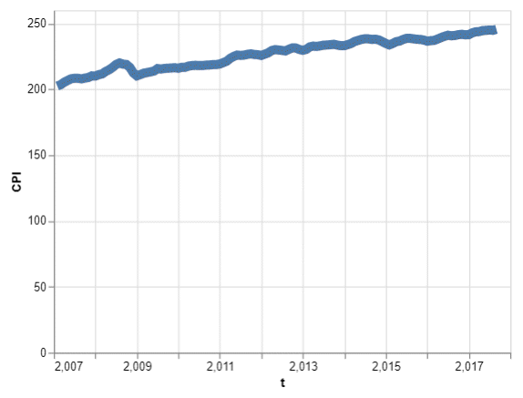
Fundamentals, Size
Line graph with thick line

Slide 7
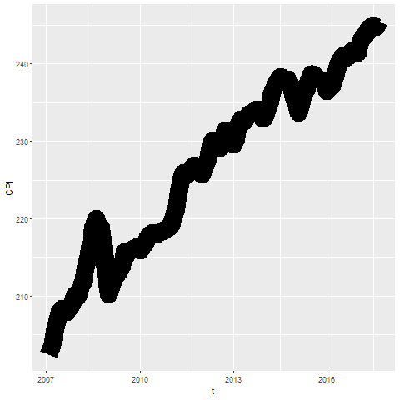
Fundamentals, Size
Notes:
Lines can change size, but some systems refer to this as line width rather than size. You might use a thick line at times to create a greater emphasis, but it does tend to obscure small sudden changes in this current graph.

Slide 8
Fundamentals, Size
Python code
mark_line(size=8)
R code
geom_line(size=8)
Tableau
Click on size button
Notes:
To change the line thickeness in R, use the size= option inside the geom_line function.

Slide 9
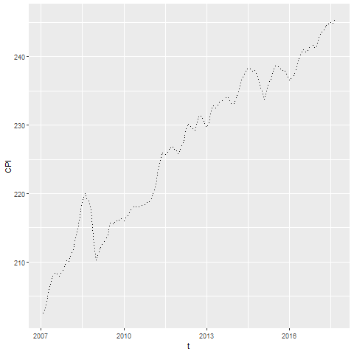
Fundamentals, Shape
Notes:
The shape of a line is not whether it is curved or straight. The shape of a line is whether it is represented using solid, dashed, or dotted lines. Most visualizations call this a line type rather than a line shape.

Slide 10
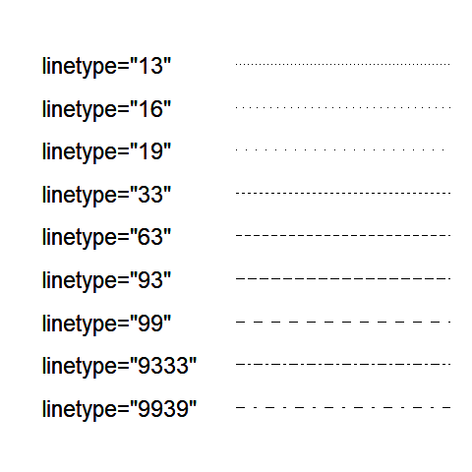
Fundamentals, Shape
Notes:
There is a code for dotted and dashed line patterns that works pretty much the same way for both Python and R. You specify a sequence of two (sometimes four) numbers. The odd numbered values (first, third, etc.) represent an “on” number of pixels which specifies the length of the dash. The even numbered values (second, fourth, etc.) represent an “off” number of pixels

Slide 11
Fundamentals, Shape
Tableau code
mark_line(strokeDash=[5, 2, 2, 2])
R code
geom_line(linetype="5222")
Tableau
NO easy solution
Notes:
In Python, set the strokeDash argument to create various dotted and dashed lines. In R, use the linetype argument. Tableau allows you a lot of freedom in choosing between dotted and dashed lines when you have two or more lines on a single graph, but it is surprisingly hard to deviate from the formal default of a solid line when you only have a single line on your graph. This is annoying, but quite honestly, there is little reason to deviate from a solid line when you only have one line on your graph.

Slide 12
Exercise, change defaults
Draw a line graph with the cpi data
x=t
y=CPI
Change the defaults for the line
Use a dashed rather than a solid lineline to a dashed line.
Make the width equal to 3
Make the color green
Notes:
Take the CPI line graph and modify some of the default options. Make the line green and increase the thickness to three pixels. Use a dashed line instead of a dotted line.

Slide 13
Exercise, Python code
Here’s the Python code
ch = alt.Chart(df).mark_line( strokeDash=[5, 5, 2, 5] ).encode( alt.X('t'), alt.Y('CPI', scale=alt.Scale(domain=(200, 400))) )

Slide 14
Exercise, Python output

Slide 15
Exercise, R code
Here’s the R code
ggplot(cpi, aes(x=t, y=CPI)) + geom_line(size=3, linetype="dashed", color="green")

Slide 16
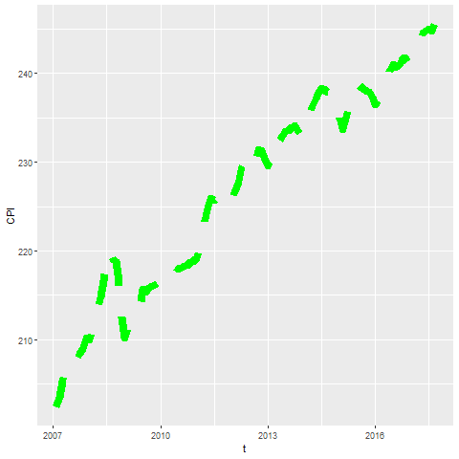
Exercise, R output

Slide 17
Exercise, Tableau steps

Slide 18
Exercise, Tableau output

Slide 19
Fundamentals, Adding lines to a scatterplot
Lines can emphasize patterns in a scatterplot
Connect means
Linear regression (not covered)
Moving average (not covered)
Smoothing splines (not covered)
Notes:
If you have a lot of data, a line can sometimes emphasize patterns or trends that you might miss with just a scatterplot.
You can do this by connecting lines between individual point means, a linear regression trend line, moving averages, or smoothing splines.
We will only cover the first approach connecting means. The other approaches are quite good and definitely worth talking about. Unfortunately, these alternative approaches are implemented inconsistently across the different programs.

Slide 20
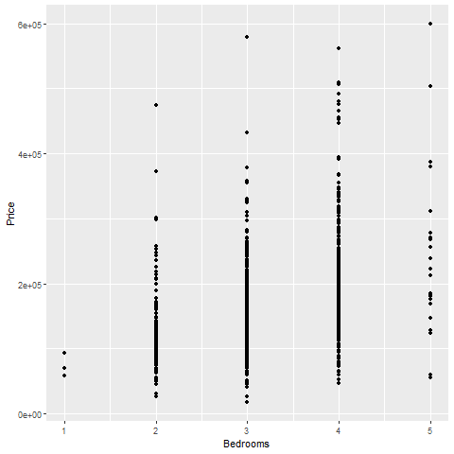
Fundamentals, Review an earlier scatterplot
Notes:
Here’s the housing data set that we looked at earlier. This scatterplot shows the relationship between number of bedrooms and price.

Slide 21
Fundamentals, Lines at individual averages, Python
Here’s the Python code
pts = alt.Chart(df).mark_point().encode( x='Bedrooms', y='Price' ) avg = alt.Chart(df).mark_line().encode( x='Bedrooms', y='mean(Price)' ) ch = pts + avg

Slide 22
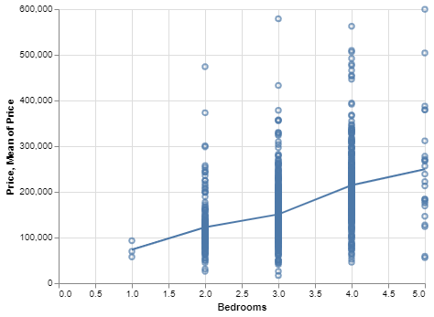
Python graph
Python graph with average summary line

Slide 23
Fundamentals, Lines at individual averages, R
Here’s the code in R
ggplot(saratoga_houses, aes(Bedrooms, Price)) + geom_point() + stat_summary(fun.y=mean, geom="line")
Notes:
Here is the R code. You need the stat_summary function to create averages for y at each discrete value of X.

Slide 24
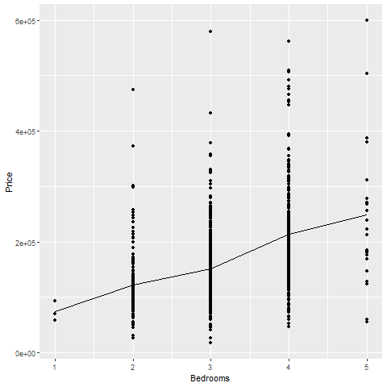
R output
Notes:
There is a clear and consistnet trend in the average price. As the number of bedrooms increase, the average price increases.

Slide 25
Fundamentals, Lines at individual averages, Tableau steps
Draw your normal scatterplot
Drag Price to opposite Y axis
Change to Measure(Average)
Change Marks for first plot to Shape
Right click on either Y axis
Select Synchronize Axis

Slide 26
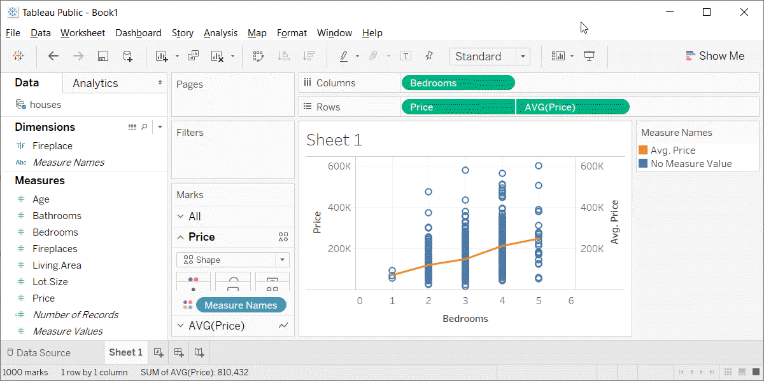
Fundamentals, Lines at individual averages, Tableau plot
Tableau plot with lines at individual averages

Slide 27
Exercise, Connect individual averages
Draw a scatterplot showing
X = Bathrooms
Y = Age
Add a line connect the individual averages
Notes:
On your own, draw a similar plot. Put the number of bathrooms on the X axis and the age of the house on the Y-axis. Add a line conencting the individual averages.

Slide 28
Exercise, Python code
pts = alt.Chart(df).mark_point().encode( x='Bathrooms', y='Age' ) avg =alt.Chart(df).mark_line().encode( x='Bathrooms', y='mean(Age)' ) ch = pts+avg

Slide 29
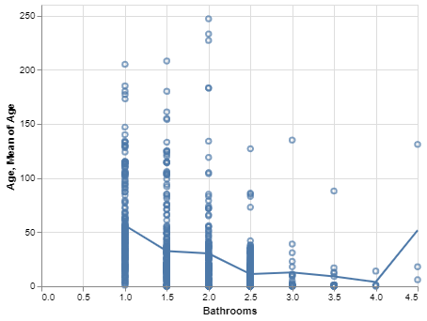
Exercise, Pyhton output
Python plot showing trend of age versus bathrooms

Slide 30
Exercise, R code
Here’s the R code
ggplot(saratoga_houses, aes(Bathrooms, Age)) + geom_point() + stat_summary(fun.y=mean, geom="line")
Notes:
The geom_point function creates the scatterplot and the stat_summary function adds the line.

Slide 31
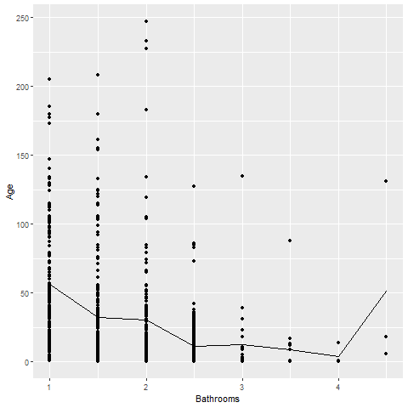
Exercise, R output
Notes:
There is a clear and consistent trend in the average age. The average age declines as the number of bathrooms increase. There is a blip at the end, but this is probably just an artefact due to the small sample size.

Slide 32
Exercise, Tableau steps

Slide 33
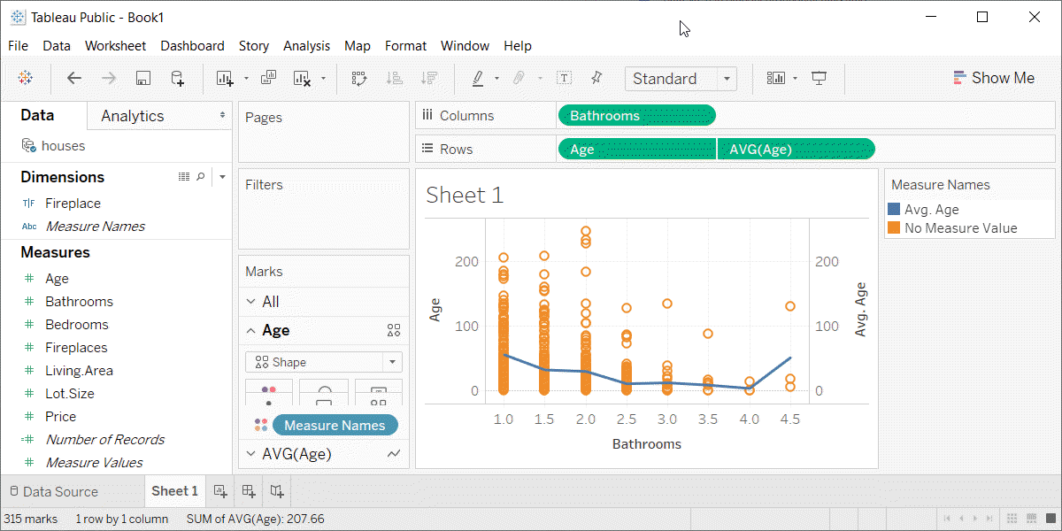
Exercise, Tabeleau output
Tableau plot showing trend in average age versus number of bathrooms

Slide 34
Families of lines
(Add three or four slides plus an exercise)

