Slide 1
Exercise, change line defaults
Steve Simon

Slide 2
Exercise, change defaults
Draw a line graph with the cpi data
x=t
y=CPI
Change the defaults for the line
Use a dashed rather than a solid lineline to a dashed line.
Make the width equal to 3
Make the color green
Notes:
Take the CPI line graph and modify some of the default options. Make the line green and increase the thickness to three pixels. Use a dashed line instead of a dotted line.

Slide 3
Exercise, Python code
Here’s the Python code
ch = alt.Chart(df).mark_line( strokeDash=[5, 5, 2, 5] ).encode( alt.X('t'), alt.Y('CPI', scale=alt.Scale(domain=(200, 400))) )

Slide 4
Exercise, Python output

Slide 5
Exercise, R code
Here’s the R code
ggplot(cpi, aes(x=t, y=CPI)) + geom_line(size=3, linetype="dashed", color="green")

Slide 6
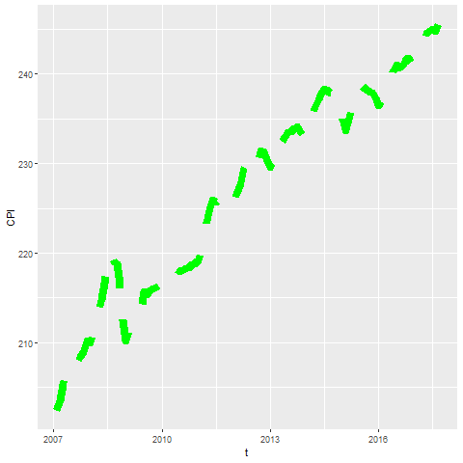
Exercise, R output

Slide 7
Exercise, Tableau steps

Slide 8
Exercise, Tableau output

