Slide 1
Line graphs, Fundamentals
Steve Simon

Slide 2
Fundamentals, how to produce a line graph
+The key step in Python
mark_line()
The key step in R
geom_line()
The key step in Tableau
Choose Line from the Marks pulldown list
Notes:
The basic steps to producing a line graph are fairly easy in each of the systems. In Tableau, you use the mark_line function. In R, you use the geom_line function. In Tableau, if you are lucky, the default graph choice will be a line graph. If not, select Line from the Marks list.

Slide 3
Fundamentals, Aesthetics for lines
Location
Size
Shape (not what you think it is!)
Color
Notes:
A line could mean a straight line or a curved line, a single line segment, a connected series of line segments or a polygon. It’s a pretty complex thing, but generally a line represents a two dimensional relationship.
You can vary the size, shape, and color of a line. Shape is not what you think it is.

Slide 4
Fundamentals, Show different types and locations of lines
((Show a curved line, a straight line, a line segment, a series of line segments, and a polygon. Show the code to create these.))

Slide 5
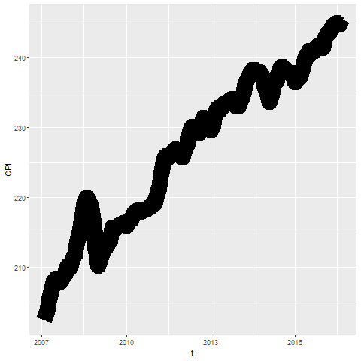
Fundamentals, Size
Notes:
Lines can change size, but some systems refer to this as line width rather than size.

Slide 6
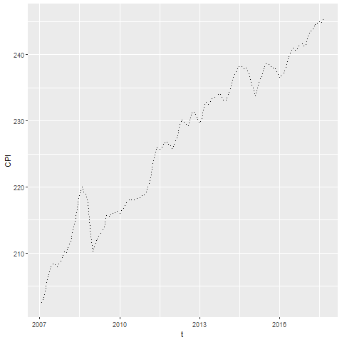
Fundamentals, Shape
Notes:
The shape of a line is not whether it is curved or straight. The shape of a line is whether it is represented using solid, dashed, or dotted lines. Most visualizations call this a line type rather than a line shape.

Slide 7
Fundamentals, On your own
change the line to a dashed line.
Make the width equal to 3
Make the color green

Slide 8
Fundamentals, Wait before showing
((Python code))
# R code ggplot(cpi, aes(x=t, y=CPI)) + geom_line(size=3, linetype="dashed", color="green")
((Tableau steps))

Slide 9
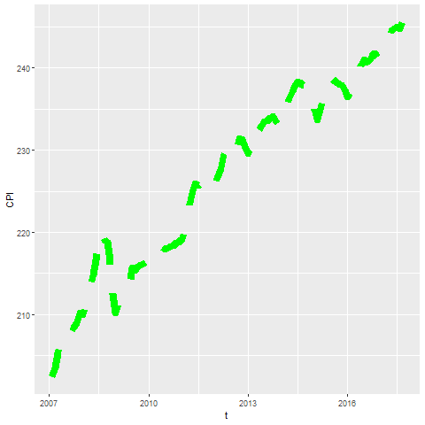
Fundamentals, What your visualization might look like

Slide 10
Fundamentals, Adding lines to a scatterplot
Lines can emphasize patterns in a scatterplot
Connect means
Linear regression
Moving average
Smoothing splines
Notes:
If you have a lot of data, a line can sometimes emphasize patterns or trends that you might miss with just a scatterplot.

Slide 11
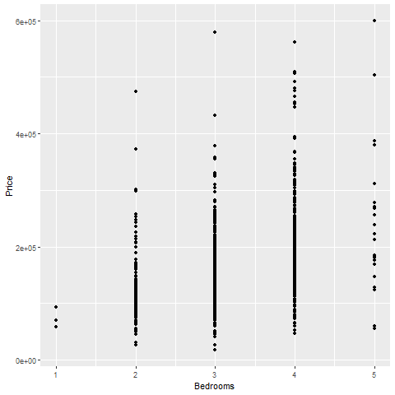
Fundamentals, Review an earlier scatterplot
Notes:
Here’s the housing data set that we looked at earlier. This scatterplot shows the relationship between number of bedrooms and price.

Slide 12
Fundamentals, Lines at individual averages, R
Here’s the code in R
ggplot(saratoga_houses, aes(Bedrooms, Price)) + geom_point() + stat_summary(fun.y=mean, geom="line")
Notes:
Here is the R code. You need the stat_summary function to create averages for y at each discrete value of X.

Slide 13
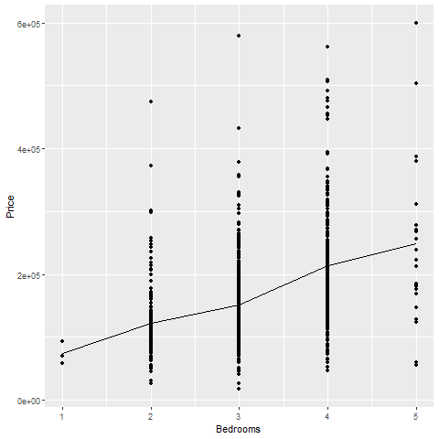
R output
Notes:
There is a clear and consistnet trend in the average price. As the number of bedrooms increase, the average price increases.

Slide 14
Fundamentals, Lines at individual averages, Python
Here’s the Python code
pts = alt.Chart(df).mark_point().encode( x='Bedrooms', y='Price' ) avg = alt.Chart(df).mark_line().encode( x='Bedrooms', y='mean(Price)' ) ch = pts + avg

Slide 15
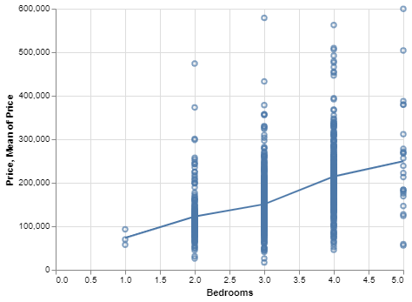
Python graph
Python graph with average summary line

Slide 16
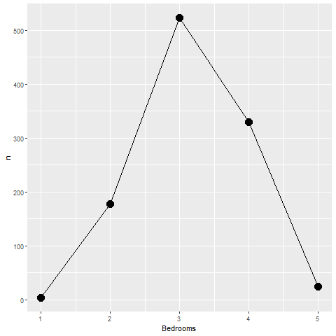
Fundamentals, Lines as counts
Notes:
This impage replaces a bunch of data points with the count at each x-value.

Slide 17
Fundamentals, On your own
Draw a line graph showing the relationship between the number of bathrooms and price.

Slide 18
Fundamentals, Wait before showing
((Add code here))

Slide 19
Fundamentals, What your visualization might look like
((Add visualization here))

Slide 20
Fundamentals, Error bars

Slide 21
Fundamentals, high-low bars

Slide 22
Fundamentals, Boxplots
((Draw example and ask students to do a similar example))

Slide 23
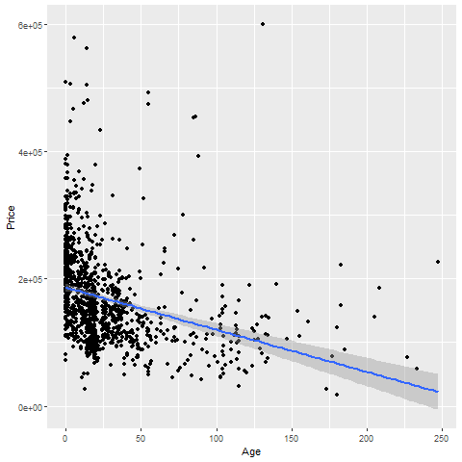
Fundamentals, Trend lines (linear)

Slide 24
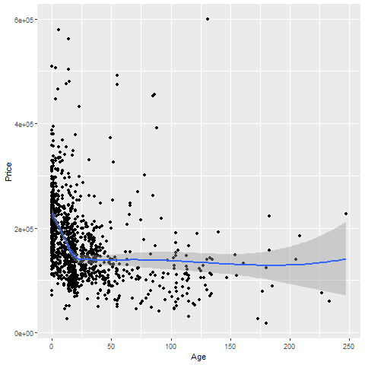
Fundamentals, Trend lines (spline)

Slide 25
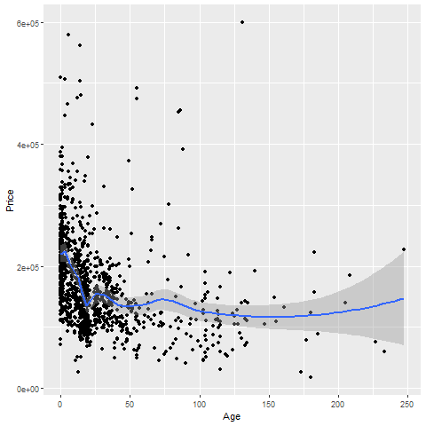
Trend lines (spline), not so smooth

Slide 26
On your own
Fit a linear trend line looking at Living.Area versus Price.
Fit a smooth curve

Slide 27
Wait before showing

Slide 28
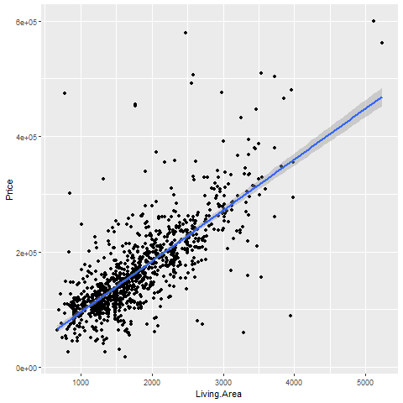
What your visualization might look like

Slide 29
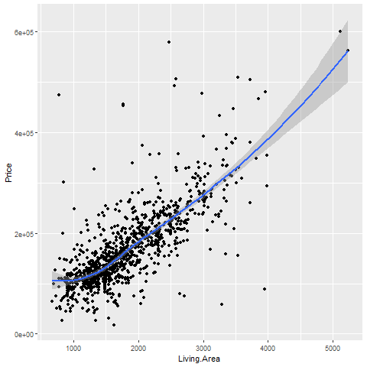
What your visualization might look like

Slide 30
Trend lines (logistic)
((Need a different data set here. Titanic???))

Slide 31
Helpful tips
((Add three or four slides here. Maybe talk about opacity.))

Slide 32
Families of lines

