Slide 1
Bar charts, Preparation
Steve Simon

Slide 2
Preparation, overview
Follow these steps to get ready for lecture #2 in data visualization.
Download and import Titanic data
Download and import scotus data

Slide 3
Preparation, Titanic data set
R code
read.csv("../../common-files/data/titanic3.csv")
Python code
import pandas as pd import altair as alt df = pd.read_csv("../../common-files/data/titanic3.csv") ch = alt.Chart(df).mark_bar().encode( x='pclass', y='count()' ) ch.save("../images/python/basic-barchart.html")
Notes:
Make sure you can import the file titanic3.csv to Python, R or Tableau.

Slide 4
Preparation, Scotus data set
Python code
(To be added)
R code
(To be added)
Notes:
Also import the scotus (Supreme Court of the United States) data.

Slide 5
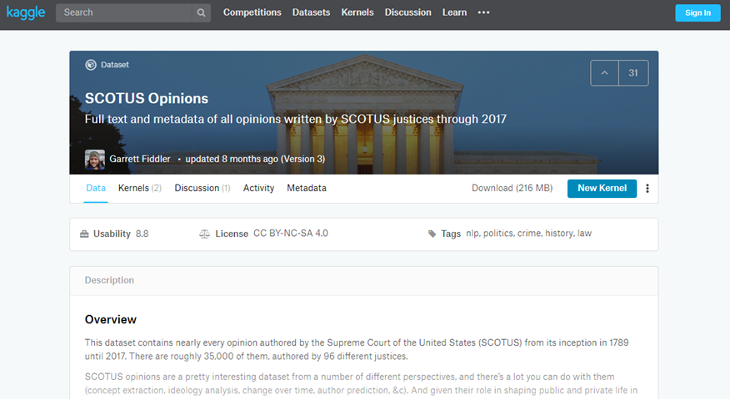
Preparation, kaggle website
Kaggle datasets webpage
Notes:
The scotus file comes originally from the Kaggle datasets webpages. I fixed a few small typos, but you can get pretty much the same results by downloading the original file and keeping the typos in there.

Slide 6
Preparation, Draw a simple bar chart
Import the data and create a bar chart showing the frequency of opinions written by year_filed. Note that there are a few typos and a few rows that do not belong. You can remove these, but they will not affect any of the analyses we are considering.

Slide 7
Preparation, Code
Python code
import pandas as pd import altair as alt df = pd.read_csv("../../common-files/data/titanic3.csv") ch = alt.Chart(df).mark_bar().encode( x='pclass:N', y='count()' ) ch.save("../images/python/basic-barchart.html")
R code
(Add later)

Slide 8
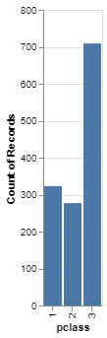
Preparation, Python output
Barchart in Python

Slide 9
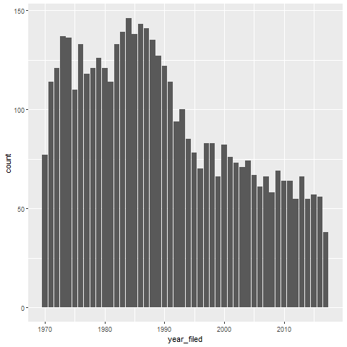
Preparation, R output

Slide 10
Preparation, Tableau steps
Import titanic3.csv
Drag pclass to columns
Change to Discete Dimension
Drag pclass to rows
Change to Measure(Count)
If needed, change Marks to Bar

Slide 11
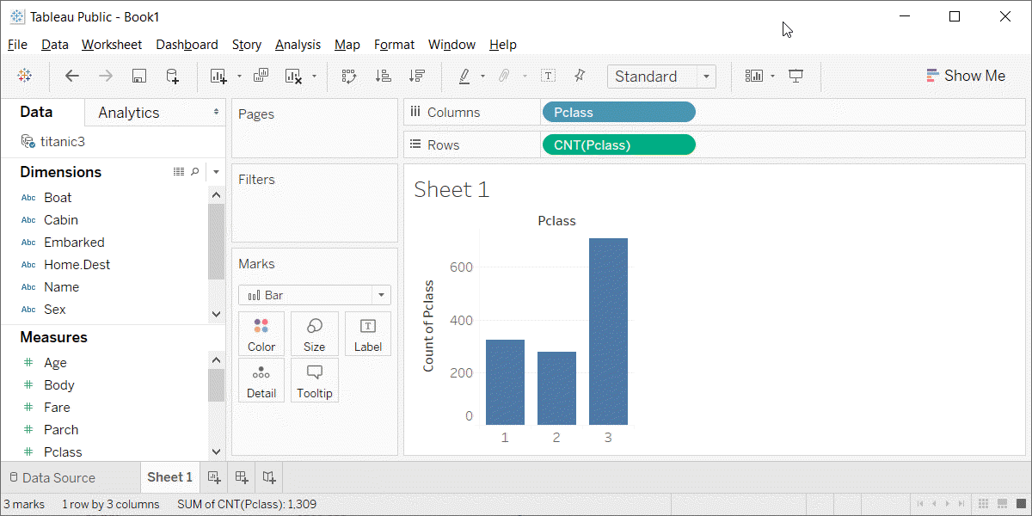
Preparation, Tableau output
Barchart in Tableau

