Slide 1
Data-viz-01, exercise, color
Steve Simon

Slide 2
Basic exercise - color
Use the Saratoga housing data set.
Draw a plot where the location is x=Age and y=Price and the color represents the number of bathrooms.

Slide 3
Here’s the Python code.
ch2 = alt.Chart(df).mark_point().encode( x="Age", y="Price", color="Baths")

Slide 4
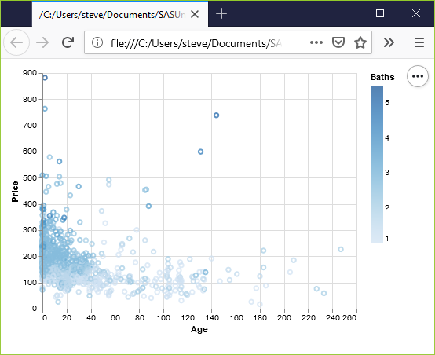
Here’s the result in Python
Python scatterplot mapping bathrooms to color

Slide 5
Here’s the R code.
ggplot(saratoga_houses, aes(x=Age, y=Price)) + geom_point(aes(color=factor(Bathrooms)))

Slide 6
Here’s the result in R
## [1] "bathroom-colors"

Slide 7
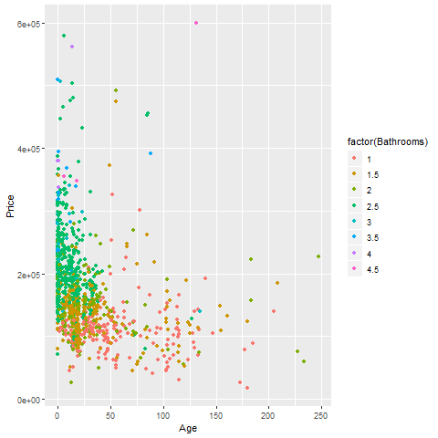
R scatterplot mapping bathrooms to color

Slide 8
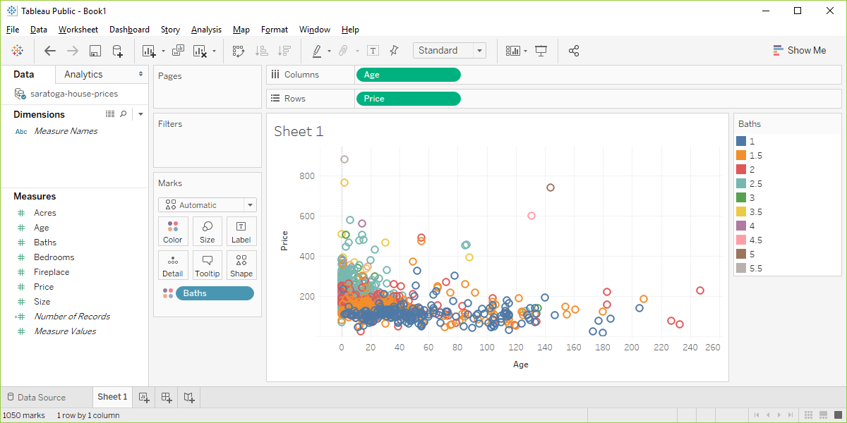
Here’s the result in Tableau.
Tableau scatterplot mapping Bathrooms to color

