Slide 1
Data-viz-01, Basic exercise - location
Steve Simon

Slide 2
Basic exercise - location
Use the Saratoga housing data set.
Revise the plot so that the location of the points represents x=Bedrooms and Y=Price.

Slide 3
Here’s the Python code
Here’s the Python code.
ch4 = alt.Chart(df).mark_point().encode( x='Bedrooms',y='Price')

Slide 4
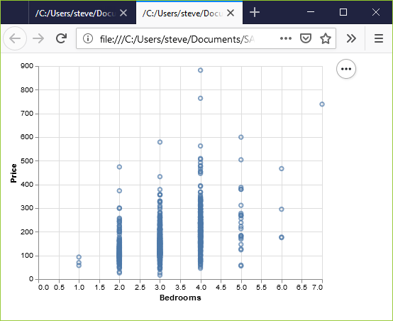
Here’s the result in Python
Python scatterplot of bedrooms and price

Slide 5
Here’s the R code
ggplot(saratoga_houses, aes(x=Bedrooms, y=Price)) + geom_point())

Slide 6
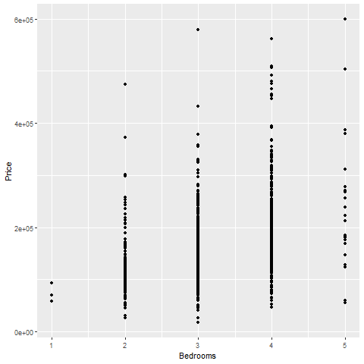
Here’s the result in R
Scatterplot of bedrooms and price

Slide 7
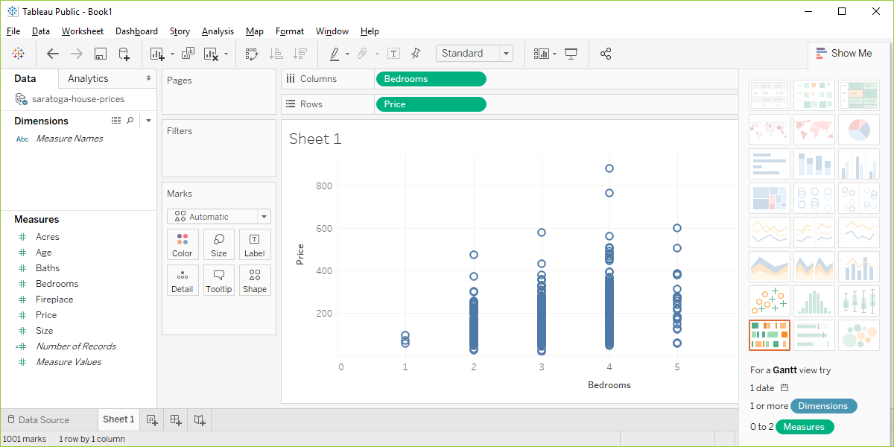
Here are the steps in Tableau.
Tableau scatterplot of Bedrooms and Price
Notes:
In Tableau, click on Age in the Columns field and choose the remove option. The graph looks a bit weird with no columns, but ignore it. Drag Bedrooms over to the Columns field. Tableau wants to use a sum, but you want individual data points. So click on SUM(Bedrooms) and change it to a Dimension.

