Slide 1
Data-viz-01, Fundamentals
Steve Simon

Slide 2
Review basic scatterplot
Python code
ch = alt.Chart(df).mark_point().encode( x='Age', y='Price' )
R code
ggplot(saratoga_houses, aes(x=Age, y=Price)) + geom_point()
Tableau
(Drag and drop)
Notes:
You’ve already drawn a basic scatterplot in Python, R, or Tableau. All three systems choose a slightly different visualization, but, for the most part, the graphs look fairly nice. You can change some of those default options.

Slide 3
Changing default options
Python code
.mark_point(shape="square", color="green").
R code
geom_point(shape="square", color="green")
Tableau
(Drag and drop)
Notes:
In Python, you can change the default from blue circles to green squares in the mark_point function. In R, you do this inside the geom_point function. In Tableau, you have to click on the color and shape buttons to change the defaults.

Slide 4
Basic exercise - global modifications
Use the Saratoga housing data set.
Try the suggested changes to the defaults and see what the visualization looks like.
Try changing the size of the points.

Slide 5
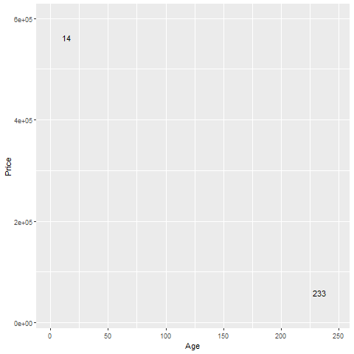
Aesthetics for points - location (1 of 2)
Illustration of location aesthetics
Notes:
This plot show only two data points, and is labeled with the variable age, corresponding to the X location.
The point in the upper left corner is a young house, only 14 years old. The point in the lower right corner is an old house, 233 years old.

Slide 6
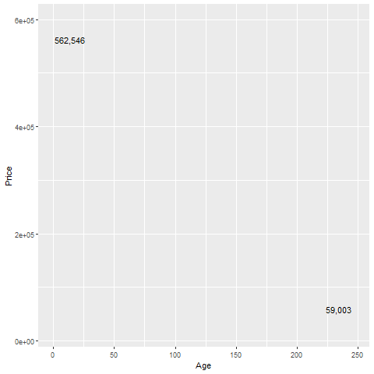
Aesthetics for points - location (2 of 2)
Illustration of location aesthetics
Notes:
This plot is labeled with the variable Price, corresponding to the Y location.
The point in the upper left corner is an expensive house, over a half million dollars. The point in the lower right corner is a cheap house, about one-tenth of the price.

Slide 7
Basic exercise - location
Use the Saratoga housing data set.
Revise the plot so that the location of the points represents x=Bedrooms and Y=Price.

Slide 8
Basic exercise - location
Use the Saratoga housing data set.
Revise the plot so that the location of the points represents x=Bedrooms and Y=Price.

Slide 9
Here’s the Python code
Here’s the Python code.
ch4 = alt.Chart(df).mark_point().encode( x='Bedrooms',y='Price')

Slide 10
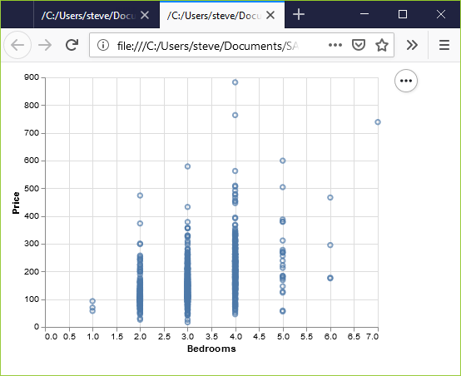
Here’s the result in Python
Python scatterplot of bedrooms and price

Slide 11
Here’s the R code
ggplot(saratoga_houses, aes(x=Bedrooms, y=Price)) + geom_point())

Slide 12
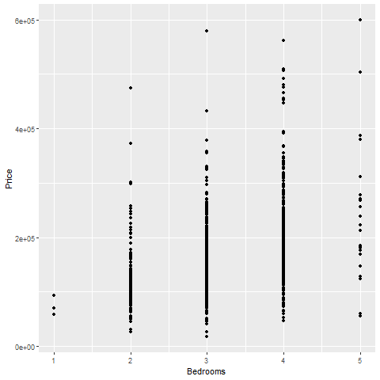
Here’s the result in R
Scatterplot of bedrooms and price

Slide 13
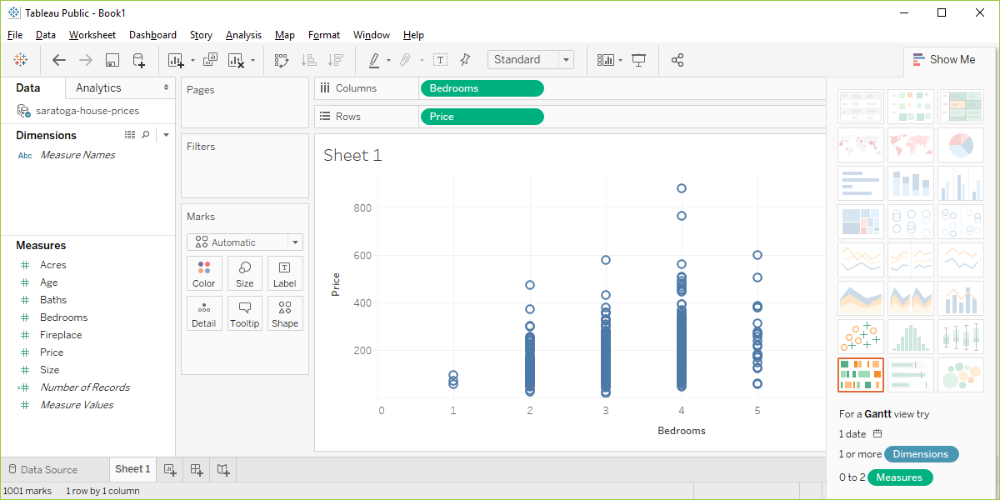
Here are the results in Tableau.
Tableau scatterplot of Bedrooms and Price
Notes:
In Tableau, click on Age in the Columns field and choose the remove option. The graph looks a bit weird with no columns, but ignore it. Drag Bedrooms over to the Columns field. Tableau wants to use a sum, but you want individual data points. So click on SUM(Bedrooms) and change it to a Dimension.

Slide 14
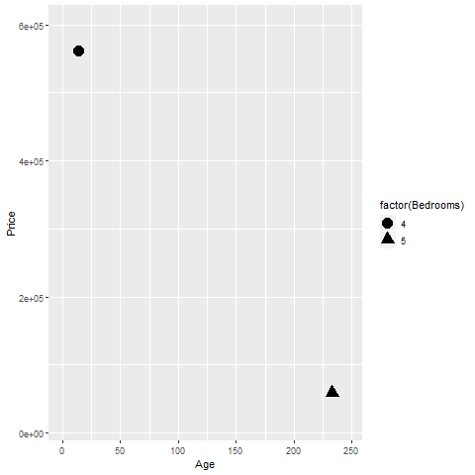
Aesthetics for points - shape
Illustration of shape aesthetics
Notes:
The house in the upper left corner has four bedrooms, and the house in the lower right corner has five bedrooms. You use circles and triangles to designate this and the legend on the right hand side tells you how to decipher the symbols.
I want to note here that this plot is effectively showing three dimensions, Age, Price, and Bedrooms, even though it is restricted to a two dimensional screen.
I also want to point out that this may not be the best way to visualize the relationship among these three variables.

Slide 15
Basic exercise - shape
Use the Saratoga housing data set.
Draw a plot of all of the data where the location is x=Age and y=Price and the symbol represents the number of bedrooms.

Slide 16
Basic exercise - shape
Use the Saratoga housing data set.
Draw a plot of all of the data where the location is x=Age and y=Price and the symbol represents the number of bedrooms.

Slide 17
Here’s the Python code.
ch5 = alt.Chart(df).mark_point().encode( x='Age',y='Price', shape='Bedrooms:N')

Slide 18
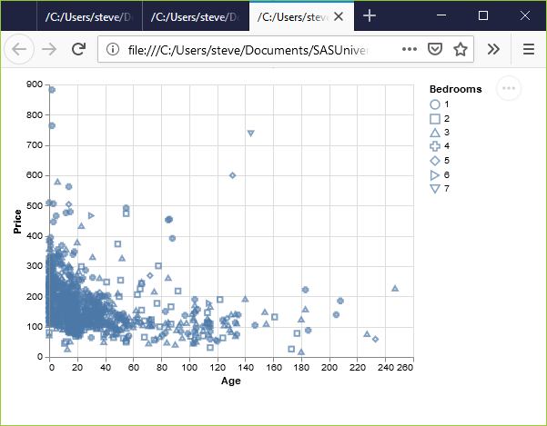
Here’s the results in Python.
Python scatterplot mapping bedrooms to shape

Slide 19
Here’s the R code.
ggplot(saratoga_houses, aes(x=Age, y=Price)) + geom_point(aes(shape=factor(Bedrooms)))

Slide 20
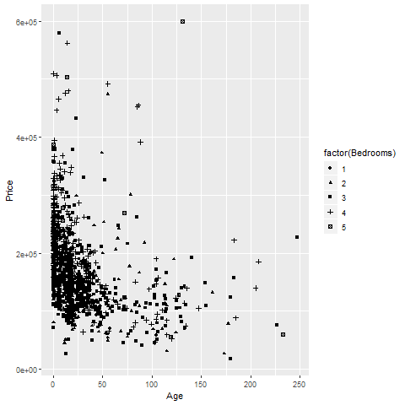
Here’s the results in R
R scatterplot mapping bedrooms to shape
Notes:
Here is what the R graph looks like. I don’t particularly like this graph. It is confusing, especially with all the overprinting.

Slide 21
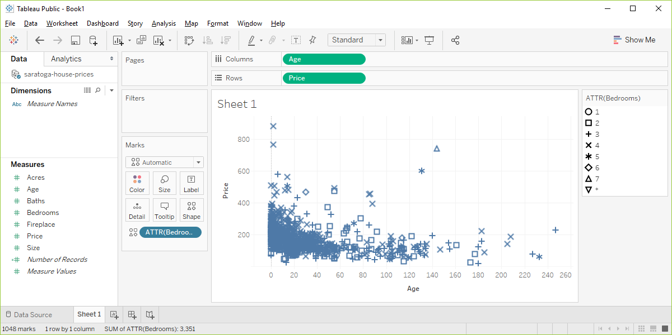
Here ’s the result in Tableau.
Tableau scatterplot using shapes to represent Bedrooms
Notes:
Here are the steps in Tableau. First revert to the earlier scatterplot where Age is in the Column fields and Price is in the Rows field. Then drag and drop Bedrooms on top of the Shape icon. Change from SUM(Bedrooms) to ATTR(Bedrooms).

Slide 22
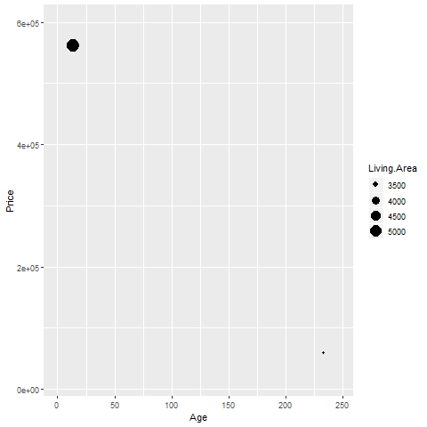
Aesthetics for points - size
Illustration of size aesthetics
Notes:
You can also use the size of a point to represent a third dimension. Here is a plot where the larger house, the house with more living area has a big circle and the house with less living area has a small circle.

Slide 23
Basic exercise - size
Use the Saratoga housing data set.
Draw a plot where the location is x=Age and y=Price and the size represents the living area.

Slide 24
Basic exercise - size
Use the Saratoga housing data set.
Draw a plot where the location is x=Age and y=Price and the size represents the living area.

Slide 25
Here’s the Python code.
ch6 = alt.Chart(df).mark_point().encode( x='Age',y='Price', size='Size')

Slide 26
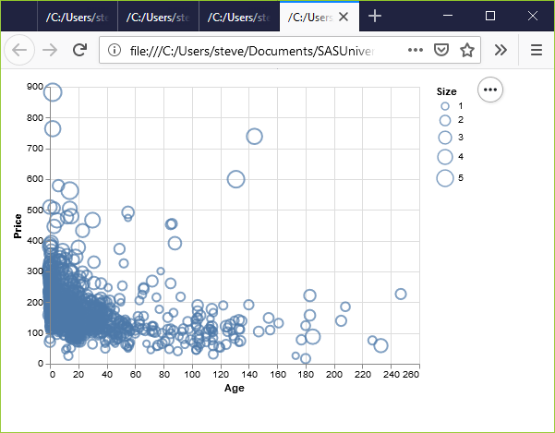
Here’s the result in Python.
Python scatterplot mapping living area to size

Slide 27
Here’s the R code.
ggplot(saratoga_houses, aes(x=Age, y=Price)) + geom_point(aes(size=Living.Area))

Slide 28
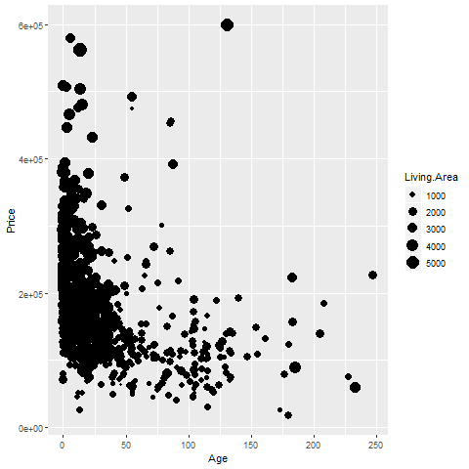
Here’s the result in R.

Slide 29
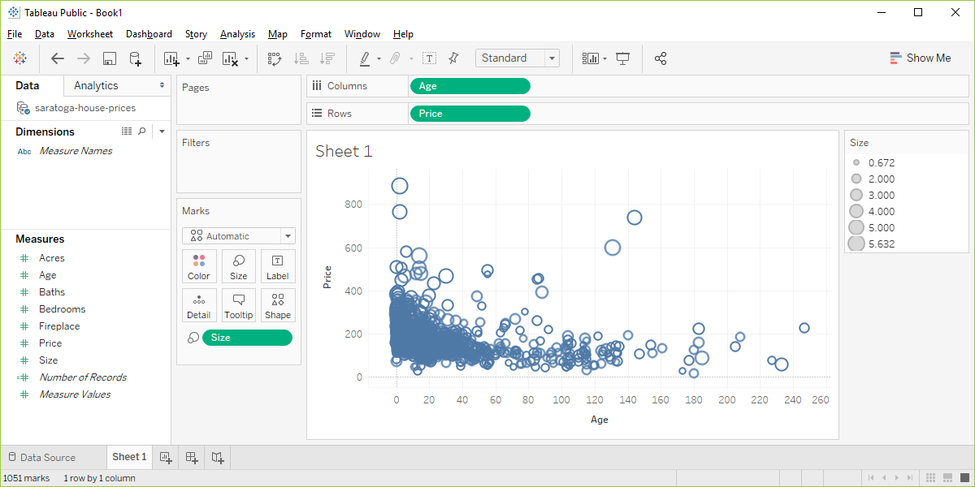
Here’s the result in Tableau.
Visualizaion using Living.Area as the size

Slide 30
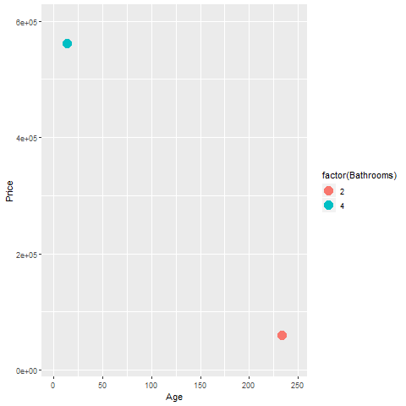
Aesthetics for points - color (1 of 2)
Illustration of color aesthetics
Notes:
This plot shows a blue point representing a four bathroom house in the upper left corner and an orange point representing a two bathroom house in the lower right corner.

Slide 31
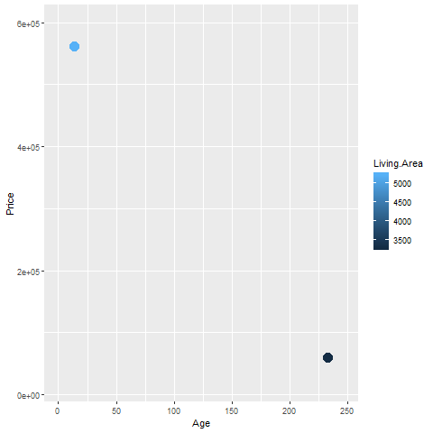
Aesthetics for points - color (2 of 2)
R graph using color to represent Living.Area
Notes:
Notice how the legend has changed.

Slide 32
Basic exercise - color
Use the Saratoga housing data set.
Draw a plot where the location is x=Age and y=Price and the color represents the number of bathrooms.

Slide 33
Basic exercise - color
Use the Saratoga housing data set.
Draw a plot where the location is x=Age and y=Price and the color represents the number of bathrooms.

Slide 34
Here’s the Python code.
ch2 = alt.Chart(df).mark_point().encode( x="Age", y="Price", color="Baths")

Slide 35
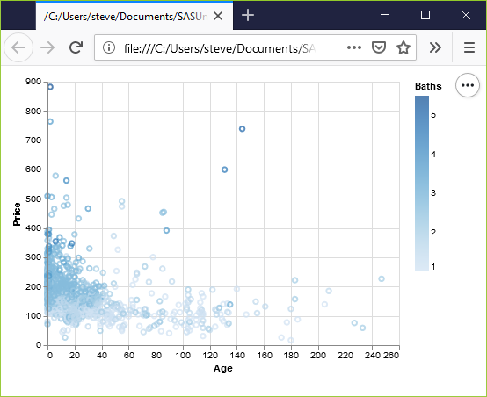
Here’s the result in Python
Python scatterplot mapping bathrooms to color

Slide 36
Here’s the R code.
ggplot(saratoga_houses, aes(x=Age, y=Price)) + geom_point(aes(color=factor(Bathrooms)))

Slide 37
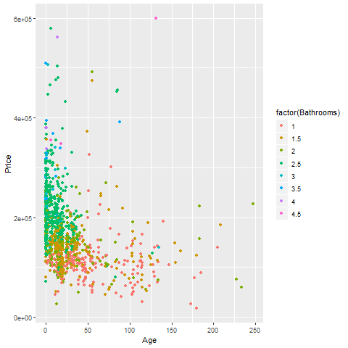
Here’s the result in R
R scatterplot mapping bathrooms to color

Slide 38
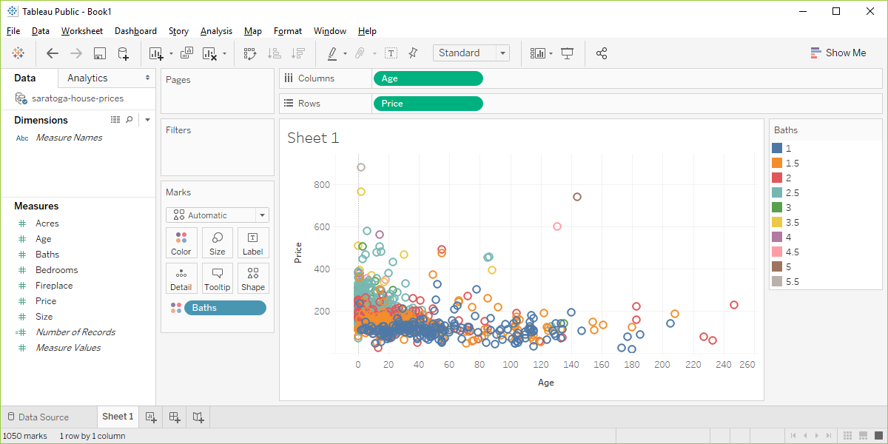
Here’s the result in Tableau.
Tableau scatterplot mapping Bathrooms to color

