Slide 1
Line graphs, Fundamentals
Steve Simon

Slide 2
Fundamentals, Aesthetics for lines
Location
Size
Shape (not what you think it is!)
Color
Notes:
A line could mean a straight line or a curved line, a single line segment, a connected series of line segments or a polygon. It’s a pretty complex thing, but generally a line represents a two dimensional relationship.
You can vary the size, shape, and color of a line. Shape is not what you think it is.

Slide 3
Fundamentals, Show different types and locations of lines
((Show a curved line, a straight line, a line segment, a series of line segments, and a polygon. Show the code to create these.))

Slide 4
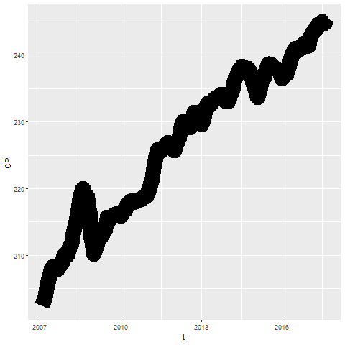
Fundamentals, Size
Notes:
Lines can change size, but most systems refer to this as line width rather than size.

Slide 5
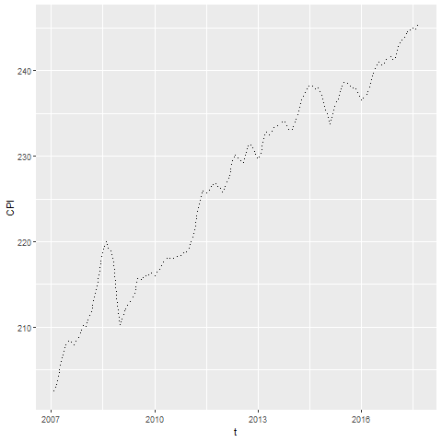
Fundamentals, Shape
Notes:
The shape of a line is not whether it is curved or straight. The shape of a line is whether it is represented using solid, dashed, or dotted lines. Most visualizations call this a line type rather than a line shape.

Slide 6
Fundamentals, On your own
change the line to a dashed line.
Make the width equal to 3
Make the color green

Slide 7
Fundamentals, Wait before showing
((Python code))
# R code ggplot(cpi, aes(x=t, y=CPI)) + geom_line(size=3, linetype="dashed", color="green")
((Tableau steps))

Slide 8
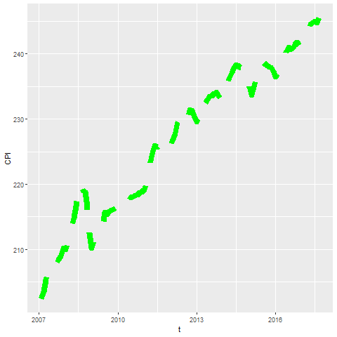
Fundamentals, What your visualization might look like

Slide 9
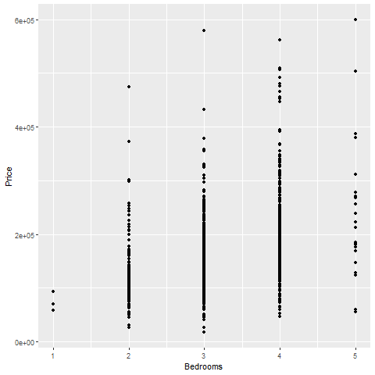
Fundamentals, Lines as summary statistics
Notes:
If you have a lot of data, a line can sometimes emphasize patterns or trends that oyu might miss with just a scatterplot.

Slide 10
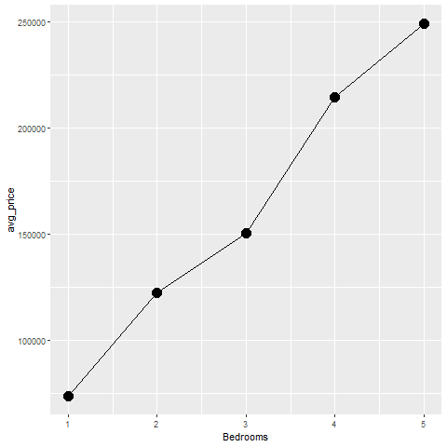
Fundamentals, Lines as averages
Notes:
This image replaces a bunch of data points with an average computed at each X-value.

Slide 11
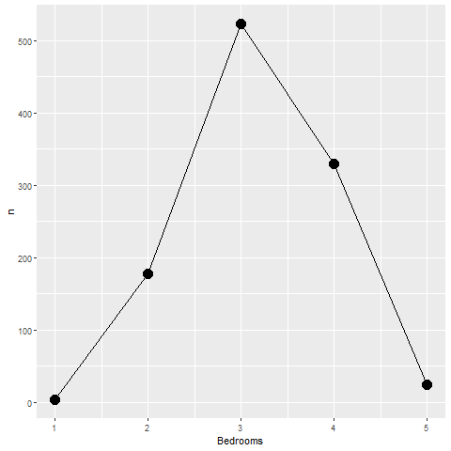
Fundamentals, Lines as counts
Notes:
This impage replaces a bunch of data points with the count at each x-value.

Slide 12
Fundamentals, On your own
Draw a line graph showing the relationship between the number of bathrooms and price.

Slide 13
Fundamentals, Wait before showing
((Add code here))

Slide 14
Fundamentals, What your visualization might look like
((Add visualization here))

Slide 15
Fundamentals, Error bars

Slide 16
Fundamentals, high-low bars

Slide 17
Fundamentals, Boxplots
((Draw example and ask students to do a similar example))

Slide 18
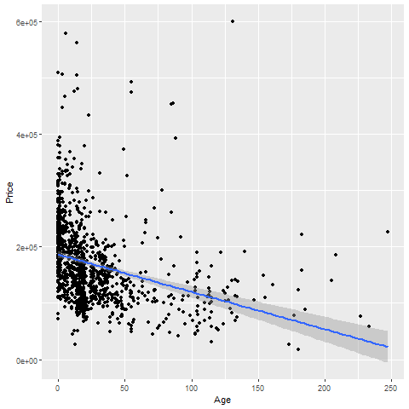
Fundamentals, Trend lines (linear)

Slide 19
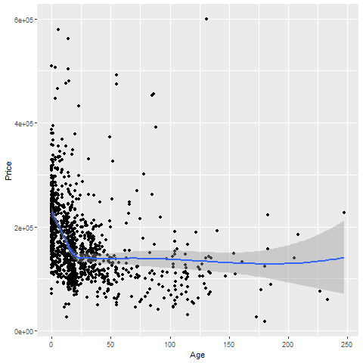
Fundamentals, Trend lines (spline)

Slide 20
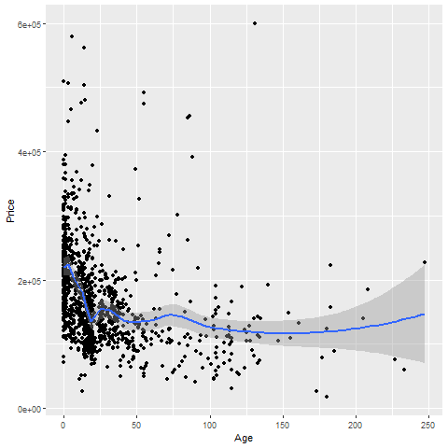
Trend lines (spline), not so smooth

Slide 21
On your own
Fit a linear trend line looking at Living.Area versus Price.
Fit a smooth curve

Slide 22
Wait before showing

Slide 23
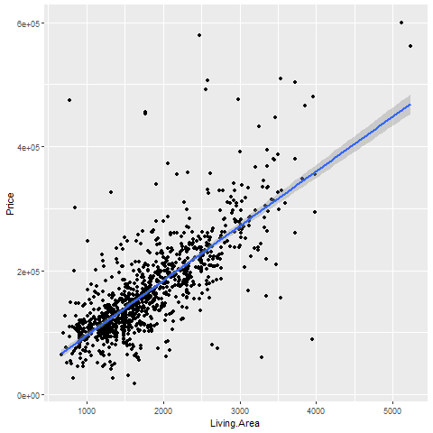
What your visualization might look like

Slide 24
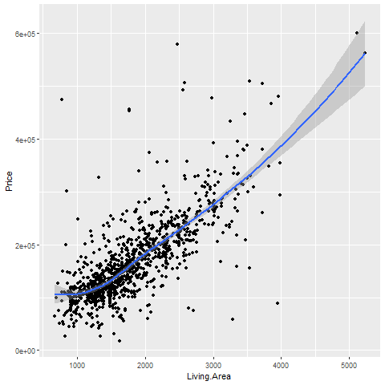
What your visualization might look like

Slide 25
Trend lines (logistic)
((Need a different data set here. Titanic???))

Slide 26
Helpful tips
((Add three or four slides here. Maybe talk about opacity.))

Slide 27
Families of lines

