Slide 1
Data visualization - 02 - bars
Steve Simon

Slide 2
## ## Attaching package: 'dplyr'
## The following objects are masked from 'package:stats': ## ## filter, lag
## The following objects are masked from 'package:base': ## ## intersect, setdiff, setequal, union
## Registered S3 methods overwritten by 'ggplot2': ## method from ## [.quosures rlang ## c.quosures rlang ## print.quosures rlang

Slide 3
Notes about this talk
This slide should not to be included in the final presentation
01-points MUST come before
03-lines could come before or after

Slide 4
To prepare for this section
((Find a data set))

Slide 5
More theory – the psychology of perception

Slide 6
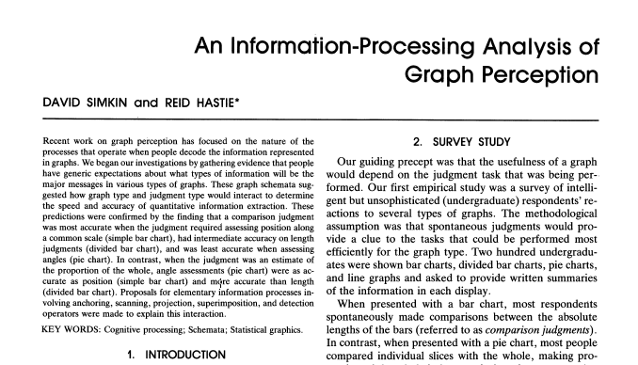
A framework for graph perception
Part of first page from Simkin and Hastie journal article
Notes:
Much of the work on the psychology of perception that I will be discussing next is drawn from this 1987 article by Simkin and Hastie.

Slide 7
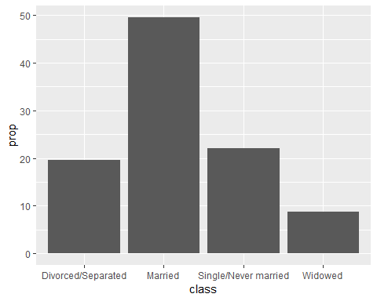
Bar chart

Slide 8
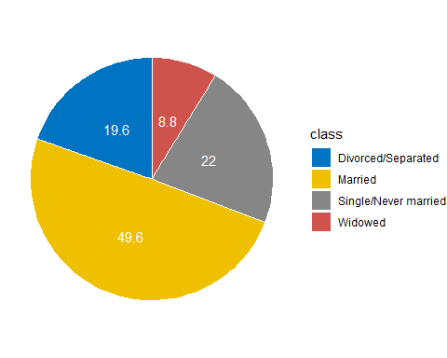
Pie chart

Slide 9
Aesthetics for bars

Slide 10
Summary
“A mapping of data to the visual aesthetics of geometries/marks”
Bars are a type of geometry/mark
Aesthetics for bars include location, size, color
Stack versus dodge
Basic tips
Place comparators close

Slide 11
Group exercise
Review the following visualization in your group.
Summarize what aesthetics (location, size, shape, color) appear in the graph
What variables map to each aesthetic?
What is the story that this graph is telling you?
Was there anything confusing?
Was there anything you might change?

