Slide 1
Scaterplots, Final exercise, Using the sleep data set
Steve Simon

Slide 2
Advanced exercise
There is a second data set on sleep in mammals. You can find a brief description of this data set at
http://www.statsci.org/data/general/sleep.html
You can download the actual data at
http://www.statsci.org/data/general/sleep.txt
Notes:
This is an interesting data set. You can download from the web, or I can provide a comma separated value format for you to use.

Slide 3
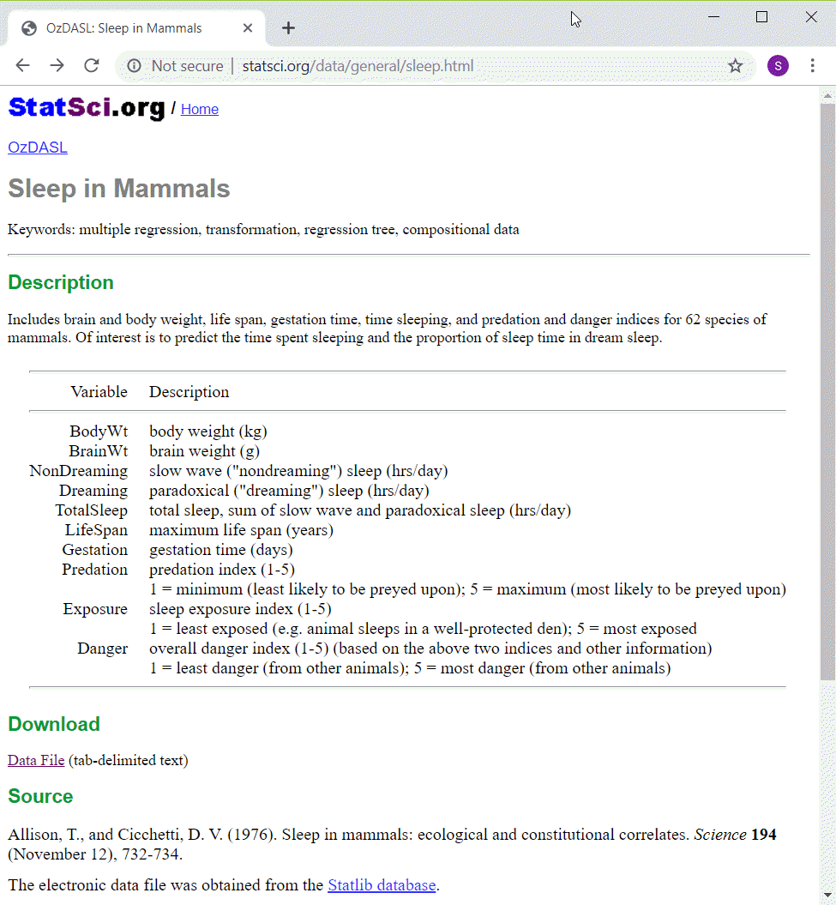
Data dictionary
Data dictionary for sleep file
Notes:
This is the data dictionary for this file, from the website listed above.

Slide 4
Advanced exercise
There are some interesting relationships among the variables. Explore whatever strikes you as interesting. Some possibiilities include
bodywt and predation
gestation and lifespan
exposure and totalsleep
Draw a visualization
illustrates an intersting interrelationships
use a third variable for shape, size, or color

Slide 5
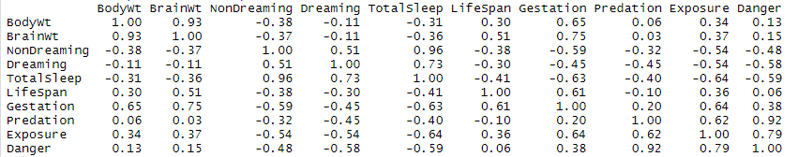
Correlations
Correlation matrix among sleep variables
Notes:
You might find this table of correlations helpful when deciding what relationships to explore.

