Slide 1
Data visualization - 02 - bars
Steve Simon

Slide 2
Notes about this talk
This slide should not to be included in the final presentation
01-points MUST come before
03-lines could come before or after

Slide 3
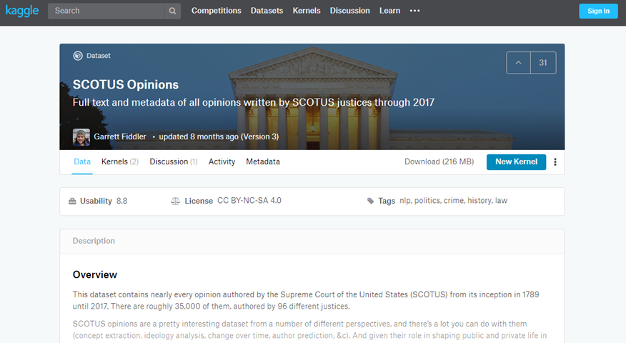
To prepare for this section
Kaggle datasets webpage

Slide 4
To prepare for this section
Download the scotus_opinions.csv data set, or go to the original source, the Kaggle datasets repository.
Import the data and create a bar chart showing the frequency of opinions written by year_filed. Note that there are a few typos and a few rows that do not belong. You can remove these, but they will not affect any of the analyses we are considering.

Slide 5
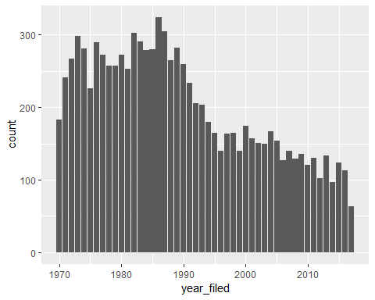
This is what your bar chart should look like

Slide 6
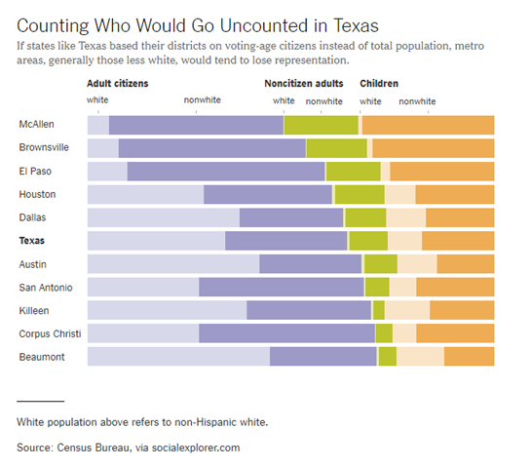
Group exercise (1 of 2)
Bar chart of demographics of selected Texas counties
Notes:
This is one of two graphs. It was published in
Badger, E. (2019). People Who Can’t Vote Still Count Politically in America. What if That Changes?. Retrieved June 24, 2019, from The New York Times website: https://www.nytimes.com/2019/06/22/upshot/america-who-deserves-representation.html
Split into pairs. Review the article briefly (about 5 minutes) and look at the graph. Explain to your partner what the graph is trying to show. Your partner will get a different graph and do the same thing with you listening this time.

Slide 7
Group exercise (2 of 2)
((Image is not yet available.))

Slide 8
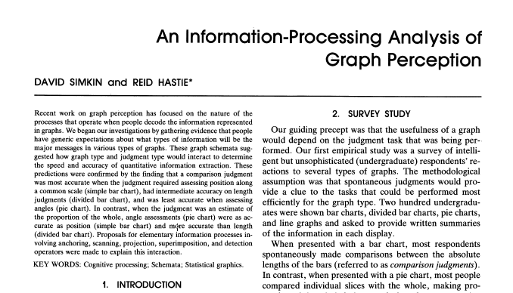
A framework for graph perception
Part of first page from Simkin and Hastie journal article
Notes:
Much of the work on the psychology of perception that I will be discussing next is drawn from this 1987 article by Simkin and Hastie.

Slide 9
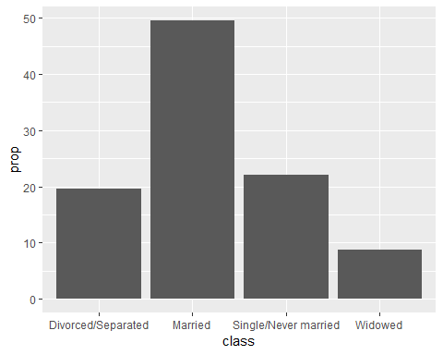
Which is better? A bar chart…

Slide 10
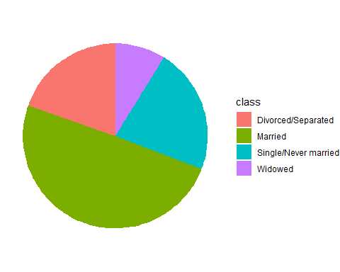
… or a pie chart

Slide 11
Answer. It depends.
What question are you trying to answer?
What proportion of the patients are single?
Are there more single or divorced patients?
Notes:
The answer really depends on what question you are asking. There are a variety of questions that you might ask. Two are illustrated above.
You can run an experiment (people have done this) where randomize and show half of them a bar chart and half of them a pie chart. Then you ask a question, like one of the questions above. Then you note the speed and accuracy of the response. Depending on the question, sometimes pie charts give faster and more accurate answers. Sometimes bar charts give faster and more accurate answers. It turns out that the results match up nicely with what we know about the psychology of perception.

Slide 12
Visual processing (1 of 3)
Projection
Shifting an object in a horizontal or vertical direction to make a comparison
Superimposition
Shifting in other directions (e.g., diagonal shifts, rotation) in order to make a comparison
Much harder than projection

Slide 13
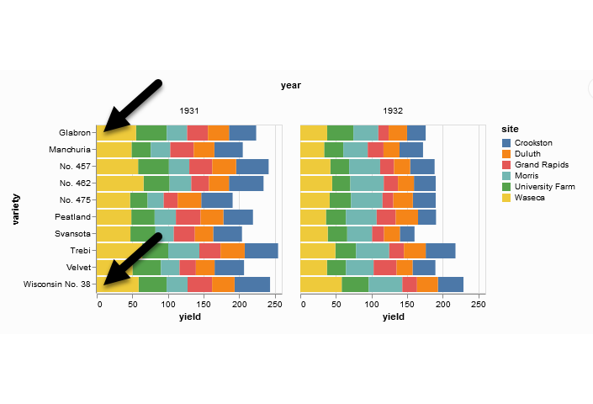
Projection (first yellow bar versus last yellow bar)
Stacked bar chart of crop yields
Notes:
The position means the vertical or horizontal location. Does the first yellow bar in 1931 (Glabron seeds planted in Wasica) extend further to the right than the last yellow bar (Wisconsin No. 38 seeds planted in Wasica)?

Slide 14
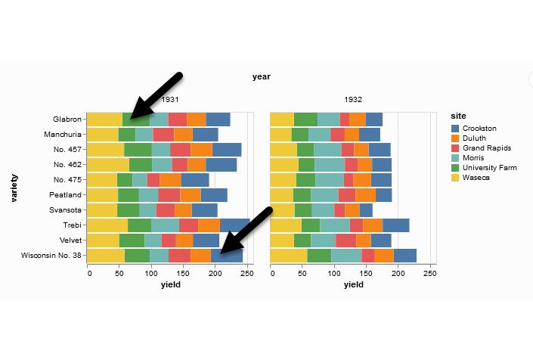
Superimposition (first green bar versus last blue bar)
Stacked bar chart of crop yields
Notes:
The length means either the width or the height. Does the first green bar in 1931 (Glabron seeds planted in University Farm) extend further to the right than the last yellow bar (Wisconsin No. 38 seeds planted in Crookston)?

Slide 15
Visual processing (2 of 3)
Scanning
Quantifying distance throug the use of a mental tape measure
Shorter distances are easier
Anchoring
Implicit or explicit development of reference points
Assists with scanning

Slide 16
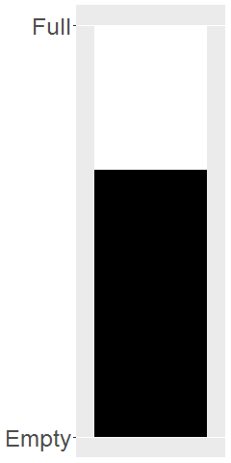
Scanning
Image of a fuel gauge, 65% full
Notes:
To understand scanning, think of a gas gauge. Usually it is a semicircular dial, but let’s set up the gas gauge as a rectangle. If the level is at the top, you have a full tank. If the level is at the bottom, you have an empty tank. This gauge shows a tank that is 65% full. Trust me, I drew the gauge. It is at 65%. Now how would you estimate the gas level?
You would take a mental tape measure, starting at the bottom and measure up to where the black box ends.
Now if you were smart, you’d start at the top and scan downwards. Less distance means that you can do this faster and more accurately.
Now if you were Albert Einstein, you’d split the gauge at the halfway point and measure from the halfway point to the top of the black box. Actually, there’s a little of Albert Einstein in all of us. That halfway point is something that all of us do subconciously. You did, because you recognized almost immediately that the tank was more than half full.

Slide 17
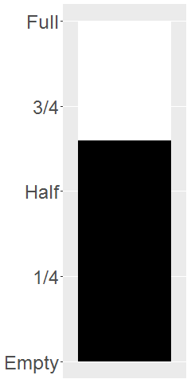
Assisting scanning with anchors
Image of a fuel gauge, anchors at 1/4, half, 3/4
Notes:
Here’s the same gas gauge, still at 65% full, but now we have added anchors at 1/4, half, and 3/4. You can read this gauge faster and more accurately, because you can scane from half up to 65% or from 3/4 down to 65%.

Slide 18
Visual processing (3 of 3)
Visually simple tasks
Position
Length
Angle/slope
Visually demanding tasks
Area
Volume
Density/Saturation/Hue
Notes:
There are a variety of perceptual tasks that you use when making comparisons within an image. These are arranged on this slide roughly in order of difficulty, with the easiest tasks at the top.

Slide 19
Position (first yellow bar versus last yellow bar)
Stacked bar chart of crop yields
Notes:
The comparison of the two yellow bars is a comparison of position. Which yellow bar extends further to the right?

Slide 20
Length (first green bar versus last blue bar)
Stacked bar chart of crop yields
Notes:
The comparison of the green and blue bars is a length comparison. The two bars start at different spots, so the position can’t help you.
Length is harder to judge than position, because it involves a superimposition rather than a projection.

Slide 21
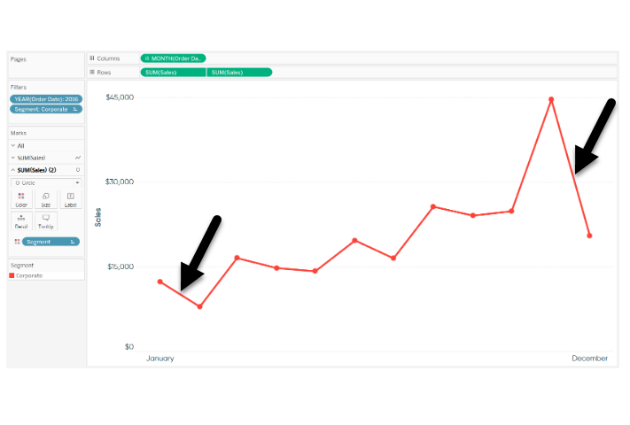
Angle/slope (first month decline versus last month decline)
Sales trend shown with a line graph
Notes:
This graph shows sales trends over a twelve month span. If you want to assess whether the first month decline (the dip in sales between January and February) was worse than the last month decline (the dip in sales between November and December), you would probably do this by judging the angle of the first line segment to the angle of the second line segment. This is not quite as easy as a position or length judgement, but it isn’t too bad either.

Slide 22
Area

Slide 23
Density/saturation/hue

Slide 24
A quick tutorial on colors

Slide 25
Aesthetics for bars
Review
Location
Size
Color
NOT shape!!!

Slide 26
Stack versus dodge

Slide 27
Summarizations
One number summary (mean or percentage)
Two number summary (error bars)
Five number summary (boxplots)
All the data
Jittering
Opacity

Slide 28
Summary
“A mapping of data to the visual aesthetics of geometries/marks”
Bars are a type of geometry/mark
Aesthetics for bars include location, size, color
Stack versus dodge
Basic tips
Place comparators close
Use axis ticks, light grid lines

Slide 29
Group exercise
Review the following visualization in your group.
Summarize what aesthetics (location, size, shape, color) appear in the graph
What variables map to each aesthetic?
What is the story that this graph is telling you?
Was there anything confusing?
Was there anything you might change?

