Slide 1
Data-viz-02, Preparation
Steve Simon

Slide 2
Preparation, overview
Follow these steps to get ready for lecture #2 in data visualization.
Download and import Titanic data
Download and import scotus data

Slide 3
Preparation, Titanic data set
# fn <- "https://dasl.datadescription.com/download/data/3484" fn <- "../data/titanic3.csv" titanic <- read.csv(fn, stringsAsFactors=FALSE)

Slide 4
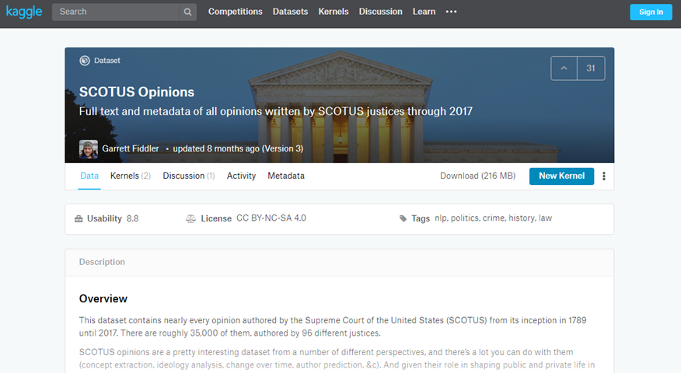
Preparation, kaggle website
Kaggle datasets webpage

Slide 5
Preparation, download scotus data
Download the scotus_cases.csv data set, or go to the original source, the Kaggle datasets repository.
Import the data and create a bar chart showing the frequency of opinions written by year_filed. Note that there are a few typos and a few rows that do not belong. You can remove these, but they will not affect any of the analyses we are considering.

Slide 6
Preparation, Python code
((Add later))

Slide 7
Preparation, R code
((Add later))

Slide 8
Preparation, Tableau steps
((Add later))

Slide 9
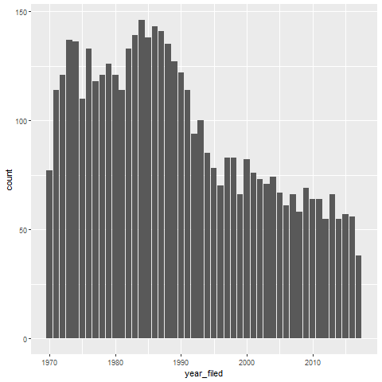
Preparation, This is what your bar chart should look like

