Slide 1
A tutorial on colors
Steve Simon

Slide 2
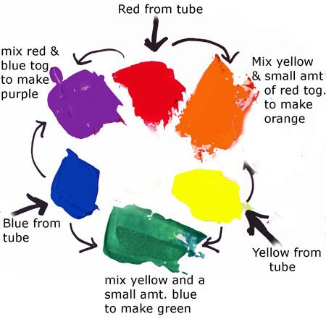
Everything I know about colors, I learned in Kindergarten.

Slide 3
Hexadecimal codes
“There are 10 types of programmers in the world, those who undestand binary and those who don’t.”
1001 1100 (base 2)
= $1*2^{7}+0*2^{6}+0*2^{5}+1*2^{4}+1*2^{3}+1*2^{2}+0*2^{1}+0*2^{0}$
= 128+16+8+4 = 156
Hexadecimal digits (base 16)
0-9, A=10, B=11, C=12, D=13, E=14, F=15
1001 1100 (base 2)
= 9C (base 16)
= $9*{16}^{1}+12*{16}^{0}$
Two hexadecimal digits represent the numbers 0-255.
00 (base 16) = 0, FF (base 16) = 255

Slide 4
Codes for colors
#rrggbb format
#000000 is pure black
#FFFFFF is pure white
#FF0000 is pure red
#00FF00 is pure green
#0000FF is pure blue
You can mix and match to get 16,777,216 colors
#800080 is purple, #FF69B4 is pink, #40e0d0 is turquoise

Slide 5
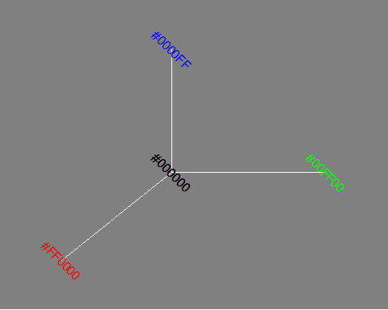
The color cube (1/2)

Slide 6
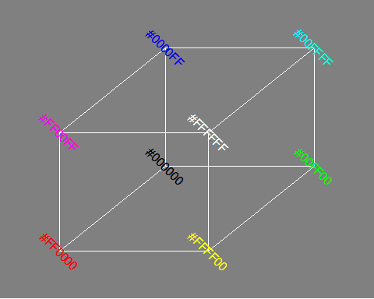
The color cube (2/2)

Slide 7
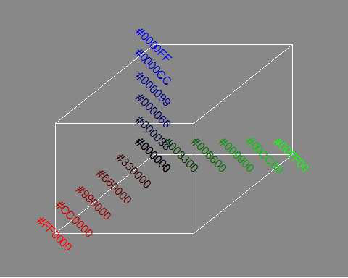
Gradients (1/4)

Slide 8
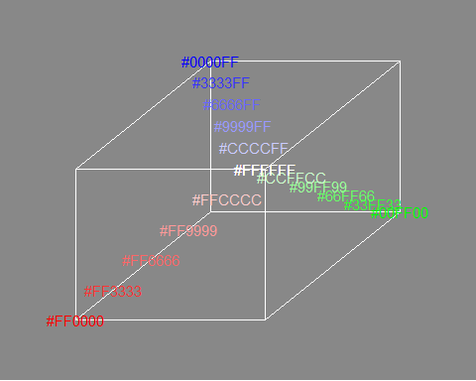
Gradients (2/4)

Slide 9
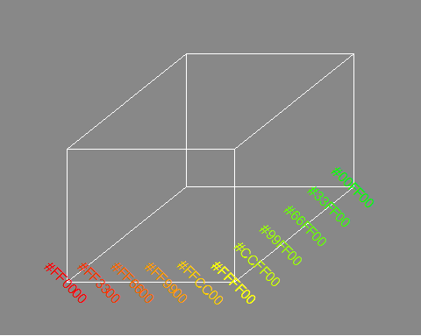
Gradients (3/4)

Slide 10
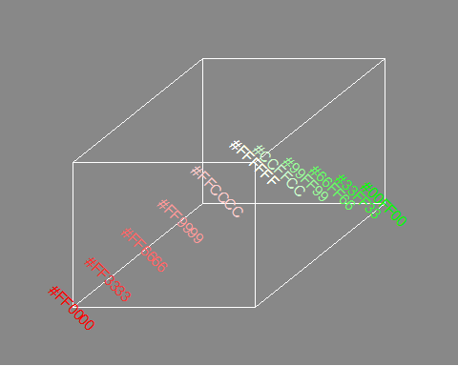
Gradients (4/4)

Slide 11
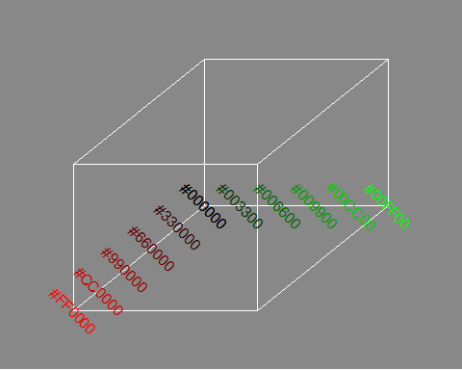
Gradients (5/5)

Slide 12
RGB combinations
Additive color mixing: adding red to green yields yellow; adding green to blue yields cyan; adding blue to red yields magenta; adding all three primary colors together yields white.

Slide 13
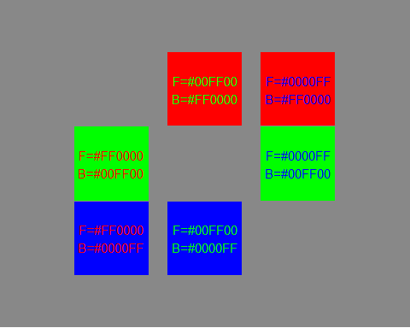
Contrasting pure colors often appear too intense

Slide 14
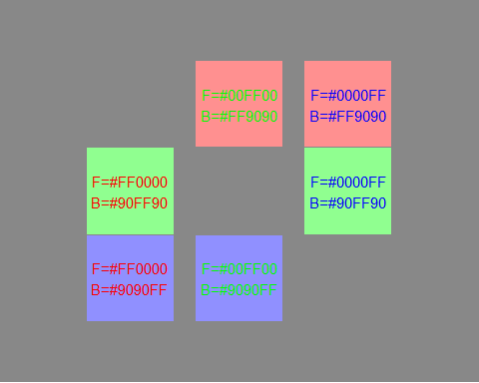
Lighten the background

Slide 15
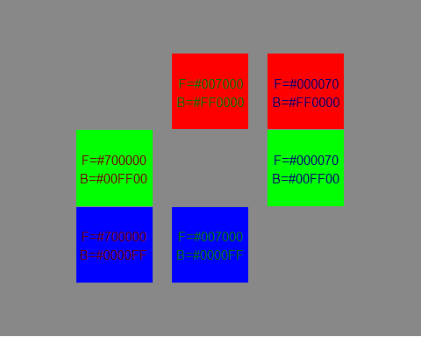
Darken the foreground

Slide 16
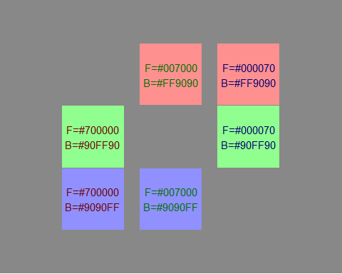
or both

Slide 17
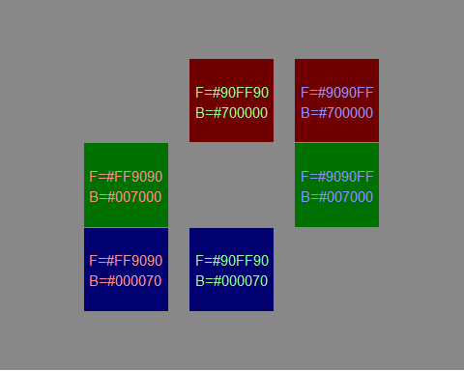
or the reverse

