Slide 1
Scatterplot exercise, change the color
Steve Simon

Slide 2
Exercise, change the color
Use the Saratoga housing data set.
Draw a plot of all of the data where
X=Age,
Y=Price,
Color=Bathrooms.
Notes:
Revisit your scatterplot. Draw a plot with x representing the age of the house, y representing the price, and the color representing the number of bathrooms.

Slide 3
Exercise, Python code
Here’s the Python code.
ch2 = alt.Chart(df).mark_point().encode( x="Age", y="Price", color="Baths")
Notes:
In Altair/Python, the variable associated with different colors goes inside the encode function.

Slide 4
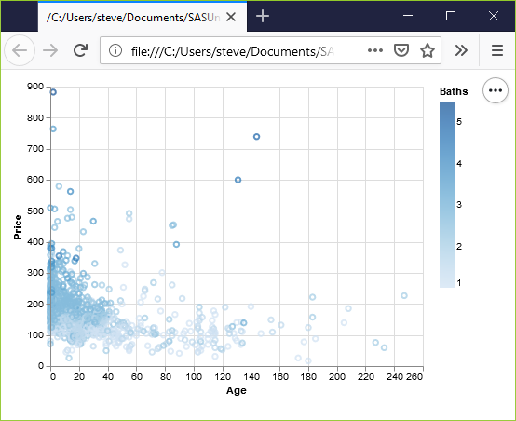
Exercise, Python output
Python scatterplot mapping bathrooms to color
Notes:
Notice that Altair/Python used a gradient of colors. This is a good choice.
The darker colors, associated with a larger number of bathrooms cluster to the left. Newer houses tend to have more bathrooms.

Slide 5
Exercise, R code
Here’s the R code.
ggplot(saratoga_houses, aes(x=Age, y=Price)) + geom_point(aes(color=factor(Bathrooms)))
Notes:
The color variable is defined inside the aes function.

Slide 6
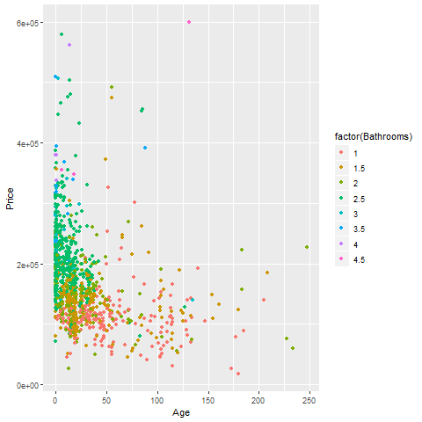
Exercise, R output
R scatterplot mapping bathrooms to color
Notes:
I deliberately defined Baths as categorical with the factor function, and notice the use of discrete colors again rather than a gradient.

Slide 7
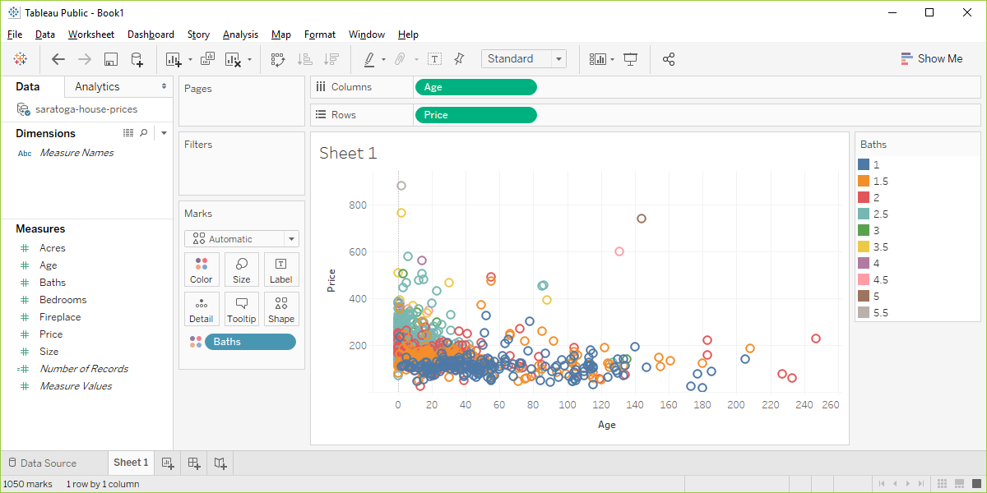
Exercise, Tableau output
Tableau scatterplot mapping Bathrooms to color
Notes:
I deliberately defined Baths as Dimension Categorical (blue pill) to show the contrast. Notice that the colors are discrete well separated values.

