Slide 1
Scatterplots exercise, change defaults
Steve Simon

Slide 2
Exercise, change the color and shape
Use the Saratoga housing data set.
Change the default color to any color you like
Change the default shape to any shape you like
Notes:
Take the scatterplot that you have already drawn and change the color of the points. Any color is fine as long as it is different from the default color. Change the shape of the points as well to any shape you want.

Slide 3
Exercise, Python code
Here’s the Python code.
ch = alt.Chart(df).mark_point( shape="square", color="green" ).encode( x='Age', y='Price' )
Notes:
In Python, you change defaults inside the mark_point function.

Slide 4
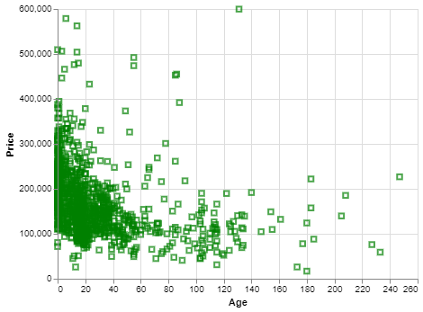
Exercise, Python output
Python scatterplot with green squares
Notes:
Here’s what my output looks like. You are welcome to experiment with different colors and different shapes.

Slide 5
Exercise, R code
Here’s the R code
ggplot(saratoga_houses, aes(x=Age, y=Price)) + geom_point(shape="square", color="green")
Notes:
The change in default shape and color are found in the geom_point function.

Slide 6
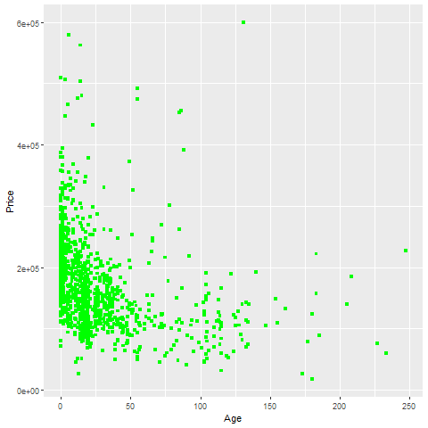
Exercise, R output
Notes:
This is the R output. Try other options if you have time.

Slide 7
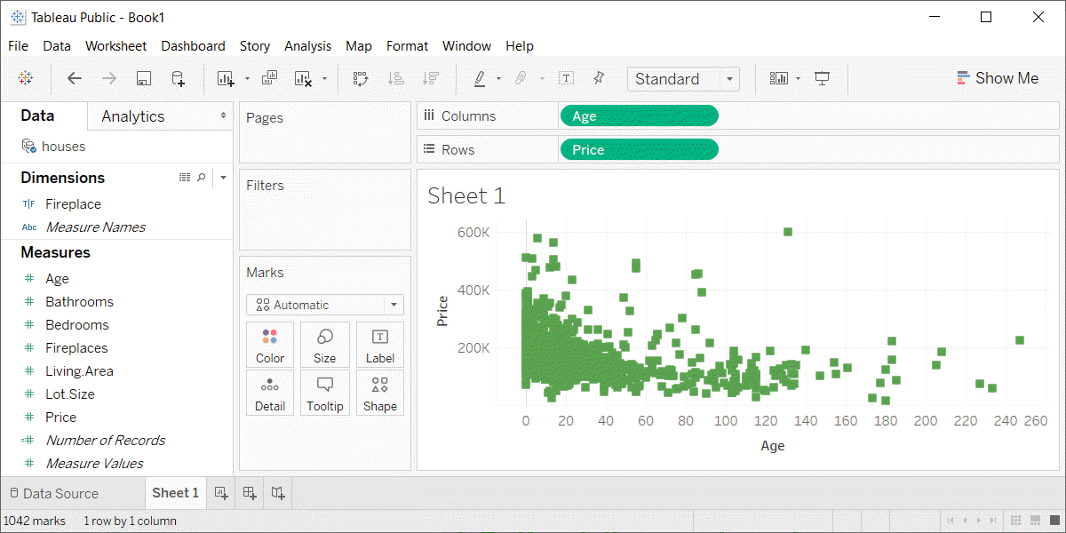
Exercise, Tableau output
Tableau scatterplot with green squares

