Slide 1
Scatterplot exercise, change the size
Steve Simon

Slide 2
Exercise, change the size
Use the Saratoga housing data set.
Draw a plot of all of the data where
X=Age,
Y=Price,
Size=Living.Area.
Notes:
Revisit your scatterplot. Draw a plot with x representing the age of the house, y representing the price, and the size representing the living area.

Slide 3
Erercise, Python code
Here’s the Python code
ch = alt.Chart(df).mark_point().encode( x='Age',y='Price', size='Living.Area')
Notes:
For Altair/Python, you define the variable associated with size in the encode function.

Slide 4
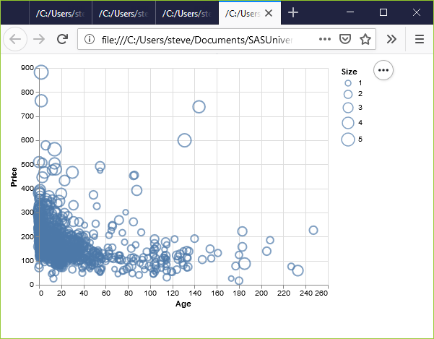
Exercise, Python output
Python scatterplot mapping living area to size
Notes:
This plot is a bit of a jumble, but you do notice that the very very high prices are all large circles, meaning spacious houses.

Slide 5
Exercise, R code
Here’s the R code.
ggplot(saratoga_houses, aes(x=Age, y=Price)) + geom_point(aes(size=Living.Area))
Notes:
With R, you put the variable associated with size in the aes function. Here, I placed this particular aes function in the geom_point function, but it would be okay to specify it as part of the earlier aes function inside the ggplot function.

Slide 6
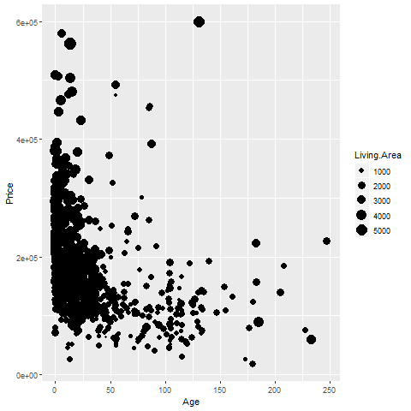
Exercise, R output
R graph using size to represent Living Area
Notes:
This plot shows the same pattern as earlier. The spacious houses tend to be clustered near the top of the graph, the expensive part of the graph.

Slide 7
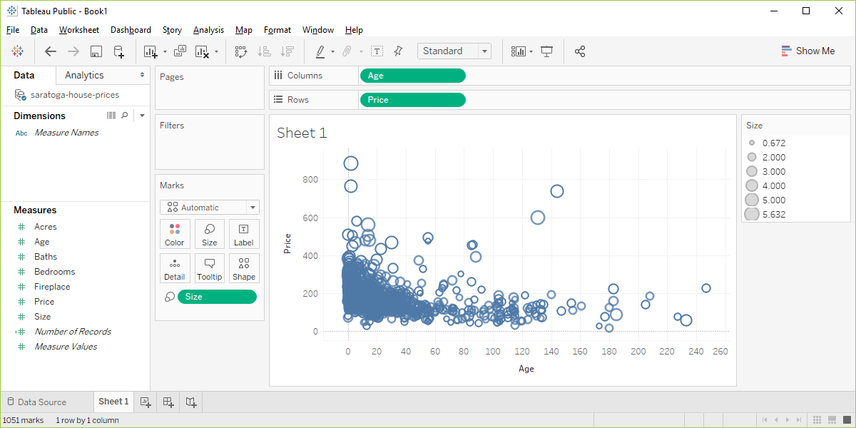
Exercise, Tableau output
Visualizaion using Living.Area as the size
Notes:
In Tableau, you drag and drop the Living.Area variable on the Size icon. The results are pretty much the same.

