Slide 1
Scatterplots, Fundamentals
Steve Simon

Slide 2
Fundamentals, Review basic scatterplot
Python code
ch = alt.Chart(df).mark_point().encode( x='Age', y='Price' )
R code
ggplot(saratoga_houses, aes(x=Age, y=Price)) + geom_point()
Tableau
(Drag and drop)
Notes:
You’ve already drawn a basic scatterplot in Python, R, or Tableau. All three systems choose a slightly different visualization, but, for the most part, the graphs look fairly nice. You can change some of those default options.

Slide 3
Fundamentals, Changing default options
Python code
.mark_point(shape="square", color="green").
R code
geom_point(shape="square", color="green")
Tableau
Click on the shape and color buttons
Notes:
In Python, you can change the default for every data point inside the mark_point function. In R, you do this inside the geom_point function. In Tableau, you have to click on the color and shape buttons to change the defaults.
Note that you may want to change the color or shape only for some of the data points. This is done inside the encode function in Altair/Python. In R, this is done inside the aes function. In Tableau, you drag and drop certain variables on top of buttons for color and shape.

Slide 4
Exercise, change the color and shape
Use the Saratoga housing data set.
Change the default color to any color you like
Change the default shape to any shape you like
Notes:
Take the scatterplot that you have already drawn and change the color of the points. Any color is fine as long as it is different from the default color. Change the shape of the points as well to any shape you want.

Slide 5
Exercise, Python code
Here’s the Python code.
ch = alt.Chart(df).mark_point( shape="square", color="green" ).encode( x='Age', y='Price' )
Notes:
In Python, you change defaults inside the mark_point function.

Slide 6
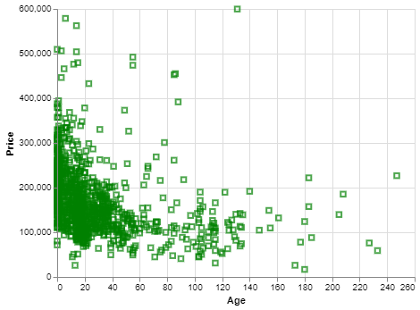
Exercise, Python output
Python scatterplot with green squares
Notes:
Here’s what my output looks like. You are welcome to experiment with different colors and different shapes.

Slide 7
Exercise, R code
Here’s the R code
ggplot(saratoga_houses, aes(x=Age, y=Price)) + geom_point(shape="square", color="green")
Notes:
The change in default shape and color are found in the geom_point function.

Slide 8
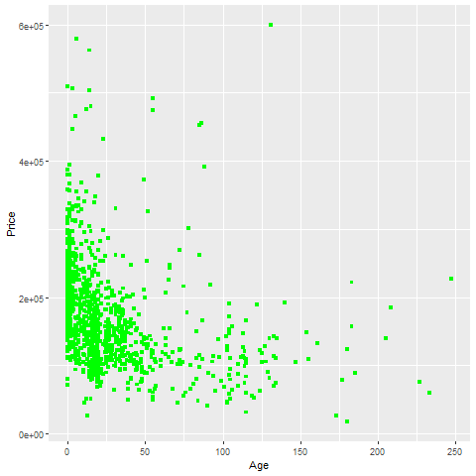
Exercise, R output
Notes:
This is the R output. Try other options if you have time.

Slide 9
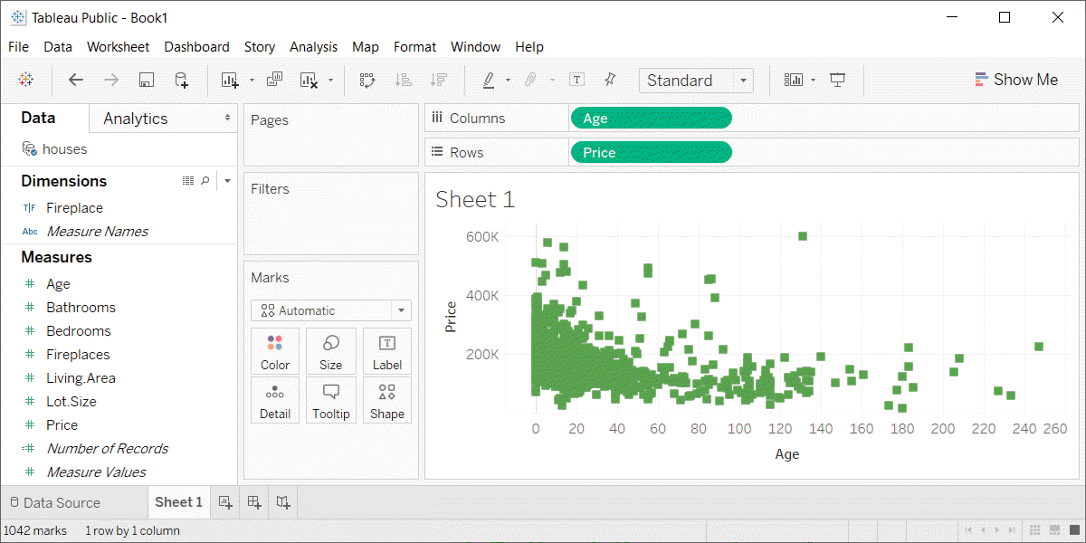
Exercise, Tableau output
Tableau scatterplot with green squares

Slide 10
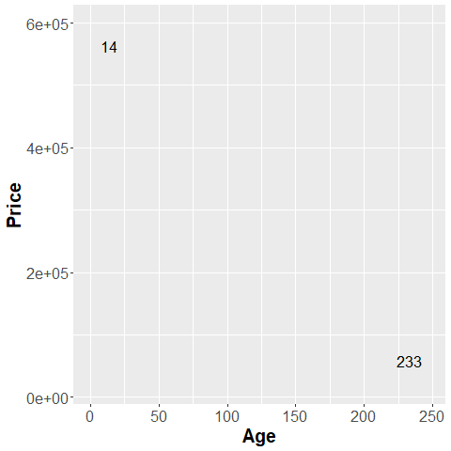
Fundamentals, Aesthetics for points - location (1 of 2)
Illustration of location aesthetics
Notes:
This plot show only two data points, and is labeled with the variable age, corresponding to the X location.
The point on the left is a young house, only 14 years old. The point on the right is an old house, 233 years old.

Slide 11
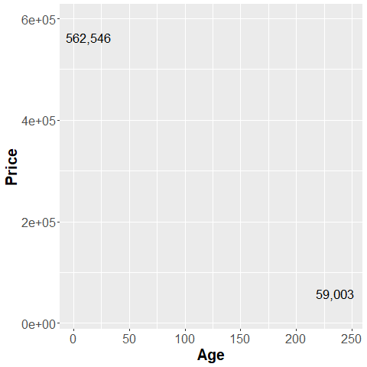
Fundamentals, Aesthetics for points - location (2 of 2)
Illustration of location aesthetics
Notes:
This plot is labeled with the variable Price, corresponding to the Y location.
The point in the up high is an expensive house, over a half million dollars. The point down low a cheap house, about one-tenth of the price.

Slide 12
Exercise, change the location
Use the Saratoga housing data set.
Revise the plot so that the location of the points represents X=Bedrooms and Y=Price.
Notes:
Go back to the plot you just drew. Modify it so that the x location is Bedrooms and not Age.

Slide 13
Exercise, Python code
Here’s the Python code.
ch = alt.Chart(df).mark_point().encode( x='Bedrooms',y='Price')
Notes:
You specify the x and y locations inside the encode function.

Slide 14
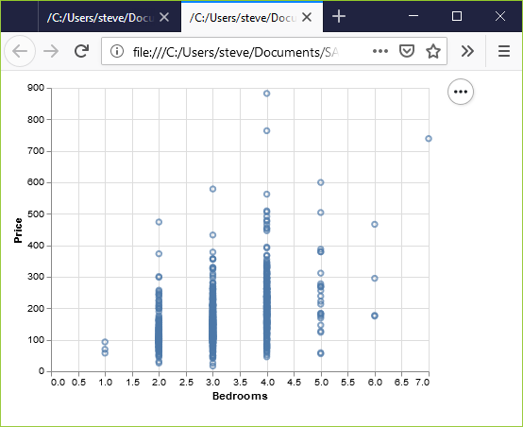
Exercise, Python output
Python scatterplot of bedrooms and price
Notes:
This is what the Python graph should look like. There is a general upward trend. Houses with more bedrooms tend to cost more.

Slide 15
Exercise, R code
Here’s the R code
ggplot( saratoga_houses, aes(x=Bedrooms, y=Price)) + geom_point())
Notes:
In R, the X and Y locations go inside the aes function. Normally the aes function sits insider the ggplot function.

Slide 16
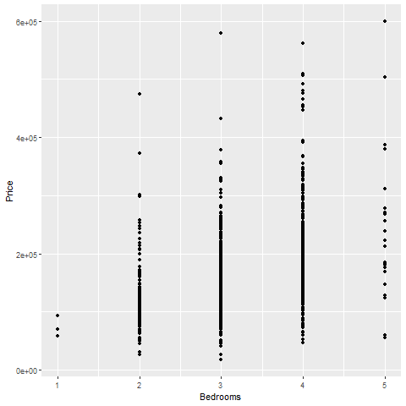
Exercise, R output
Scatterplot of bedrooms and price
Notes:
This is the plot in R. It shows a general upward trend.

Slide 17
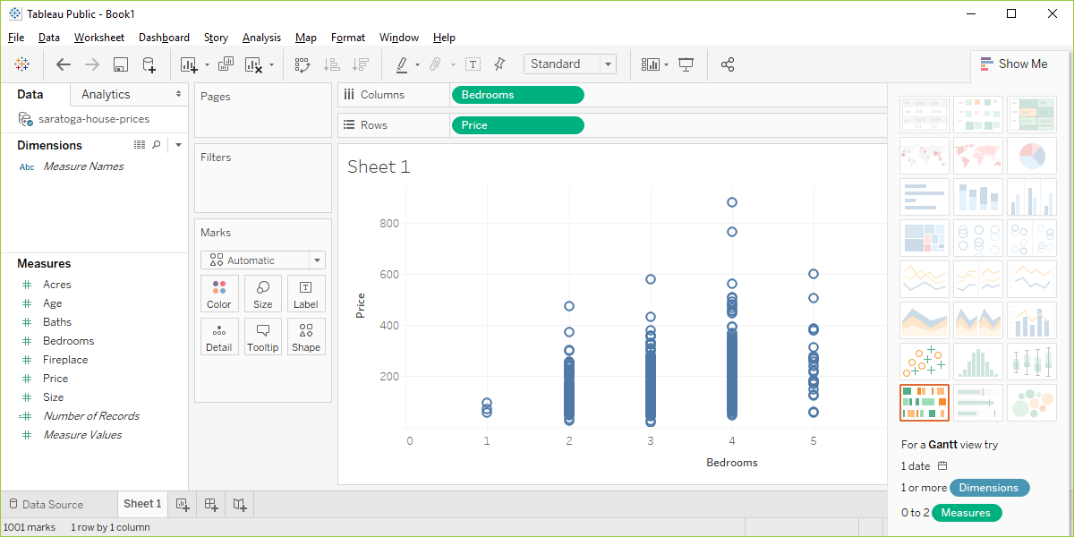
Exercise, Tableau output
Tableau scatterplot of Bedrooms and Price
Notes:
In Tableau, click on Age in the Columns field and choose the remove option. The graph looks a bit weird with no columns, but ignore it. Drag Bedrooms over to the Columns field. Tableau wants to use a sum, but you want individual data points. So click on SUM(Bedrooms) and change it to a Dimension.

Slide 18
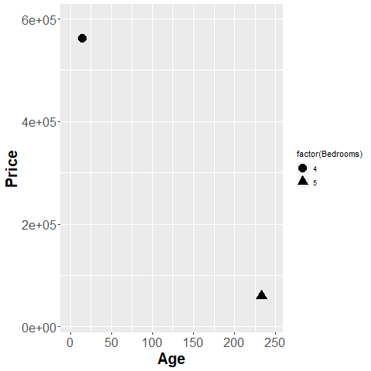
Fundamentals, Aesthetics for points - shape
Illustration of shape aesthetics
Notes:
The house in the upper left corner has four bedrooms, and the house in the lower right corner has five bedrooms. You use circles and triangles to designate this and the legend on the right hand side tells you how to decipher the symbols.
I want to note here that this plot is effectively showing three dimensions, Age, Price, and Bedrooms, even though it is restricted to a two dimensional screen.
I also want to point out that this may not be the best way to visualize the relationship among these three variables.

Slide 19
Exercise, change the shape
Use the Saratoga housing data set.
Draw a plot of all of the data where
X=Age,
Y=Price,
Symbol=number of bedrooms.
Notes:
Revisit your scatterplot. Draw a plot with x representing the age of the house, y representing the price, and the symbol representing the number of bedrooms.

Slide 20
Exercise, Python code
Here’s the Python code.
ch = alt.Chart(df).mark_point().encode( x='Age',y='Price', shape='Bedrooms:N')
Notes:
In Python, when you want the shape to vary by the levels of a particular variable, you specify this in the encode function. This Python program has three variables that are mapped. Age is mapped to the X location, Price is mapped to the Y location, and Bedrooms is mapped to various shapes.
Bedrooms is on a continuous scale, and you have to tell Python that you want to treat it as if it were nominal.

Slide 21
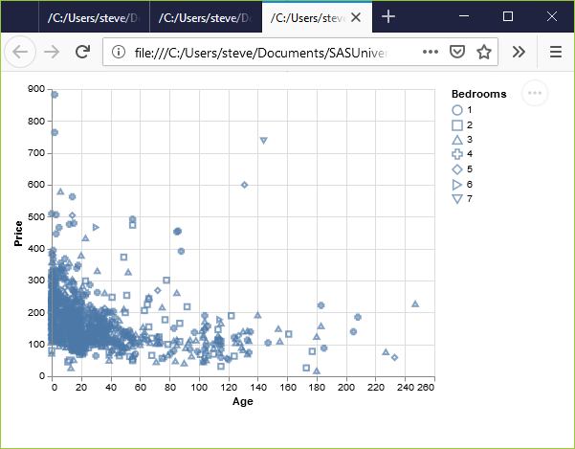
Exercise, Python output
Python scatterplot mapping bedrooms to shape
Notes:
This is what the plot looks like. There is a terrible mix of shapes with no obvious pattern.

Slide 22
Exercise, R code
Here’s the R code.
ggplot(saratoga_houses, aes(x=Age, y=Price)) + geom_point(aes(shape=factor(Bedrooms)))
Notes:
Here is the R code. When the shape of a point is dependent on a variable, you need to specify that variable inside the aes function. You could have defined it inside the existing aes function in the first line of code, but you can also add an aes function to the geom_point function.
I like the second option because it makes the code a bit easier to read.
Bedrooms is numeric, and by default in R is treated as a continuous variable. You can convert it to a nominal variable with the factor function.

Slide 23
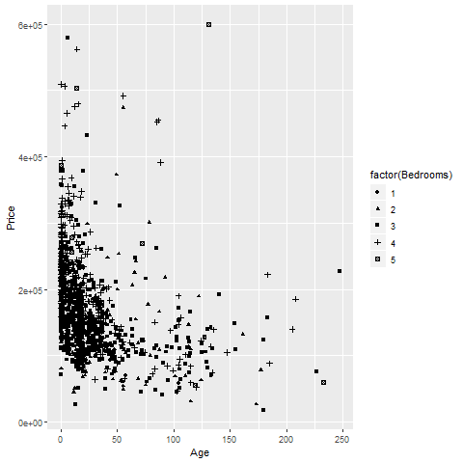
Exercise, R output
R scatterplot mapping bedrooms to shape
Notes:
Here is what the R graph looks like. I don’t particularly like this graph. It is confusing, especially with all the overprinting.

Slide 24
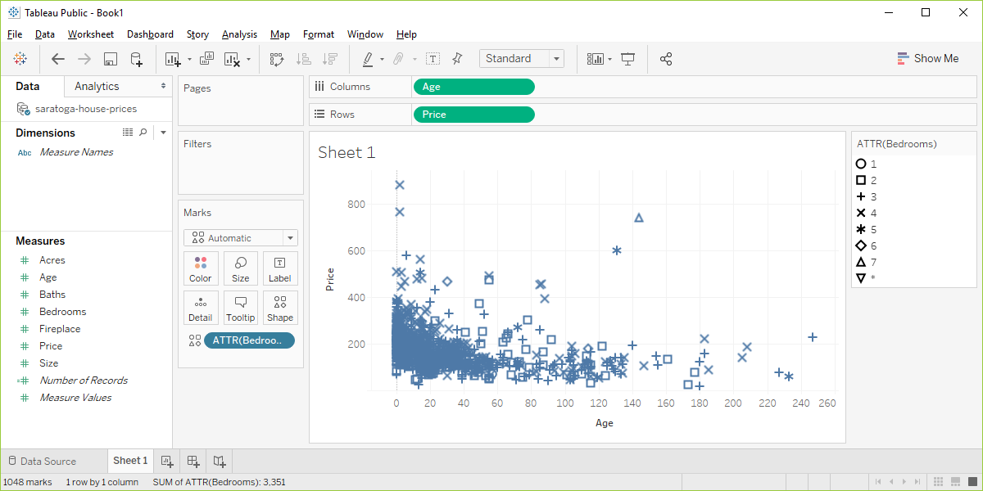
Exercise, Tableau output
Tableau scatterplot using shapes to represent Bedrooms
Notes:
Here are the steps in Tableau. First revert to the earlier scatterplot where Age is in the Column fields and Price is in the Rows field. Then drag and drop Bedrooms on top of the Shape icon. Change from SUM(Bedrooms) to Dimension Categorical.

Slide 25
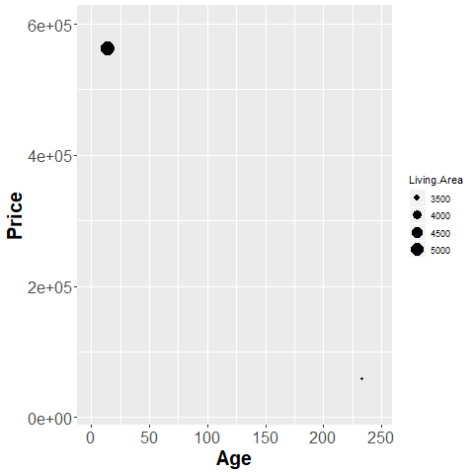
Fundamentals, Aesthetics for points - size
Illustration of size aesthetics
Notes:
You can also use the size of a point to represent a third dimension. Here is a plot where the larger house, the house with more living area has a big circle and the house with less living area has a small circle.

Slide 26
Exercise, change the size
Use the Saratoga housing data set.
Draw a plot of all of the data where
X=Age,
Y=Price,
Size=Living.Area.
Notes:
Revisit your scatterplot. Draw a plot with x representing the age of the house, y representing the price, and the size representing the living area.

Slide 27
Erercise, Python code
Here’s the Python code
ch = alt.Chart(df).mark_point().encode( x='Age',y='Price', size='Living.Area')
Notes:
For Altair/Python, you define the variable associated with size in the encode function.

Slide 28
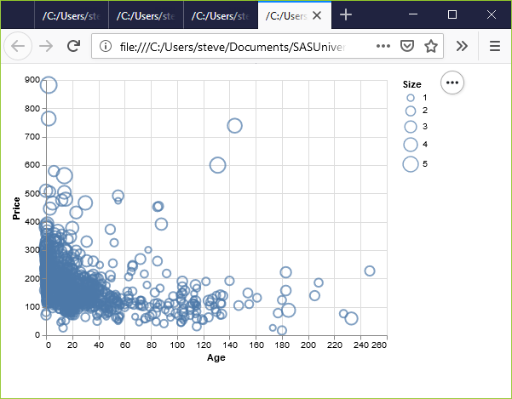
Exercise, Python output
Python scatterplot mapping living area to size
Notes:
This plot is a bit of a jumble, but you do notice that the very very high prices are all large circles, meaning spacious houses.

Slide 29
Exercise, R code
Here’s the R code.
ggplot(saratoga_houses, aes(x=Age, y=Price)) + geom_point(aes(size=Living.Area))
Notes:
With R, you put the variable associated with size in the aes function. Here, I placed this particular aes function in the geom_point function, but it would be okay to specify it as part of the earlier aes function inside the ggplot function.

Slide 30
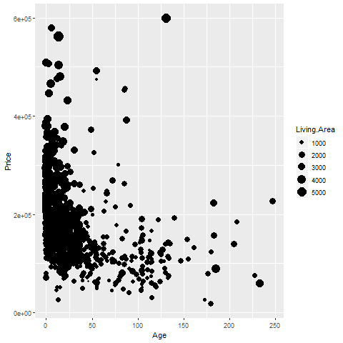
Exercise, R output
R graph using size to represent Living Area
Notes:
This plot shows the same pattern as earlier. The spacious houses tend to be clustered near the top of the graph, the expensive part of the graph.

Slide 31
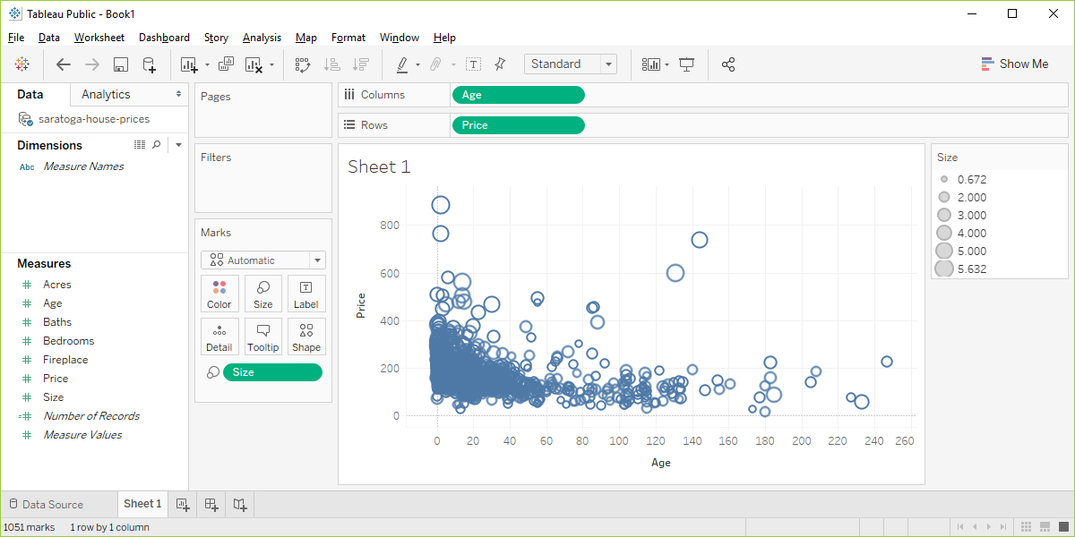
Exercise, Tableau output
Visualizaion using Living.Area as the size
Notes:
In Tableau, you drag and drop the Living.Area variable on the Size icon. The results are pretty much the same.

Slide 32
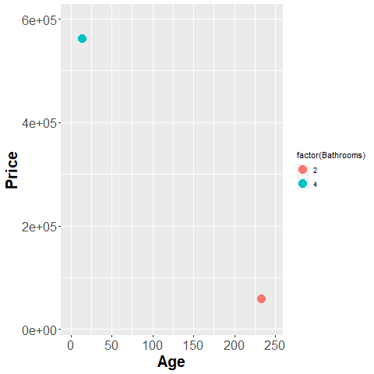
Fundamentals, Aesthetics for points - color (1 of 2)
Illustration of color aesthetics
Notes:
This plot shows a blue point representing a four bathroom house in the upper left corner and an orange point representing a two bathroom house in the lower right corner.

Slide 33
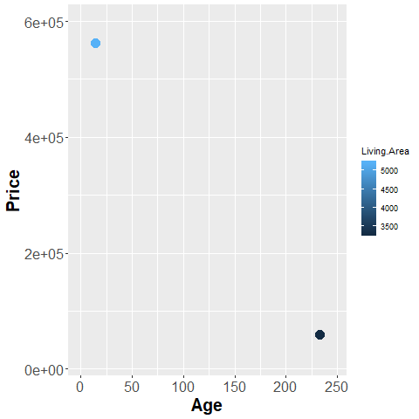
Fundamentals, Aesthetics for points - color (2 of 2)
R graph using color to represent Living.Area
Notes:
Notice how the legend has changed. All of the graphic packages use a set of discrete, easily distinguishable colors for categorical data. For continuous data, these graphic packages use a gradient.

Slide 34
Exercise, change the color
Use the Saratoga housing data set.
Draw a plot of all of the data where
X=Age,
Y=Price,
Color=Bathrooms.
Notes:
Revisit your scatterplot. Draw a plot with x representing the age of the house, y representing the price, and the color representing the number of bathrooms.

Slide 35
Exercise, Python code
Here’s the Python code.
ch2 = alt.Chart(df).mark_point().encode( x="Age", y="Price", color="Baths")
Notes:
In Altair/Python, the variable associated with different colors goes inside the encode function.

Slide 36
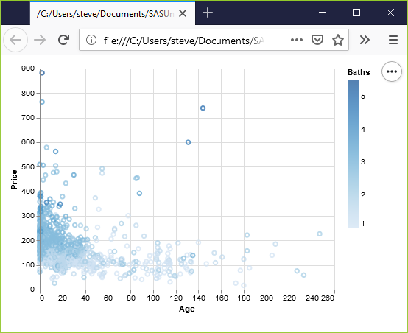
Exercise, Python output
Python scatterplot mapping bathrooms to color
Notes:
Notice that Altair/Python used a gradient of colors. This is a good choice.
The darker colors, associated with a larger number of bathrooms cluster to the left. Newer houses tend to have more bathrooms.

Slide 37
Exercise, R code
Here’s the R code.
ggplot(saratoga_houses, aes(x=Age, y=Price)) + geom_point(aes(color=factor(Bathrooms)))
Notes:
The color variable is defined inside the aes function.

Slide 38
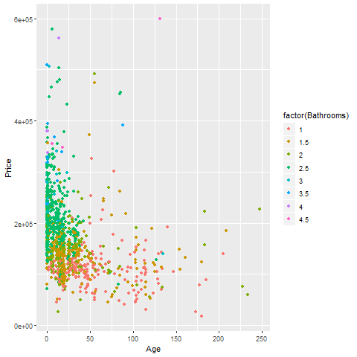
Exercise, R output
R scatterplot mapping bathrooms to color
Notes:
I deliberately defined Baths as categorical with the factor function, and notice the use of discrete colors again rather than a gradient.

Slide 39
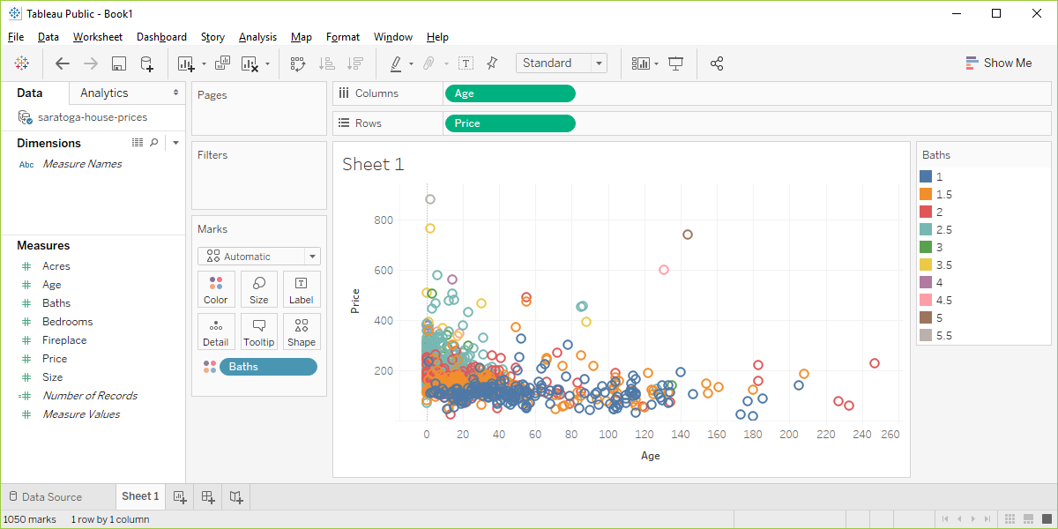
Exercise, Tableau output
Tableau scatterplot mapping Bathrooms to color
Notes:
I deliberately defined Baths as Dimension Categorical (blue pill) to show the contrast. Notice that the colors are discrete well separated values.

Slide 40
Fundamentals, summary
In this section, you learned how to use Python, R, and/or Tableau to
Assign variables to the x and y position of a graph
Change the defaults for aesthetics like shape and color
Assign a third variable to shape, size, or color
Notes:
Pat yourself on the back because you’ve alredy learned a lot. You know how to assign variables to the x and y positions of a graph. You can change the appears of the points on that graph. You can include a third variable in your graph, represented by shape, size, or color.
(Note to myself) The use of panels is an important aspect of visualization, and it is unclear to me where best to introduce it. Possibly it could be another dimension of location. You have your x position and your y position, but you also have a position within one of several panels.

