Slide 1
Exercise, first-class-red
Steve Simon

Slide 2
Exercise, First class red
Make the first class bar red (#FF0000)
Make the other two bars gray (#808080)
Notes:
One way to emphasize a particular category is to make it a bright color and to set the other colors to a less prominent color like gray that lets them fade into the background. It’s okay to use the same color for more than one category.
Make the first class category red and set the second and third class categories to gray.

Slide 3
Exercise, Python code
Here’s the Python code
ch = alt.Chart(df).mark_bar().encode( alt.Color( 'pclass:N', scale=alt.Scale( range=['#FF0000', '#808080', '#808080'] ) ), x='pclass:N', y='count()' )

Slide 4
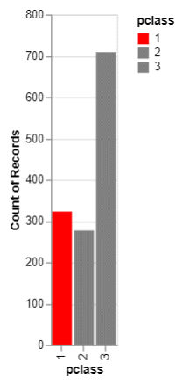
Exercise, Python output
Bar chart with red accent color

Slide 5
Exercise, R code
Here’s the R code
ggplot(titanic, aes(x=pclass)) + geom_bar(aes(fill=pclass)) + scale_fill_manual(values=c("#FF0000", "#808080", "#808080"))
Notes:
Here is the graph in Python.

Slide 6
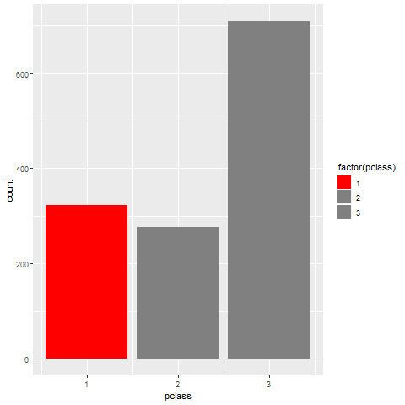
Exercise, R output
Barchart with red highlight
Notes:
Here is the graph in R.

Slide 7
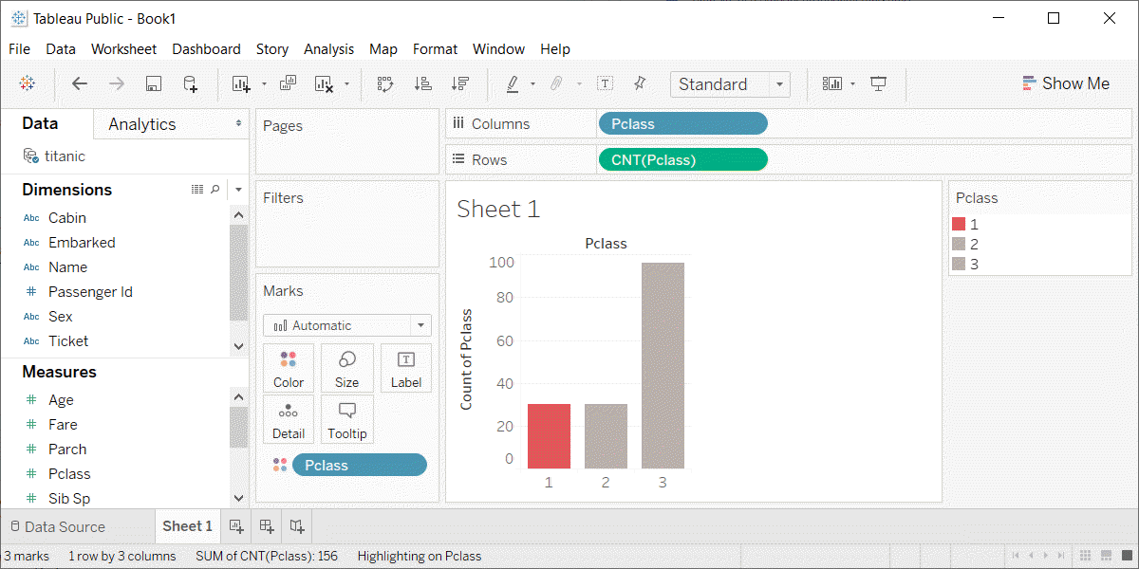
Exercise, Tableau output
Barchart with red highlight

