Slide 1
Exercise, Mortality by gender
Steve Simon

Slide 2
Exercise, Mortality by gender
Draw a bar chart showing counts involving both mortality and gender. Use normalized bars.
Notes:
Mortality on the Titanic reflects the fact that this was an era when people really did believe in the concept of “women and children first.” Someone like me, I’d be shoving the little kids aside so I could get on one of the lifeboats.
Anyway, examine how mortality is related to gender. It’s a spoiler alert, but on the Titanic, Kate survives, but Leonardo, I am so sad to say this, didn’t make it.

Slide 3
Exercise,Python code
Python code
ch = alt.Chart(df).mark_bar().encode( x='sex', y=alt.Y('count()', stack='normalize'), color='survived' )
Alternative
ch = alt.Chart(df).mark_bar().encode( x='survived', y=alt.Y('count()', stack='normalize'), color='sex' )
Notes:
Here is the Python code. Notice that there are two different approaches.

Slide 4
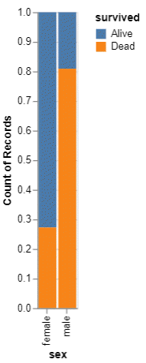
Exercise, Python output, Mortality by sex
Mortality by sex barchart
Notes:
This is what the Python normalized barchart looks like.

Slide 5
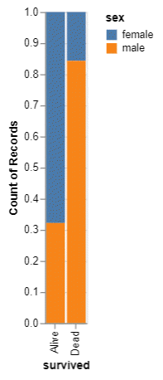
Exercise, Python output, Sex by mortality
Sex by mortality barchart
Notes:
This is what the alternate version of the Python normalized barchart.

Slide 6
Exercise, R code
R code
ggplot(titanic, aes(x=survived, fill=sex)) + geom_bar(position="normalize")
Alternate version
ggplot(titanic, aes(x=sex, fill=survived)) + geom_bar(position="normalize")

Slide 7
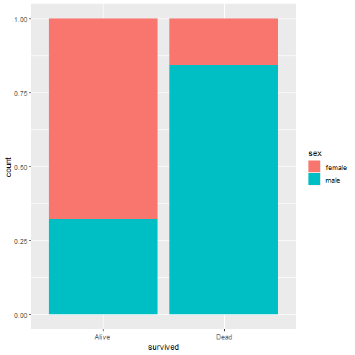
Exercise, R output, Mortality by sex
Notes:
Here is the R output.

Slide 8
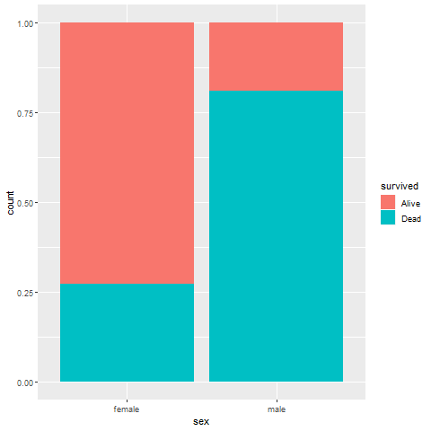
Exercise, R output, Sex by mortality
Notes:
Here is the alternate version.

Slide 9
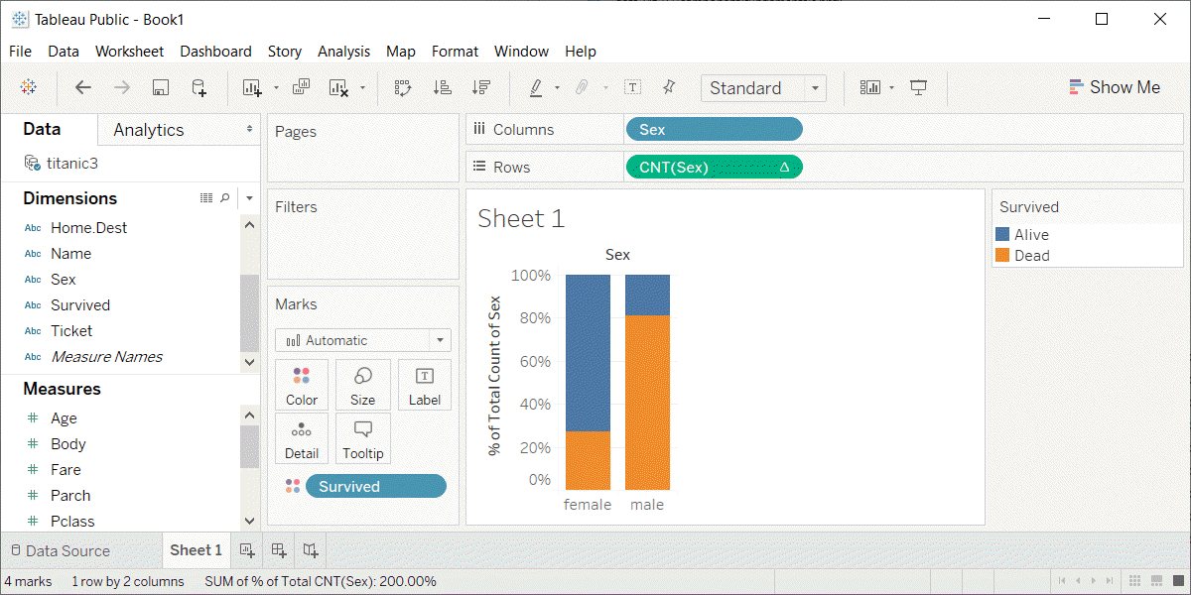
Exercise, Tableau output, mortality by sex
Mortality by sex barchart
Notes:
Here is the Tableau output.

Slide 10
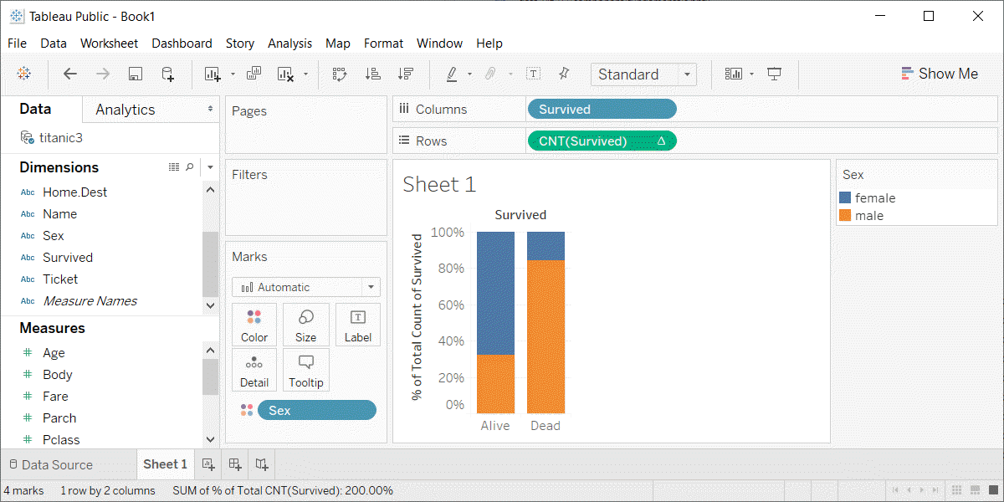
Exercise, Tableau output, sex by mortality
Sex by mortality barchart
Notes:
Here is the alternate version.

