Slide 1
Barchart fundamentals
Steve Simon

Slide 2
Barchart fundamentals
Fewer in numbers than points
Usually a summary statistic
Count
Percent
Average
Total
A bar chart is NOT a histogram
Notes:
Bar charts are different than point charts. There are usually only a few bars. These bars usually represent a summary statistic, like a count, percent, average, or total.
There is a technical distinction between a bar chart and a histogram. Histograms are a great diagnostic tool, but usually ends up on the cutting room floor. So I won’t be talking about it much, if at all, in this workshop.

Slide 3
Barchart fundamentals, Aesthetics for bars
Review
Location
Size
Color
NOT shape!!!
Notes:
Recall that aesthetics are visual attributes associated with a geometry/mark. You can map variables to the location, size, and/or color of bars, but you cannot assign a variable to the shape of a bar.
There is a bit of potential ambiguity on bar charts. If you are looking at a vertical bar chart (the bar chart shown earlier is a vertical bar chart), then the location on the x-axis represents which category. For the vast majority of bar charts, the bars are anchored on the x-axis, though there are a few exceptions.
The location of the Y-axis, then, is the measure of the bar’s height. You could, if you wanted to, call this the bar’s size, but most people think of the bar’s size as the width of the bar. For the vast majority of cases, the width of a bar is constant, but there are a few exceptions.
The color of a bar can refer to the interior of the bar or the border of the bar. Usually these two colors are the same, but there are some exceptions.
We won’t talk about the exceptions in this lecture, but you are welcome to ask about them, if you are curious.
You cannot vary the shape of a bar. A bar is a bar.

Slide 4
Barchart fundamentals, Basic barchart
Python code
ch = alt.Chart(df).mark_bar().encode( x='pclass:N', y='count()'
R code
ggplot(ti, aes(x=pclass)) + geom_bar()
Tableau
Drag and drop
Notes:
The Python/Altair code uses the mark_bar function instead of mark_point. You encode the passenger class on the x axis, but you have to remind Python/Altair that the values of 1, 2, and 3 represent categories of first class, second class, and third class. The y axis represents the count.
The code in R uses the geom_bar function. You can get away with specifying only a single location, the x-axis, because the default in geom_bar is to use the count as the location on the y-axis.

Slide 5
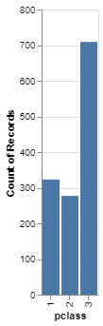
Barchart fundamentals, Python output for basic barchart
Barchart in Python
Notes:
This is the Python version of the barchart.
This is data from the Titanic, a ship that was as massive as its name. It was considered unsinkable, but on its maiden voyage in 1912, the ship hit an iceberg and sank. It sank during an era where people really believed in women and children first, and this shows quite clearly in the mortality statistics. There was a difference, though, between third class passengers like Leonardo diCaprio and first class passengers like Kate Winslet.
This shows a simple bar chart. The x-axis is passenger class and the y-axis is count. Note that there are about the same number of first and second class passengers, but the two combined does not come close to the number of third class passengers.

Slide 6
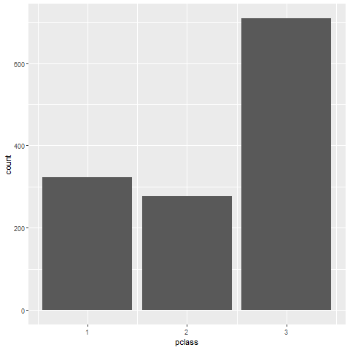
Barchart fundamentals, R output for basic barchart
Notes:
This is the R version of the barchart.

Slide 7
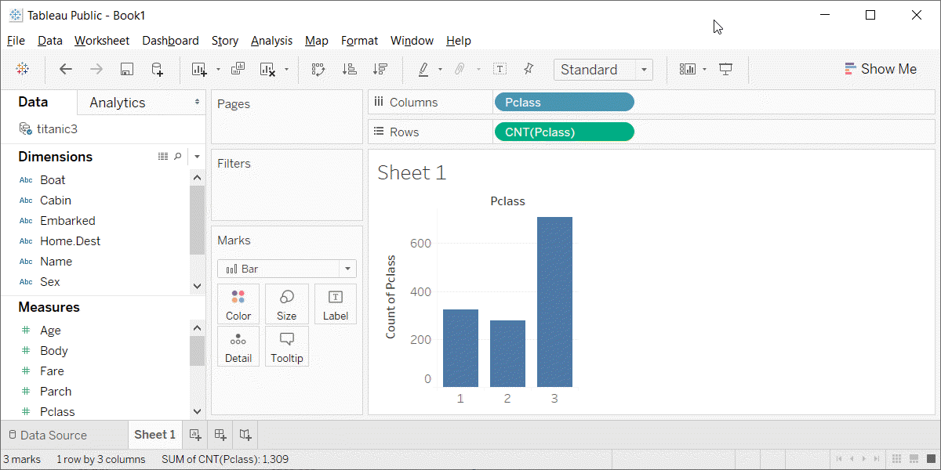
Barchart fundamentals, Tableau output for basic barchart
Barchart in Tableau
Notes:
Here is the Tableau output. Notice the columns (the x-axis) is a blue pill. That tells Tableau that passenger class is a discrete dimenion (or categorical). The rows (y-axis) is the count summary function.

Slide 8
Exercise, Gender barchart
Draw a bar chart showing the number of people in each gender (use the Sex variable).

Slide 9
Exercise, Python code
Here’s the Python code
ch = alt.Chart(df).mark_bar().encode( x='sex', y='count()' )

Slide 10

Exercise, Python output

Slide 11
Exercise, R code
Here’s the R code
ggplot(titanic, aes(sex)) + geom_bar()

Slide 12
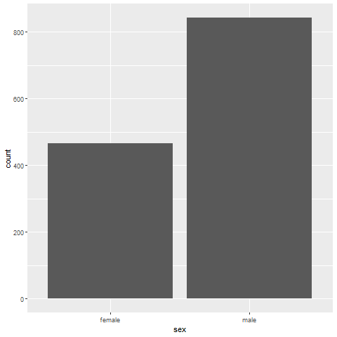
Exercise, R output

Slide 13
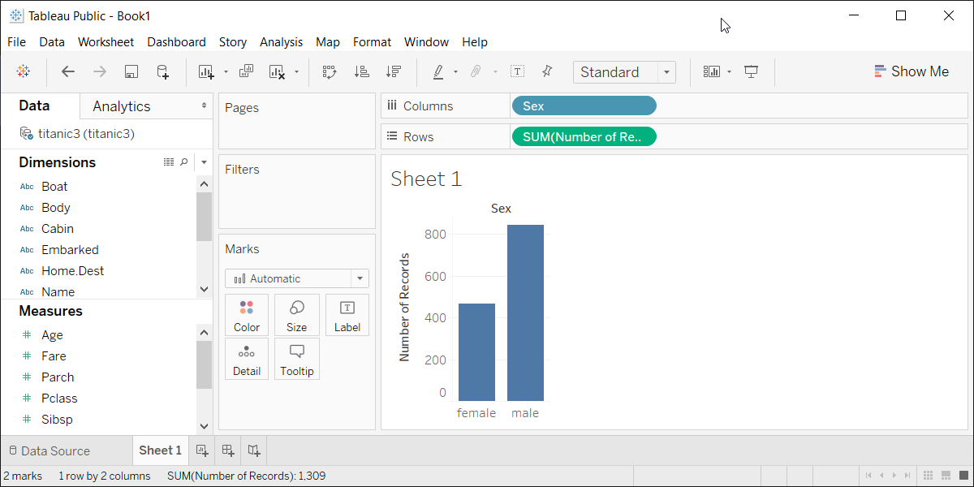
Exercise, Tableau output
Tableau barchart

Slide 14
Barchart fundamentals, changing the default
Python code
ch = alt.Chart(df).mark_bar( color='#FF0000', size=5 ).encode( x='pclass:N', y='count()' )
R code
ggplot(titanic, aes(pclass)) + geom_bar(fill="#FF0000", width=0.5)
Tableau
Point and click
Notes:
Here is the code to change the color and the size of all the bars. In Altair/Python, you place color and size arguments inside the mark_bar function. The size represents the number of pixels (not counting a one pixel border), so a value of 5 will produce a 7 pixel barrather narrow bar. The default in Python is to leave a 3 pixel gap between each bar.
In R, the arguments are different. You specify the color of a bar with the fill argument. If you tried to use the color argument, it would change the color of the border, and leave the interior of the bar as the default color.
R also uses the width argument rather than size. This might not be the best choice, but width is less ambiguous than size, which could just as easily refer to the height as the width of the bar.
In R, width is a relative measure, and a value of 1 would mean that the bars fill up the entire space without any gaps. The value of 0.5 shown here will make the bars fill 50% of the space, making the bar widths equal to the width of the gaps. The default in R is 0.8.
In Tableau, you click on the color button to change the color for every bar. You click on the size button to change the width of the bars. Slide all the way to the right to have the bars touching and all the way to the left to get a single pixel width bar.

Slide 15
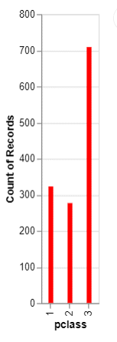
Barchart fundamentals, Python output for changing the default
Bar chart with red bars

Slide 16
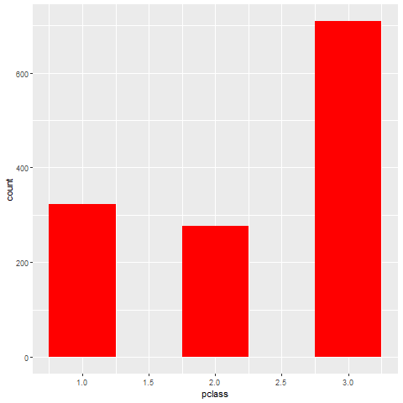
Barchart fundamentals, R output for changing the default
Bar chart of passenger class count
Notes:
Here is the output in R. Notice that the gaps between the bars are equal to the widths of the bars themselves.

Slide 17
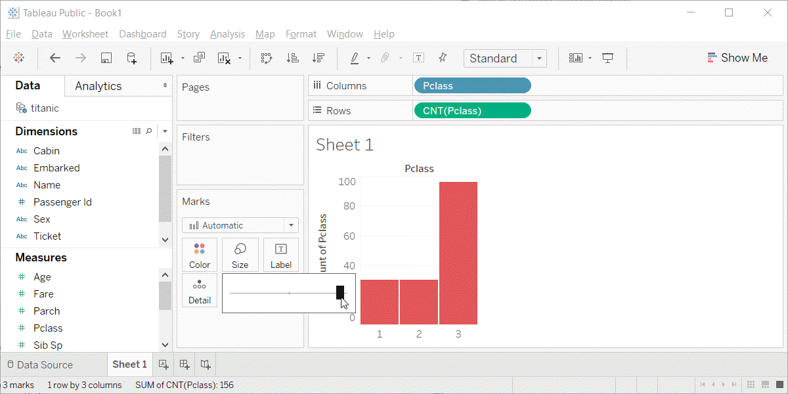
Barchart fundamentals, Tableau output for changing the default
Barchart with red bars
Notes:
This is what Tableau produces. I am showing the slider bar that appears when you click on the size button. It is almost all the way to the right, so the bars are very fat and there is only a very tiny gap between the bars.

Slide 18
Barchart fundamentals, Color
Use for emphasis in simple bar charts
Very important for stacked or side-by-side bar charts
Notes:
For simple bar charts like all the ones we’ve seen so far, color is not really needed. You already can distinguish between the passenger classes using the location. If you do use color in a simple bar chart, it is often to emphasize a point. In the previous bar chart, I used red for third class, because Kate Winslet, a rich first class passenger, found true love in third class, with the adorable Leonardo di Caprio.
Color becomes very important in just a minute when we add another layer of complexity.

Slide 19
Barchart fundamentals, Coding colors
Python code
ch = alt.Chart(df).mark_bar().encode( alt.Color('pclass:N'), x='pclass:N', y='count()' )
R code
ggplot(titanic, aes(x=pclass)) + geom_bar(aes(fill=pclass))
Tableau
Point and click
Notes:
If you want each bar to be a different color, then in Python, you have to include the color inside the encode function.
In R, you have to place the variable inside the aes function.
In Tableau, you have to drag and drop the variable on top of the color button.

Slide 20
Barchart fundamentals, Choosing your own colors
Python code
ch = alt.Chart(df).mark_bar().encode( alt.Color( 'pclass:N', scale=alt.Scale( range=['#00FF00', '#FFFF00', '#FF0000'] ) ), x='pclass:N', y='count()' )
Notes:
While the default colors chosen by your software are almost always good, you should experiment with different color combinations. A common choice for a three level ordinal variable is the traffic light colors of red, yellow, and green.
In Python, you add a scale argument to encode.

Slide 21
Barchart fundamentals, Choosing your own colors
R code
ggplot(titanic, aes(x=pclass)) + geom_bar(aes(fill=pclass)) + scale_fill_manual(values=c("#00FF00", "#FFFF00", "#FF0000"))
Tableau
Point and click
Notes:
In R, you have to add another layer to the graph with the scale_fill_manual function.
In Tableau, you click on each color in the legend, then click in the upper corner to lock in that bar only. Then click on the color button to change that bar to the desired color.

Slide 22
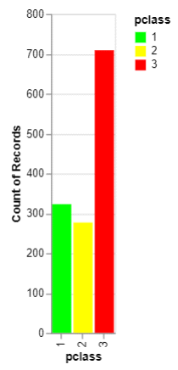
Barchart fundamentals, Python output for coding colors
Bar chart with traffic light colors
Notes:
This is what the Python bar chart looks like.

Slide 23
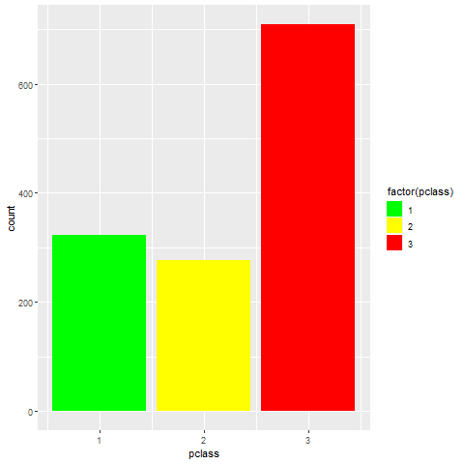
Barchart fundamentals, R output for coding colors
Barchart with traffic light colors
Notes:
This is what the R graph looks like.

Slide 24
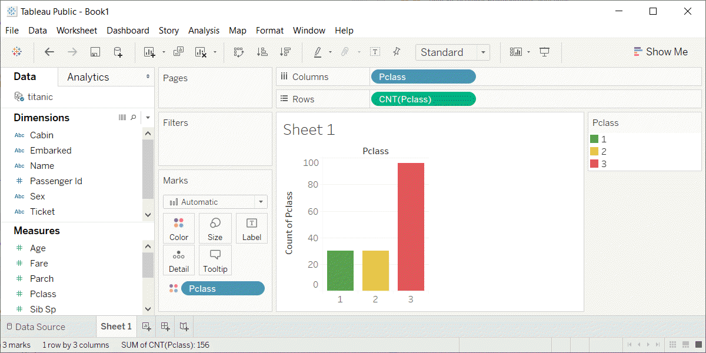
Barchart funadamentals, Tableau output for coding colors
Barchart with traffic light colors

Slide 25
Exercise, First class red
Make the first class bar red (#FF0000)
Make the other two bars gray (#808080)
Notes:
One way to emphasize a particular category is to make it a bright color and to set the other colors to a less prominent color like gray that lets them fade into the background. It’s okay to use the same color for more than one category.
Make the first class category red and set the second and third class categories to gray.

Slide 26
Exercise, Python code
Here’s the Python code
ch = alt.Chart(df).mark_bar().encode( alt.Color( 'pclass:N', scale=alt.Scale( range=['#FF0000', '#808080', '#808080'] ) ), x='pclass:N', y='count()' )

Slide 27
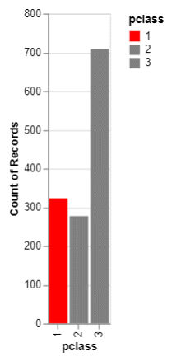
Exercise, Python output
Bar chart with red accent color

Slide 28
Exercise, R code
Here’s the R code
ggplot(titanic, aes(x=pclass)) + geom_bar(aes(fill=pclass)) + scale_fill_manual(values=c("#FF0000", "#808080", "#808080"))
Notes:
Here is the graph in Python.

Slide 29
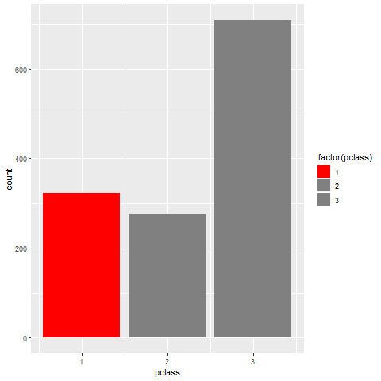
Exercise, R output
Barchart with red highlight
Notes:
Here is the graph in R.

Slide 30
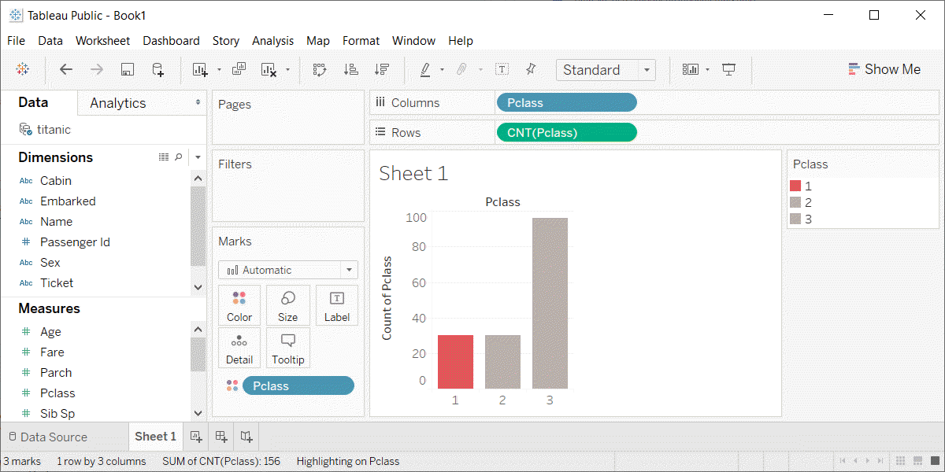
Exercise, Tableau output
Barchart with red highlight

Slide 31
Barchart fundamentals, Stack, Dodge, Normalize
Summarize by two categories
Dodge
Side by side
Stack
One on top, one on bottom
Normalize
Stack and set full bar to 100%
Notes:
Bar charts that represent a summary across a single categorical variable are fairly simple and easy to handle. But when you want to summarize by two categories simultaneously, things get interesting. Interesting in a good way.
You can present the extra category in side by side comparisons. This is called “dodge” in R, but is handled indirectly in Python and Tableau.
The stack option, where one category level is placed above another category level above another, is the default in all three packages, though you should take the trouble of specifying stack if you are using R.
The normalize option creates stacked bars, but then forces each stack to have a height of 1 (or 100%).

Slide 32
Barchart fundamentals, code for stack
Python code
ch = alt.Chart(df).mark_bar().encode( x='pclass:N', y='count()', color='sex' )
R code
ggplot(titanic, aes(x=pclass, fill=sex)) + geom_bar(position="stack")

Slide 33
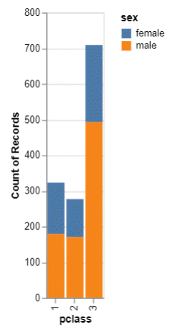
Barchart fundamentals, Python output for stacked bars

Slide 34
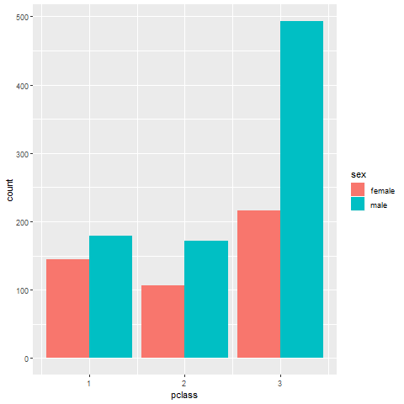
Barchart fundamentals, R output for stacked bars

Slide 35
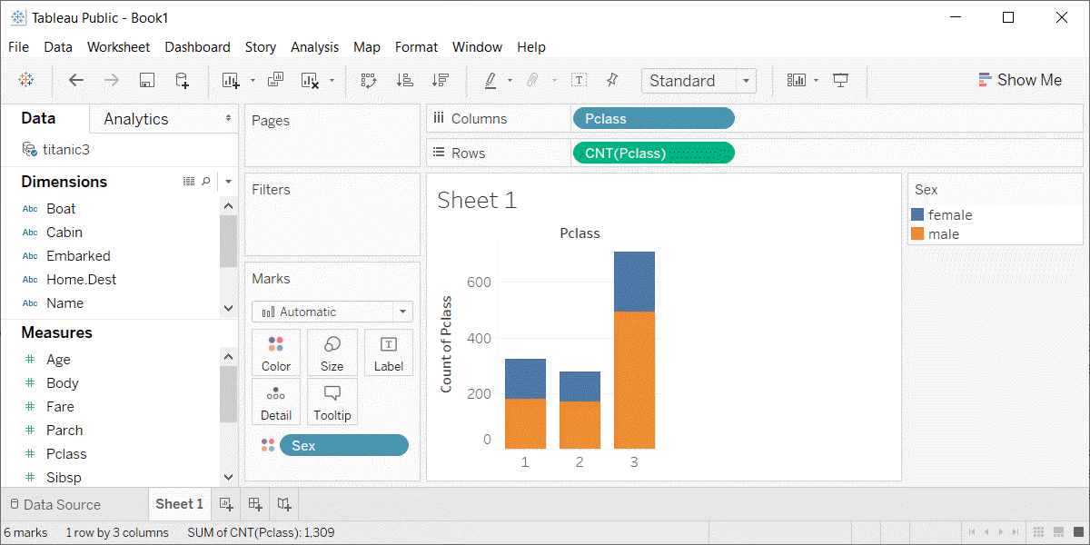
Barchart fundamentals, Tableau output for stacked bars
Notes:
Here is the stacked barchart in Tableau. Drag pclass to the x-axis, count of pclass to the y-axis, and sex to the color button.

Slide 36
Barchart fundamentals, code for dodge
Python code
ch = alt.Chart(df).mark_bar().encode( x='sex', y='count()', color='sex', column='pclass:N'
R code
ggplot(titanic, aes(x=pclass, fill=sex)) + geom_bar(position="dodge")
Tableau
Point and click

Slide 37
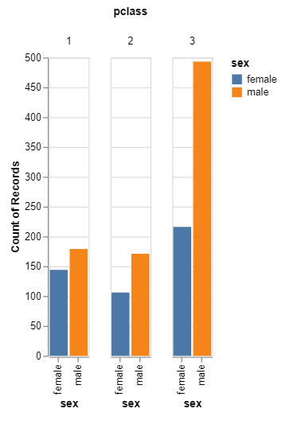
Barchart fundamentals, Python output for dodged bars
Grouped barchart for passenger class and gender

Slide 38
Barchart fundamentals, R output for dodged bars
Notes:
This is what the dodged bar chart looks like in R.

Slide 39
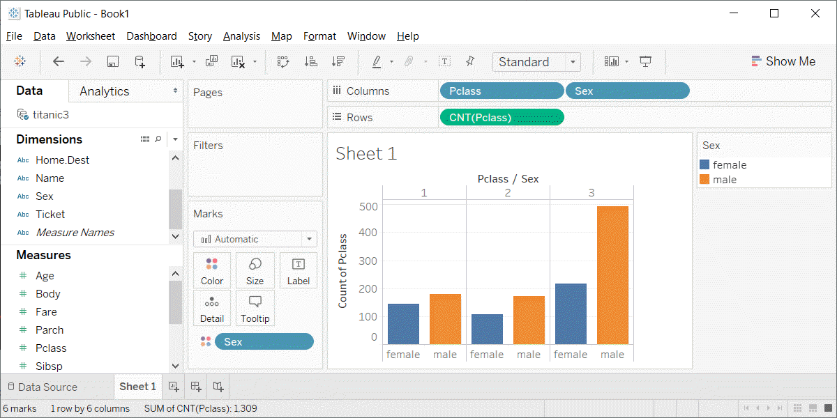
Barchart fundamentals, Tableau output for dodged bars
Notes:
This is what the Tableau output looks like.
Drag pclass to columns
Set to Dimension Discrete
Drag pclass to columns
Set to measure, count.
Drag sex to columns (to the right of pclass)
Set to Dimension Discrete
Drag sex to colur button
Set to Dimension Discrete

Slide 40
Barchart fundamentals, Code for normalize
Python code
ch = alt.Chart(df).mark_bar().encode( x='sex', y=alt.Y('count()', stack='normalize'), color='pclass:N' )
R code
ggplot(titanic, aes(survived)) + geom_bar(aes(fill=sex), position="fill")
Tableau
Drag and drop
Notes:
If you want a stacked barchart in Altair/Python, you need to use the alt.Y function with the stack=‘normalize’ argument.
In R, you use the position=‘fill’ argument in the geom_bar function. Note that this argument falls outside of the aes function.
In Tableau, you right click on the count summary, and pick Add Table Calculation from the drop down menu. In the dialog box, select Percent of Total and Compute Using Cell.

Slide 41
Barchart fundamentals, Python output for normalized bars
Notes:
This is what the Python normalized barchart looks like.

Slide 42
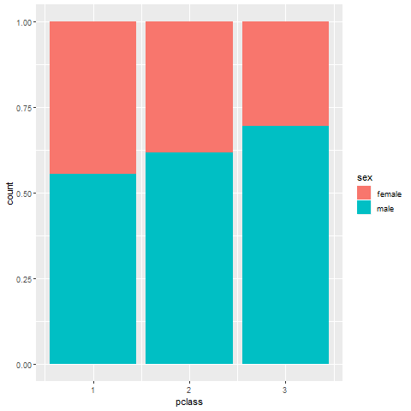
Barchart fundamentals, R output for normalized bars
Notes:
This is what the normalized bar chart looks like in R.

Slide 43
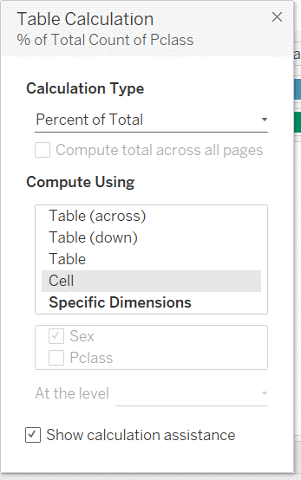
Barchart fundamentals, Tableau output for normalized bars
Notes:
In Tableau, you right click on the count summary, and pick Add Table Calculation from the drop down menu. In the dialog box, select Percent of Total and Compute Using Cell.

Slide 44
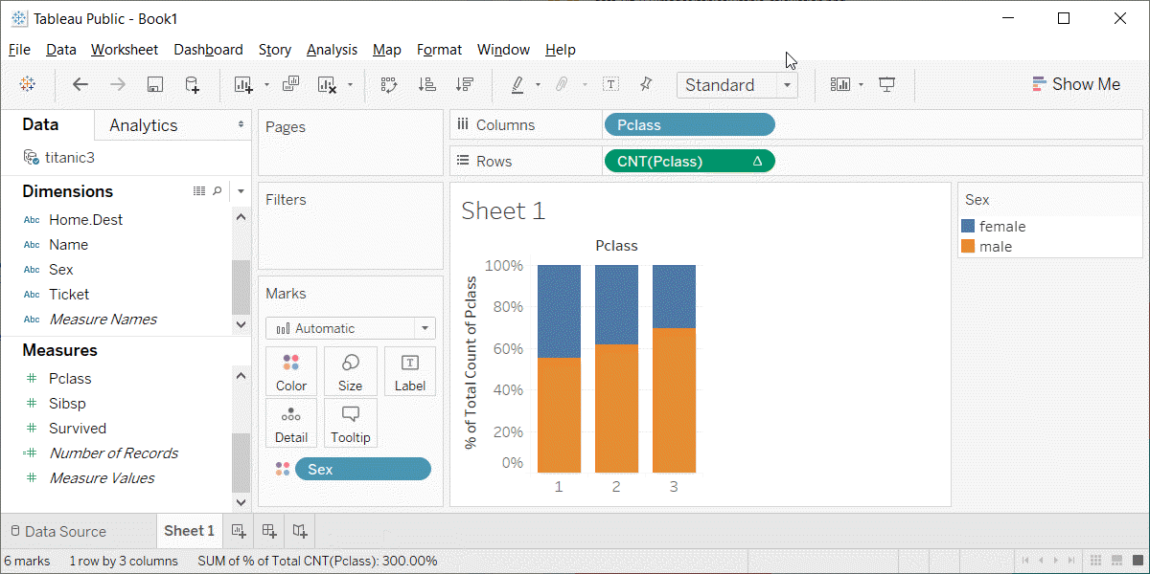
Barchart fundamentals, Tableau output for normalized bars
Notes:
This is what the visualization looks like in Tableau.

Slide 45
Exercise, Mortality by gender
Draw a bar chart showing counts involving both mortality and gender. Use normalized bars.
Notes:
Mortality on the Titanic reflects the fact that this was an era when people really did believe in the concept of “women and children first.” Someone like me, I’d be shoving the little kids aside so I could get on one of the lifeboats.
Anyway, examine how mortality is related to gender. It’s a spoiler alert, but on the Titanic, Kate survives, but Leonardo, I am so sad to say this, didn’t make it.

Slide 46
Exercise,Python code
Python code
ch = alt.Chart(df).mark_bar().encode( x='sex', y=alt.Y('count()', stack='normalize'), color='survived' )
Alternative
ch = alt.Chart(df).mark_bar().encode( x='survived', y=alt.Y('count()', stack='normalize'), color='sex' )
Notes:
Here is the Python code. Notice that there are two different approaches.

Slide 47
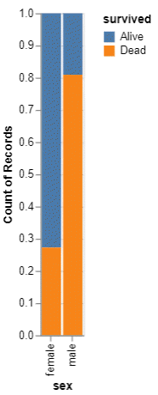
Exercise, Python output, Mortality by sex
Mortality by sex barchart
Notes:
This is what the Python normalized barchart looks like.

Slide 48
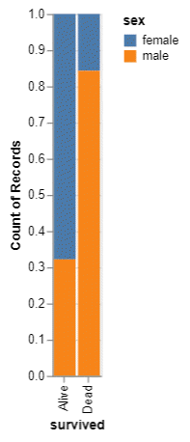
Exercise, Python output, Sex by mortality
Sex by mortality barchart
Notes:
This is what the alternate version of the Python normalized barchart.

Slide 49
Exercise, R code
R code
ggplot(titanic, aes(x=survived, fill=sex)) + geom_bar(position="normalize")
Alternate version
ggplot(titanic, aes(x=sex, fill=survived)) + geom_bar(position="normalize")

Slide 50
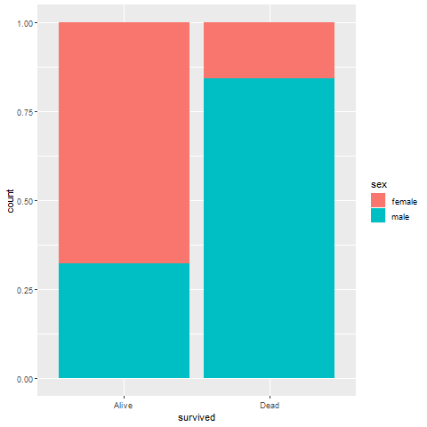
Exercise, R output, Mortality by sex
Notes:
Here is the R output.

Slide 51
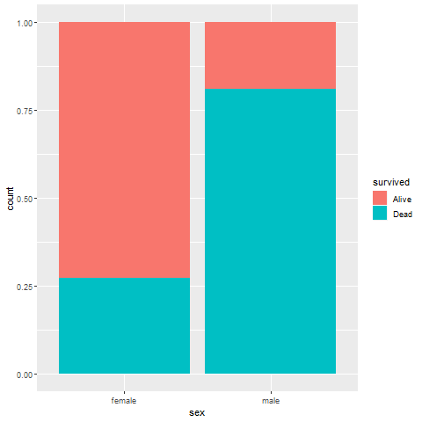
Exercise, R output, Sex by mortality
Notes:
Here is the alternate version.

Slide 52
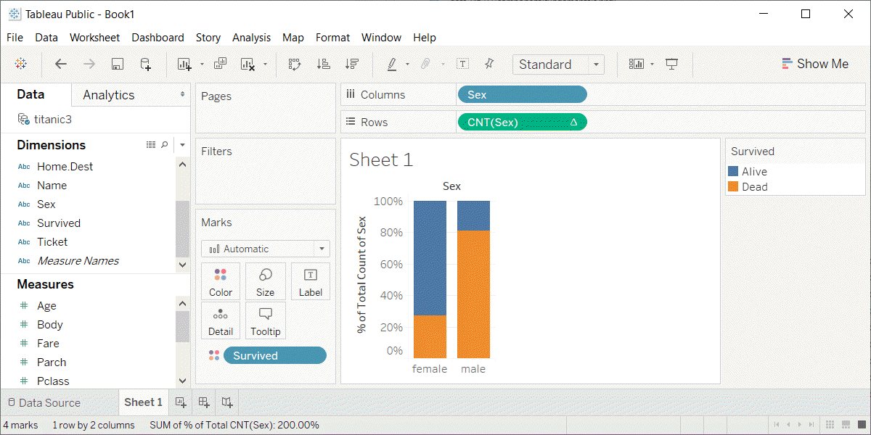
Exercise, Tableau output, mortality by sex
Mortality by sex barchart
Notes:
Here is the Tableau output.

Slide 53
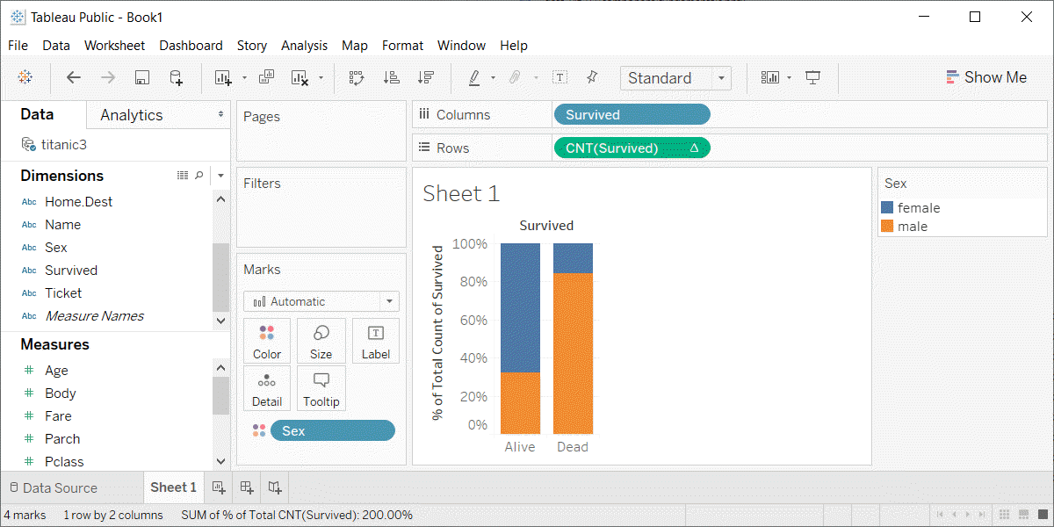
Exercise, Tableau output, sex by mortality
Sex by mortality barchart
Notes:
Here is the alternate version.

Slide 54
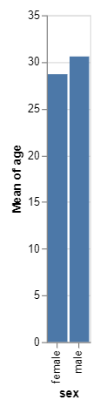
Barchart fundamentals, Python output for mean bars
Barchart of mean ages by sex

Slide 55
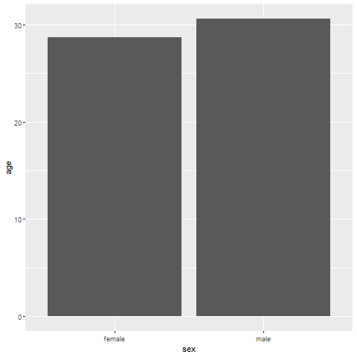
Barchart fundamentals, Example with means
Barchart of mean ages by sex

Slide 56
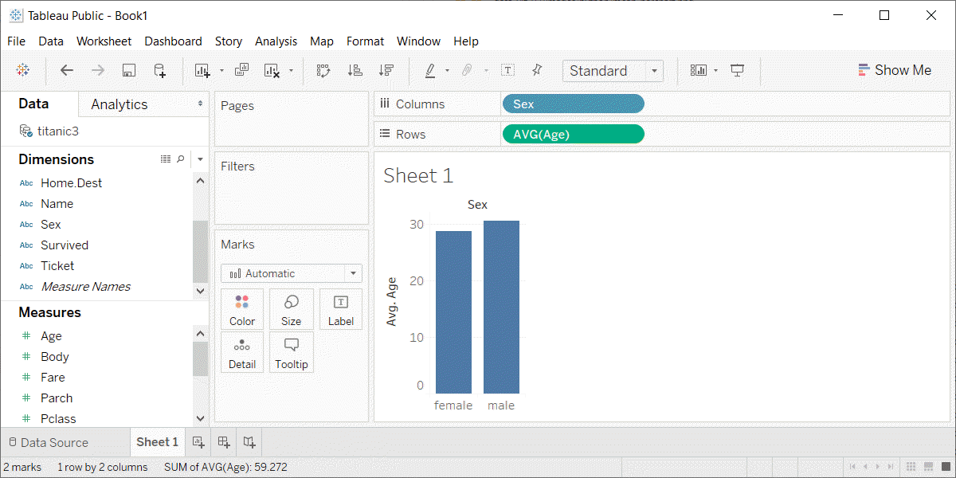
Barchart fundamentals, Tableau output of mean barchart
Barchart of mean ages by sex

Slide 57
Barchart fundamentals, Summary
“A mapping of data to the visual aesthetics of geometries/marks”
Bars are a type of geometry/mark
Aesthetics for bars include location, size, color
Stack versus dodge versus normalize
Notes:
Recall the definition of data visualization, the mapping of data ro the visual aesthetics of geometries/marks. Bars are a type of geometry or mark and you can vary the location, size, and color, though size (meaning width) is usually held constant.
You can control the placement of different color bars using dodge, stack, or normalize. Note that the terminology here is not standardized across the different packages.
(Note to myself) If I have time, it might be nice to include error bars and boxplots at the end of this section.

