Slide 1
Bar charts, What is the message?
Steve Simon

Slide 2
Group exercise
These bar charts come from recent newspaper articles.
People Who Can’t Vote Still Count Politically in America. What if That Changes?
Attacks by White Extremists Are Growing. So Are Their Connections.
The Best VPN Service.
Notes:
The following images are taken from various newspaper articles or press releases. Look at the graph and read/skim the article.

Slide 3
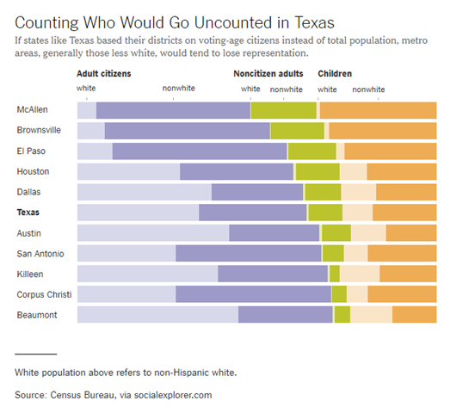
Graphs in the news, Voters in Texas
Bar chart of demographics of selected Texas counties
Notes:
This graph was published in a newspaper article,
Badger, E. (2019). People Who Can’t Vote Still Count Politically in America. What if That Changes? Retrieved June 24, 2019, from The New York Times website: https://www.nytimes.com/2019/06/22/upshot/america-who-deserves-representation.html

Slide 4
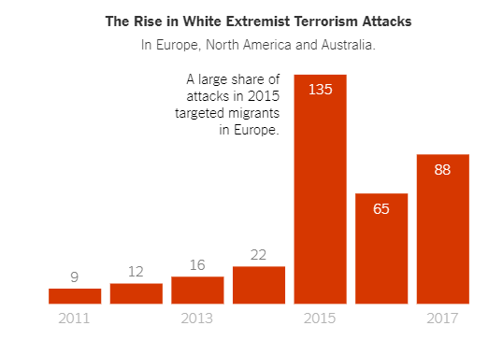
Graphs in the news, White extremist terrorism attacks
Bar chart counting white extremist terrorism attacks over time
Notes:
This graph was published in a newspaper article,
Weiyi Cai, Simone Landon. Attacks by White Extremists Are Growing. So Are Their Connections. The New York Times, April 3, 2019. Retrieved August 8, 2019 from https://www.nytimes.com/interactive/2019/04/03/world/white-extremist-terrorism-christchurch.html

Slide 5
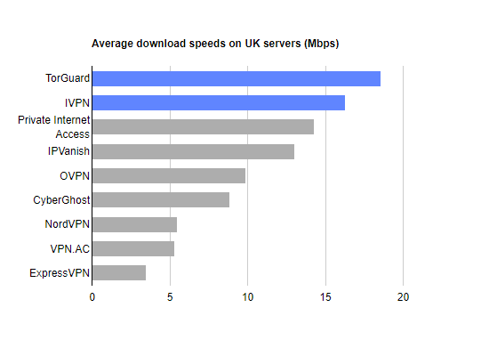
Graphs in the news, VPN speeds
Bar chart showing speeds of various VPN providers
Notes:
The graph was published in a web news article,
Mark Smirniotis. The Best VPN Service. Wirecutter, February 8, 2019. Retrieved August 14, 2019 from https://thewirecutter.com/reviews/best-vpn-service/.

Slide 6
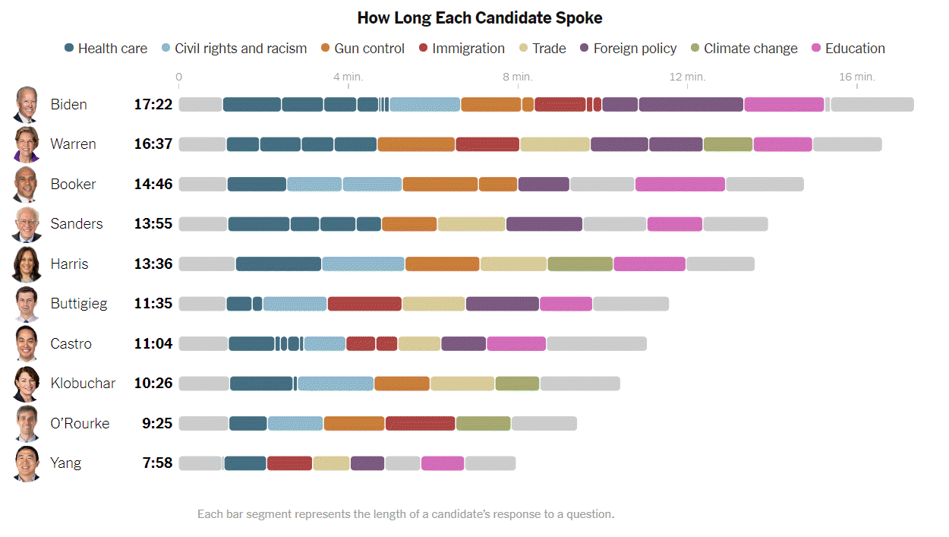
Graphs in the news, Debate speaking time
Bar chart showning speaking time at Democratic debate
Notes:
This graph was published in a newspaper article,
Weiyi Cai, Jasmine C. Lee, Jugal K. Patel. Speaking Time in the Democratic Debate. The New York Times, Sept. 12, 2019. Retrieved September 12, 2019 from https://www.nytimes.com/interactive/2019/09/12/us/elections/debate-speaking-time.html.

