Slide 1
Perception tutorial
Steve Simon

Slide 2
Perception, introductory tutorial
Visual tasks
Projection,
Superimposition,
Scanning,
Anchoring
Notes:
Understanding perception is the key to making effective visualizations. There are several key visual tasks: projection, superimposition, scanning, and anchoring. You want to design visualizations that facilitate these perceptual tasks.

Slide 3
Perception, introductory tutorial
Hierarchy of comparisons
Position
Length
Angle
Area
Volume
Color
Notes:
Comparisons are the heart of most visualizations. Comparisons follow a hierarchy from easy to difficult. Position is the easiest comparison. Does one bar in a bar chart reach higher than another? Other comparisons: length, angle, and area comparisons become increasingly more difficult. Comparisons involving volume (requiring estimation in a three dimentional space) and color (comparing the relative brightness of two colors) are the most difficult comparisons to make.

Slide 4
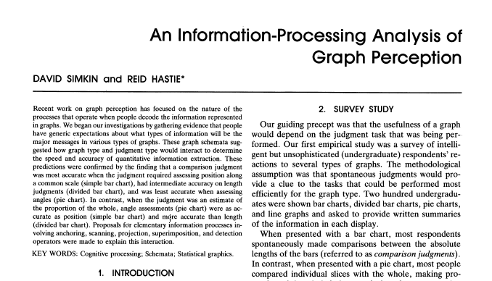
Perception, A framework for graph perception
Part of first page from Simkin and Hastie journal article
Notes:
Much of the work on the psychology of perception that I will be discussing next is drawn from this 1987 article by Simkin and Hastie.

Slide 5
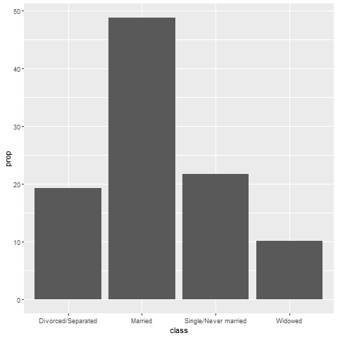
Perception, Which is better? A bar chart…
Bar chart
Notes:
You have already seen this question, but it is worth examining in a bit more detail.

Slide 6
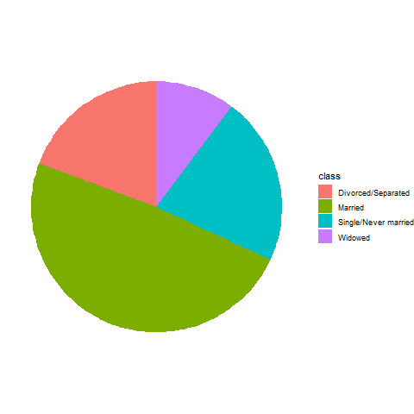
Perception, … or a pie chart
Pie chart
Notes:
The pie chart gets very little respect, and the question is why? It can do reasonably well, depending on the question being asked. Being able to recognize when it does well and when it does not requires you to understand the psychology of perception.

Slide 7
Perception, Answer. It depends.
What question are you trying to answer?
What proportion of the patients are single?
Are there more single or divorced patients?
Notes:
The answer really depends on what question you are asking. There are a variety of questions that you might ask. Two are illustrated above.
You can run an experiment (people have done this) where randomize and show half of them a bar chart and half of them a pie chart. Then you ask a question, like one of the questions above. Then you note the speed and accuracy of the response. Depending on the question, sometimes pie charts give faster and more accurate answers. Sometimes bar charts give faster and more accurate answers. It turns out that the results match up nicely with what we know about the psychology of perception.

Slide 8
Perception, Visual processing (1 of 3)
Projection
Shifting an object in a horizontal or vertical direction
Superimposition
Shifting in other directions (e.g., diagonal shifts, rotation) in order to make a comparison
Much harder than projection
Distance affects speed and accuracy of both projection and superimposition
Notes:
Your eye will try to move objects like bars in a bar chart to try to make comparisons. If these movements are solely in a horizontal or vertical direction, you are making a projection. If these movements are in a diagonal direction or if it involves rotation, you are making a superimposition.
Projections are easier than superimpositions. Both are affected by distance. The further the distance that you have to project, for exapmle, the more time it takes and the less accurate you get, on average.

Slide 9
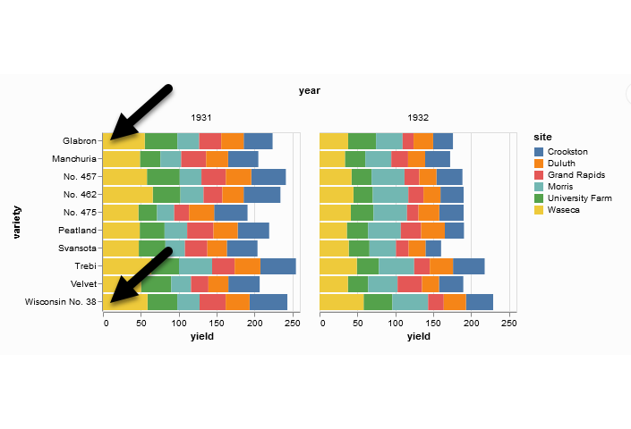
Perception, Projection (first yellow bar versus last yellow bar)
Stacked bar chart of crop yields
Notes:
The position means the vertical or horizontal location. Does the first yellow bar in 1931 (Glabron seeds planted in Wasica) extend further to the right than the last yellow bar (Wisconsin No. 38 seeds planted in Wasica)?
This requires a projection. You slide the top yellow bar down to compare it to the bottom yellow bar.

Slide 10
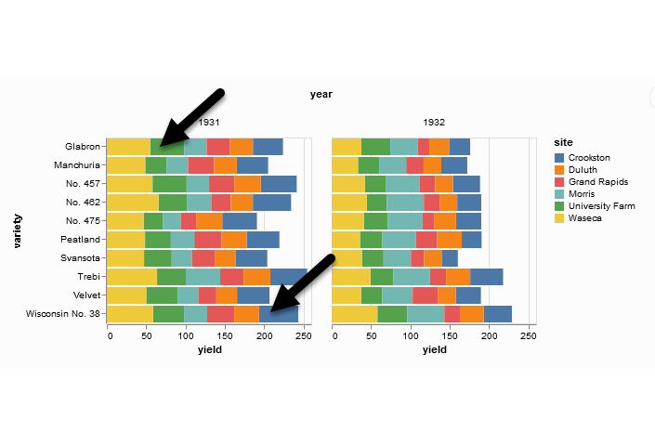
Perception, Superimposition (first green bar versus last blue bar)
Stacked bar chart of crop yields
Notes:
The length means either the width or the height. Does the first green bar in 1931 (Glabron seeds planted in University Farm) extend further to the right than the last yellow bar (Wisconsin No. 38 seeds planted in Crookston)?
This requires you to shift in a diagonal direction. This is a superimposition, a task that is harder than a projection. Expect that this comparison will take longer and be less accurate, on average.

Slide 11
Perception, Scanning and Anchoring
Scanning
Quantifying distance throug the use of a mental tape measure
Shorter distances are easier
Anchoring
Implicit or explicit development of reference points
Assists with scanning
Notes:
Scanning is a visual assessment of distance. Think of it as a mental tape measure. Scanning is easiest for short distances. You are slower and less accurate when your mental tape measure has to cover a large distance.
Anchoring is the implicit or explicit development of reference points. They can assist with scanning by shortening the distance of your mental tape measure.

Slide 12
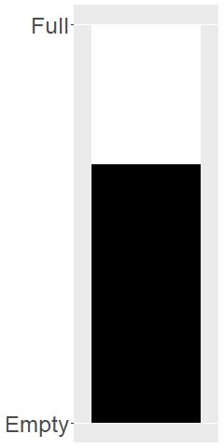
Perception, Scanning
Image of a fuel gauge, 65% full
Notes:
To understand scanning, think of a gas gauge. Usually it is a semicircular dial, but let’s set up the gas gauge as a rectangle. If the level is at the top, you have a full tank. If the level is at the bottom, you have an empty tank. This gauge shows a tank that is 65% full. Trust me, I drew the gauge. It is at 65%. Now how would you estimate the gas level?
You would take a mental tape measure, starting at the bottom and measure up to where the black box ends.
Now if you were smart, you’d start at the top and scan downwards. Less distance means that you can do this faster and more accurately.
Now if you were Albert Einstein, you’d split the gauge at the halfway point and measure from the halfway point to the top of the black box. Actually, there’s a little of Albert Einstein in all of us. That halfway point is something that all of us do subconciously. You did, because you recognized almost immediately that the tank was more than half full.

Slide 13
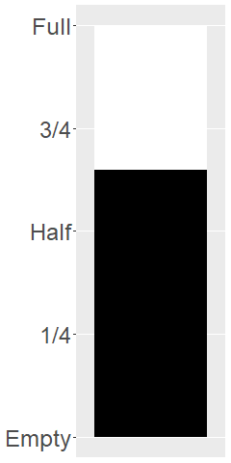
Perception, Assisting scanning with anchors
Image of a fuel gauge, anchors at 1/4, half, 3/4
Notes:
Here’s the same gas gauge, still at 65% full, but now we have added anchors at 1/4, half, and 3/4. You can read this gauge faster and more accurately, because you can scane from half up to 65% or from 3/4 down to 65%.

Slide 14
Perception, Visual processing (3 of 3)
Visually simple tasks
Position
Length
Angle/slope
Visually demanding tasks
Area
Volume
Density/Saturation/Hue
Notes:
There are a variety of perceptual tasks that you use when making comparisons within an image. These are arranged on this slide roughly in order of difficulty, with the easiest tasks at the top.

Slide 15
Perception, Position (first yellow bar versus last yellow bar)
Stacked bar chart of crop yields
Notes:
The comparison of the two yellow bars is a comparison of position. Which yellow bar extends further to the right?
We’ve seen this before, and described it as a projection. Projections are easy which explains why relative position is a simple visual comparison.

Slide 16
Perception, Length (first green bar versus last blue bar)
Stacked bar chart of crop yields
Notes:
The comparison of the green and blue bars is a length comparison. The two bars start at different spots, so the position can’t help you.
Length is harder to judge than position, because it involves a superimposition rather than a projection. It is still easy, however, compared to some other visual tasks.

Slide 17
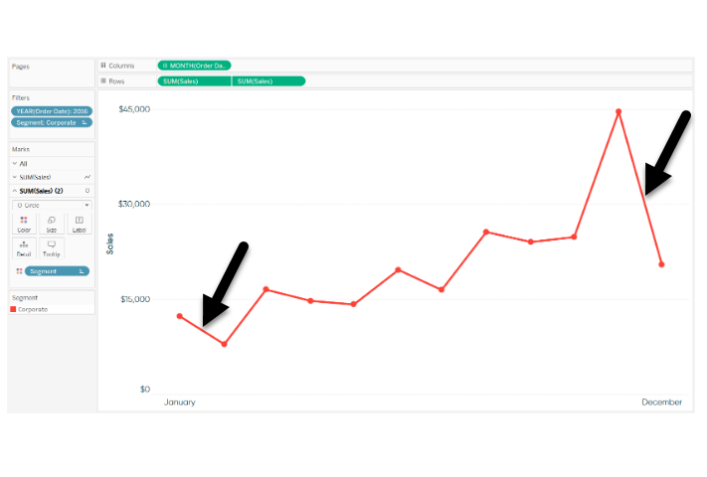
Perception, Angle/slope (first month decline versus last month decline)
Sales trend shown with a line graph
Notes:
This graph shows sales trends over a twelve month span. If you want to assess whether the first month decline (the dip in sales between January and February) was worse than the last month decline (the dip in sales between November and December), you would probably do this by judging the angle of the first line segment to the angle of the second line segment. This is not quite as easy as a position or length judgement, but it isn’t too bad either.

Slide 18
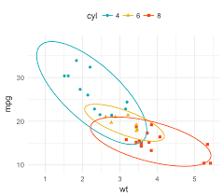
Perception, Area
Three ellipses
Notes:
There are three ellipses here. Is the one above and to the left bigger than the one lower and off to the right? This is an area comparison. It’s not too hard here because the one ellipse is markedly larger, but area judgements in general are more difficult than length judgements.

Slide 19
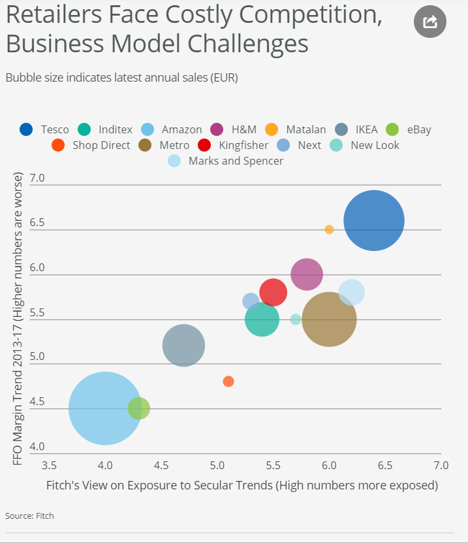
Perception, Area (or maybe length)
Bubble plot
Notes:
This graph shows exposure and margin trends on the x and y axes. Larger values are worse on both axes. The size of the bubble is the size of the company (annual sales). There is some ambiguity here–is size measured in terms of diameter or in terms of area. Which is bigger, the brown circle (Metro) or the dark blue circle (Tesco)? Either way, it is more difficult than the relative position comparison.

Slide 20
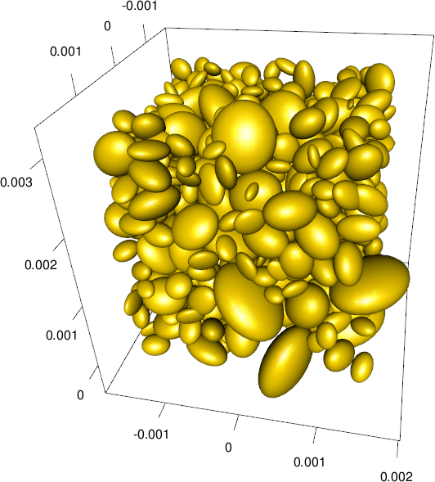
Perception, Volume
Ellipsoid plot
Notes:
Volume comparisons are especially difficult. This graphic image, busy beyond belief, shows three dimensional ellipsoids of various orientations. Picking out the biggest among these ellipsoids is not easy, even if you restricted it to ellipsoids that are fully visible.

Slide 21
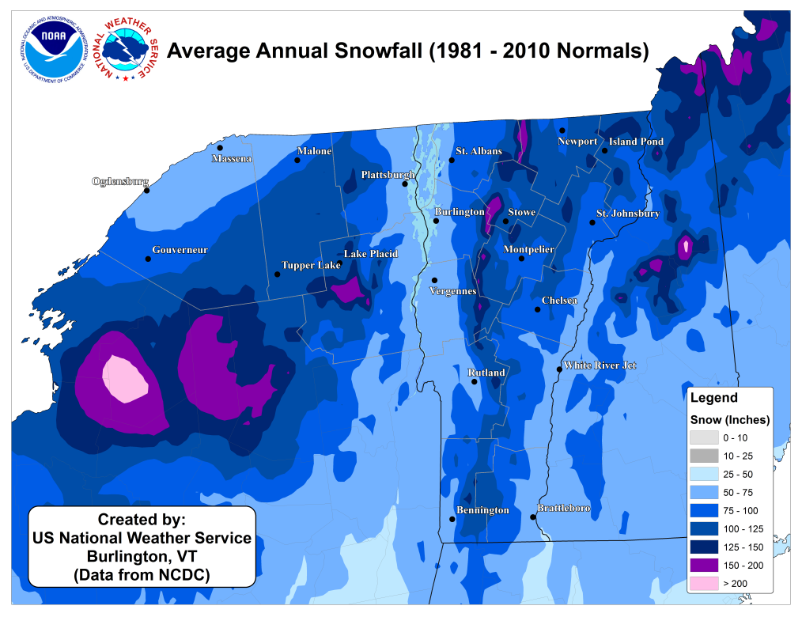
Perception, Color
Weather map of annual snowfall
Notes:
What city gets more snowfall, Remington, in the southwester corner of the state, or Newport, in the northeast corner of the state? This is a comparison of color, more specifically the lightness or darkness of a color. This is a very difficult task, unless the colors have a marked variation. So Th pink areas of upstate New York are not to difficult to distinguish from the light and dark blue areas of New Hampshire and Vermont. But the comparison of Remington to Newport involves a region of the map that is mostly shades of blue.

Slide 22
Perception, summary
Visual tasks
Projection, Superimposition, Scanning, Anchoring
Hierarchy of comparisons
Position, Length, Angle, Area, Volume, Color
Notes:
Your visualization should try to facilitate the visual tasks of projection, superimposition, scanning, and anchoring. If you want to make comparisons, they rank from easiest to hardest as comparisons of position, length, angle, area, volune, and color.
(NOte to myself) Another important visual task is “look up” or the ability to rapidly identify a particular component of a visualization. A table is the best tool for look up, but moving a legend to a more prominent location or replacing it with labels placed directly on the graphs can often help. Alphabetical lists in legends and in bar placements can also improve the speed and accuracy of lookup. The use of an accent color helps, if you know in advance what component your viewers are going to want to look up.

