Slide 1
Data-viz-03, Exercise, What’s the message in this graph
Steve Simon

Slide 2
Group exercise
Review one of the following graphs/newspaper articles
What is the message?
Summarize in 25 words or less
We Charted Arctic Sea Ice for Nearly Every Day Since 1979. You’ll See a Trend.
Record shares of Americans now own smartphones, have home broadband.
F.D.A. Seeks Restrictions on Teens’ Access to Flavored E-Cigarettes and a Ban on Menthol Cigarettes.
Notes:
The following images are taken from various newspaper articles or press releases. Look at the graph and read/skim the article.
What message do you think the journalist is trying to convey with this graph. Summarize this message in 25 words or less.

Slide 3
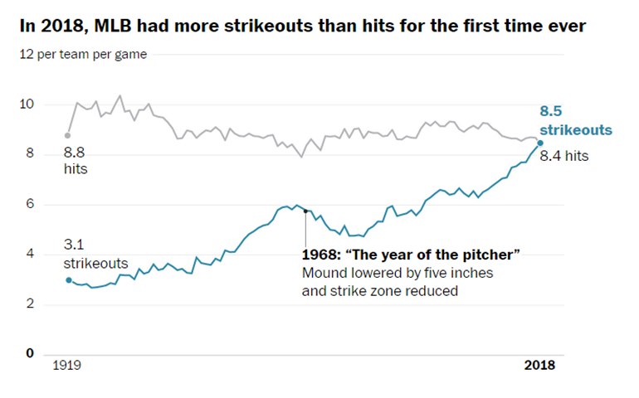
Graphs in the news, baseball strikeouts
Line graph of strikeouts and hits over time
Notes:
Popvich, N., Fountain, H., & Pearce, A. (2017, September 22). We Charted Arctic Sea Ice for Nearly Every Day Since 1979. You’ll See a Trend. - The New York Times. The New York Times. Retrieved from https://www.nytimes.com/interactive/2017/09/22/climate/arctic-sea-ice-shrinking-trend-watch.html

Slide 4
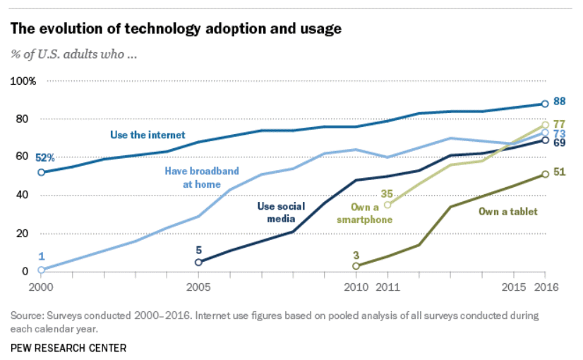
Graphs in the news, technology adaptation
Line graph of technology trends
Notes:
Aaron Smith, Record shares of Americans now own smartphones, have home broadband. Pew Research Center, January 12, 2017. Retrived August 14, 2019 from https://www.pewresearch.org/fact-tank/2017/01/12/evolution-of-technology/.

Slide 5
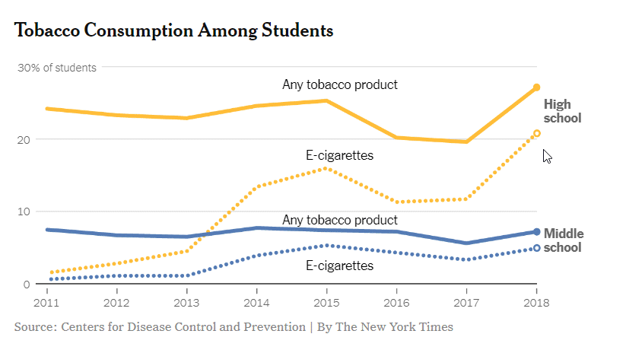
Graphs in the news, Tobacco and e-cigarette consumption
Line graph of tobacco and e-cigarette consumption
Notes:
Sheila Kaplan and Jan Hoffman, F.D.A. Seeks Restrictions on Teens’ Access to Flavored E-Cigarettes and a Ban on Menthol Cigarettes. The New York Times, November 15, 2018. Retrieved from http://nytimes.com/2018/11/15/health/ecigarettes-fda-flavors-ban.html

