Slide 1
Data-viz=03
Steve Simon

Slide 2
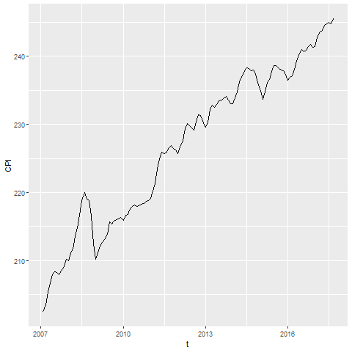
CPI line graph
Line graph showing increase over time of the consumer price index

Slide 3
To prepare for this section
((Download the Titanic data set))

Slide 4
Python code

Slide 5
R code

Slide 6
Tableau steps

Slide 7
Group exercise
Review one of these graphs/newspaper articles
More Strikeouts Than Hits? Welcome to Baseball’s Latest Crisis.
Record shares of Americans now own smartphones, have home broadband.
F.D.A. Seeks Restrictions on Teens’ Access to Flavored E-Cigarettes and a Ban on Menthol Cigarettes.
What is the message? Summarize in 25 words or less.
Notes:
The following images are taken from various newspaper articles or press releases. Look at the graph and read/skim the article.
What message do you think the journalist is trying to convey with this graph. Summarize this message in 25 words or less.

Slide 8
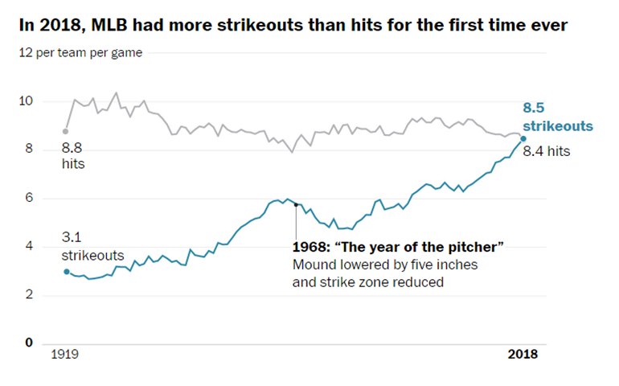
Graphs in the news, baseball strikeouts
Line graph of strikeouts and hits over time
Notes:
Tyler Kepner. More Strikeouts Than Hits? Welcome to Baseball’s Latest Crisis. The New York Times, Augst 16, 2018. Retrieved from https://www.nytimes.com/2018/08/16/sports/baseball-mlb-strikeouts.html.

Slide 9
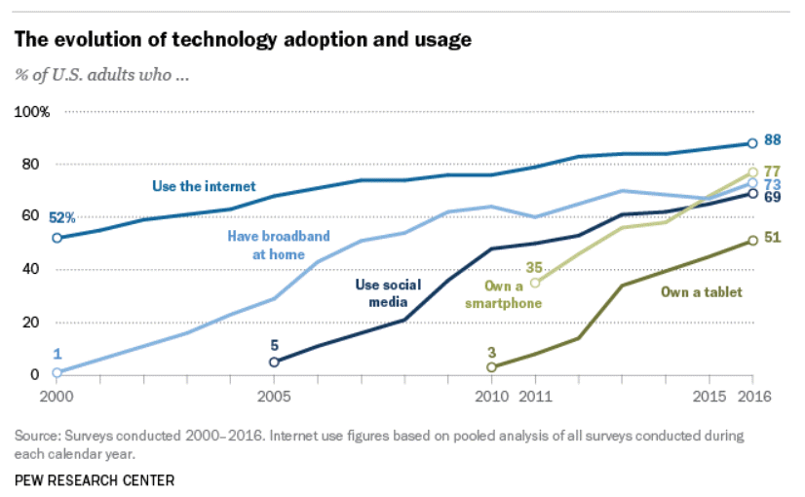
Graphs in the news, technology adaptation
Line graph of technology trends
Notes:
Aaron Smith, Record shares of Americans now own smartphones, have home broadband. Pew Research Center, January 12, 2017. Retrived August 14, 2019 from https://www.pewresearch.org/fact-tank/2017/01/12/evolution-of-technology/.

Slide 10
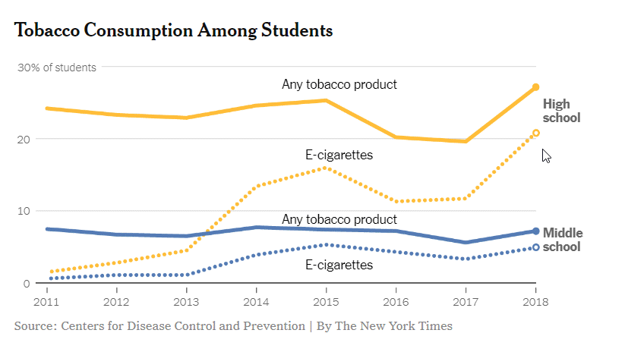
Graphs in the news, Tobacco and e-cigarette consumption
Line graph of tobacco and e-cigarette consumption
Notes:
Sheila Kaplan and Jan Hoffman, F.D.A. Seeks Restrictions on Teens’ Access to Flavored E-Cigarettes and a Ban on Menthol Cigarettes. The New York Times, November 15, 2018. Retrieved from http://nytimes.com/2018/11/15/health/ecigarettes-fda-flavors-ban.html

Slide 11
Summary (1 of 2)
Gestalt principles
((List here))
Aesthetics for lines
Size, Shape, Color
Lines as summary statistics
One number summary (mean, total, count, percent)
Two number summary (error bars)
Five number summary (boxplots)

Slide 12
Summary (2 of 2)
Trend lines (linear, logistic, spline)
Helpful tips
((List here))

