Slide 1
Exercise, change line defaults
Steve Simon

Slide 2
Exercise, change defaults
Draw a line graph with the cpi data
x=t
y=CPI
Change the defaults for the line
Make the width equal to 3
Make the color green
Make the Y-axis start at 200 and end at 260
Notes:
Take the CPI line graph and modify some of the default options. Make the line green and increase the thickness to three pixels. Use a dashed line instead of a dotted line.

Slide 3
Exercise, Python code
Here’s the Python code
ch = alt.Chart(df).mark_line( color='green', size=3 ).encode( alt.X('t'), alt.Y('CPI', scale=alt.Scale(domain=(200, 260))) )
Notes:
HEre is the Python code. Notice that the color and width are changed inside the mark_line function.

Slide 4
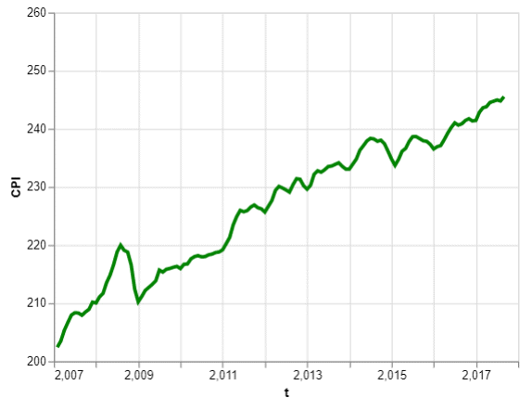
Exercise, Python output
Line graph with green dashed line

Slide 5
Exercise, R code
Here’s the R code
ggplot(cpi, aes(x=t, y=CPI)) + geom_line(size=3, color="green")
Notes:
Here is the R code. Notice that you change the size and color inside the geom_line function.

Slide 6
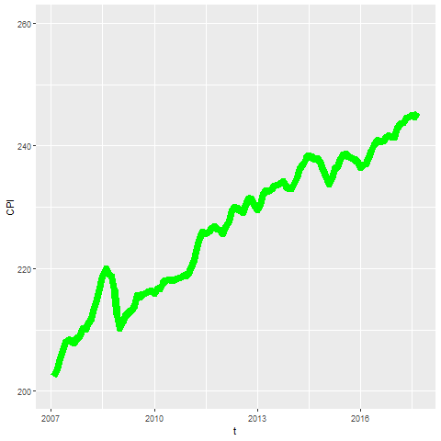
Exercise, R output
Notes:
Here is the R output.

Slide 7
Exercise, Tableau steps
Drag T to coumns, CPI to rows
Set both as Dimension, Continuous (Green pill)
Change Marks pull-down to Line
Click on the color button, select green
Click on size button, move slider to the right
Double click on Y axis
Select Range, Fixed
Enter 200, 260 as fixed start, fixed end
Notes:
Here are the Tableau steps.

Slide 8
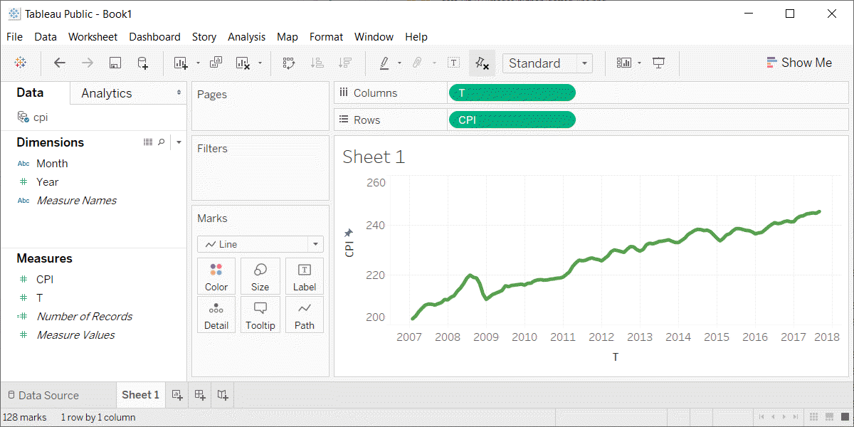
Exercise, Tableau output
Line graph with thick green line
Notes:
Here is the Tableau output.

