Slide 1
Graphs in the news, scatterplots
Steve Simon

Slide 2
Graphs in the news, group exercise
Review one of these graphs/newspaper articles
We Charted Arctic Sea Ice for Nearly Every Day Since 1979. You’ll See a Trend.
We Read 150 Privacy Policies. They Were an Incomprehensible Disaster.
How Medicine Became the Stealth Family Friendly Profession.
Notes:
The following images are taken from various newspaper articles. Look at the graph and read/skim the article.

Slide 3
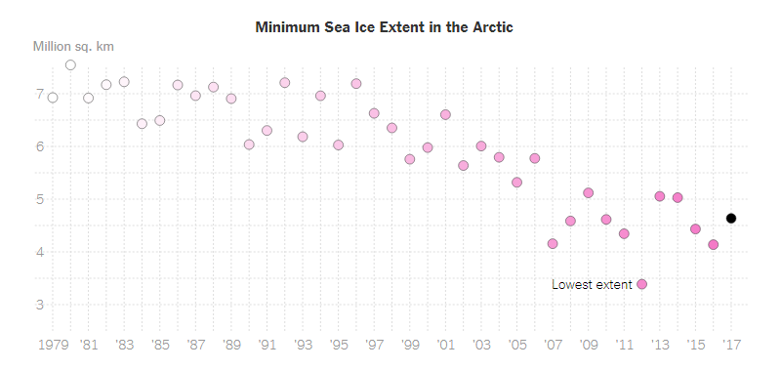
Graphs in the news, Arctic ice levels
Scatterplot of Arctic ice levels
Notes:
This image was found in a newpaper article,
Popvich, N., Fountain, H., & Pearce, A. (2017, September 22). We Charted Arctic Sea Ice for Nearly Every Day Since 1979. You’ll See a Trend. - The New York Times. The New York Times. Retrieved from https://www.nytimes.com/interactive/2017/09/22/climate/arctic-sea-ice-shrinking-trend-watch.html

Slide 4
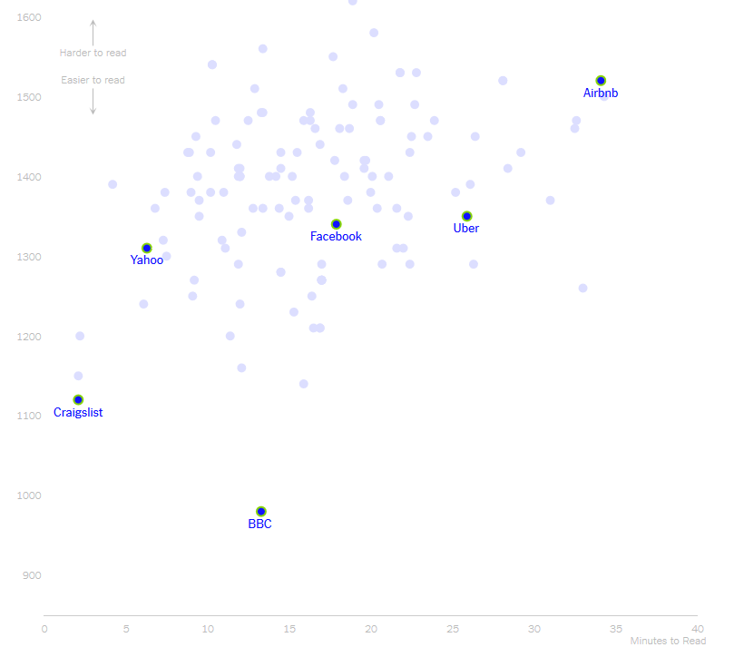
Graphs in the news, Privacy policies
Scatterplot of length versus reader difficulty
Notes:
This image was found in a newpaper article,
Kevin Litman-Navarro. We Read 150 Privacy Policies. They Were an Incomprehensible Disaster. The New York Times. Retrieved from https://www.nytimes.com/interactive/2019/06/12/opinion/facebook-google-privacy-policies.html

Slide 5
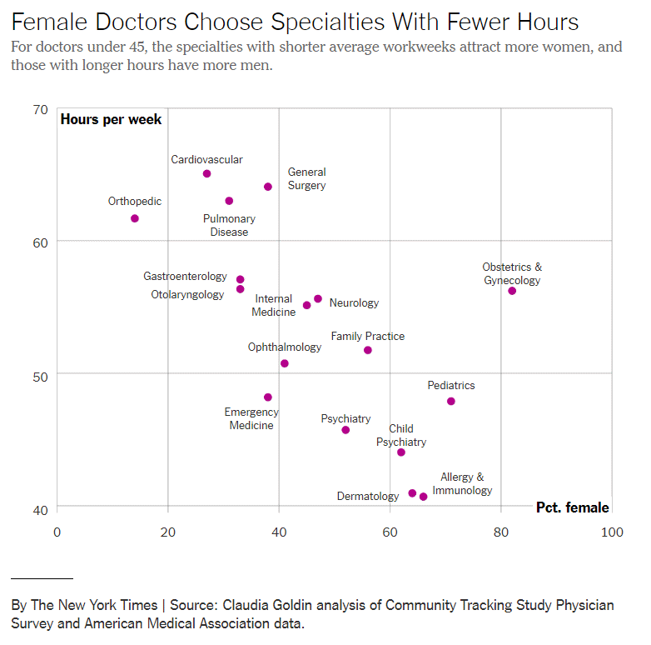
Graphs in the news, Family friendly profession
Notes:
This image was found in a newpaper article,
Claire Cain Miller (2019, August 21). How Medicine Became the Stealth Family Friendly Profession. The New York Times. Retrieved from https://nytimes.com/2019/08/21/upshot/medicine-family-friendly-profession-women.html

