Slide 1
Exercise, Mortality by gender
Steve Simon

Slide 2
Exercise, Mortality by gender
Draw a bar chart showing counts involving both mortality and gender. Use stacked bars, then dodged bars. Which do you like best?
Notes:
Mortality on the Titanic reflects the fact that this was an era when people really did believe in the concept of “women and children first.” Someone like me, I’d be shoving the little kids aside so I could get on one of the lifeboats.
Anyway, examine how mortality is related to gender. It’s a spoiler alert, but on the Titanic, Kate survives, but Leonardo, I am so sad to say this, didn’t make it.

Slide 3
Exercise,Python code
Python code
((Python code))

Slide 4
Exercise, Python output
((Python results))

Slide 5
Exercise, R code
R code
titanic %>% ggplot(aes(x=sex, fill=survived)) + geom_bar() + facet_grid(cols=vars(survived))

Slide 6
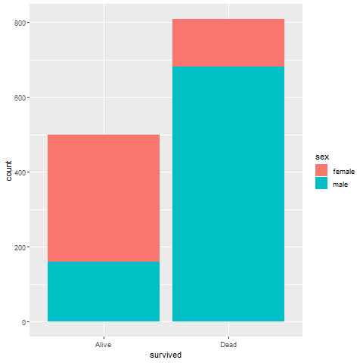
Exercise, R output

Slide 7
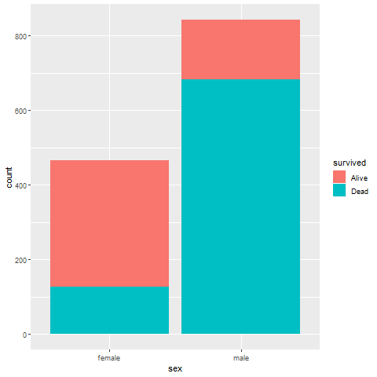
Exercise, R output

Slide 8
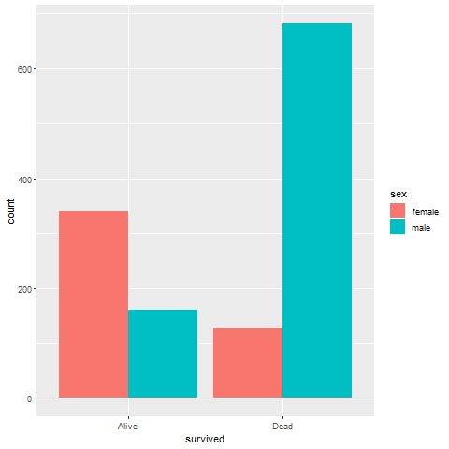
Exercise, R output

Slide 9
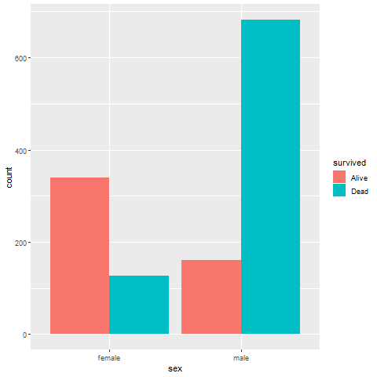
Exercise, R output

Slide 10
Exercise, Tableau output
((Tableau results))

