Slide 1
Colors, recommendations
Steve Simon

Slide 2
Python change colors

Slide 3
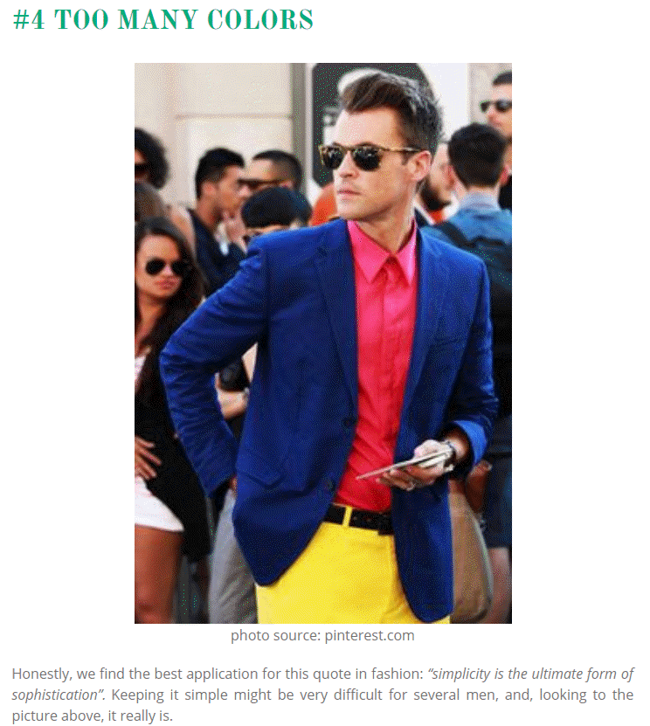
Barchart recommendations, similar to fashion
Image of man wearing three bold colors
Notes:
It’s a well known fasion mistake to wear too many colors at the same time. Maybe this guy could get away with it, but most of us would look like idiots if we tried to dress that way.
There’s a similar lesson for data visualization.

Slide 4
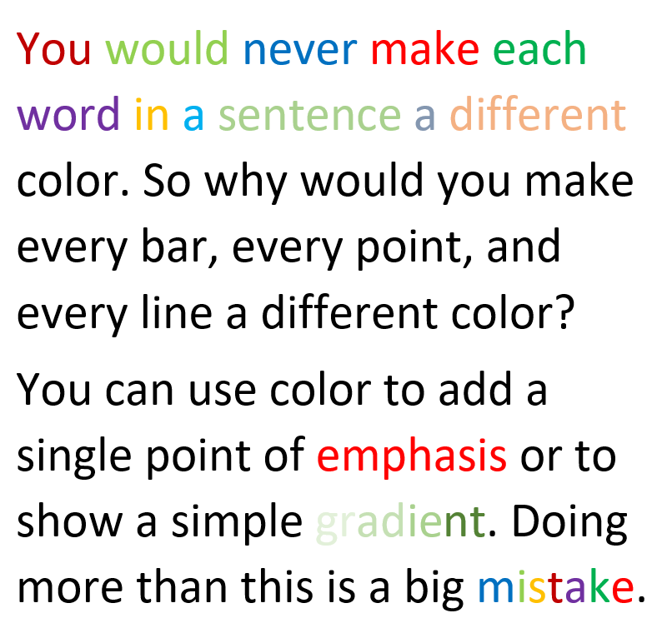
Barchart recommendations, Don’t overuse colors.
Text will a variety of colors
Notes:
Naomi Robbins, an expert on data visualization, made an interesting observation. You would never make each word in a sentence a different color. So why would you make every bar, every point, and every line a different color?
Too many colors dilutes the impact that color can have.
You can use a second color to add emphasis. Or maybe a gradient between two different colors could work. Doing more than this is usually a big mistake.

Slide 5
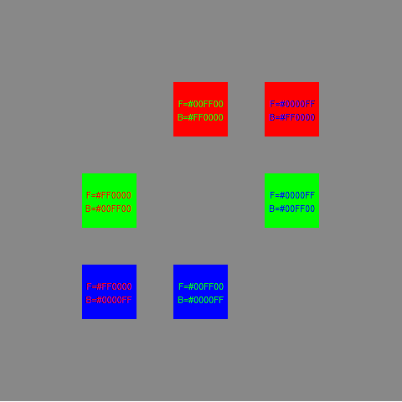
Colors, Contrasting pure colors often appear too intense

Slide 6
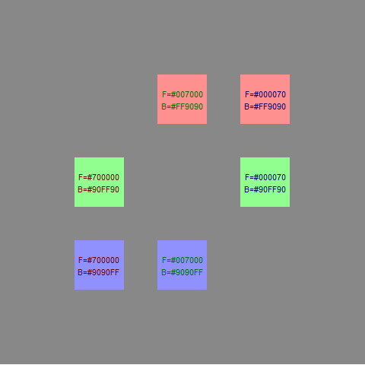
Colors, Lighter background, darker foreground

Slide 7
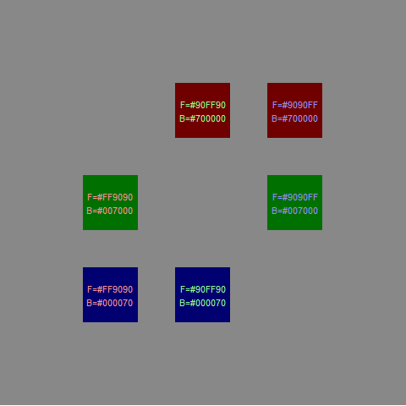
Colors, or the reverse

Slide 8
Avoid the rainbow gradient
(To be added)

