Slide 1
Line graphs, Fundamentals
Steve Simon

Slide 2
Fundamentals, how to produce a line graph
+The key step in Python
mark_line()
The key step in R
geom_line()
The key step in Tableau
Choose Line from the Marks pulldown list
Notes:
The basic steps to producing a line graph are fairly easy in each of the systems. In Tableau, you use the mark_line function. In R, you use the geom_line function. In Tableau, if you are lucky, the default graph choice will be a line graph. If not, select Line from the Marks list.

Slide 3
Fundamentals, Changing axis range
Python
alt.Y(scale=alt.Scale(zero=False))
or
alt.Y(scale=alt.Scale(domain=(100, 200)))
R code
expand_limits(y=0)
or
ylim(100, 200)
Tableau steps
Double click on axis
Notes:
This example is the first one where you can see a big difference between the default options. Python wants to include zero on the y-axis, no matter what. It may make sense for a barchart to always include zero, but it is less obvious for a line graph.

Slide 4
Fundamentals, Aesthetics for lines
Location
Size
Shape (not what you think it is!)
Color
Notes:
A line could mean a straight line or a curved line, a single line segment, a connected series of line segments or a polygon. It’s a pretty complex thing, but generally a line represents a two dimensional relationship.
You can vary the size, shape, and color of a line. Shape is not what you think it is.

Slide 5
Fundamentals, Location
Sequence of x,y pairs
sorted by x
Connected in order
((Show a curved line, a straight line, a line segment, a series of line segments, and a polygon. Show the code to create these.))

Slide 6
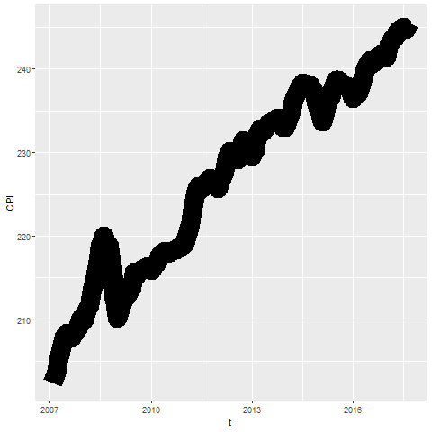
Fundamentals, Size
Notes:
Lines can change size, but some systems refer to this as line width rather than size.

Slide 7
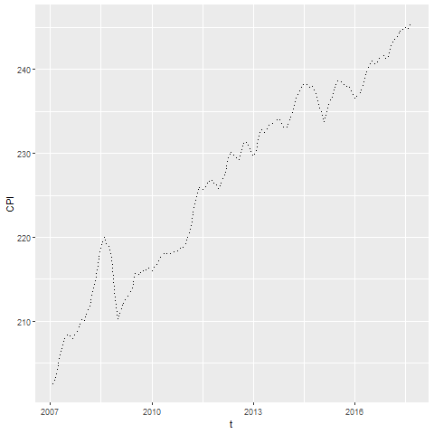
Fundamentals, Shape
Notes:
The shape of a line is not whether it is curved or straight. The shape of a line is whether it is represented using solid, dashed, or dotted lines. Most visualizations call this a line type rather than a line shape.

Slide 8
Exercise, change defaults
Draw a line graph with the cpi data
x=t
y=CPI
Change the defaults for the line
Use a dashed rather than a solid lineline to a dashed line.
Make the width equal to 3
Make the color green
Notes:
Take the CPI line graph and modify some of the default options. Make the line green and increase the thickness to three pixels. Use a dashed line instead of a dotted line.

Slide 9
Exercise, Python code
Here’s the Python code
ch = alt.Chart(df).mark_line( strokeDash=[5, 5, 2, 5] ).encode( alt.X('t'), alt.Y('CPI', scale=alt.Scale(domain=(200, 400))) )

Slide 10
Exercise, Python output

Slide 11
Exercise, R code
Here’s the R code
ggplot(cpi, aes(x=t, y=CPI)) + geom_line(size=3, linetype="dashed", color="green")

Slide 12
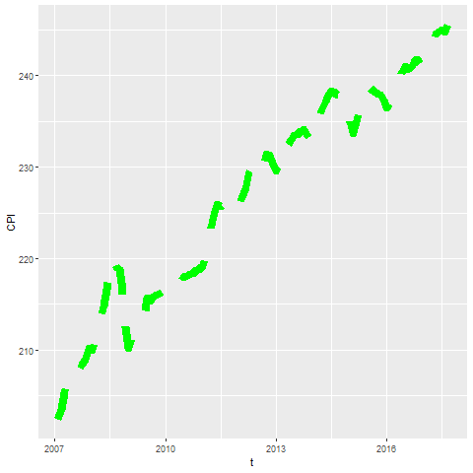
Exercise, R output

Slide 13
Exercise, Tableau steps

Slide 14
Exercise, Tableau output

Slide 15
Fundamentals, Adding lines to a scatterplot
Lines can emphasize patterns in a scatterplot
Connect means
Linear regression (not covered)
Moving average (not covered)
Smoothing splines (not covered)
Notes:
If you have a lot of data, a line can sometimes emphasize patterns or trends that you might miss with just a scatterplot.
You can do this by connecting lines between individual point means, a linear regression trend line, moving averages, or smoothing splines.
We will only cover the first approach connecting means. The other approaches are quite good and definitely worth talking about. Unfortunately, these alternative approaches are implemented inconsistently across the different programs.

Slide 16
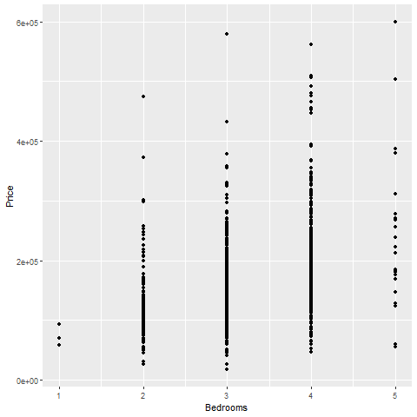
Fundamentals, Review an earlier scatterplot
Notes:
Here’s the housing data set that we looked at earlier. This scatterplot shows the relationship between number of bedrooms and price.

Slide 17
Fundamentals, Lines at individual averages, Python
Here’s the Python code
pts = alt.Chart(df).mark_point().encode( x='Bedrooms', y='Price' ) avg = alt.Chart(df).mark_line().encode( x='Bedrooms', y='mean(Price)' ) ch = pts + avg

Slide 18
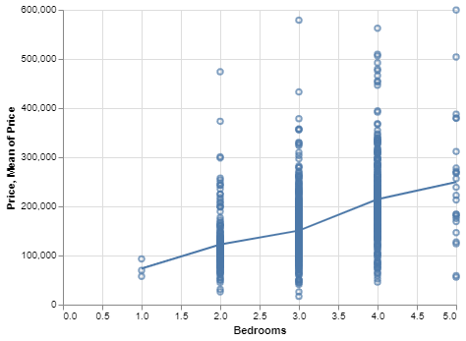
Python graph
Python graph with average summary line

Slide 19
Fundamentals, Lines at individual averages, R
Here’s the code in R
ggplot(saratoga_houses, aes(Bedrooms, Price)) + geom_point() + stat_summary(fun.y=mean, geom="line")
Notes:
Here is the R code. You need the stat_summary function to create averages for y at each discrete value of X.

Slide 20
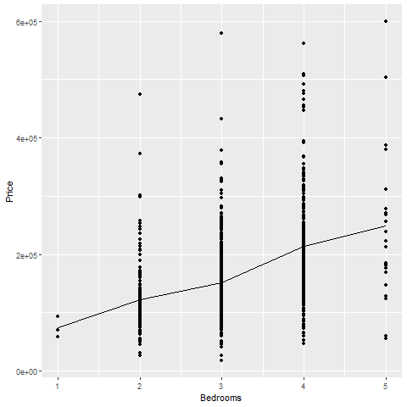
R output
Notes:
There is a clear and consistnet trend in the average price. As the number of bedrooms increase, the average price increases.

Slide 21
Fundamentals, Lines at individual averages, Tableau steps
Draw your normal scatterplot
Drag Price to opposite Y axis
Change to Measure(Average)
Change Marks for first plot to Shape
Right click on either Y axis
Select Synchronize Axis

Slide 22
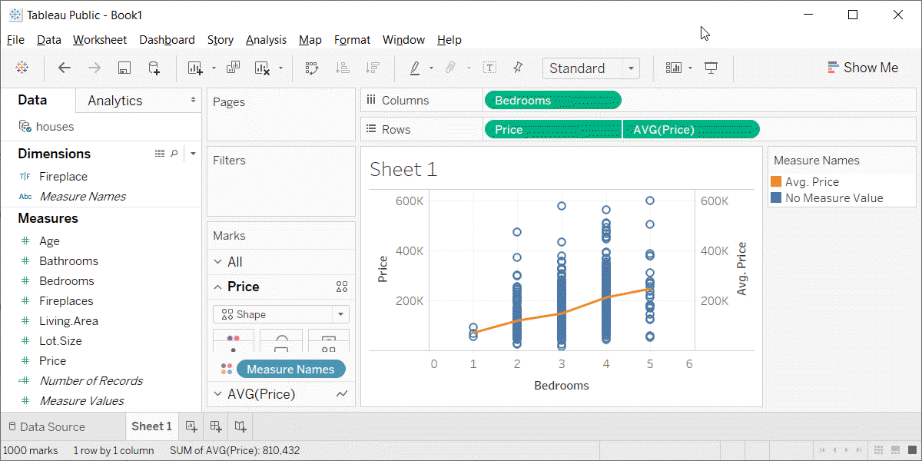
Fundamentals, Lines at individual averages, Tableau plot
Tableau plot with lines at individual averages

Slide 23
Exercise, Connect individual averages
Draw a scatterplot showing
X = Bathrooms
Y = Age
Add a line connect the individual averages
Notes:
On your own, draw a similar plot. Put the number of bathrooms on the X axis and the age of the house on the Y-axis. Add a line conencting the individual averages.

Slide 24
Exercise, Python code
pts = alt.Chart(df).mark_point().encode( x='Bathrooms', y='Age' ) avg =alt.Chart(df).mark_line().encode( x='Bathrooms', y='mean(Age)' ) ch = pts+avg

Slide 25
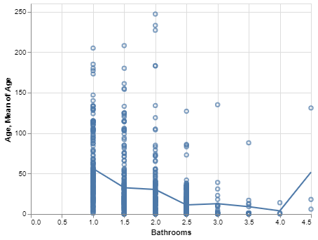
Exercise, Pyhton output
Python plot showing trend of age versus bathrooms

Slide 26
Exercise, R code
Here’s the R code
ggplot(saratoga_houses, aes(Bathrooms, Age)) + geom_point() + stat_summary(fun.y=mean, geom="line")
Notes:
The geom_point function creates the scatterplot and the stat_summary function adds the line.

Slide 27
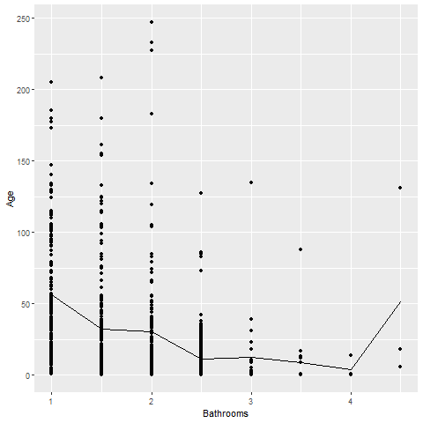
Exercise, R output
Notes:
There is a clear and consistent trend in the average age. The average age declines as the number of bathrooms increase. There is a blip at the end, but this is probably just an artefact due to the small sample size.

Slide 28
Exercise, Tableau steps

Slide 29
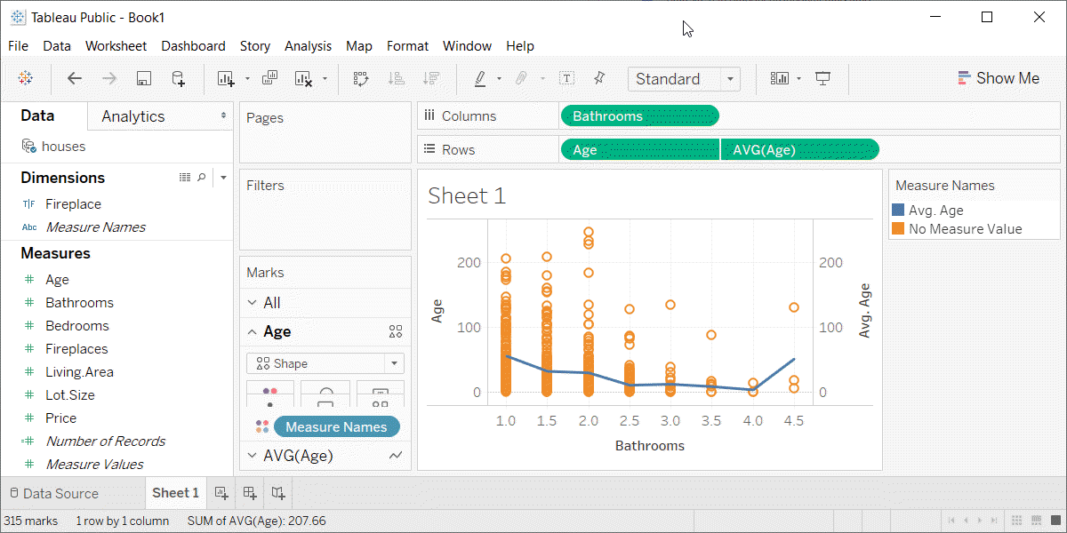
Exercise, Tabeleau output
Tableau plot showing trend in average age versus number of bathrooms

Slide 30
Families of lines
(Add three or four slides plus an exercise)

